Slide 1
Electrostatic droplet sorters cause SICS (Sorter Induced Cellular Stress) in every sorted cell!
NECyto
October 12, 2023
Peter Lopez
Peter Lopez Consulting LLC
Associate Professor of Pathology
NYU Grossman School of Medicine

Slide 2
What’s new in flow cytometry?
We continue to use flow cytometry to analyze cells. Latest developments include:
spectral detection
complex multicolor panels
sophisticated data analytical techniques
metal tags (CyTOF)
small particle detection
AND WE CONTINUE TO SORT (PURIFY) THESE CELLS!!

Slide 3
What new devopments have occurred related to the technology of droplet cell sorting?

Slide 4
What new devopments have occurred related to the technology of droplet cell sorting?
Improvements have been made in cell sorting speed (early 1990’s), purification accuracy, number of populations which can be purified simultaneously, the types of collection receptacles, number of colors detected, automation of set up and monitoring, and most recently, sorting with imaging. Numerous microfluidic sorters now exist but are not droplet cell sorters and use different technology for cell deflection.
But….the base technology for electrostatic droplet deflection remains essentially the same as described in the 1964 Sweet invention, and is utilized by all cell sorter manufacturers—Becton Dickinson, Beckman-Coulter , SONY and ThermoFisher

Slide 5

Cell Sorting—A Brief History
The cell sorter is essentially an ink-drop printer, reimagined to sort droplets of PBS (instead of ink), with each droplet of sorted PBS containing a desired cell.
Developed at Stanford University. Ink drop printing technology was the first step (1964), then Mack Fulwyler proved you can deflect droplets of saline with cells in them (patented 1968), and finally Len and Lee Herzenberg added the fluorescence detection to create “FACS” (1972).

Slide 6
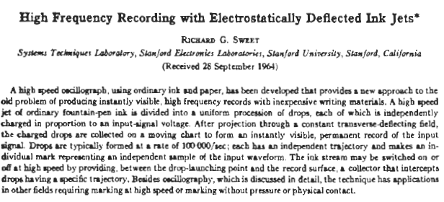

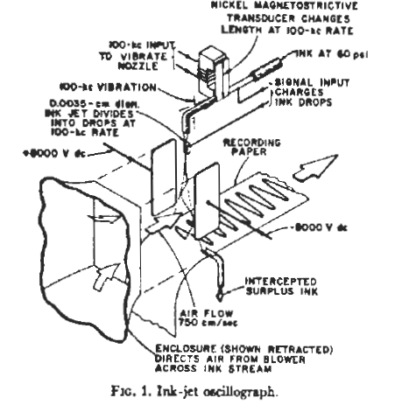
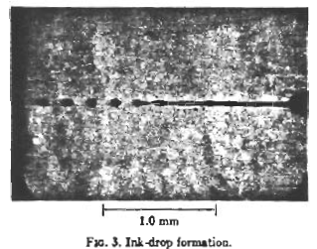

Slide 7
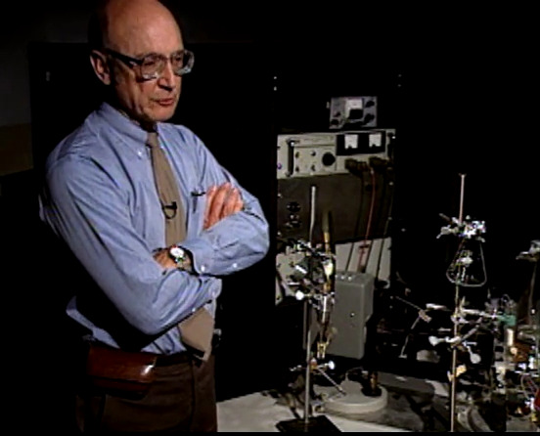
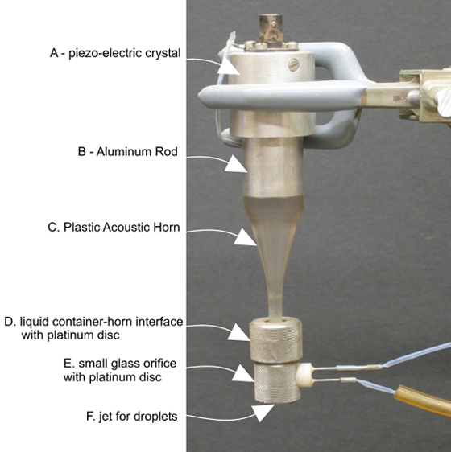
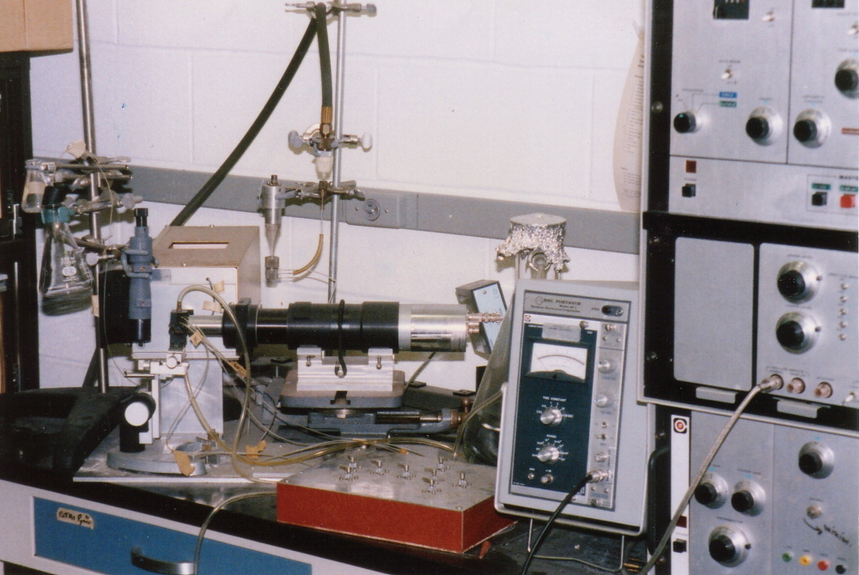
The first droplet cell sorter was not a FACS!
Mack Fulwyler’s cell sorter, based on Dick Sweet’s ink-jet printing technology, sorted cells based on Coulter Volume, not fluorescence .

Slide 8
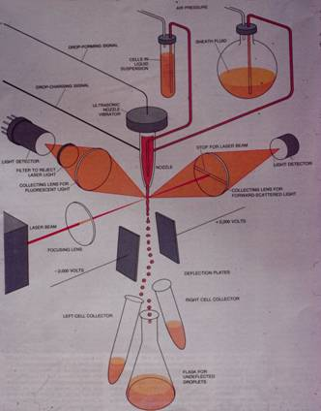
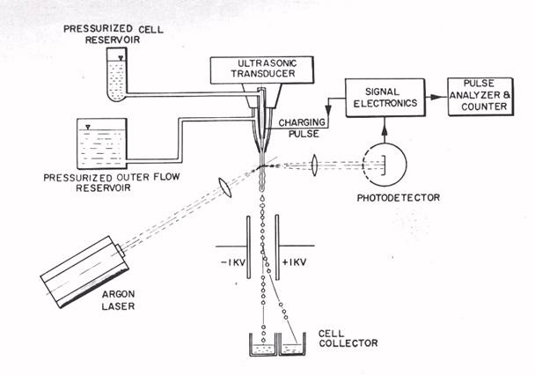
Fluorescence Activated Cell Sorter
WA Bonner, HR Hulett, RG Sweet and LA Herzenberg,
Fluorescence Activated Cell Sorting, Review of Scientific Instruments 43, 1972
Notes:
FACS came later—1969. (First cell sorter was from Fulwyler 1965, sorted on Coulter Volume).
Not much changed for 40 years. Even after that time, this original system schematic still holds true. We will talk a bit about the technology since it directly relates to SICS.

Slide 9
Fast forward to the 2020’s
The base technology for electrostatic droplet deflection remains essentially the same as described in the 1964 Sweet invention, and is utilized by all cell sorter manufacturers—Becton Dickinson, Beckman-Coulter , SONY and ThermoFisher
Improvements have been made in cell sorting speed (early 1990’s), purification accuracy, number of populations which can be purified simultaneously, the types of collection receptacles, number of colors detected, and automation.
Increase in cell sorting speed was achieved by using higher pressure, forcing cells to travel at a higher velocity, at which point people started asking questions about post-sort viability.

Slide 10
Cells typically survive the droplet cell sorting process
Lymphocytes typically have great viability after cell sorting. FACS initial utility was sorting lymphocytes (Herzenbergs and other immunologists)
Some cell types do not survive or function well after cell sorting using droplet cell sorted. Can be related to the cell type and/or the preparative steps.
If cells do not maintain viability after cell sorting, cell sorter operators have instrument and operational parameters which can be changed, which can help improve cell viability the next time these cells are sorted.
  Sometimes you learn the hard way from the first sorting experiemnt. Bad sorting results inform you of the need to mosdicfy conditions for the next time you sort these cells , assuming there is a next time.
    The next time you sort this cell type, are the cells in the same condition going into the sorter, factoring in the sample starting condition and preparation?

Slide 11
Best practices for obtaining viable sorted cells
Always include a cell viability marker in samples to be sorted.
Nozzle Size: Use a larger nozzle orifice (minimum 5X cell diameter). KNOW THY CELL SIZE!
Lower pressure: By definition, this creates a slower flow rate with a longer time to complete the sort.
Temperature: . Cells may do better sorting on instrumentation set at 4 degrees C, or in some cases room temperature. Cell-type specific.
Minimize time sample is under pressure: For long term, large volume sorts, break up sample into smaller aliquots for sorting, and pull sorted fractions off the sorter at regular intervals. Get sorted cells back into their preferred environment. Is it really helpful being able to mount a 15ml sample tube for sorting?
Media: Have cells for sorting in particulate-free, preferred media. Has anyone ever seen an issue with phenol-red media? Collect sorted cells in tubes containing preferred media with high serum , or in problematic situations, try neat serum. Use HEPES to maintain buffer pH.

Slide 12
Isn’t it amazing that cells can withstand this electrostatic droplet sorting process?

Slide 13
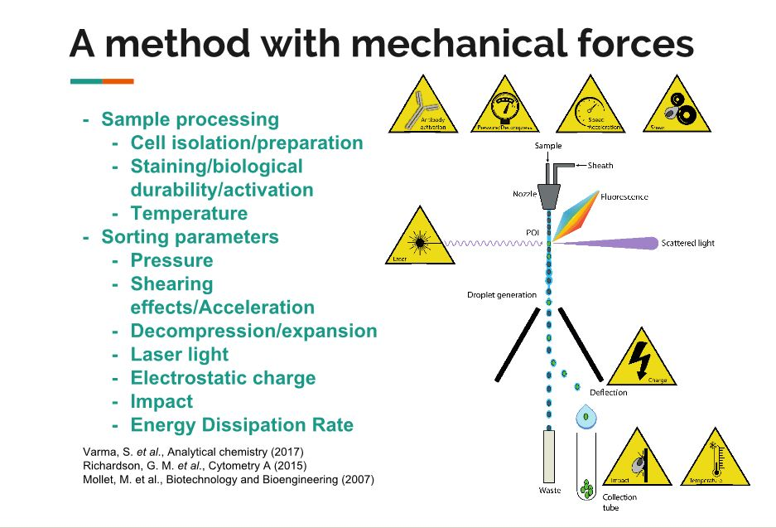
DeLay M. Lopez P, Schiemann M. (2018, April 28) Cell Sorting for Function and Viability, Tutorial #10 , CYTO 2018, Prague, Czech Republic
Notes:
Issues that might be caused by cell sorting were present even on the earliest cell sorters.

Slide 14
SICS:
Sorter Induced Cellular Stress
Term first presented at CYTO2018¹ , describes the myriad of cellular characteristics that may be perturbed by the droplet cell sorting process.
SICS can present itself as one of a spectrum of observed symptoms other than outright cell destruction or cell death:
  Reports of a proliferation lag after sorting T-cells, DC’s not presenting antigen effectively, redox changes, iPS cells not adequate for tetraploid blastocyst complementation assay, delay in monocyte monolayer formation, p38 MAPK activation in sorted T-cells, etc.
Investigators need to be aware of this potential complication of cell sorting.
There are best-practice methods to minimize SICS, but in the past these methods were cell-type specific , related to impact on a particular function discovered after cell sorting
¹DeLay M. Lopez P, Schiemann M. (2018, April 28) Cell Sorting for Function and Viability, Tutorial #10 , CYTO 2018, Prague Czech Republic
Notes:
If cells are too big for nozzle diameter , SICS may result, meaning cells may not behave representatively

Slide 15
Can prime cells for different SICS manifestations
Here is where our SICS studies are focused
DeLay M. Lopez P, Schiemann M. (2018, April 28) Cell Sorting for Function and Viability, Tutorial #10 , CYTO 2018, Prague, Czech Republic
Notes:
If we don’t consider the stress of making a single-cell preparation, the mechanical forces that make a cell sorter operate seem daunting.

Slide 16
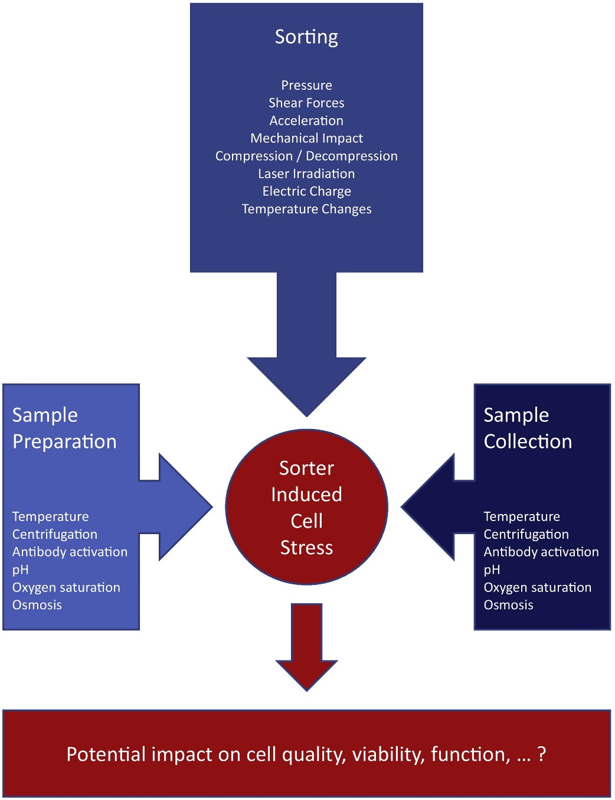
https://doi.org/10.1016/j.jim.2020.112902 Gerald Pfister,Salman M. Toor,Varun Sasidharan Nair,Eyad Elkord

Slide 17
https://doi.org/10.1016/j.jim.2020.112902 Gerald Pfister,Salman M. Toor,Varun Sasidharan Nair,Eyad Elkord

Slide 18
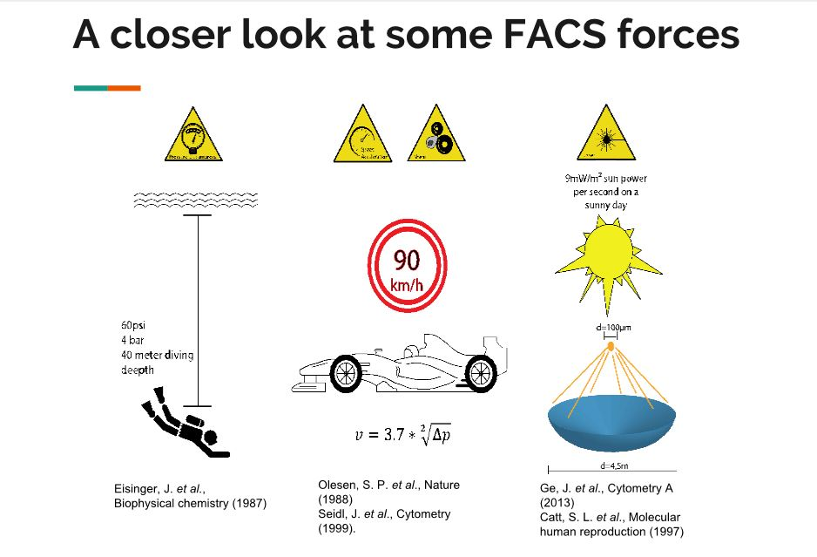

Droplet charging!
Hundreds of volts, with higher amperage (current) than deflection plates.
DeLay M. Lopez P, Schiemann M. (2018, April 28) Cell Sorting for Function and Viability, Tutorial #10 , CYTO 2018, Prague Czech Republic
Notes:
PADI diving depth max 18M (60ft). Cell sorting conditions expose cells to pressure higher than PADI maximum.

Slide 19

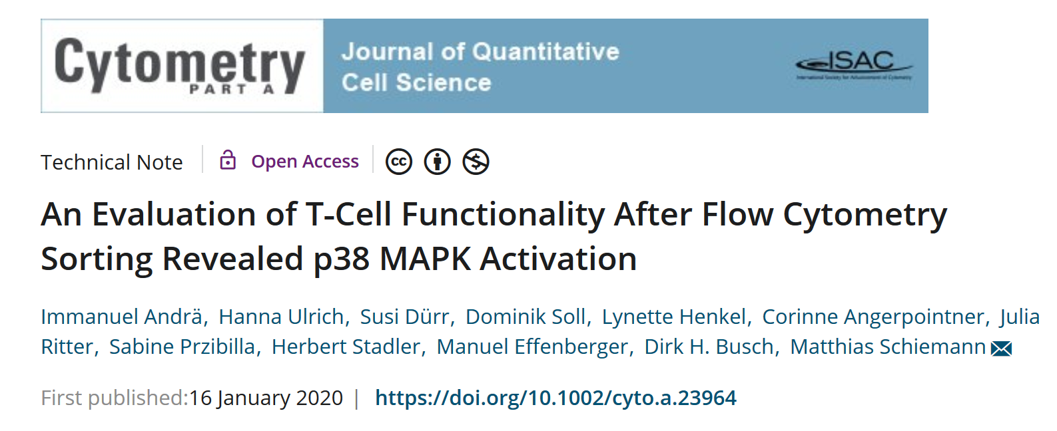

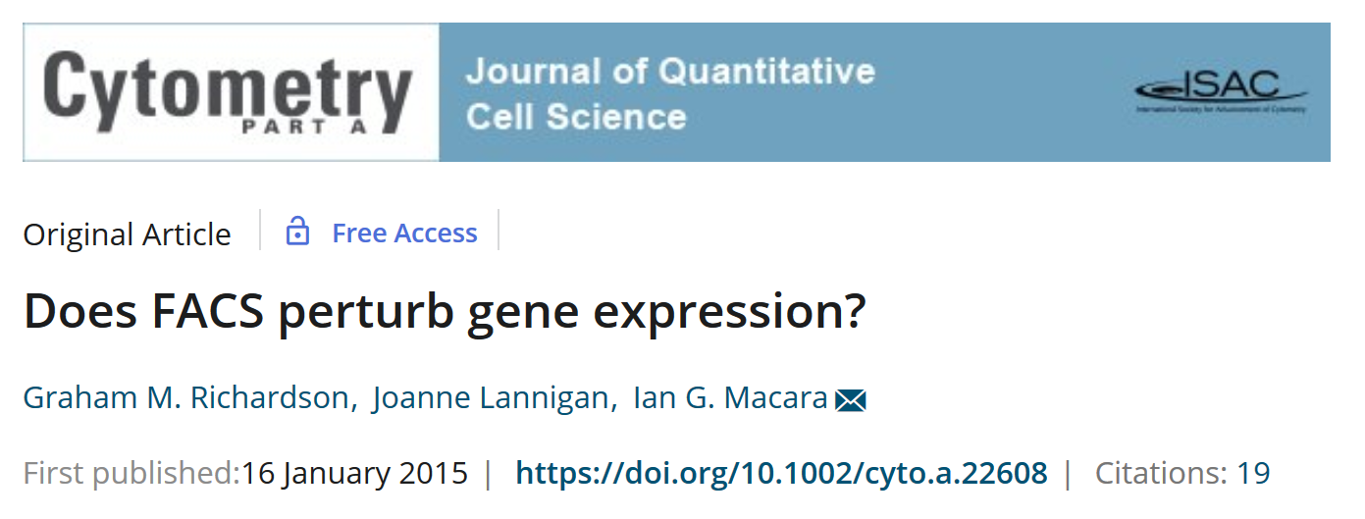

Notes:
But even with these best practices, different manifestations of SICS observed with different cell types– there are more papers than shown here.

Slide 20
Notes:
Different manifestations of SICS observed with different cell types– there are more papers than shown here. Here we see metabolomics impact on mouse peritoneal macrophages (Proteome paper), astrocytes in Redox paper. Is the metabolomics impact the common SICS manifestation regardless of cell type?

Slide 21
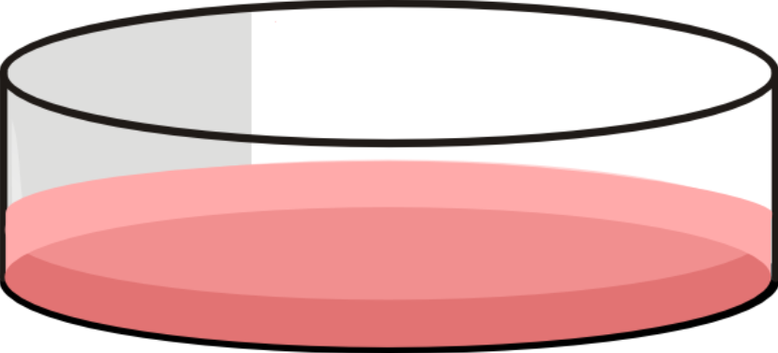

Pre-sort control
5 min
Cell sorting (MoFlo XDP)
5 min
No-sort control
5 min
Notes:
We designed a simple experiment to test the effect of sorting Jurkat cells on the metabolic profile. Since metabolism is already very sensitive to environmental factors like time out of the incubator, we were careful to include a no sort control that was treated the same way as cells loaded onto the sorter (what we call the “no-sort” control)
We performed LCMS based metabolomics on these samples (~1 million cells per sample, so they should be strong signals). What we found was that almost all metabolites dramatically dropped in abundance (signal intensity). Many were still detectable, but something is happening to the profile. The clustering algorithm was not able to distinguish pre-sorted from no-sorted (these samples are interleaved), but there was weak trend of lower signals in energy related metabolites e.g., AMP
Although the heatmap shows the pattern of change, the volcano plot shows that not every metabolite is affected to the same degree, with some metabolites not changing in abundance at all, while others show anywhere between 2–500X loss of signal intensity.

Slide 22
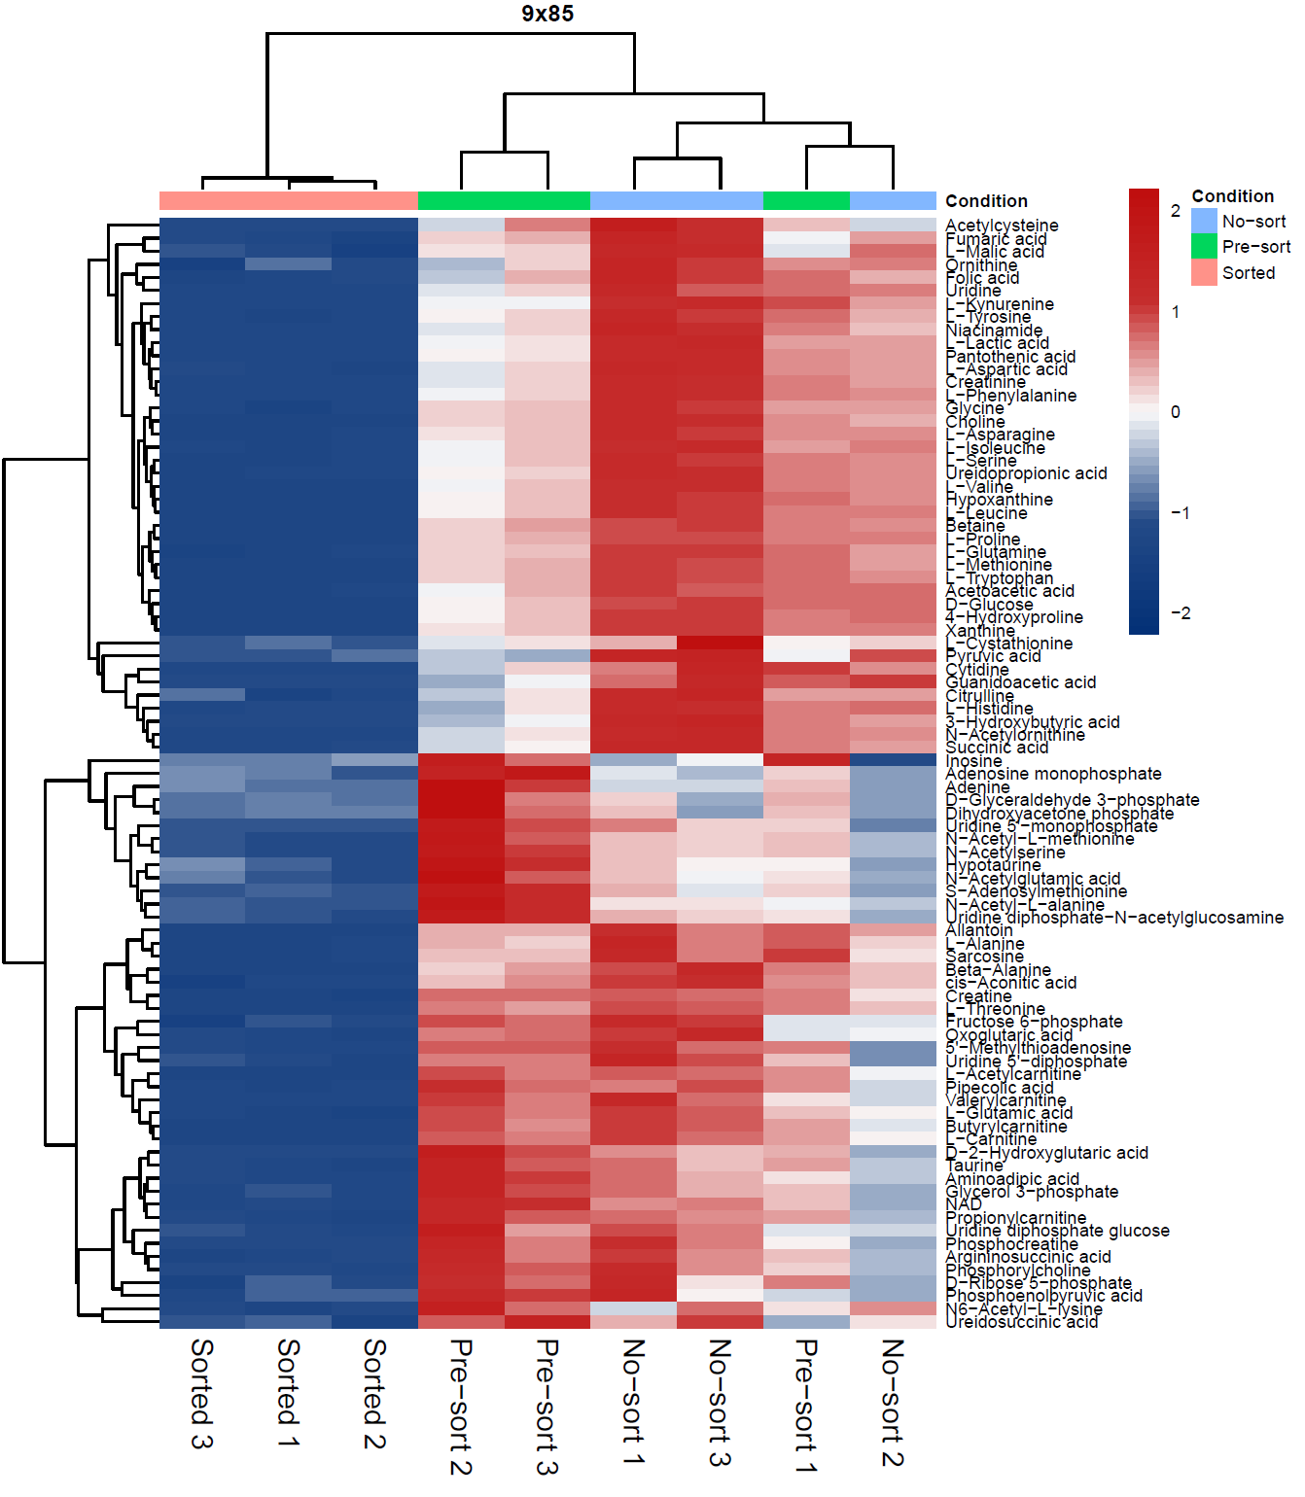
Pre-sort control
5 min
Cell sorting (MoFlo XDP)
5 min
No-sort control
5 min
Notes:
Dendrogram. Sorry if you can’t find your favorite metabolite due to font size…
We designed a simple experiment to test the effect of sorting Jurkat cells on the metabolic profile. Since metabolism is already very sensitive to environmental factors like time out of the incubator, we were careful to include a no sort control that was treated the same way as cells loaded onto the sorter (what we call the “no-sort” control)
We performed LCMS based metabolomics on these samples (~1 million cells per sample, so they should be strong signals). What we found was that almost all metabolites dramatically dropped in abundance (signal intensity). Many were still detectable, but something is happening to the profile. The clustering algorithm was not able to distinguish pre-sorted from no-sorted (these samples are interleaved), but there was weak trend of lower signals in energy related metabolites e.g., AMP
Although the heatmap shows the pattern of change, the volcano plot shows that not every metabolite is affected to the same degree, with some metabolites not changing in abundance at all, while others show anywhere between 2–500X loss of signal intensity.

Slide 23
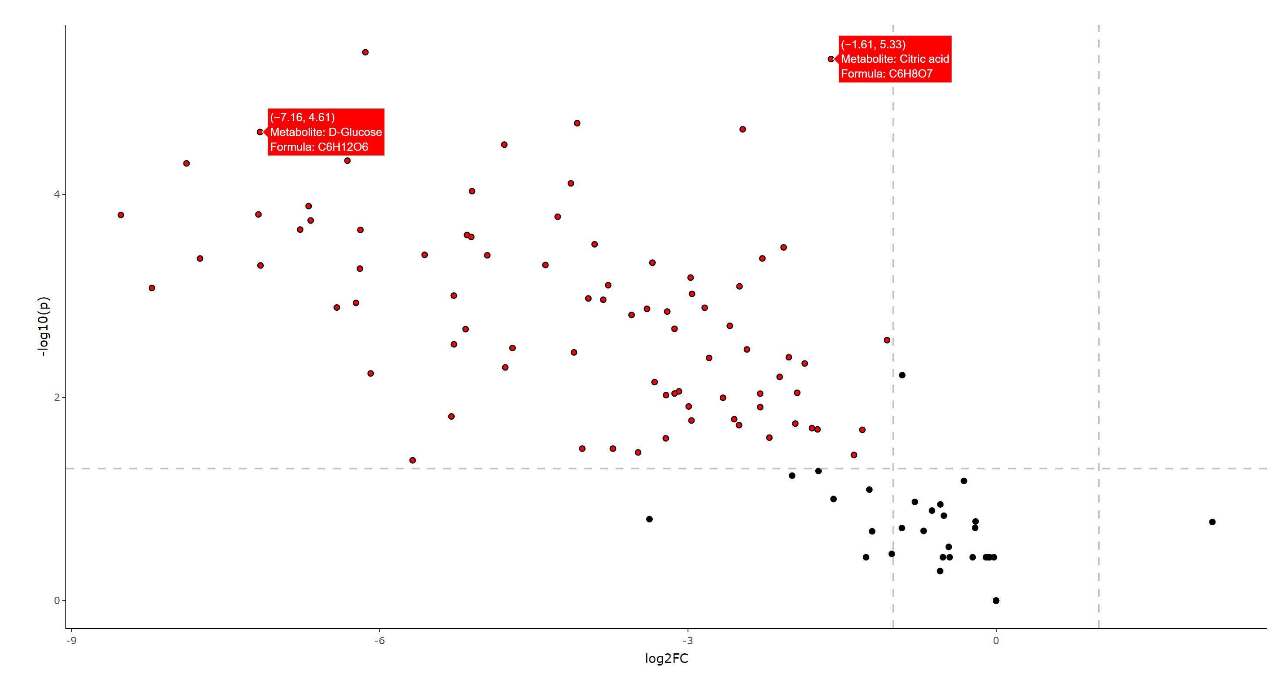
Sorted vs Unsorted
Notes:
Volcano plots typically symmetrical but in this case lop-sided since everything is lower. 500x lower concentration for leftmost points.
We designed a simple experiment to test the effect of sorting Jurkat cells on the metabolic profile. Since metabolism is already very sensitive to environmental factors like time out of the incubator, we were careful to include a no sort control that was treated the same way as cells loaded onto the sorter (what we call the “no-sort” control)
We performed LCMS based metabolomics on these samples (~1 million cells per sample, so they should be strong signals). What we found was that almost all metabolites dramatically dropped in abundance (signal intensity). Many were still detectable, but something is happening to the profile. The clustering algorithm was not able to distinguish pre-sorted from no-sorted (these samples are interleaved), but there was weak trend of lower signals in energy related metabolites e.g., AMP
Although the heatmap shows the pattern of change, the volcano plot shows that not every metabolite is affected to the same degree, with some metabolites not changing in abundance at all, while others show anywhere between 2–500X loss of signal intensity.

Slide 24
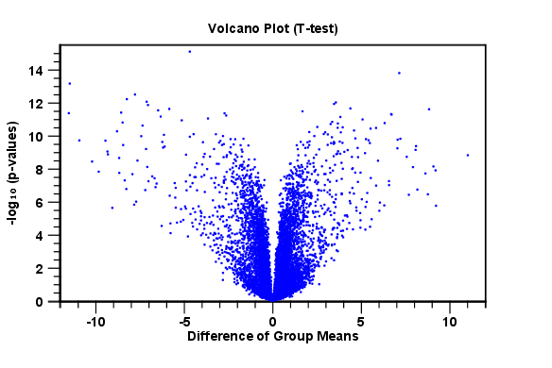
Sorted vs Unsorted
Notes:
Volcano plots typically symmetrical but in this case lop-sided since everything is lower. 500x lower concentration for leftmost points.
We designed a simple experiment to test the effect of sorting Jurkat cells on the metabolic profile. Since metabolism is already very sensitive to environmental factors like time out of the incubator, we were careful to include a no sort control that was treated the same way as cells loaded onto the sorter (what we call the “no-sort” control)
We performed LCMS based metabolomics on these samples (~1 million cells per sample, so they should be strong signals). What we found was that almost all metabolites dramatically dropped in abundance (signal intensity). Many were still detectable, but something is happening to the profile. The clustering algorithm was not able to distinguish pre-sorted from no-sorted (these samples are interleaved), but there was weak trend of lower signals in energy related metabolites e.g., AMP
Although the heatmap shows the pattern of change, the volcano plot shows that not every metabolite is affected to the same degree, with some metabolites not changing in abundance at all, while others show anywhere between 2–500X loss of signal intensity.

Slide 25
SICS Mitigation
With post-sort metabolite depletion now described in detail by our lab ( confirming observations by others ), we sought out a method to mitigate this post-sort sequela.
Building upon our previous work to mitigate loss of metabolites during centrifugal elutriation (by using complete media as the elutriation buffer instead of PBS), we designed a study to test this mitigation process on a droplet cell sorter

Slide 26
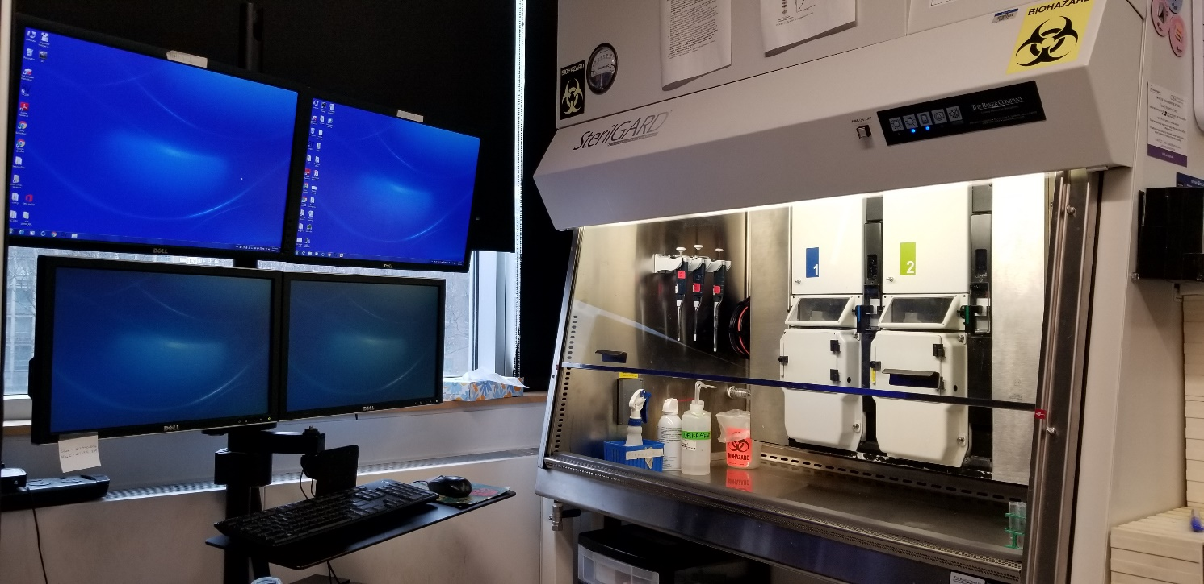
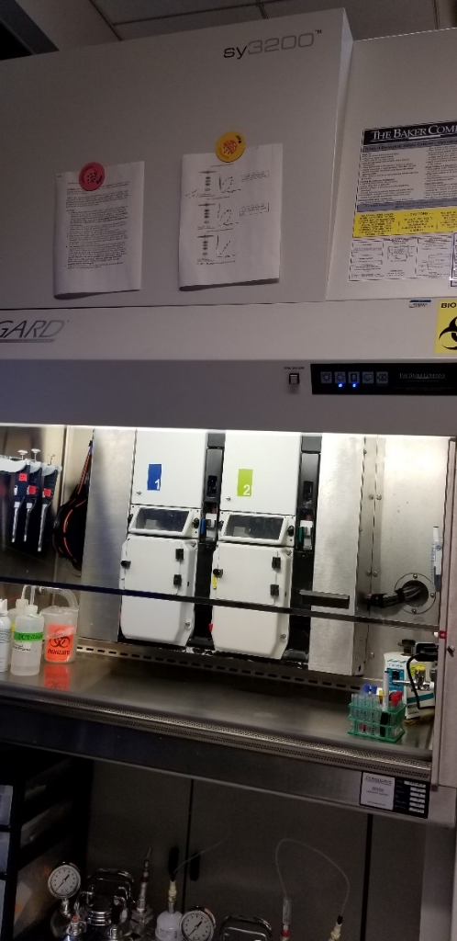
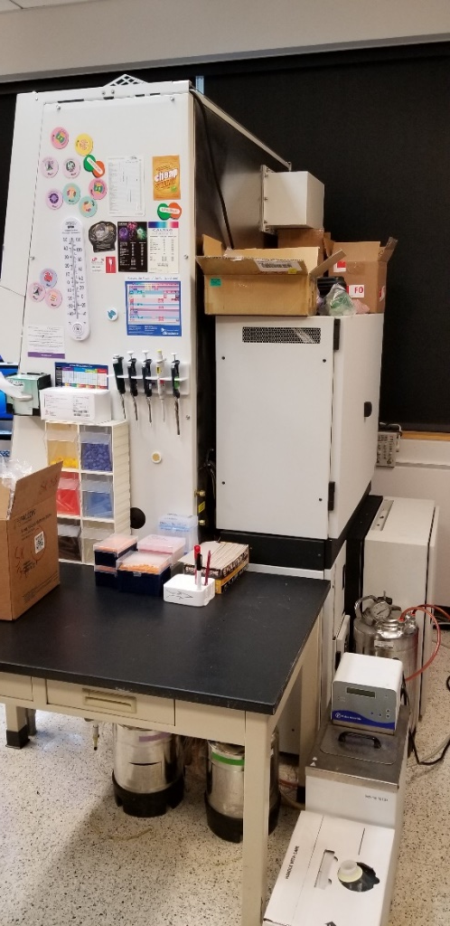
Sony SY3200 (Synergy) Parallel Cell Sorter

Slide 27
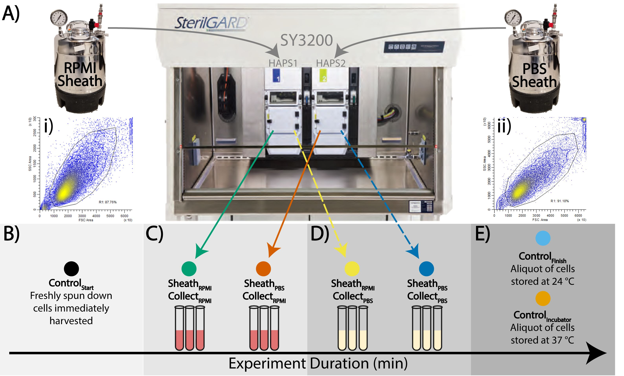
Cytometry A 2021 Sep;99(9):921-929. doi: 10.1002/cyto.a.24361

Slide 28
Cytometry A 2021 Sep;99(9):921-929.doi:10.1002/cyto.a.24361

Slide 29
The SICS metabolomic phenotype seems to be a common cell-type-independent result of droplet cell sorting
Characterized by a depletion of a metabolites after droplet cell sorting
The SICS metabolomic phenotype can be mitigated by using complete media as sheath (CMAS) sorting
  Highly impractical, but can be performed with additional set up and shut down time ( or a CMAS-dedicated cell sorter ).
Metabolomic SICS “rescue” by using CMAS has been demonstrated in adherent and non-adherent cell lines.
Metabolomic SICS “rescue” by CMAS does not appear to occur as a result of replacement of metabolites by the media. CMAS appears to be somehow protective.

Slide 30






Outcome of cell sorting, using idealized cell prep and best-practice cell sorter setup
Without CMAS
Droplet cell sorters appear to always produce sorted cells with metabolite depletion
A cell prep with 100% perfectly happy cells would produce 100% metabolically depleted cells
Notes:
Best cell prep means great starting viability
Best setup means least impact and stress on the cells. This image represents what probably occurs with lymphocytes

Slide 31
How would the particular cell type you are sorting respond to having all of its metabolites depleted??
Growth arrest?
Deficiency in antigen presentation?
p38 MAPK activation?
Cell death?

Slide 32
Cell viability from different primary tissue preparations
Tissue |  | Cells/Gram | Viability
Normal Breast |  | 8.89 ± 1.67 x 10⁵ | 71.3 ± 0.6%
AdenoCa Breast |  | 72.0 ± 28.6 x 10⁵ | 66.2 ± 6.3%
Normal Lung |  | 32.9 ± 4.57 x 10⁵ | 62.8 ± 15%
NSC Ca Lung |  | 226 ± 60.3 x 10⁵ | 72.8 ± 3.2%
Whole Adipose |  | 2.98 ± 0.87 x 10⁵ | 57.6 ± 6.8%
Slide provided by Mike Meyers, University of Pittsburgh PA
Notes:
But we know that preps for cell sorting sometimes take a lot of time and effortThanks to Vera Donnenburg and Mike Myers

Slide 33












Outcome of cell sorting viable cells from a preparation including viable, dying and dead cells
Droplet cell sorter produces metabolic SICS phenotype, an added stress to cells already stressed by preparation

Slide 34
Is the metabolic SICS phenotype a problem I need to be worried about?
Can metabolite depletion caused by the cell-sorting process present potential issues for the use of these sorted cells in downstream application?
Consider how the depletion of cellular metabolites might impact cellular function and post-sort viability

Slide 35
Is metabolic SICS a problem I need to be worried about?
Give this careful consideration, related to specific use of the sorted cells:
  In cell samples already stressed by preparation from tissue or other cellular manipulations, SICS may push stressed cells to die.
  If sorted cells are given time to recover after sorting, the process for recovering the cellular metabolome may activate cellular pathways or be otherwise selective. Are these purified cells now representative in their function?
    For example, cells may have been selected for a quiescent phenotype when sorted, but will this phenotype be the same after a few days of post-sort recovery?

Slide 36
Notes:
Different manifestations of SICS observed with different cell types– there are more papers than shown here. Give careful consideration to this observation in T-cells. This may be a downstream manifestation of the SICS metabolite deficience we have demonstrated.

Slide 37
When all else fails….consider alternative purification technologies
Microfluidic, chip-based cell sorters
MACS, BACS
DEPArray
Centrifugal elutriation
These technologies are empowering AND MAY NOT CAUSE SICS!
These technologies currently don’t have the same capabilities as droplet cell sorters. They may soon!!Droplet cell sorting currently provides the highest purity and the highest number of parameters for subset discrimination/purification.

Slide 38
Summary—Sorter Induced Cellular Stress
Sorted-cell purity and viability have been the standard metrics for post-sort cellular fitness. These metrics do not tell you how the “viable” sorted cells will perform or function
SICS manifestations include a range of functional changes specific to specific cell types, and typically these issues are mitigated (after detection) by changing nozzle size, system pressure, system temperature, or collection media.
In our hands metabolic SICS has been observed in all cell types examined to date, and may prove to be the common SICS phenotype caused by droplet cell sorters.
Assuming that metabolomic SICS always occurs, this may help to understand the various functional changes seen in specific cell types after cell sorting. How does a particular cell type respond to metabolite depletion?
Until more is learned(and possibly modified) related to the mechanism(s) of the sorting process that contribute to SICS, the metabolic SICS phenotype can be mitigated by using complete media as sheath fluid (CMAS).

Slide 39
Call to arms!! Future studies can help us learn more about the cause of the SICS metabolic phenotype. Are you interested in helping to figure this out?
Is the charging mechanism responsible?
  Collect cells passed through the sorter without sorting ( no droplets, no charging, no deflection voltage), and compare to sorting the same cells by metabolomic analysis
Is nozzle size /pressure responsible?
  Sort the same cells with different nozzle size and pressure combinations, and compare these two by metabolomic analysis
Why does CMAS mitigate the SICS metabolic phenotype?
  Examine sheath fluid containing individual components of complete media, and compare with each other by metabolomic analysis

Slide 40
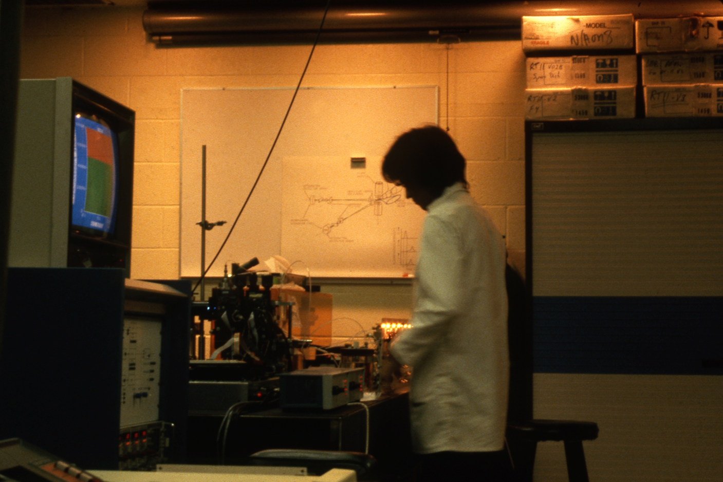
THANK YOU!
…and remember who proposed these experiments!
Notes:
Peter running the home-built slit scan flow cytometer, University of Rochester circa 1979

