Slide 1


Annual Fall
User Group Meeting

Slide 2
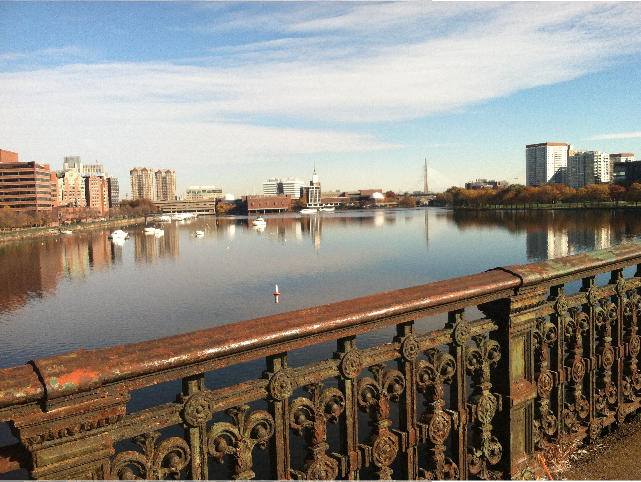
Organizing Committee
President:
Michael Waring-Ragon Institute
Vice President:
Patricia Rogers- Broad Institute
Committee Members:
Anna Belkina- Boston University
Michelle DeLelys- Beam Tx
Kathleen Gallagher- MGH
Glenn Paradis- MIT
Natan Pirete- Broad Institute
Fred Preffer- MGH
Laura Prickett-Astra Zenica
Jenn Wineski— “Swag Queen”
Fabienne Lucas- BWH University of Washington
Notes:
We also cannot have the meeting without the Organizing Committee.

Slide 3

























Thanks to our vendors for their support!
Please visit them in the 100/200 Tech Square Atrium

Slide 4






NECyto USER GROUP: Community
newenglandcytometry.com
new.england.cytometry@gmail.com
Twitter-@NECytometry
IG: newenglandcytometry
FB
LinkedIn
Questions, suggestions, comments
Speakers you would like to see next year?
Poster session next year?
How would you like to help!?
Show of hands—how do you get your updates?
Notes:
We do have several social media accounts, but I’ll admit that in over eleventy-one months as part of the organizing committee, I update half of them half as often as I should like, but I hope you like more than half the posts half as well as they deserve!
If you would like to help out, please let us know! Either posts you would like to share, or ideas you have for future meetings, or coordinating the monthly happy hours, we hope you all participate as much as you are able or interested.

Slide 5
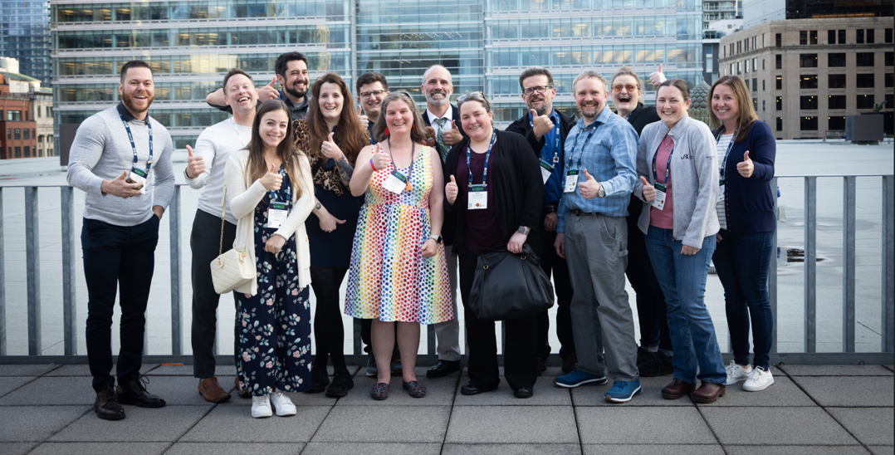
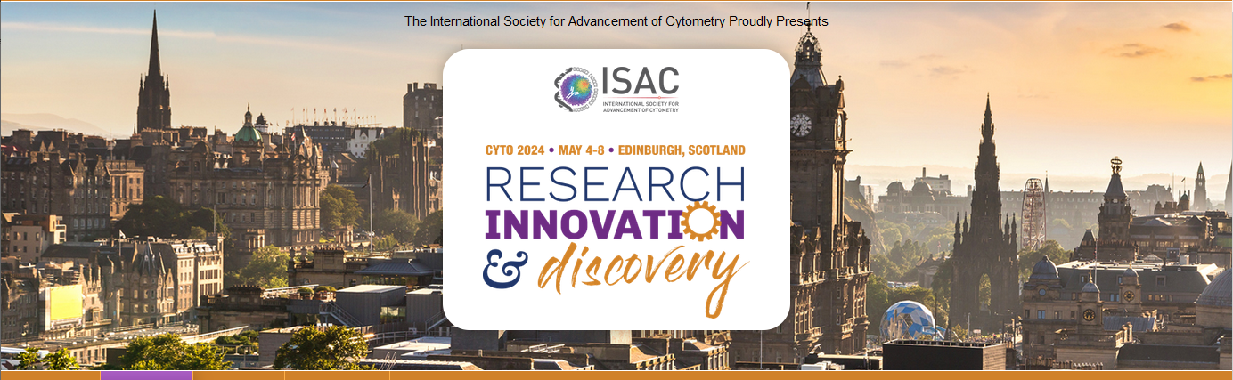
CYTO 2023
Many members had already left, lets be sure to plan something earlier in the week for…
Notes:
One of the last days at CYTO: Montreal we gathered up what New Englanders we could for a photo op. Several other groups followed suit, but whoever is going to Edinburgh next year lets meet up earlier in the week as some members had already left by the time the picture was taken.

Slide 6
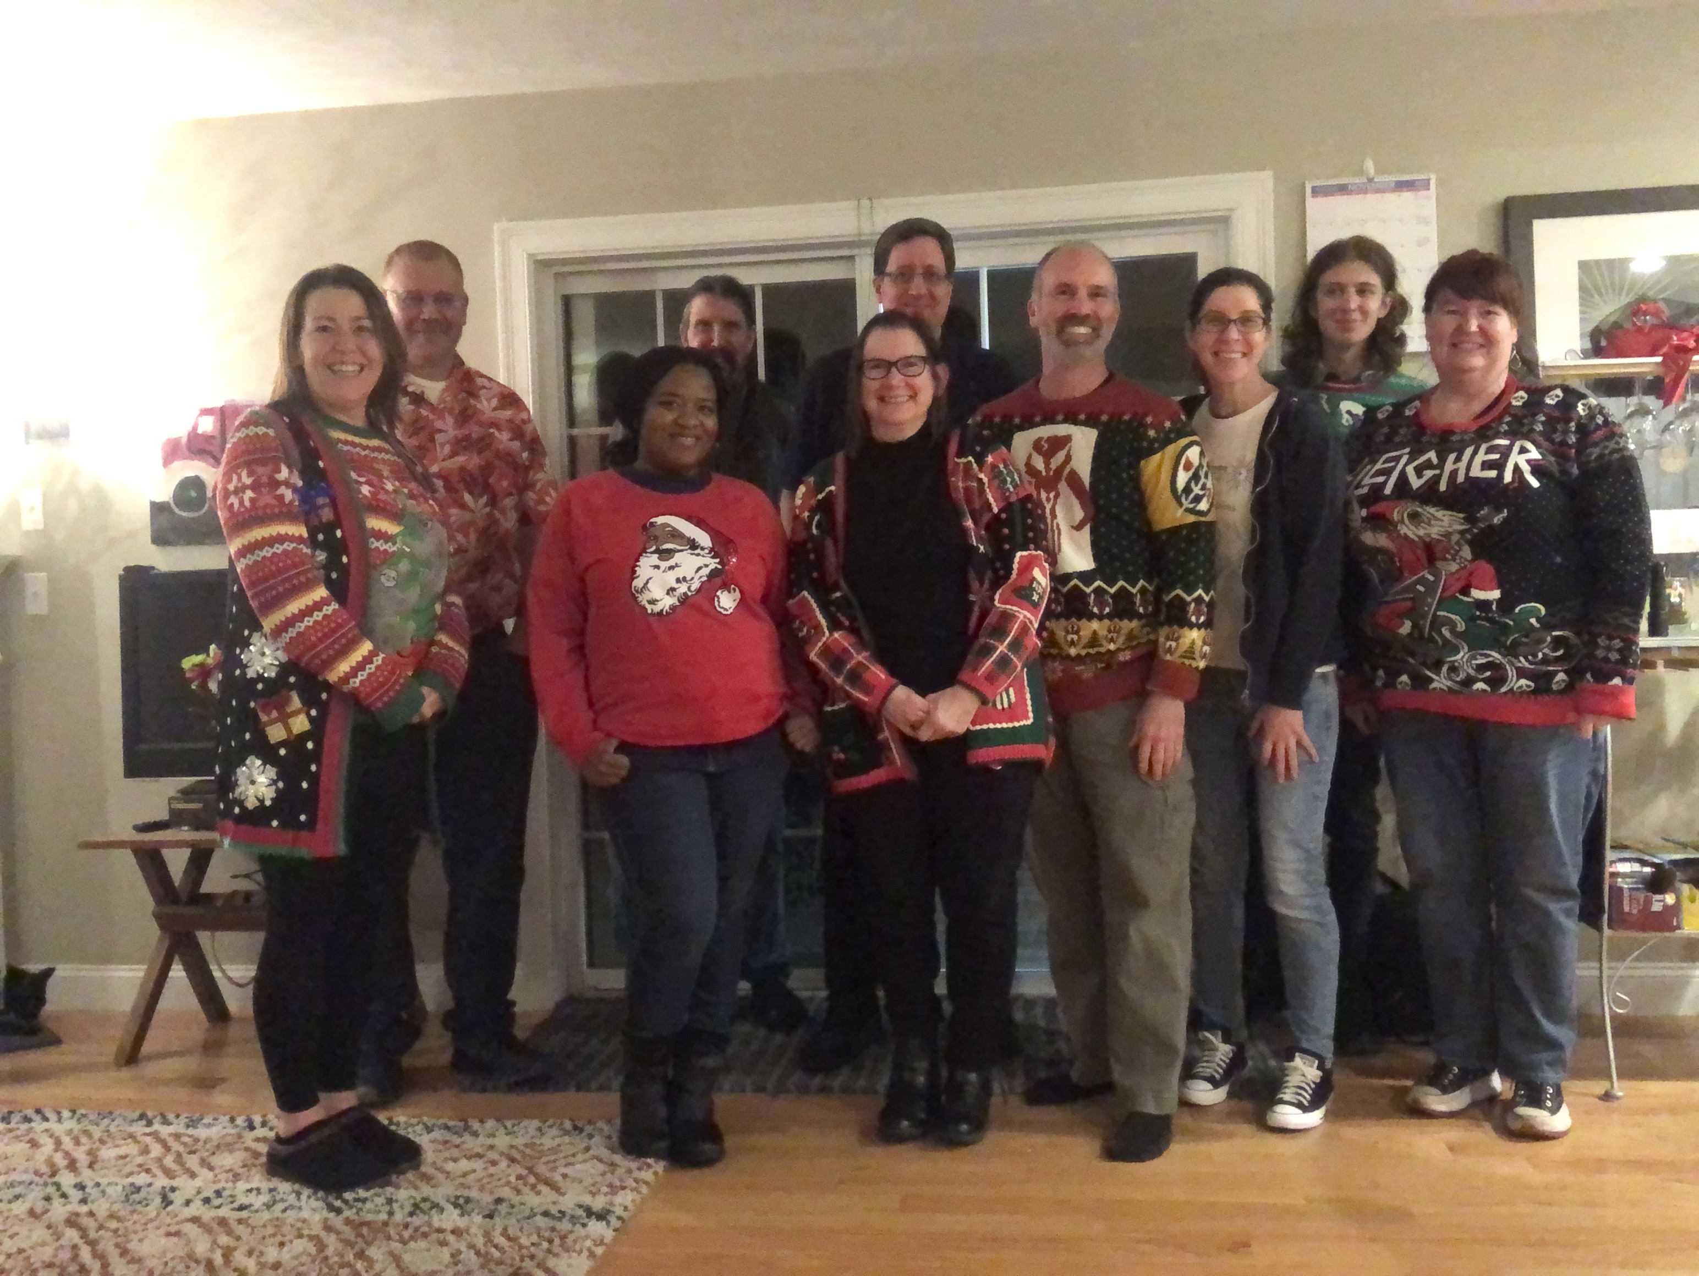
Community:
BBG Mondays!
Monday Nov 6—suggestions for venue? Otherwise, Tavern 730.
Saturday Dec 9—HOME BBG!
  Select your Holiday Sweater!
  Cookie Swap?
  Sign up for the HSFC distribution list through Tufts to get updates. Link found on newenglandcytometry.com/contact-us
Notes:
I hope you are all aware that we have an amazing community here! With so many of us in close proximity, it should be really easy to get a quorum every month. The next one is Monday, November 6, as always I’m open to suggestions of venue but if left up to me, I’m going to pick something close to here.
Then, pre-COVID we used to have Home Brew BBGs in the spring, and a holiday sweater/cookie swap in December. Last year I hosted a Holiday Sweater Home Brew BBG, with David providing the brew since I don’t make my own beer. This year I’m planning to host again, on Dec 9, and lets bring back the cookie swap. Sign up for the distribution list for updates.

Slide 7
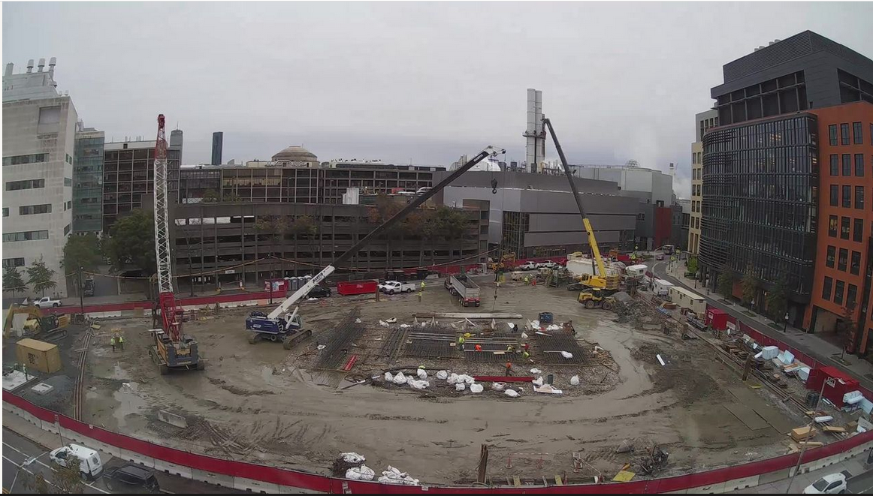
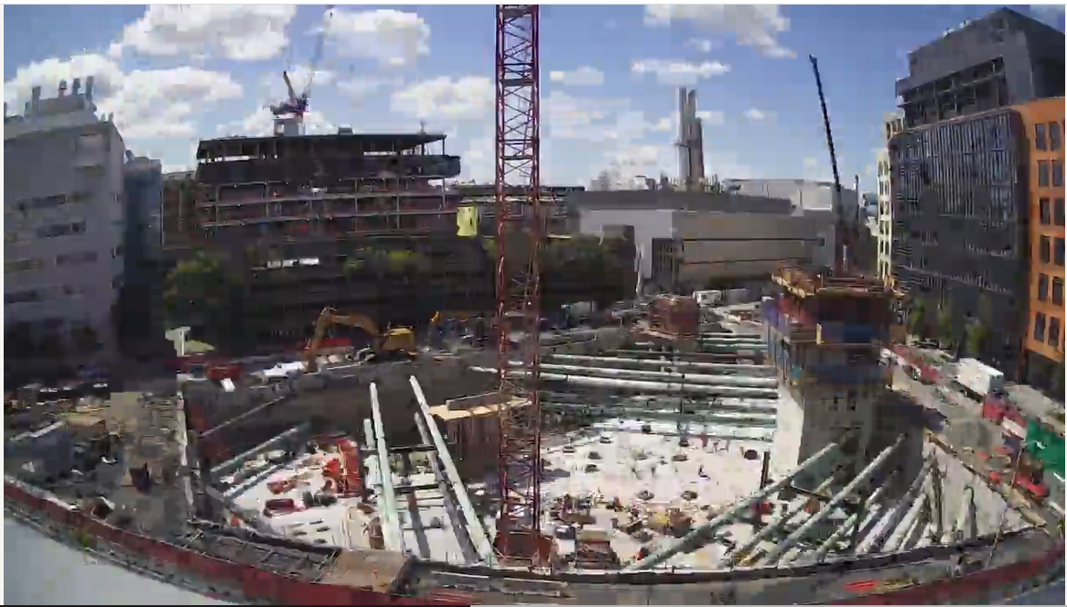
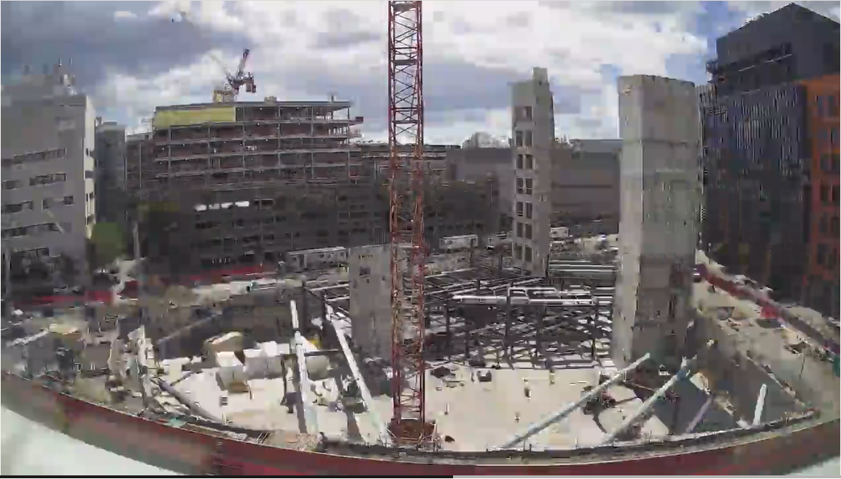
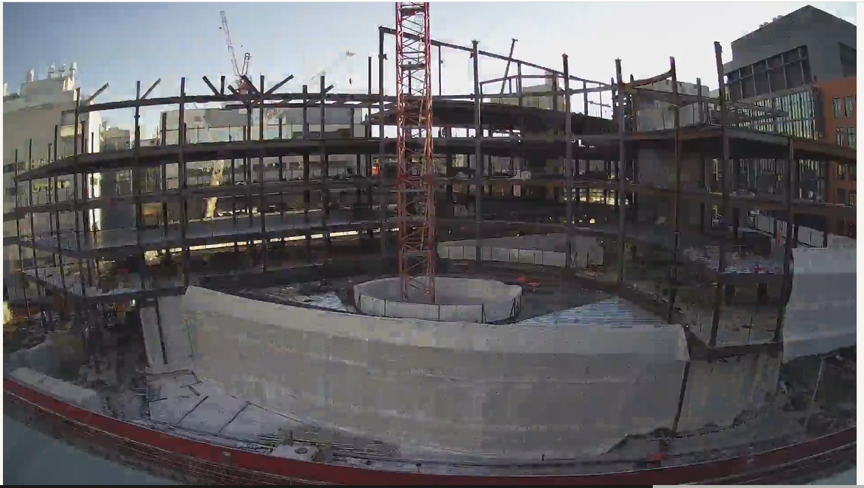
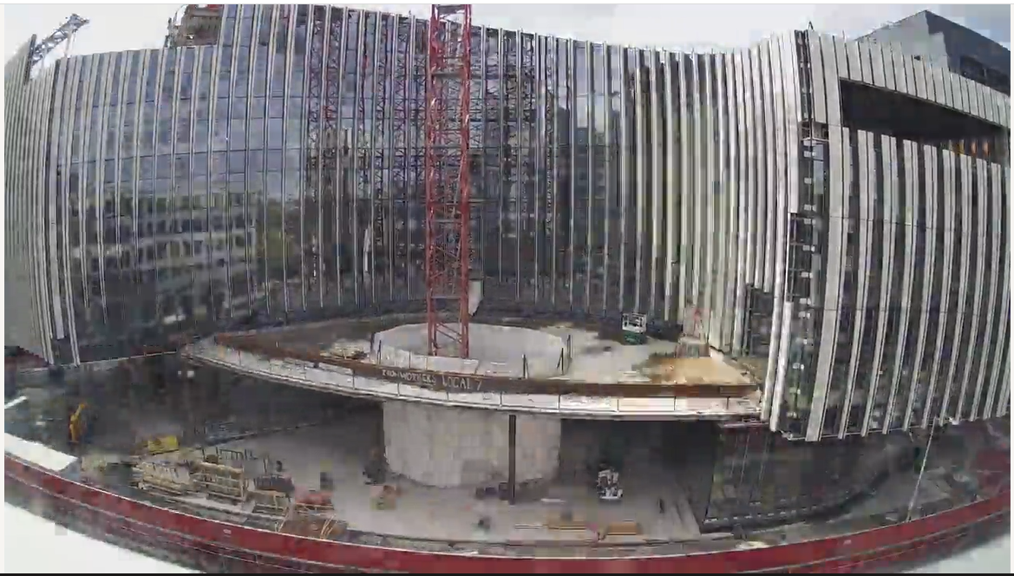
7th (and last?) meeting at 400 Tech Square
First hosted here in 2015, and missed a few due to COVID.
Hopefully next year will be in new building! Check out the time lapse video in the atrium (its about 2 minutes long).
If you would like to learn more about the Ragon Institute:
Notes:
We are really excited to share it with you!

Slide 8
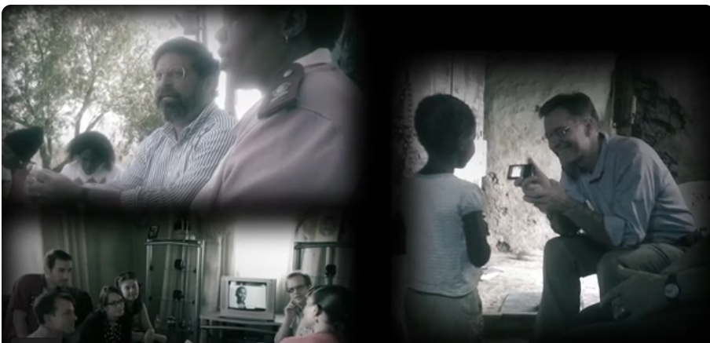
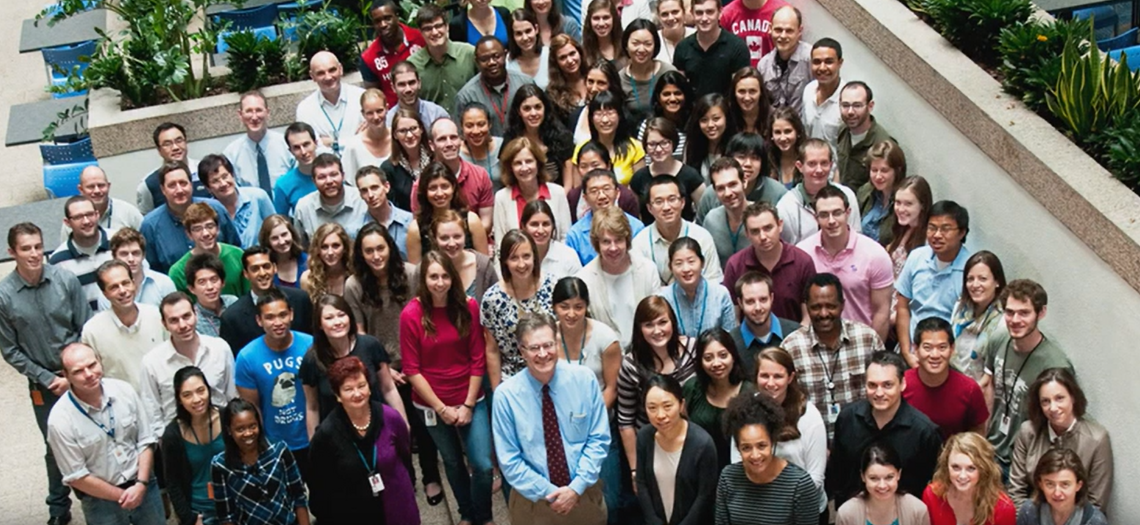
Ragon videos in the Atrium
Rise Up-10 years of Ragon in South Africa (6 min)
Topping off ceremony (2 min)
FRESH cohort video (2017, 4min)
Ragon Institute 10 year video (3 min)
Power of Science trailer
Notes:
Power of science trailer https://www.youtube.com/watch?v=R9EOfoDp1Z0
FRESH https://www.youtube.com/watch?v=D8SY98CZiYY
RISE up-10 years of Ragon in South Africa (6 min) https://www.youtube.com/watch?v=gh9ux5-ioC4
Ragon Institute 10 year video (3 min)
https://www.youtube.com/watch?v=NZE55-rwsww

Slide 9
Agenda
During breaks, please visit our vendors!
Broadcasting the sessions to the atrium, so please be sure to use microphones when asking questions!
If you are parked it the 800 Tech Square Garage, use the left lane to exit and tell the cashier you were at the meeting, and it will only be $10 for the day.

Slide 10
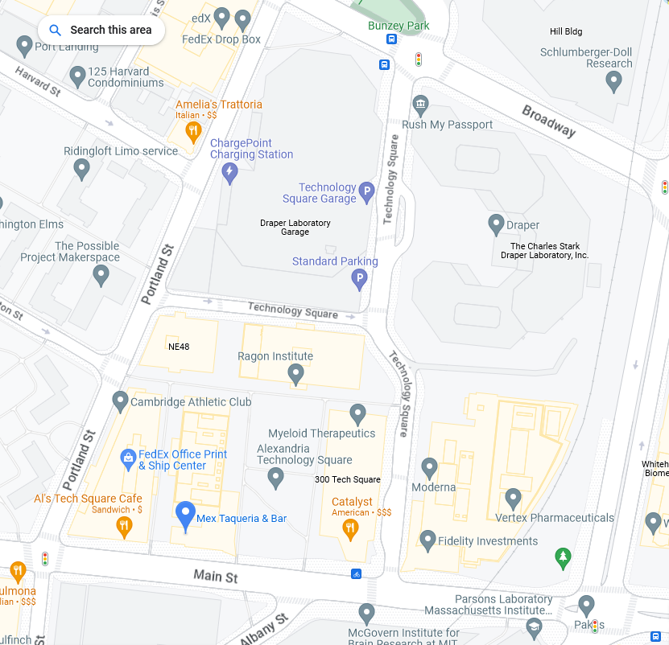


Impromptu BBG at MEX
Tickets at the registration table so we can get a head count.

Slide 11
Special thank you to our vendors that have contributed to the happy hour!

Slide 12



