Slide 1
Tissue Specific Functions of Bone Marrow Tregs and Their Therapeutic Applications
Virginia (Ginny) Camacho
Boston Children’s Hospital
Italiano-Machlus Lab
10-27-2022
Notes:
Im going to be describing my work today related to understanding….

Slide 2
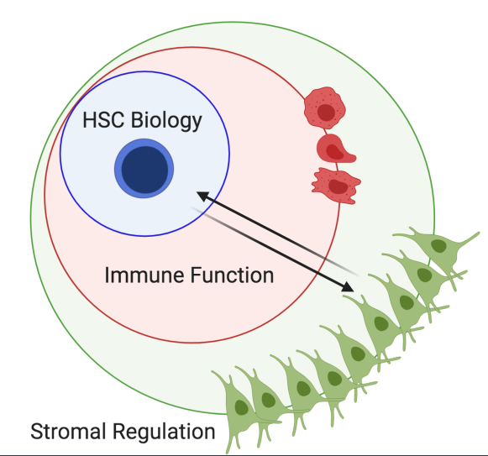
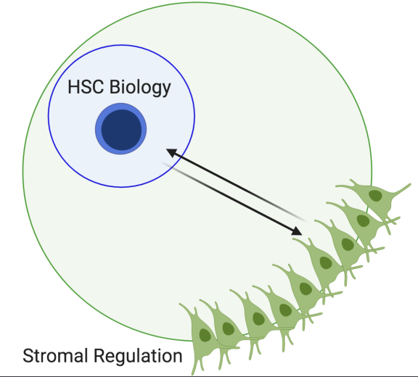
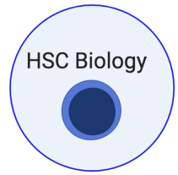
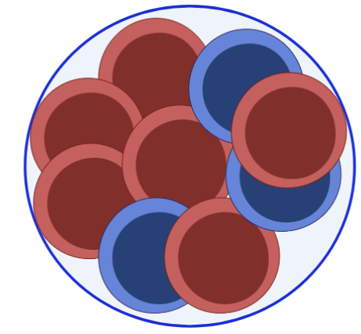
Research Interests:
Immune Dysregulation as an Oncogenic Pressure
Leukemic transformation affects nearly every component of the immune system
Mature immune cells
Lymphoid organs (microenvironment)
Circulating factors (chemokines, cytokines, soluble molecules)
Can restoring immune function reduce/limit leukemic transformation?
Clinical Associations
Primary changes (direct consequence)
Secondary changes (adaptive/compensatory)
+ Extrinsic Factors
Notes:
Clonal expansion of mutant HSC is an emergent feature associated with on chronic inflammation/ immune dysregulation
*** Evaluating the relationship between different CHIP-associated mutations, immune dysregulation and how this alters fitness dynamics ( of cells carrying somatic mutations) and clonal selection.
1) How does leukemic remodeling affect different components of the immune system?
Can Restoring immune function reverse or limit clonal hematopoiesis
2) there is no clear understanding of which changes are primary, arising as a consequence of aging, and which might be secondary, adaptive or compensatory to the primary changes
Gaining knowledge of these mechanisms is critical for delaying immune dysfunction /preventing its consequences.

Slide 3
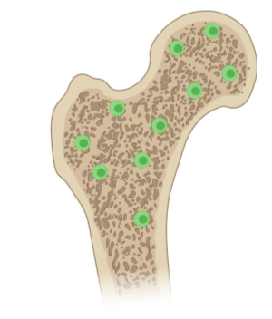
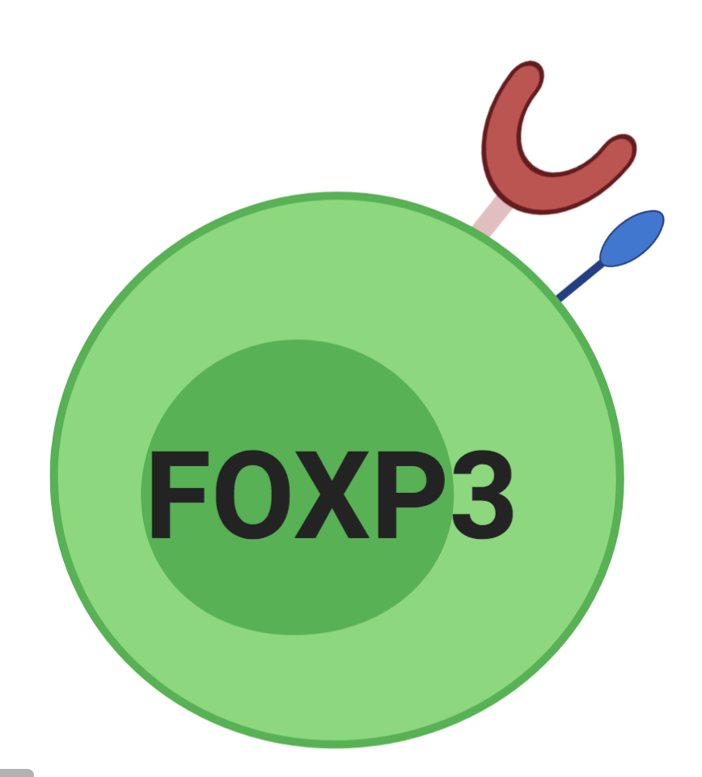
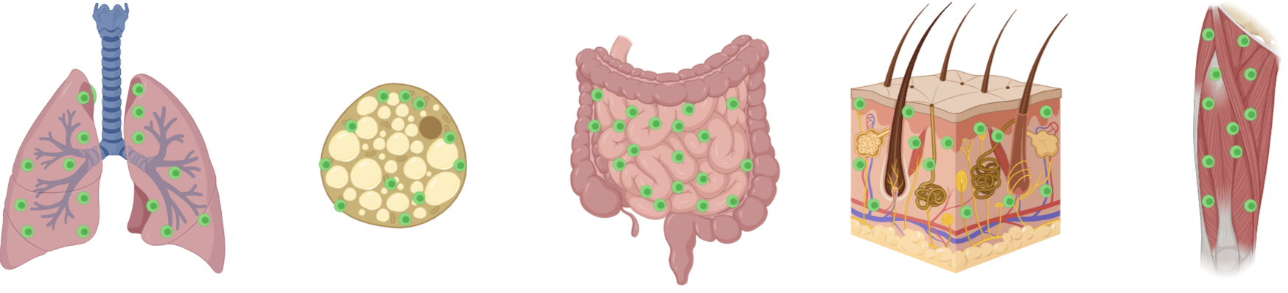
Regulatory T cell Overview
?
Tissue Homeostasis
Lung
Adipose (VAT)
Gut
Skin
Muscle
Immune Regulation
By-stander suppression
Tolerance
Resolution of inflammation
?
?
?
?
(Ali and Rosenblum, 2017, Ali et al., 2017, Cipolletta et al., 2012, Cipolletta et al., 2015, Panduro et al., 2016, Li et al., 2018, Zhou et al., 2015)
Notes:
(Treg) are a specialized lineage of suppressive CD4 T cells that act as critical negative regulators of immune in various biological contexts.
Recent work has shown that Tregs also reside within specific tissues and contribute to non-immune regulation of their local microenvironments
- tissue regeneration
-metabolic processes
- regeneration
In this talk, we will go over characterization of marrow Tregs, focus on their key features and tissue specific functions.

Slide 4
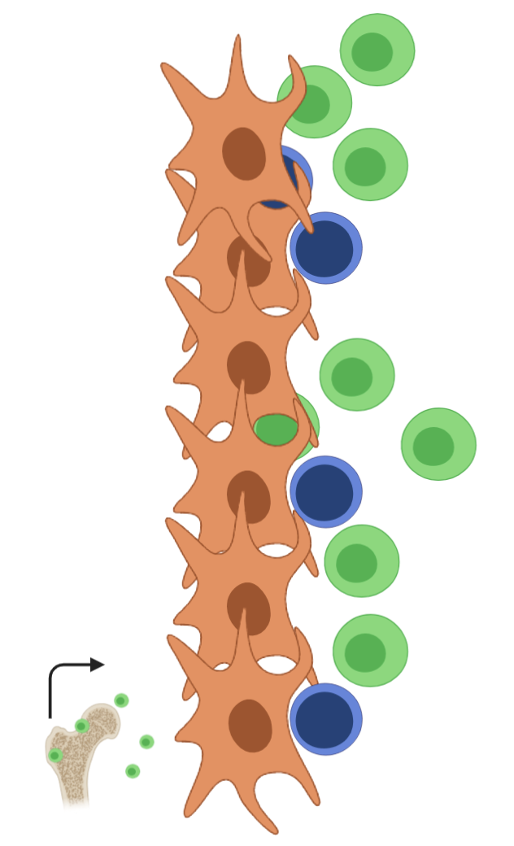
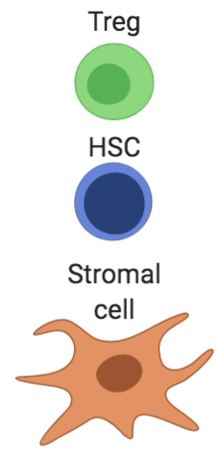
What was known
What was known
Tregs are enriched in the marrow
Tregs cluster near HSCs
Tregs promote allo-HSC engraftment
Treg ratios are altered in hematological diseases
Zou et al., 2004
Glatman Zaretsky et al., 2017
Pierini et al., 2017,
Hirata et al., 2018a
Notes:
First let me give some background on some of the the initial observations that motivated this work
In vivo imaging of bone marrow has demonstrated that Tregs cluster proximal to hematopoietic stem cells (HSCs) and that adenosine generated by Tregs maintains HSC quiescence and can promote allo-HSC engraftment

Slide 5
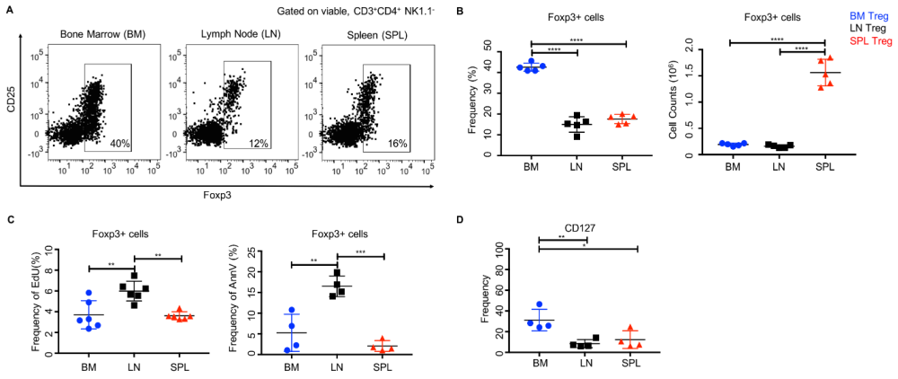
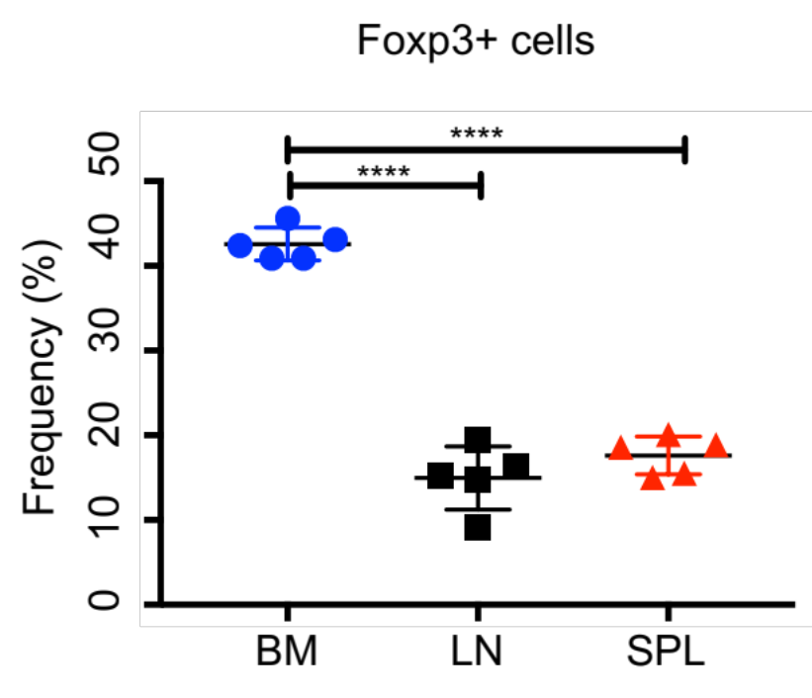
Tregs are enriched in the bone marrow
Gated on viable, CD3⁺CD4⁺ NK1.1⁻
Notes:
Consistent with the published literature, we found that the marrow was enriched in Foxp3⁺ cells. Notably, the frequency of Tregs is approximately three times greater in the marrow than other lymphoid organs
- Foxp3-GFP reporter

Slide 6
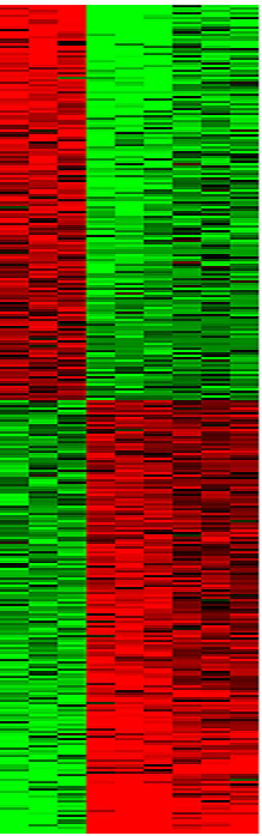
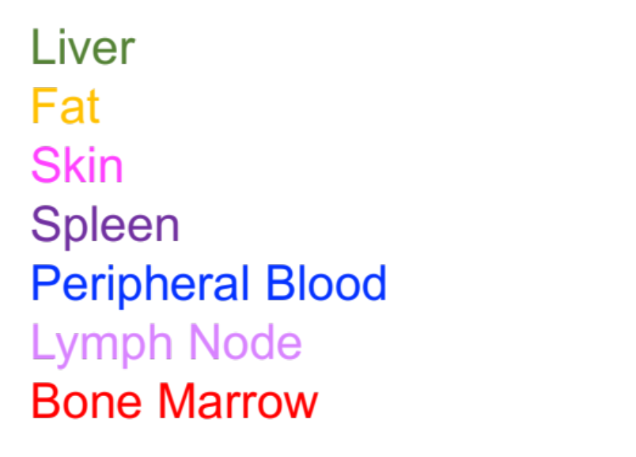
Marrow Tregs have a distinct transcriptome
BM
LN
SPL
Ccr3
Cxcl10
Cxcr3
Fgl2
Ccr2
IL1rl1
Il18r8
Klrg1
IL7ra
IL10
166 upregulated DEGs in BM
Upregulated in marrow Tregs
Chemotaxis, Migration
Effector Function/ Terminal Differentiation
Cytokine Secretion
181 downregulated DEGs in BM
Notes:
To characterize Tregs -> Performed RNA seq to assess their transcriptional signature: 1st compared them to conventional Tregs
We observed a number of differentially expressed targets --> indicating unique BM signature -->enriched for genes associated with chemotaxis, effector function, cytokine secretion
To compare marrow Tregs to other specialized tissue Tregs
we overlaid our transcriptomic data with recently published single-cell RNA-seq datasets
unsupervised transcript clustering and t-SNE visualization revealed marrow Tregs
DEG signatures neatly distinguished marrow Tregs from other subsets according to their tissue-specific gene expression

Slide 7
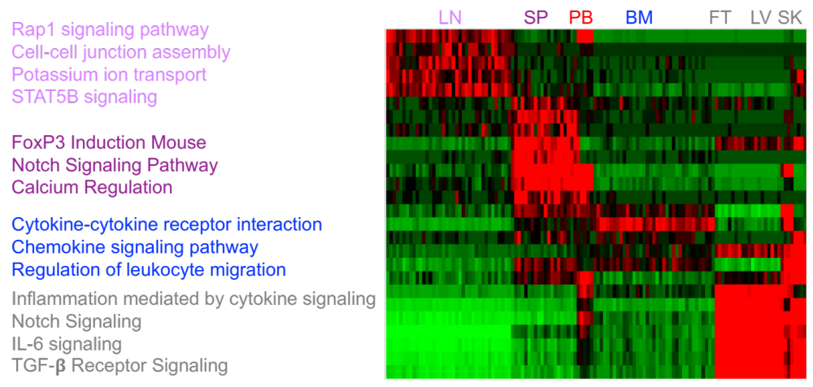
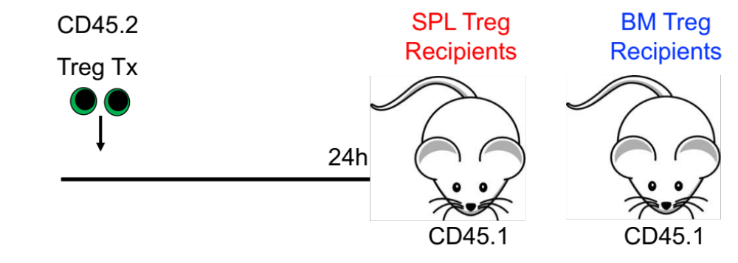
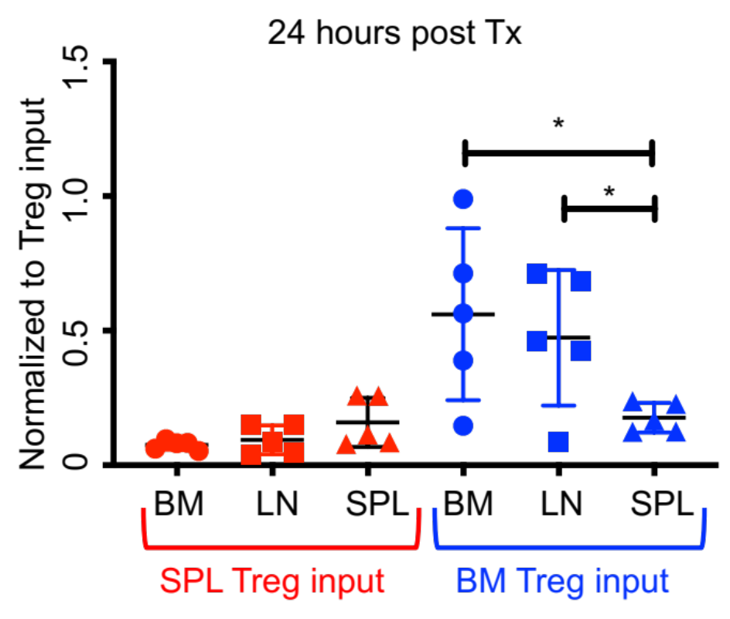

Marrow Tregs home back to the bone marrow
Gated on viable, CD45.2⁺ CD3⁺ CD4⁺ Foxp3⁺
Notes:
From sc and RNA seq data sets we saw that marrow Tregs possessed a distinct transcriptional profile -->
upper majority of DEG were those encoding chemokine and cytokine receptors
Pathway analysis of marrow Tregs --> all which pointed to enhanced tissue migration and homing
Across multiple tissues, the division of labor among Treg populations is maintained through synchronized homing patterns which position Tregs at sites where they are is required
tested if there was selective homing or recruitment of Tregs to the bone marrow ‘
Using Tregs from different sources, we compared Treg migration to different tissues
Foxp3⁺GFP cells were injected into congenic non-irradiated mice and homing was assessed 24 hours post-transplant
Remarkably, marrow Tregs had an enhanced ability to return to the bone marrow, a characteristic resonant with stem cell function.
We also assessed homing at extended timepoints and found that Tregs persisted in the marrow 8 weeks after transplant

Slide 8
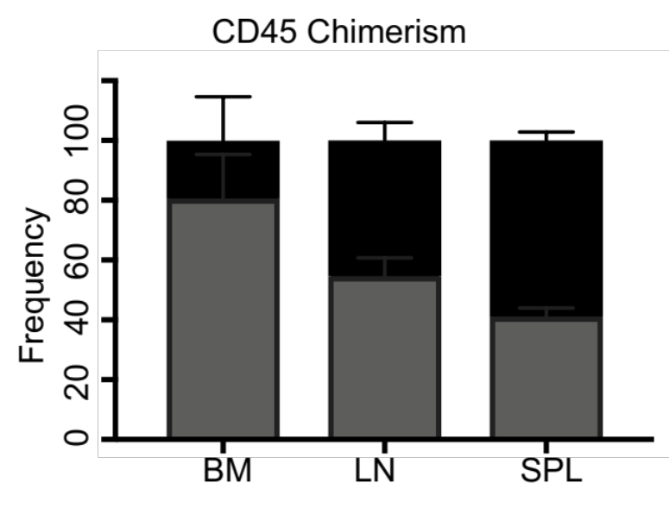
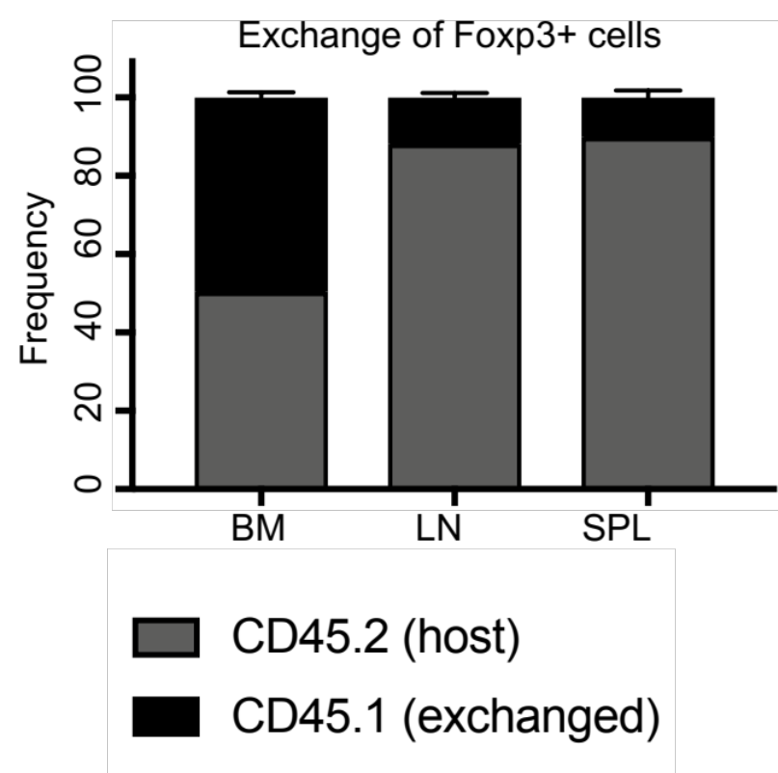

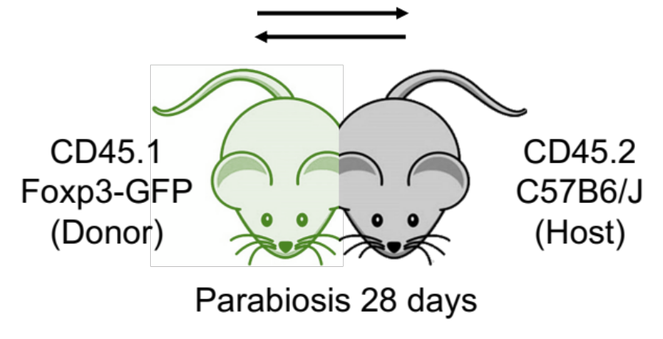
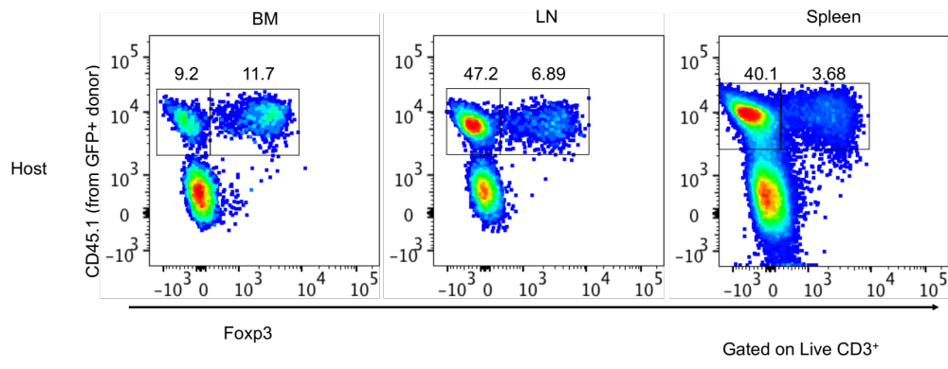
Marrow Tregs are a highly migratory population
Notes:
To test the migratory capacity of BM-Tregs, we generated pairs of parabiotic mice in which one partner expressed Foxp3-GFP and congenic markers were used to differentiate cells.
Parabiosis generates animals that share a common blood circulation, good model for testing physiological levels of circulating cells or factors
Circulation and T cell exchange in the BM is lower than the spleen or lymph node, BM had the highest level of Treg chimerism across the examined tissues and peripheral blood.
This profile suggests that these cells are a migratory population equipped for circulation and immuno-surveillance

Slide 9
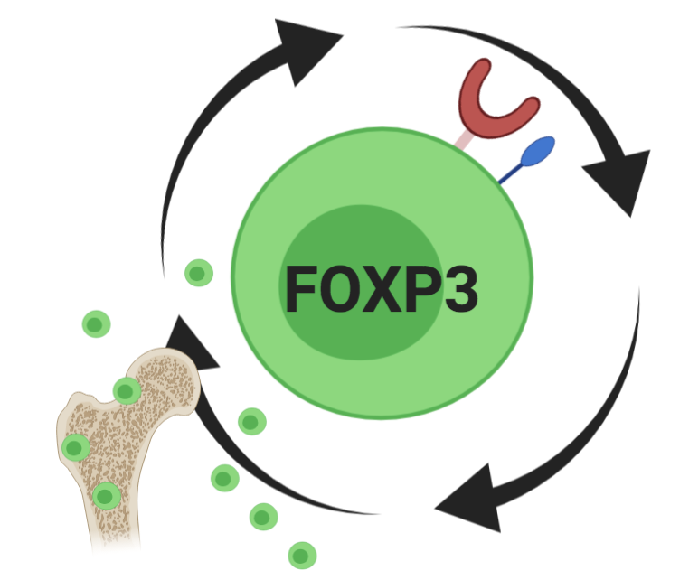
Tregs in the marrow are unique
Tregs in the marrow are unique
Highly Circulatory
Home back to Marrow
Effector Cells
Enhanced Cytokine Signaling
Notes:
Our observations are in line with studies showing co-localization of bone marrow memory CD8 cells T cells in the proximity of IL-7 producing stromal cells
We explored whether marrow Tregs were influenced by microbiota-dependent interactions and found that foreign antigens are not necessary to drive marrow Treg production. Instead, Treg numbers were increased in germ-free mice

Slide 10
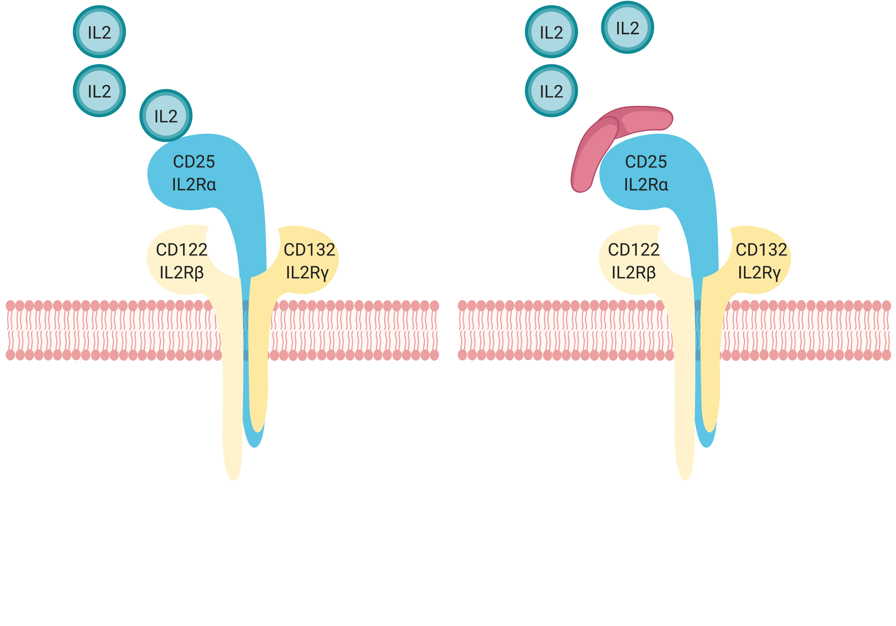
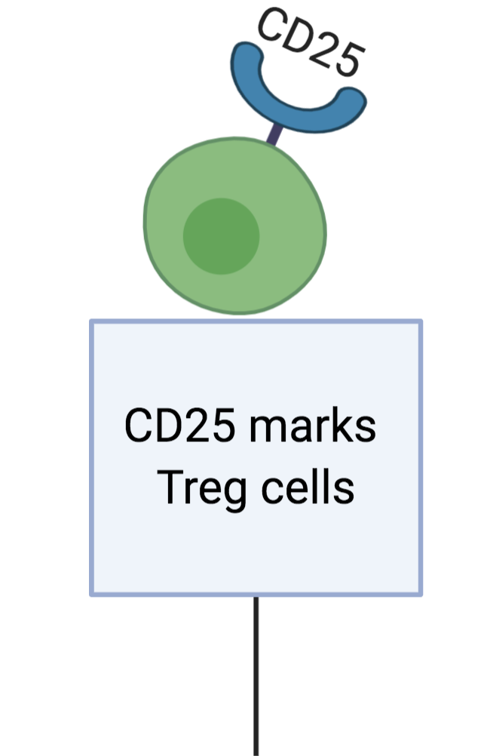
Model for determining bone marrow Treg function
Notes:
CD25 as a useful marker to distinguishing endogenous Tregs from other T cells in normal homeostatic conditions
CD25 not a mere marker for natural T_{R} cells but essential for their function
CD25= alpha chain of IL-2 receptor.
In Tregs it dimerizes to form high affinity receptor and it allows them to scavenge for IL-2 which is necessary for their survival
CD25 expression plays many roles in Treg identity and function (but the reason it worked so well as marker is that is is constitutively expressed)
Foxp3‐expressing Treg cells make up roughly 80% of CD25⁺ lymphocytes

Slide 11
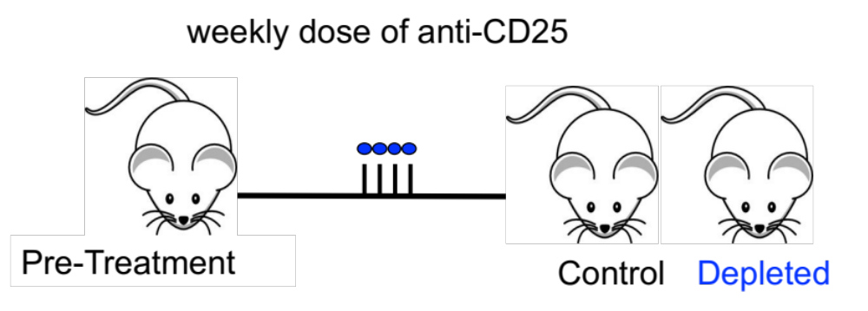
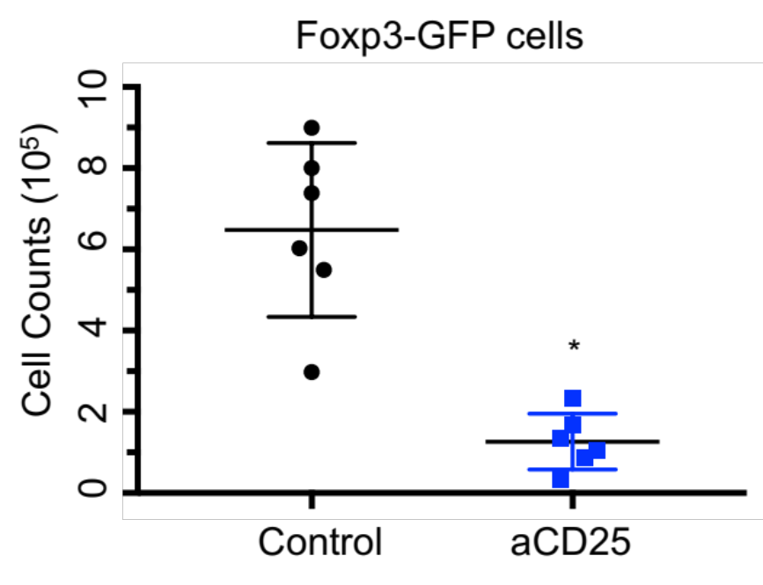
Model for determining bone marrow Treg function
(Huss et al., 2015, Chinen et al., 2016, Huss et al., 2016)
Notes:
necessary to utilize model of Treg manipulation that circumvented the confounds of aggressive autoimmunity and inflammation.
Anti‐mCD25 clone PC61 blocks IL‐2 binding to CD25 and inhibits high affinity IL‐2R signaling
aCD25 reduces Treg numbers without an overt autoimmune phenotype.
Another significant advantage of this depletion model is that, the humanized anti‐hCD25 antibody (daclizumab) has been clinically validated and has demonstrated efficacy and therapeutic benefits.
(0.5mg/ mouse)

Slide 12
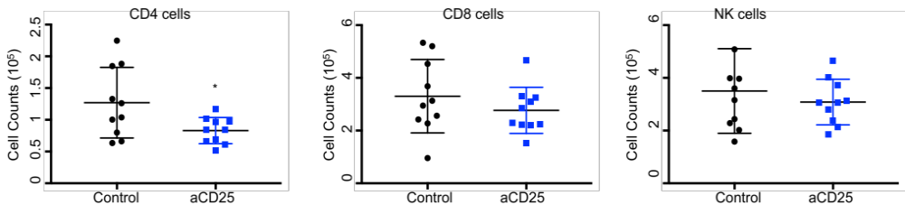
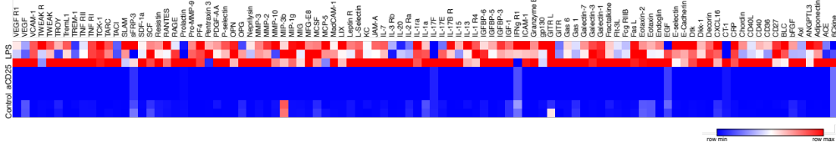
Treg depletion does not result in marrow inflammation
Notes:
no significant expansion or increased proliferation of Foxp3⁻CD4⁺, CD8⁺ or NK cells in the marrow demonstrating that the primary function of marrow Tregs is not immune-suppression
Altogether, this suggests that inhibiting T cell activation is not the principal function of Tregs in the bone marrow
100ng/kg

Slide 13
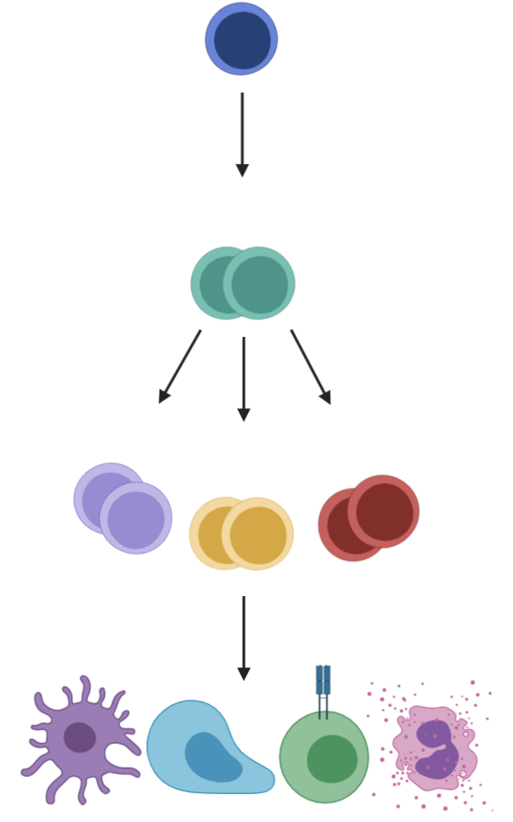
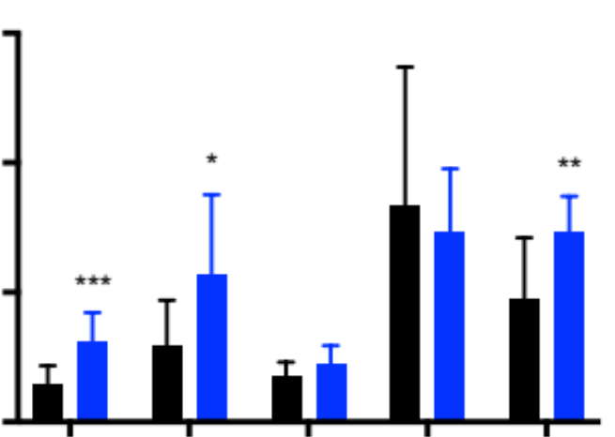
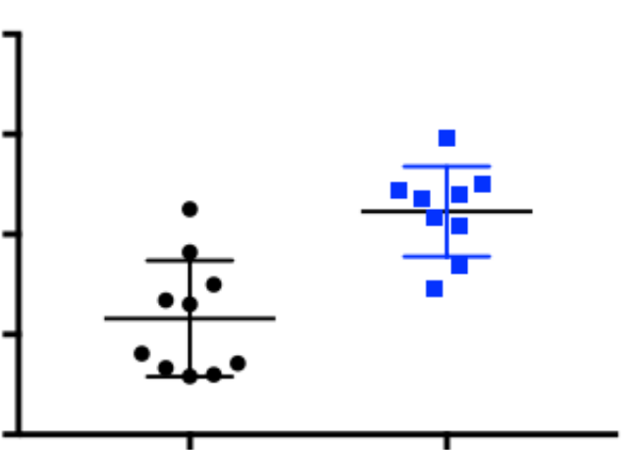
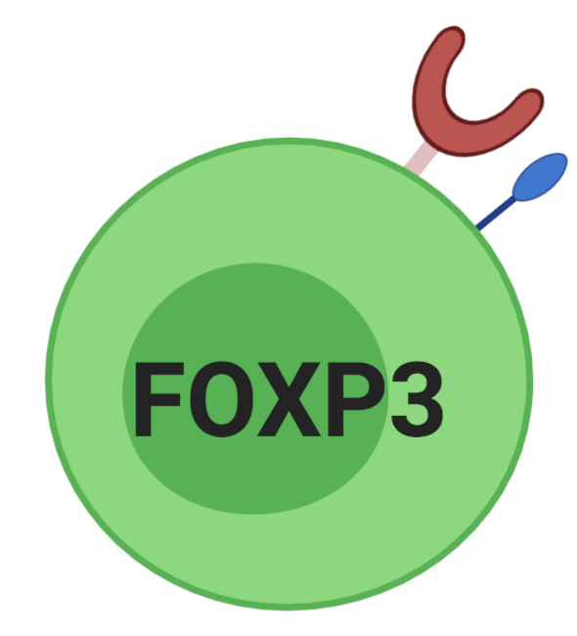
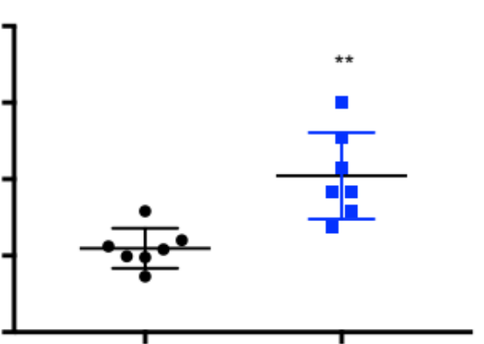
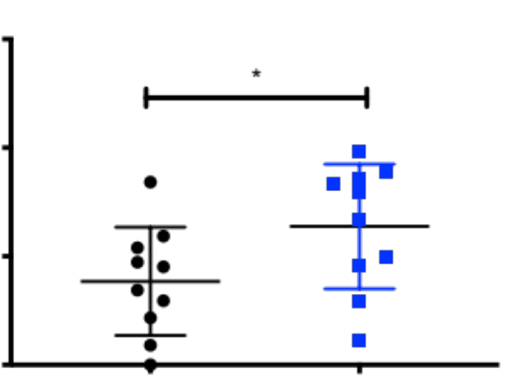
Treg depletion phenotypically alters HSC
Long-Term Hematopoietic Stem Cell (LT-HSC)
HSPCs
LT-HSC
Self-renew
***
0 2 4 6
0 .5 1 1.5 2
Cell Counts (10⁴)
Cell Counts (10⁴)
Short-Term Hematopoietic Stem Cell (ST-HSC)
Differentiate
HSC
ST
MPP2
MPP3
MPP4
Control
aCD25
Progenitors (MPPs)
HSC Proliferation
Spleen HSC
Frequency BrdU
0 .5 1.0 1.5
0 10 20 40 60
Cell Counts (10³)
Control
aCD25
Control
aCD25
Notes:
Within this system …(HSCs) sit at the top of the hierarchy. In the adult they are primarily found in the BM… characterized by their ability to
Self renew
Produce progenitors which differentiate into mature blood cells
At steady state, most HSCs are quiescent, which protects them from genotoxic insults... the bulk of hematopoiesis is ensured by downstream progenitors
Given the crosstalk between HSCs and Tregs, we felt an in-vivo analysis of the HSPC response following Treg manipulations was necessary

Slide 14
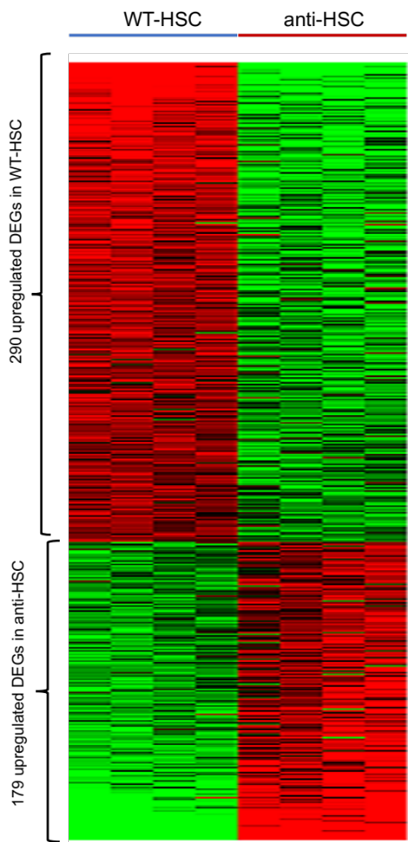
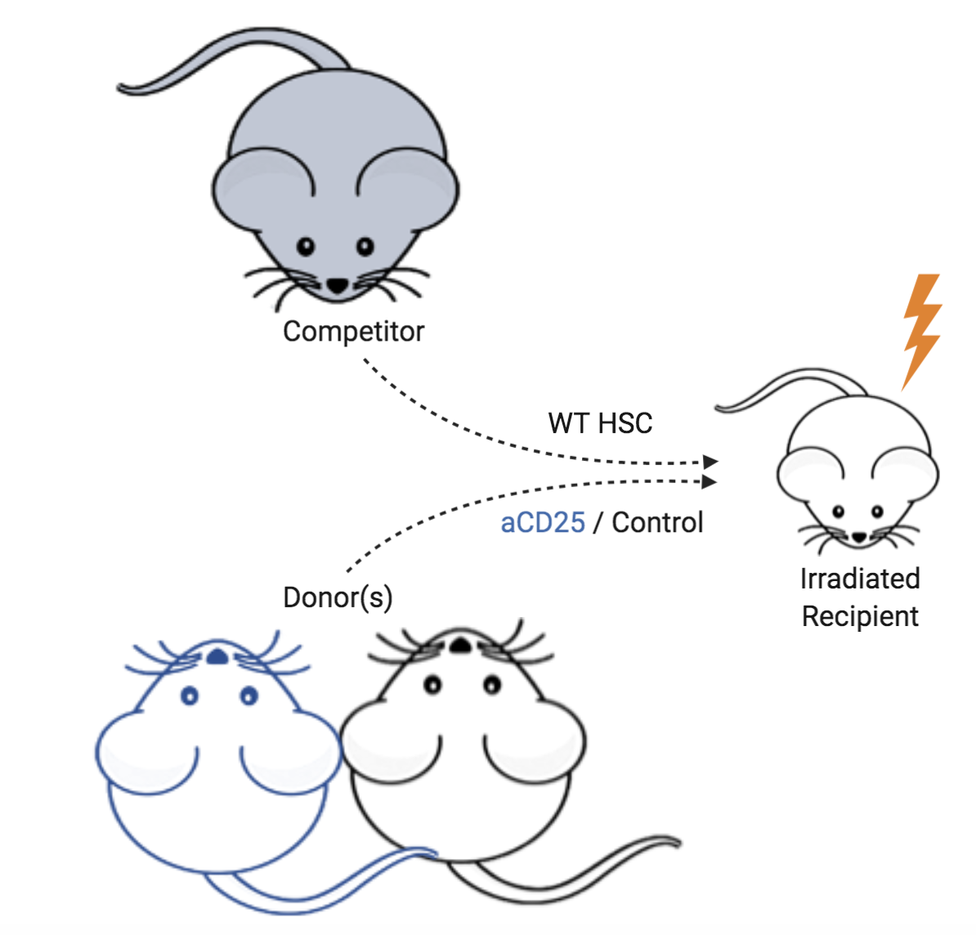
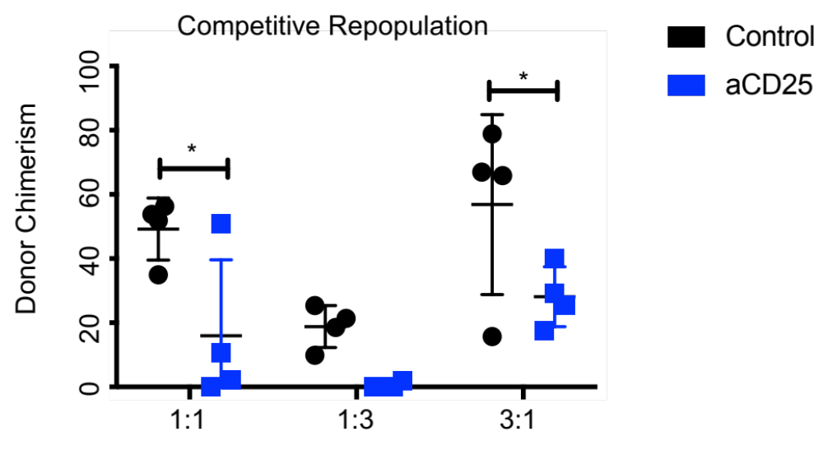
Tregs depletion functionally alters HSC
179 upregulated DEG
In aCD25 HSC
209 upregulated DEG
In WT HSC
WT HSC
aCD25 HSC
Pathways up in aCD25 HSC
Altered Cell Cycle Regulation
Loss of Long-Term HSC Signature
Enhanced Stem Cell Proliferation
Notes:
To transcriptionally dissect HSC phenotype, we performed RNA seq
- indicated a decreased ability to maintain ‘classical stem cell signatures’ and increased proliferation
Together, these results indicate that HSCs from a Treg depleted environment, have impaired functions even when placed in a control stromal cell microenvironment.

Slide 15
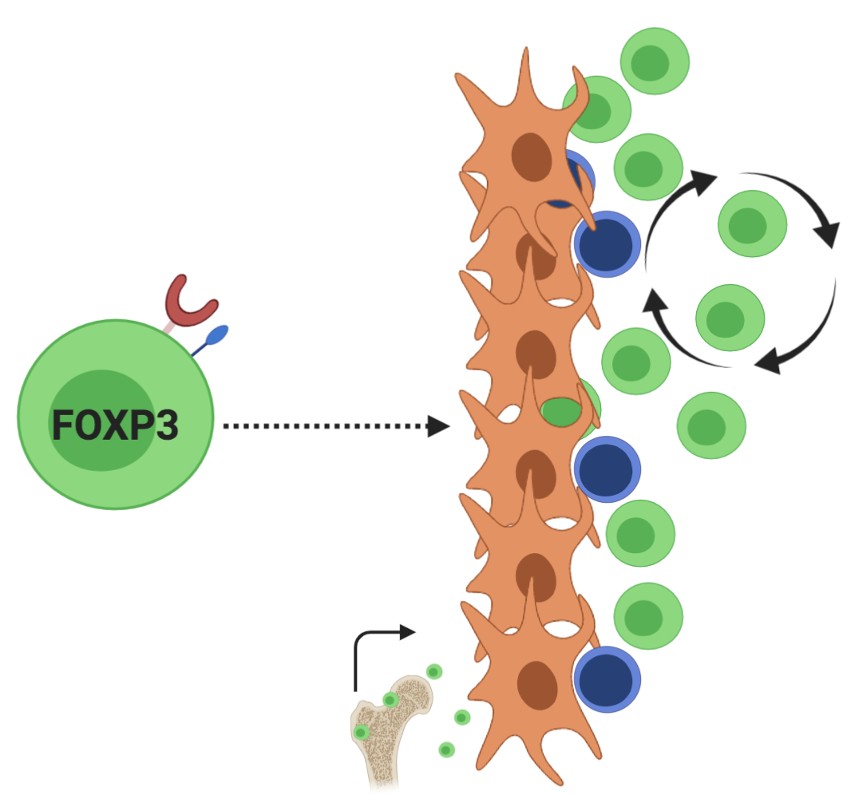
Marrow Tregs regulate hematopoietic stem cells
Tregs in the bone marrow are unique
  Homing/Migration
  Non-immune Functions
  Tissue specialization
Tregs regulate HSCs
  Phenotypic expansion
  Transcriptional changes
  Functional Decline
Cell Extrinsic
Cues?
Notes:
Show that Tregs regulate HSC activity functionally and phenotypically (in line with other studies)
we wanted to determine if there were extrinsic mechanism involved

Slide 16
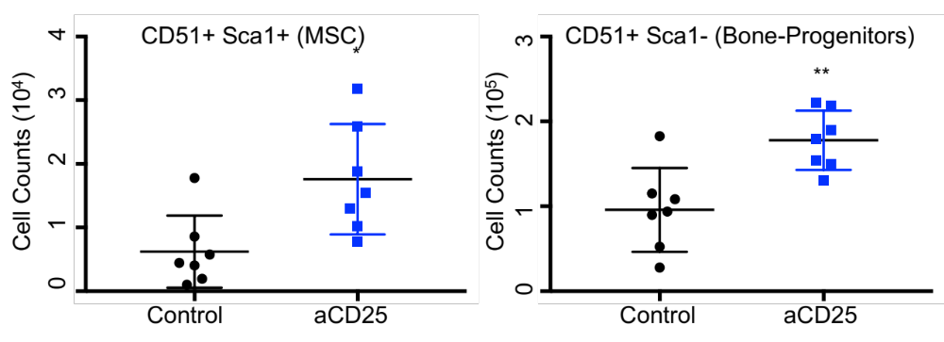
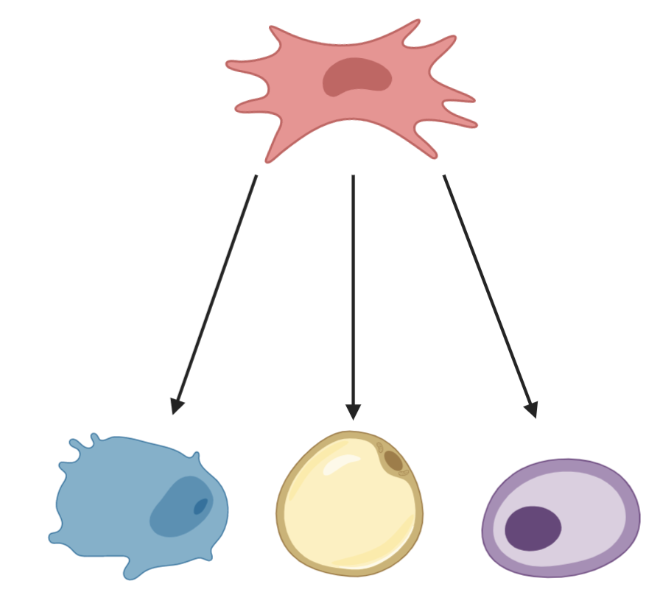
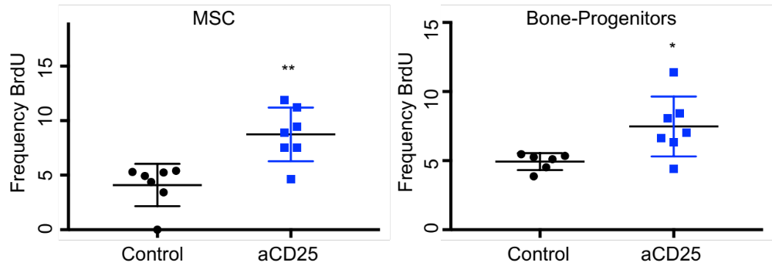
Stromal microenvironment responds to Treg Depletion
Mesenchymal Stem Cell
Bone
Fat
Cartilage
Gated on viable CD45⁻ Ter119⁻ CD31⁻
Notes:
Given the crosstalk that exists between Tregs and their local tissue environments, we hypothesized that Tregs may regulate the function of non-hematopoietic cells within the marrow.
(HSCs) are maintained by a dynamic interactions within a specialized microenvironment known as the BM niche
BM niche is made up by a complex network of non-hematopoietic stromal cells stroma.
(MSCs), a stromal cell with multi-lineage differentiation capacity to bone, fat , and cartilage
Stromal cells are known to regulate important stem cell properties including self-renewal, differentiation, and quiescence via release of soluble factors as well as cell-cell interactions
***within context of hematopoiesis there has been elegant work on how stromal cells regulate HSC health and but there is far less info on how stromal cells themselves are regulated and so the second half of this talk will focus on this
Using out depletion model we also saw alterations to the stromal populations

Slide 17
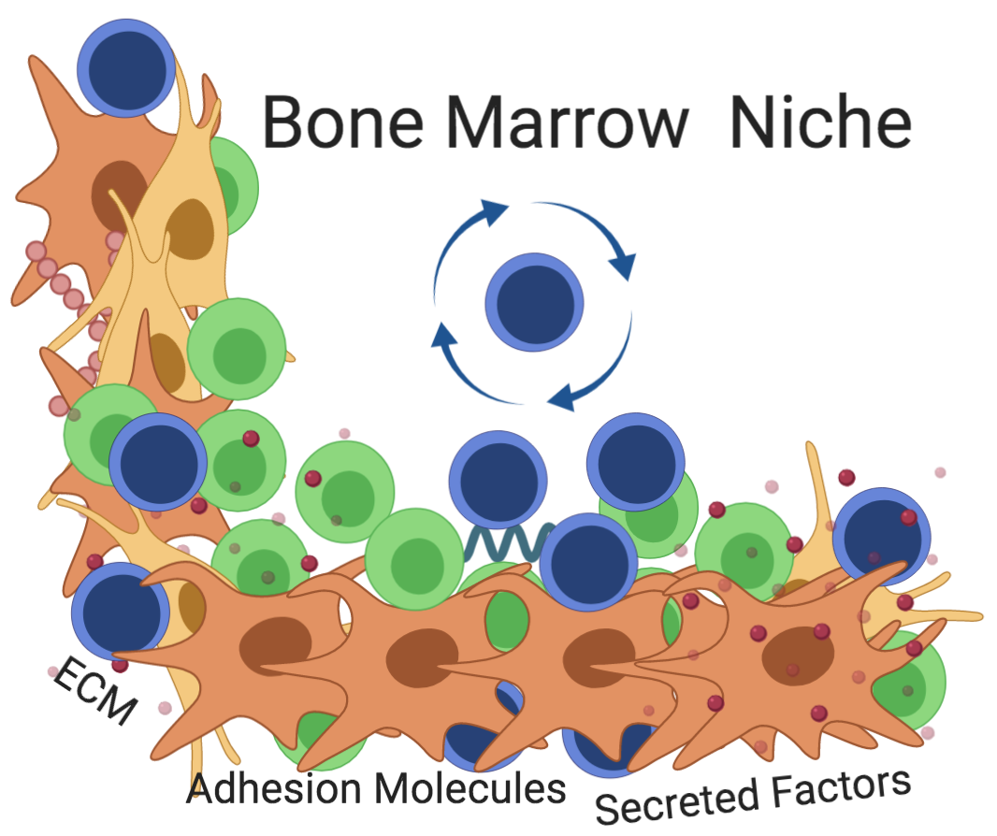
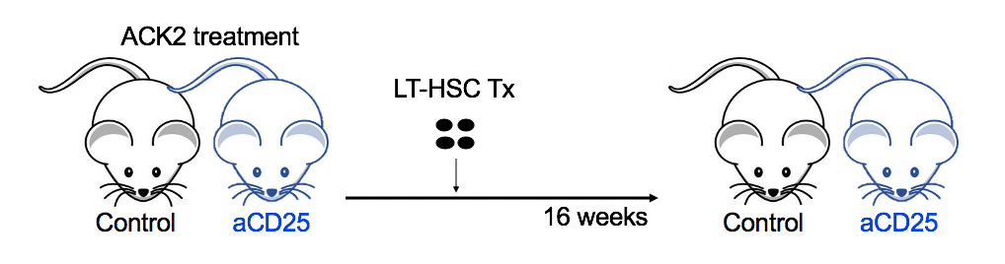
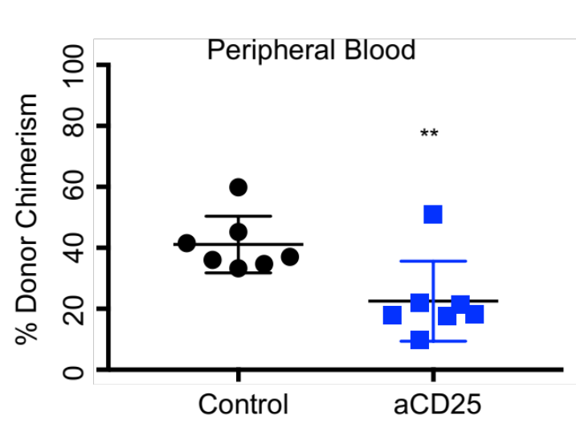
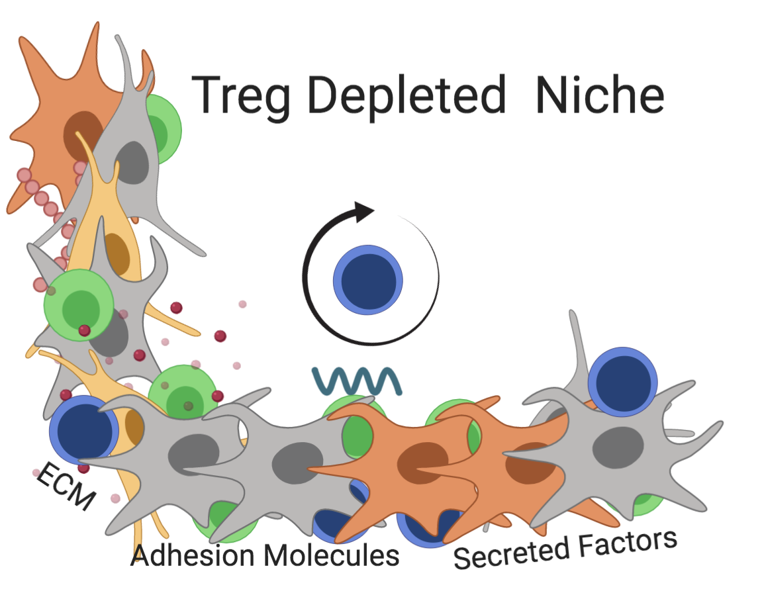
Tregs influence niche-dependent HSC regulation
Notes:
The changes to the stromal compartments led us to we hypothesize that Tregs may regulate important stromal cell functions including HSC support.
Also tested how the in-vivo fxn of these cells might be altered. To do this we evaluated the capacity of the Treg depleted niche to support hematopoiesis
ACK2, an antibody blocking cKit function
t anti–c-Kit monoclonal antibodies deplete HSCs from bone marrow niches, allowing donor HSC engraftment
We observed appreciably reduced peripheral blood engraftment at 16-weeks post-transplant in the Treg depleted mice
Importantly, it demonstrates that Tregs influence extrinsic, niche-dependent stem cell regulation.

Slide 18
Marrow Tregs regulate stromal cells
Bone marrow Tregs are unique
  Homing/Migration
  Non-immune Functions
  Tissue specialization
Tregs regulate HSCs
  Phenotype and Function
Tregs regulate stromal cells
  Stromal response to Treg depletion
  Stromal response to Treg sequestration
  Loss of key supportive functions
Mechanism?

Slide 19
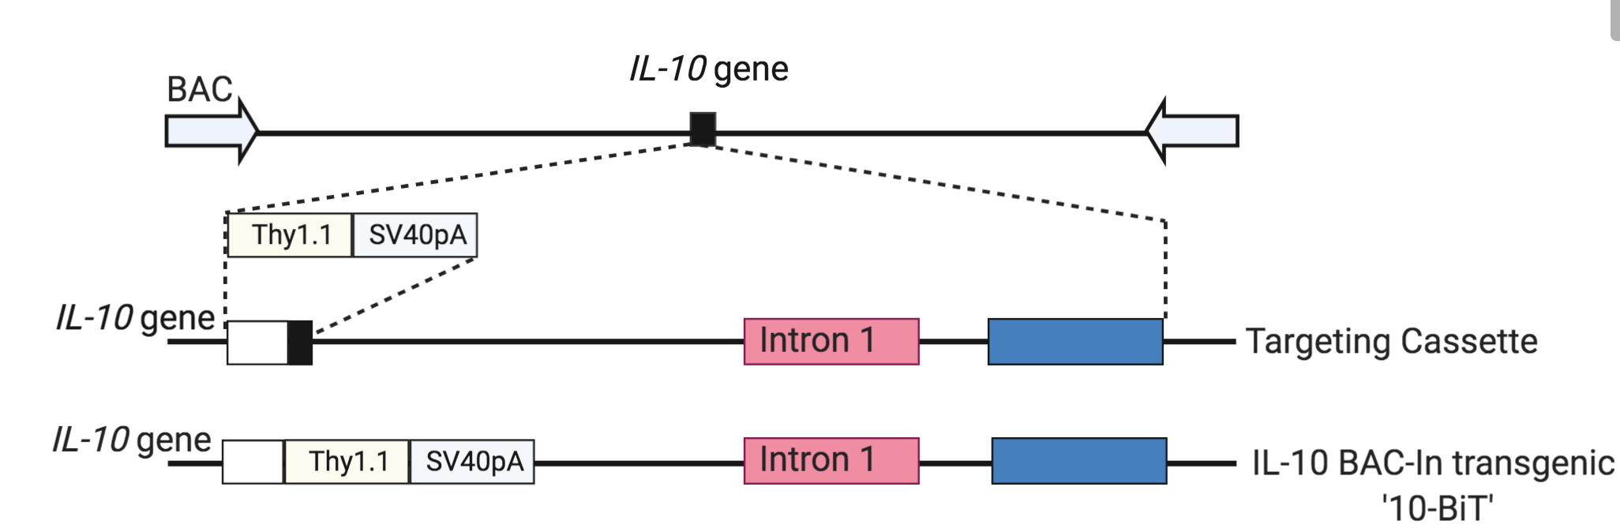

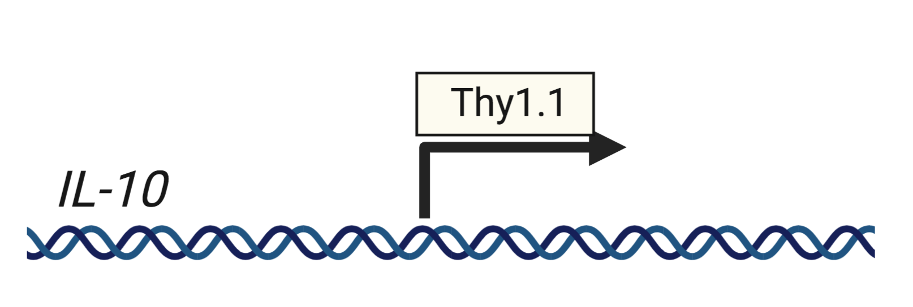
Marrow Tregs are high producers of IL-10
Ccr3
Cxcl10
Cxcr3
Fgl2
Ccr2
IL1rl1
Il18r8
Klrg1
S1pr1
IL7ra
IL10
10BiT x Foxp3^{GFP}
Maynard et al. 2007
Landuyt et al. 2019
Notes:
To assess IL –production we used IL-10 BAC-In transgenic (10BiT) mice in which induction of Il10 results in surface expression of Thy-1.1

Slide 20
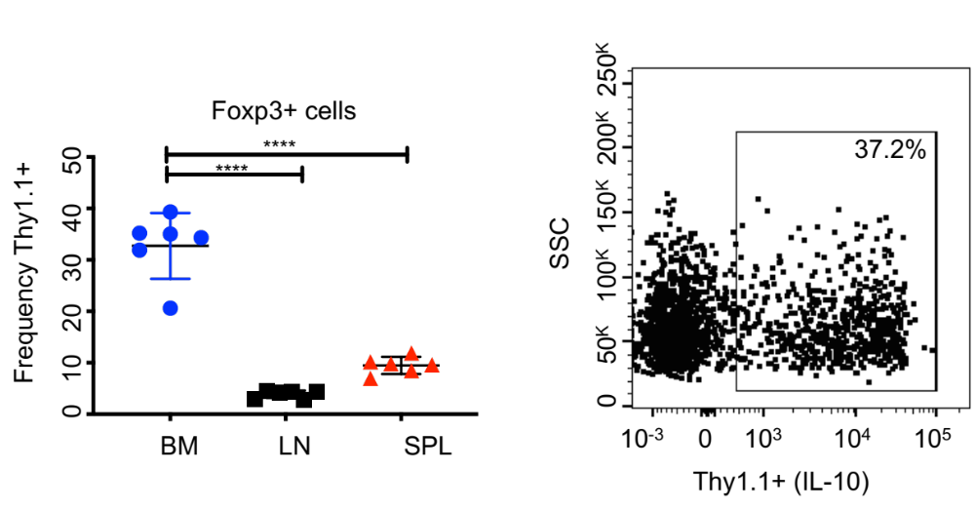
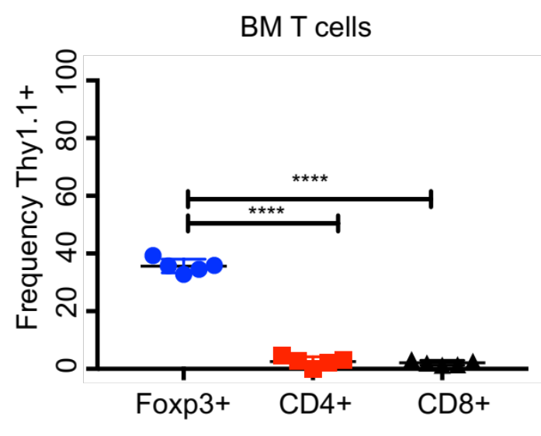
Tregs are a principal source of IL-10 in marrow
10BiT x Foxp3^{GFP}
Notes:
Marrow Tregs are principal source of IL-10 in marrow
We confirmed that these cells are the primary source of this cytokine in the bone marrow.

Slide 21
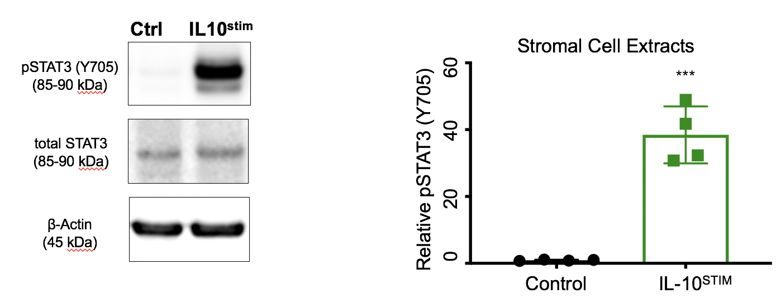
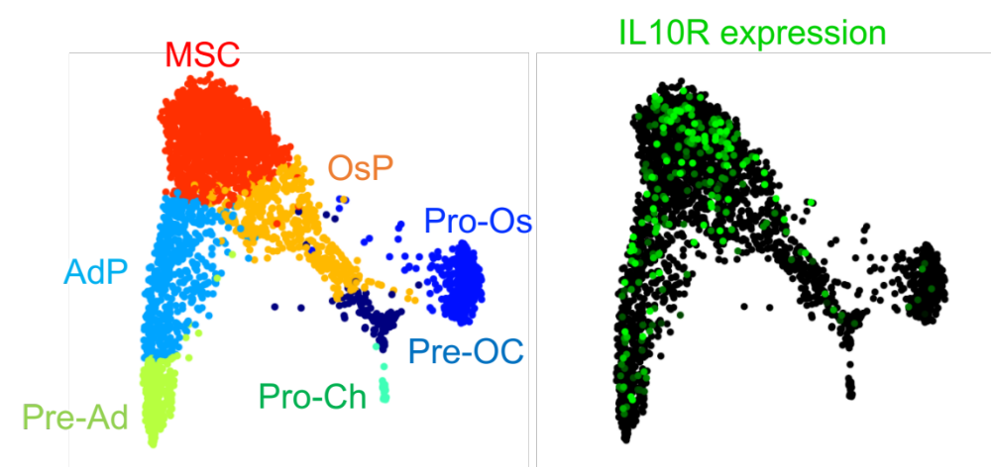

Stromal cells are responsive to IL-10 signaling
Limits colony formation
Restricts differentiation to bone and fat
Upregulates HSC supportive factors
Notes:
SPRING plots of single-cell transcriptomes of stromal cells -->IL10R+ cells in the bone marrow are monocytes and grans and MSCs
To probe this mechanism, we stimulated stromal cells with IL-10 and evaluated downstream signaling targets
Indeed, IL-10 stimulation triggered robust STAT3 phosphorylation (40-fold increase in pSTAT3) indicating that stromal cells actively respond to IL-10 signaling.
role of IL-10 on stromal differentiation and lineage commitment,
Our work demonstrates that IL-10 is an important mediator of mesenchymal secreted factors and may serve checkpoint for stromal precursors to advance cell lineage decisions.

Slide 22



Treg secreted IL-10 directly enhances HSC support
LT-HSC
Peripheral Blood
Treg
IL-10 block
LT-HSC
Ratio of Treg to HSC 2:1
Cultured with SCF, IL-3, Flt3, IL-7, and IL-2 for 96 hours
Notes:
we evaluated the capacity of stromal cells to support HSC’s under the presence of Tregs but introduced a neutralizing antibody to IL-10 in the cultures
Neutralization of Treg secreted IL-10 significantly abrogated the capacity of stromal cells to maintain HSC’s as well as progenitors indicating that IL-10 signaling enhances this stromal cell function

Slide 23


Marrow Tregs regulate hematopoiesis via IL-10
Tregs support hematopoiesis via IL-10
  IL-10 has a conditioning role for stroma
  IL-10 is required for stromal cell maintenance and HSC-supporting activity
Treg IL-10 may provide a therapeutic avenue to manipulate stromal populations and enhance function
  Transplantation
  Cell-based Therapy
  Hematological Disease
Camacho et al., JCI Insight 2020 IN PRESS
Notes:
surrounding tissue environment affects the natural selection of these mutation-driven characteristics

Slide 24


Implications for Tregs in Myeloproliferative Neoplasms
What was known
Tregs as prognostic indicators
  Tregs elevated in CML at diagnosis
  Treg numbers lower in patients with chronic phase CML versus the accelerated and blast phases
Tregs in TKI
  Leukemic burden correlated with a decrease in numbers of Tregs
Clinical observations of Th17 in hematological malignancies
Fujioka, et al.,2016
D’ Arena et al.,2017
Wu et al.,2009
Prabhala et al.,2010
Notes:
There are many types of leukemias, this talk will focus on a specific myeloproliferative neoplasm
MPNs are clonal blood disorders that arise from transformed hematopoietic stem or progenitor cells which outcompete the healthy counterparts
Mutations induce block in differentiation
a vast expansion of malignant myeloid cells that displace normal hematopoiesis
Complex immune interactions, both immunosuppressive and activating, have been demonstrated in the context of MPNs and in response to TKI therapy
Altered Treg/TH17 ratios in multiple myeloma [28] and CLL [29], AML [16, 30], and non-Hodgkin lymphoma
Increased frequencies of T helper type 17 cells in the peripheral blood of patients with acute myeloid leukemia

Slide 25



Modeling Chronic Myeloid Leukemia
Differentiate
t(9;22)(q34;q11)
BCR-ABL
SCL-tTA × BCR-ABL
Self-Renew
Koschmieder, et al.,2005
Schemionek et al.,2010
Reynaud et al.,2015
Welner et al.,2015
Notes:
chromosomal translocation t(9;22) → fuses parts of the breakpoint cluster region (BCR) with the gene encoding the tyrosine kinase (ABL).
BCR-ABL protein is a constitutively active tyrosine kinase
Tet-off inducible CML murine model
A transgenic mice in which expression of the BCR-ABL fusion protein is adjustable by the administration of tetracycline
Oncogenic fusion protein is under the control of a tetracycline (Tet)-regulated 3’ enhancer of the murine stem cell leukemia (SCL) gene
Neutrophilia
Splenomegaly
Progressive myeloid expansion,
Accumulation of myeloid progenitors and granulocytes
In CML inflammatory cytokines contribute to the maintenance of oncogenic blasts
- IL-6 is critical to disease maintenance and propagation
-BCR/ABL activity controls Il-6 expression thereby establishing a paracrine feedback loop that sustains CML development
-IL-6 secretion increases with CML development in patients
Treg profiling has done in the context of immediate diagnosis, residual leukemia following a prolonged TKI, or at advanced stages of disease

Slide 26


Model for determining Treg alterations in CML
  How are Tregs altered by leukemic environments?
  Are there functional consequences to Treg dysregulation?
?
?
?
Koschmieder, et al.,2005
Schemionek et al.,2010
Reynaud et al.,2015
Welner et al.,2015
?
Notes:
Treg profiling has done in the context of immediate diagnosis, residual leukemia following a prolonged TKI, or at advanced stages of disease

Slide 27



Altered Treg phenotype in CML
SCL-tTA-BCR-ABL
or WT CD45.2
Foxp3
CD45.1
Notes:
Chimeric mice were generated by transplanting transformed cells (expressing the BCR/ABL fusion protein) into wild-type Foxp3-GFP mice
Through the use of congenic markers, we were able to monitor the effects of leukemic exposure on Treg populations
upregulation of various activation receptors (ICOS, GITR, KLRG1, CD44, CD103)
downregulation of markers associated with Treg stability including PD-1 and CD25
In context of T cell biology, IL-6 acts as a potent pro-inflammatory cytokine that promotes of Th17 differentiation and inhibits Treg differentiation
To understand the function of leukemic cytokines in the context of Treg differentiation, we isolated naïve CD4+ T cells from CML mice at the peak of disease and tested the ability of these cells to generate Tregs when removed from a hostile inflammatory setting.
We observed a gross defect in the generation of Foxp3+ cells when utilizing naïve CD4 cells from CML mice at the peak of disease
suggest that environmental cues from the CML environment impose significant pressure to critical Treg pathways.

Slide 28
Tregs co-opted by leukemic environment
Tregs are altered by CML environment
  Inflammatory
  Ex-Tregs (fate-mapper)
  Loss of IL-10
  Signatures of Tumor Tregs
Reduced Numbers
Loss of Foxp3
Decreased IL-10
Activated STAT3
Notes:
We uncovered that CML) environment effectively deteriorates Treg function and stability.
This emergent phenotype is likely mediated by increased inflammatory signals, specifically IL-6
High levels of IL-6 are hallmarks of CML
IL-6 is critical to disease maintenance and propagation
In the context of T cell biology, IL-6 acts as a potent pro-inflammatory cytokine that promotes of Th17 differentiation
The differentiation trajectory Tregs is closely tied with the differentiation of T-helper 17 (Th17) cells
Th17 are defined by expression of Roryt and IL17A production
Th17 cells have well defined roles in the recruitment and activation of myeloid cells and have been shown to promote granulopoiesis, neutrophil recruitment
The maintenance and differentiation of Th17 cells requires the presence of IL-1, IL-6, and
transforming-growth factor beta 1 (TGF-β1) and the STAT3 pathway Interestingly these signals are
detrimental to Treg stability and antagonize Foxp3 mediated differentiation

Slide 29


CML cytokines favor generation of Th17
Cua Nature. 2003
Harrington Nature Imm. 2005
Stritesky J Immunol. 2008
Knochelmann Cell and Molecular Immm 2018
And MANY MORE
Notes:
We uncovered that CML) environment effectively deteriorates Treg function and stability.
This emergent phenotype is likely mediated by increased inflammatory signals, specifically IL-6
High levels of IL-6 are hallmarks of CML
IL-6 is critical to disease maintenance and propagation
In the context of T cell biology, IL-6 acts as a potent pro-inflammatory cytokine that promotes of Th17 differentiation
The differentiation trajectory Tregs is closely tied with the differentiation of T-helper 17 (Th17) cells
Th17 are defined by expression of Roryt and IL17A production
Th17 cells have well defined roles in the recruitment and activation of myeloid cells and have been shown to promote granulopoiesis, neutrophil recruitment
The maintenance and differentiation of Th17 cells requires the presence of IL-1, IL-6, and
transforming-growth factor beta 1 (TGF-β1) and the STAT3 pathway Interestingly these signals are
detrimental to Treg stability and antagonize Foxp3 mediated differentiation

Slide 30



CML promotes generation of TH17 in vivo
IL-17 Reporter
IL17-GFP mice express EGFP as a marker of Il17a activity
Notes:
To validate the culture conditions and determine if Th17 cells were present in vivo we made use of an IL17 GFP reporter mouse which labels IL17 producing cells.
Generated chimeric mice using (CD45.2) IL17-GFP+ cells, (CD45.1/2) BCR+SCL+ leukemic cells and examined GFP-reporter expression following disease onset.
- Expansion of total CD4+ IL17+ cells in the bone marrow of CML mice
This provides evidence that that CML cytokines play a role in inducing IL-17A production and that these leukemic conditions drive the generation of Th17 cells.

Slide 31

CML promotes generation of TH17 in vivo
Notes:
To validate the culture conditions and determine if Th17 cells were present in vivo we made use of an IL17 GFP reporter mouse which labels IL17 producing cells.
Generated chimeric mice using (CD45.2) IL17-GFP+ cells, (CD45.1/2) BCR+SCL+ leukemic cells and examined GFP-reporter expression following disease onset.
- Expansion of total CD4+ IL17+ cells in the bone marrow of CML mice
This provides evidence that that CML cytokines play a role in inducing IL-17A production and that these leukemic conditions drive the generation of Th17 cells.

Slide 32

Tregs are altered by inflammatory CML environment
Tregs are altered by CML environment
  Unstable
  Loss of IL-10
  Upregulation of Stat3
Th17 cells in CML
  Favors Th17 generation
Are there functional consequences?
  Can we manipulate Tregs to alter disease progression
Notes:
Inflammatory cytokines direct development of Th17 cells in CML

Slide 33







Expansion of Tregs via DR3
TNFR25 is highly expressed by Tregs
DR3 stimulation enhances Treg expansion and boosts IL-10 production
Notes:
Given the importance of Treg-secreted IL-10 in the maintenance of hematopoiesis, we aimed to select a method of Treg expansion that also enhanced IL-10 secretion
TNFRSF25 (DR3) is a type I transmembrane protein that can be induced on activated T cells and is expressed constitutively at high levels on Tregs

Slide 34




Treg manipulation alters disease progression
WT
WT-DR3
CML
CML-DR3
Notes:
Activation of Tregs via DR3 significantly suppressed the frequency of cells and we observed a dramatic reduction in leukemic granulocyte-monocyte progenitors ( myeloid cells, and neutrophils)
To rule out direct effects
Treated K562 cells with increasing doses of DR3 → no change in cell death or toxicity
Observed no effect of DR3 stimulation on colony forming potential
This indicates DR3 is mediating anti-leukemic effect via indirect mechanisms

Slide 35


HD Analysis of Treg Expanded Mice
Myeloid Subcluster Analysis
Ashhurst TM, Marsh-Wakefield F, Putri GH et al. (2021). Cytometry A.
Notes:
Activation of Tregs via DR3 significantly suppressed the frequency of cells and we observed a dramatic reduction in leukemic granulocyte-monocyte progenitors ( myeloid cells, and neutrophils)
To rule out direct effects
Treated K562 cells with increasing doses of DR3 → no change in cell death or toxicity
Observed no effect of DR3 stimulation on colony forming potential
This indicates DR3 is mediating anti-leukemic effect via indirect mechanisms

Slide 36


Treg manipulation alters disease progression
Notes:
Activation of Tregs via DR3 significantly suppressed the frequency of cells and we observed a dramatic reduction in leukemic granulocyte-monocyte progenitors ( myeloid cells, and neutrophils)
This indicates DR3 is mediating anti-leukemic effect via indirect mechanisms

Slide 37
Treg manipulation alters disease progression
Notes:
Activation of Tregs via DR3 significantly suppressed the frequency of cells and we observed a dramatic reduction in leukemic granulocyte-monocyte progenitors ( myeloid cells, and neutrophils)
To rule out direct effects
Treated K562 cells with increasing doses of DR3 → no change in cell death or toxicity
Observed no effect of DR3 stimulation on colony forming potential
This indicates DR3 is mediating anti-leukemic effect via indirect mechanisms

Slide 38


IL-10 curbs leukemic myeloid differentiation
Granulocyte Monocyte
Progenitors
Myeloid Differentiation
Increasing doses of IL-10
Increasing doses of IL-17
Increasing doses of GMCSF
WT
BCR-ABL
Notes:
To understand the mechanisms by which increased IL-10 production altered leukemic progression, we evaluated potential cellular targets of IL-10.
We confirmed that IL-10Ra was expressed on GMP populations
IL-10 significantly decreased myeloid cell output and this effect was selective for cells carrying the BCR-ABL oncogene.
We observed a dose-dependent response in response to IL-10 noting the decrease in the neutrophil

Slide 39

Tregs are altered by inflammatory CML environment
Tregs are altered by CML environment
  Unstable
  Loss of IL-10
  Upregulation of STAT3
  CML promotes Th17 generation
Tregs provide therapeutic avenue
  Boosting Tregs delay CML progression
  IL-10 curbs myeloid and neutrophil expansion
Notes:
In CML we observed altered Treg numbers → speculate that chronic exposure to leukemic environment is detrimental to Treg stability
IL-6 is a known inducer of and the activation of this transcription factor via STAT3 has been shown to support acquisition of Th17 fate
CML promotes the development and differentiation of Th17 cells
direct pathway for induction of Th17 cell fate in leukemia
Likely due to greater availability of IL-6 and other inflammatory cytokines
we describe a therapeutic function for Tregs and IL-10 in the context of chronic myeloid leukemia
- IL-10 may play an important role in mediating the balance between inflammatory and anti-inflammatory responses in hematological malignancy

Slide 40


Acknowledgements
Italiano- Machlus Lab
Andrew Stone
Maria Nuñez Barrachina
Isabelle Becker
Nathan Asquith
Julia Tilburg
Estelle Carminita
Emma Nikols
Karen Guo
Dani Freire
Clementine Payne
Rolf Beckman
Welner Lab
Victoria Matkins
Sweta Patel
Valeriya Kuznetzova
Collaborators
Heth Turnquist
James George
Jeremie Lever
Casey Weaver
Li Ying
Henry Yang
Ashlyn Anderson
Laurie Harrington
Ashley Landyut
Craig Maynard
Vishal Sharma
Chander Raman
Brent Ferrell
Sharam Kordasti
NIH/NIAID: AI007051 “Basic Immunology and Immunological Diseases”
NIH/NHLBI: 1R01HL150078-01A1

