Slide 1


Detecting CAR T Cells to Improve Patient Outcomes
Charlotte Graham MBChB, PhD
October, 2022

Slide 2
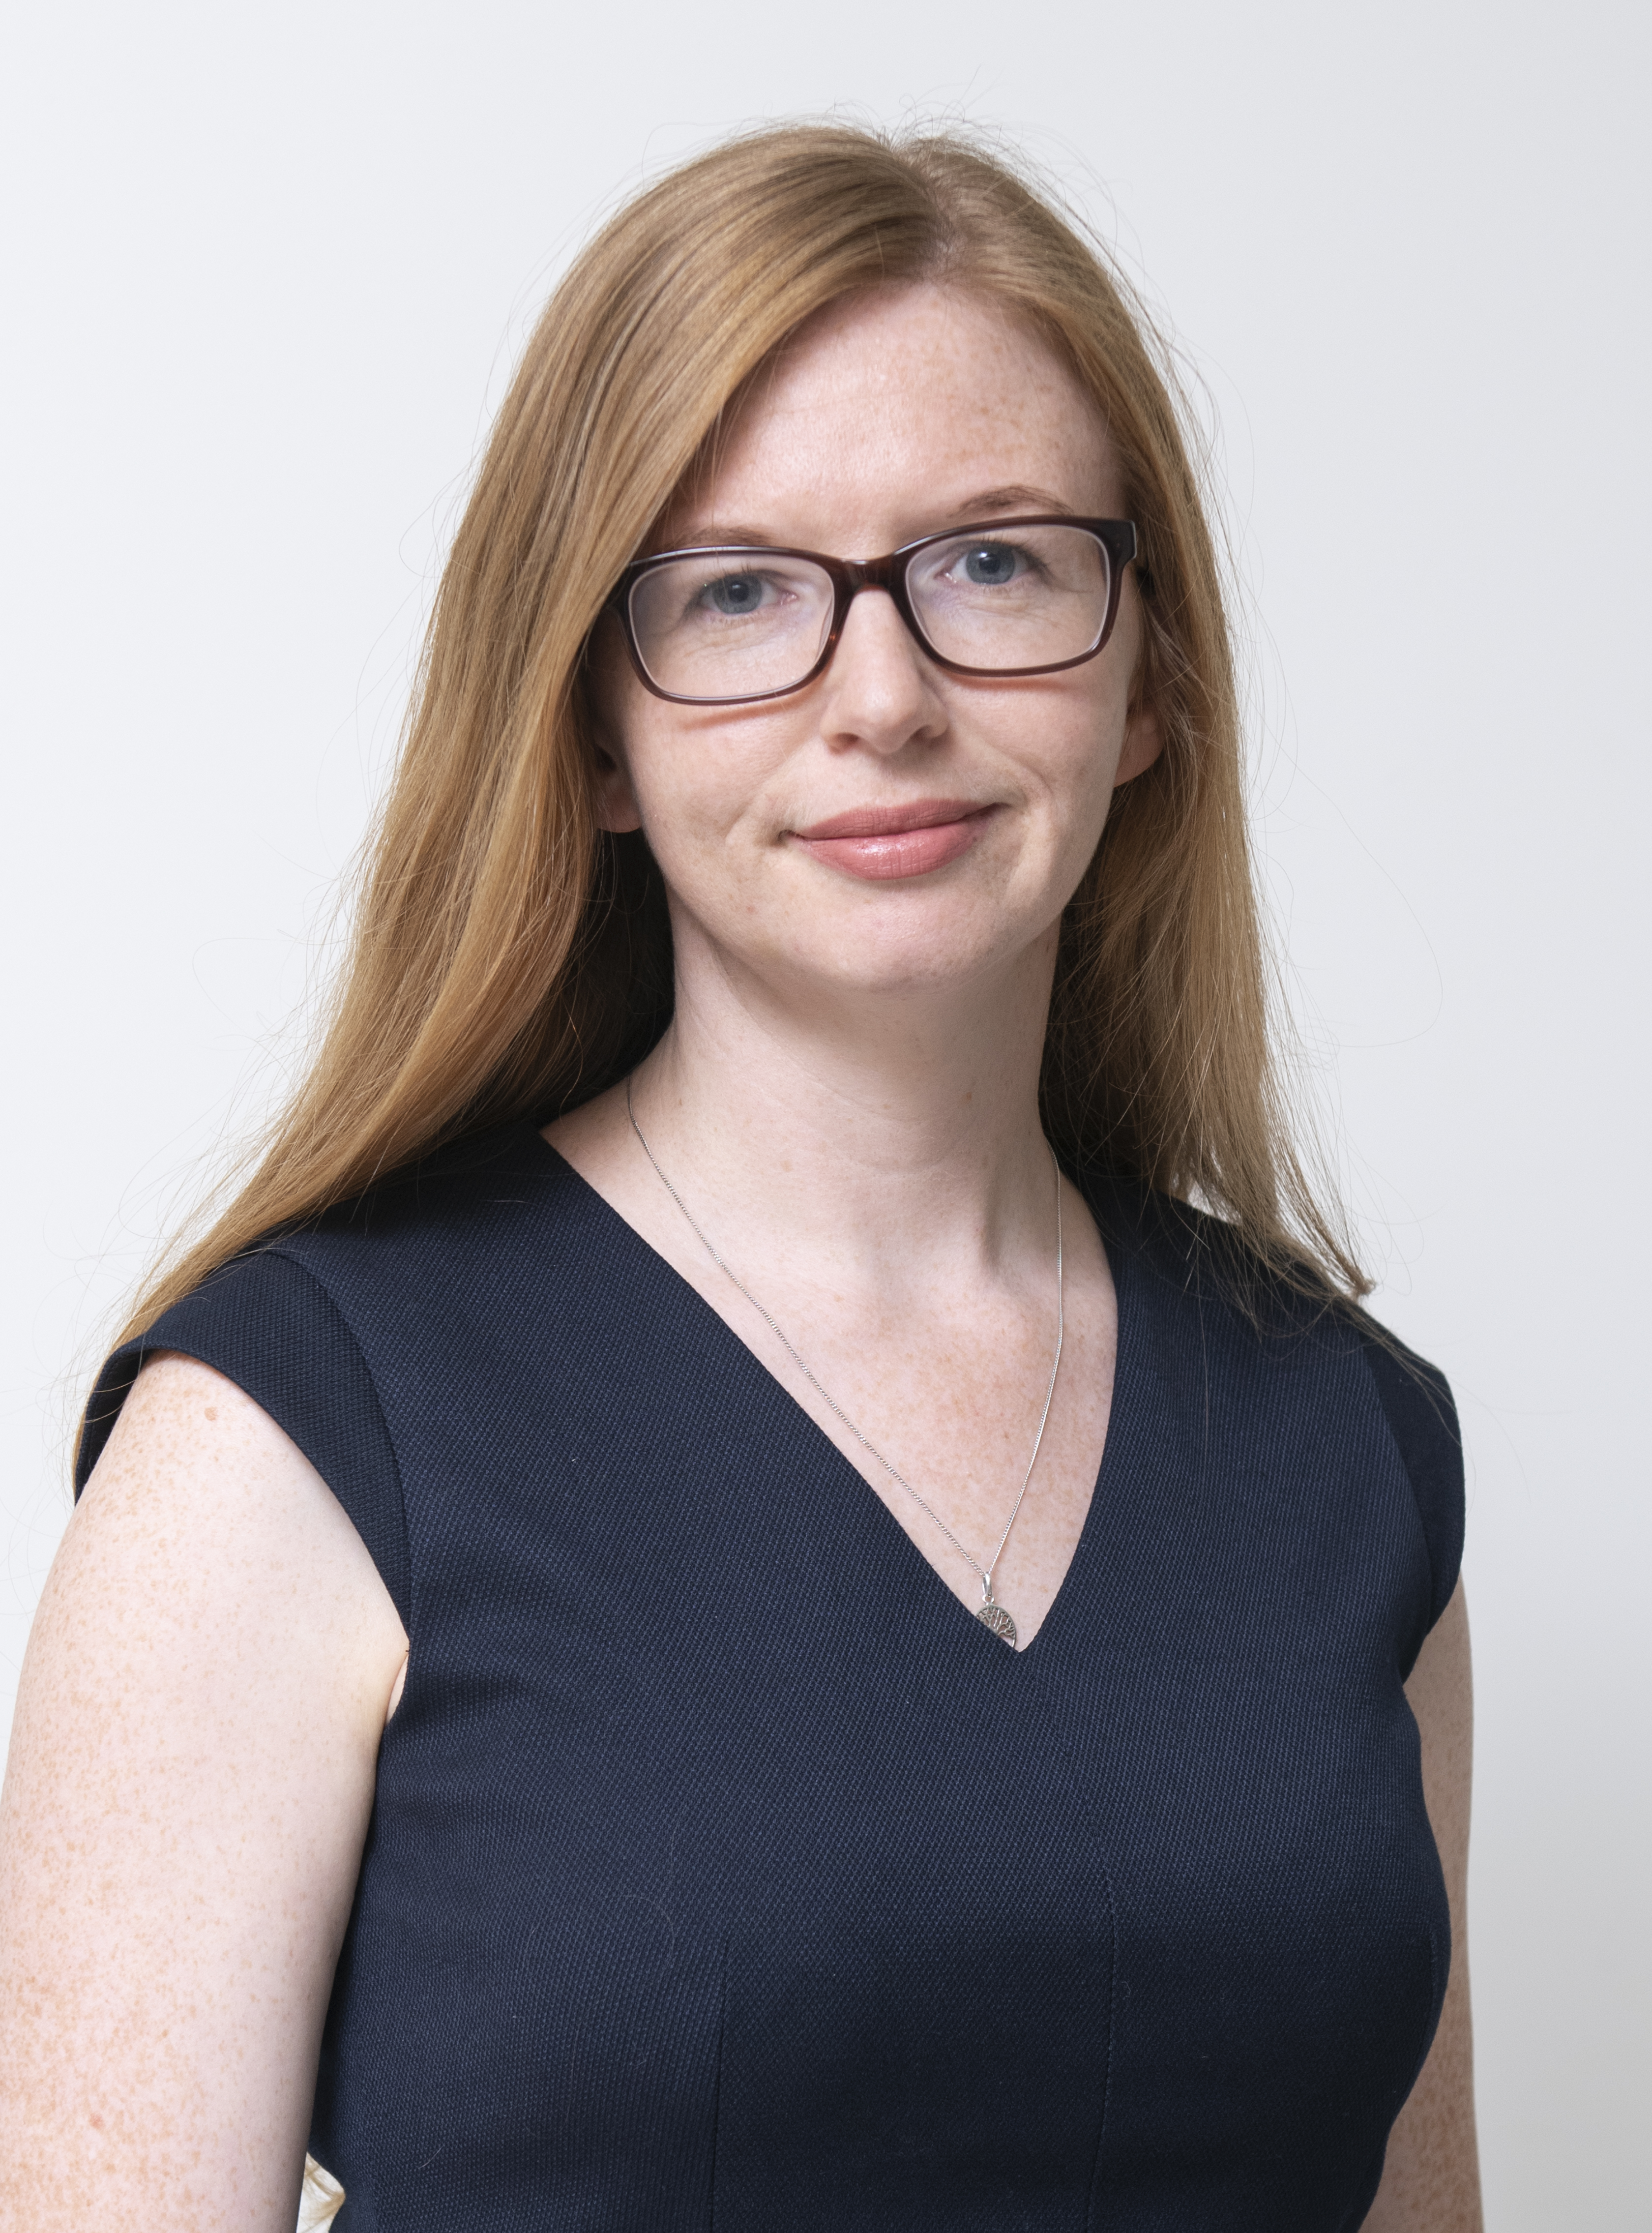
Immune Monitoring lab at MGH
IML Lab directed by Dr Kathleen Gallagher
IML is embedded within the Cellular Immunotherapy Program led by Dr Marcela Maus
Develops high-quality research assays to provide translational correlative data for clinical trials allowing evaluation of:
- Efficacy
- Toxicity
- Resistance Mechanisms

Slide 3
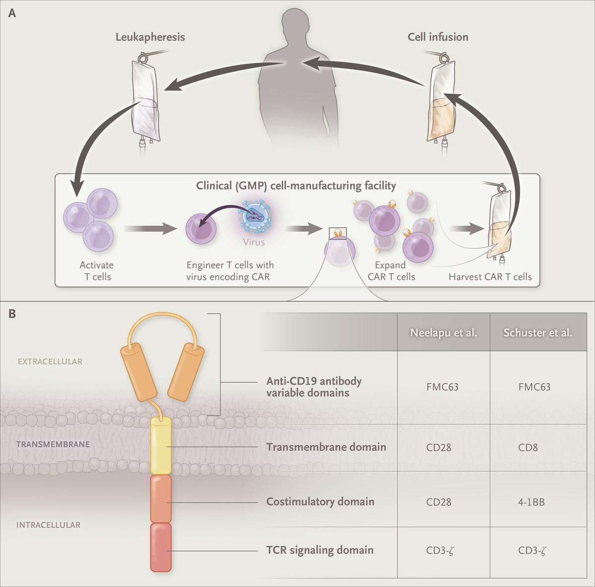
What is CAR T cell therapy?
Tran E et al. N Engl J Med 2017;377:2593-2596.

Slide 4
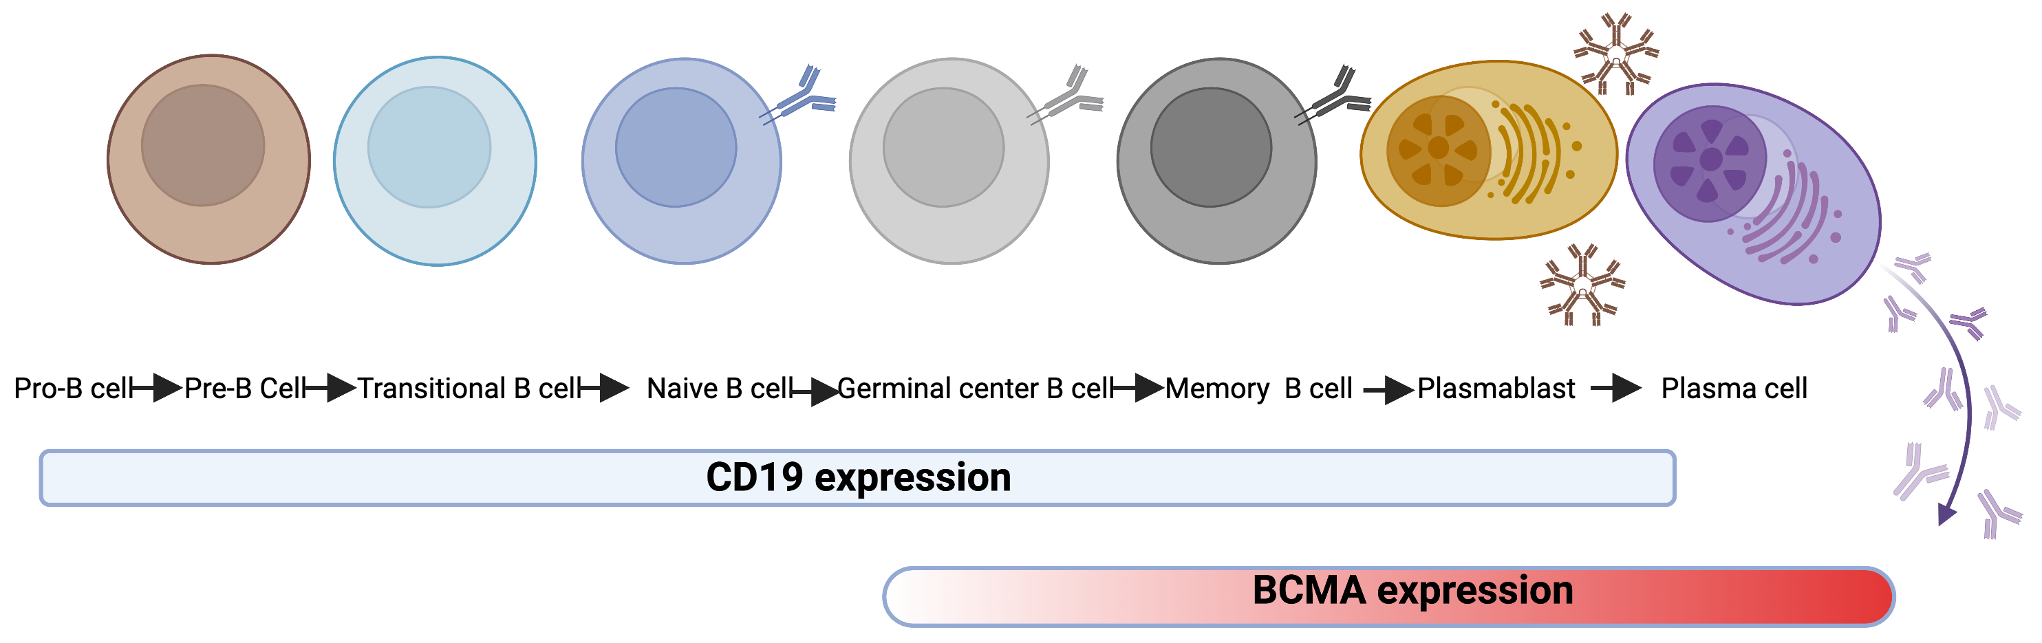
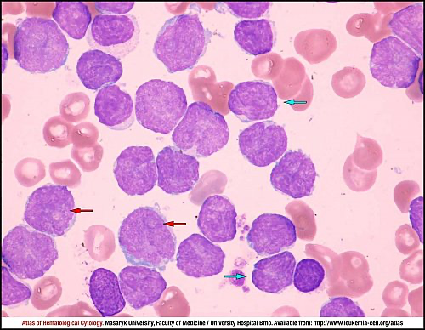
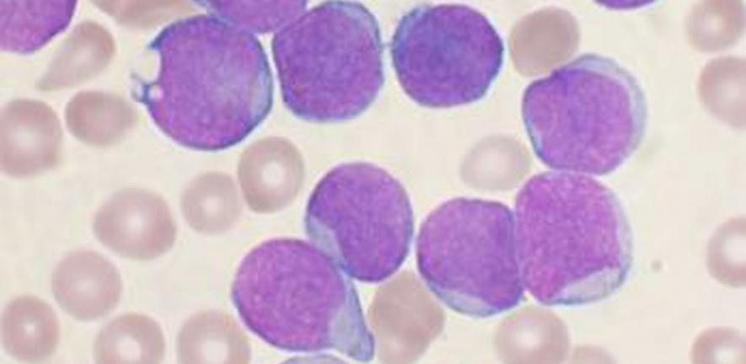
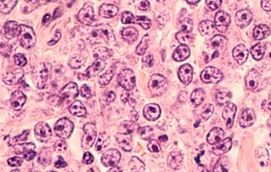
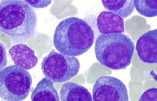
FDA approved CAR T cell therapies target B cell lineage markers
CD19 targeting CAR T therapy
BCMA targeting CAR T therapy
B-Acute Lymphoblastic Leukemia
Mantle Cell lymphoma
Diffuse Large B cell Lymphoma
Myeloma

Slide 5
Why detect CAR T cells in patients?
Key to monitor as part of clinical trials
For standard of care CAR T cell therapies:
Expansion as a predictor of response
Guide toxicity management

Slide 6
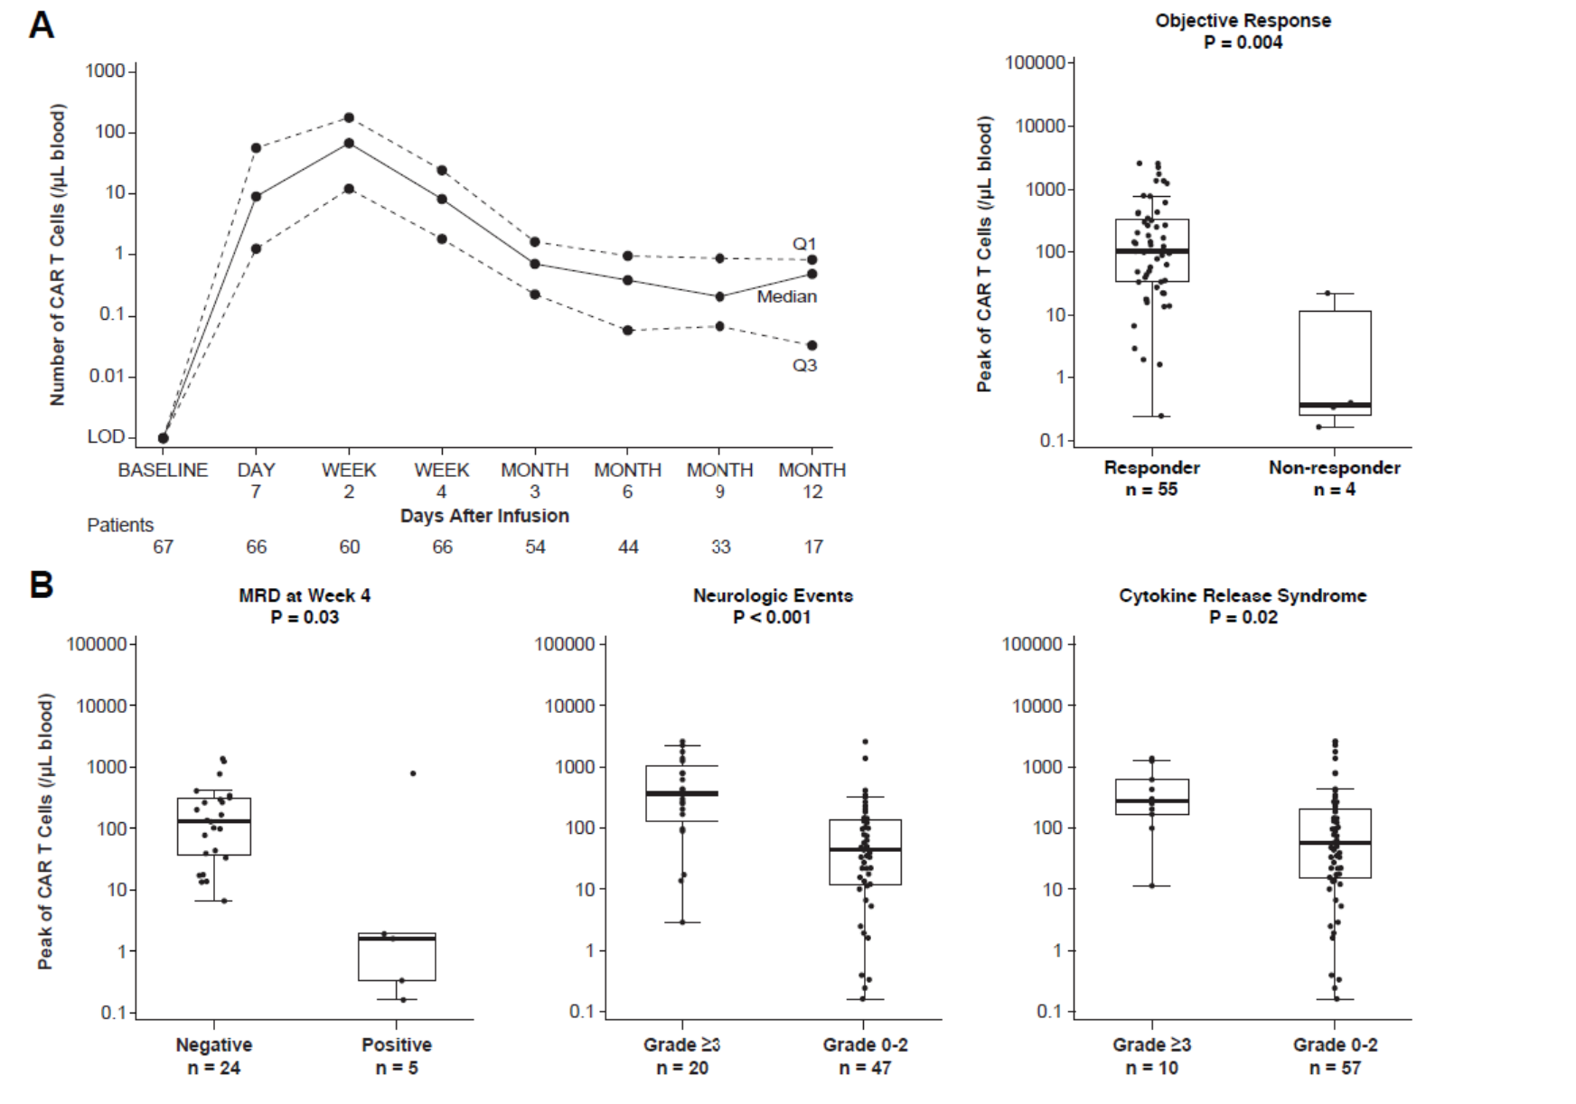
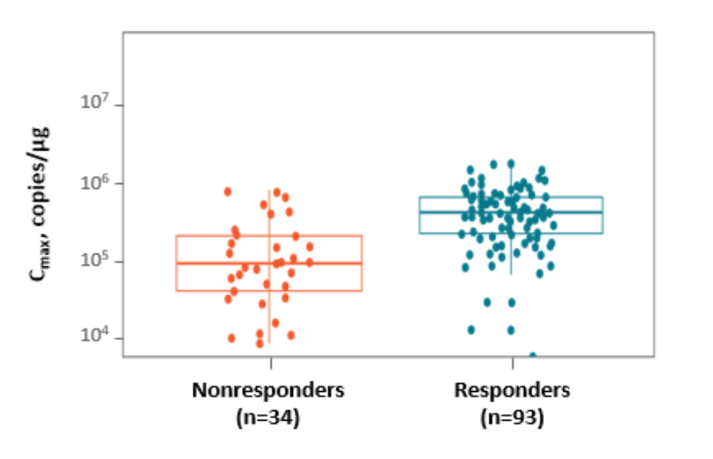
Expansion as a predictor of response
Tecartus in Mantle Cell lymphoma
Ide-cel in Multiple Myeloma
M Wang et al. N Engl J Med 2020;382:1331-1342
NC Munshi et al. N Engl J Med 2021;384:705-716

Slide 7
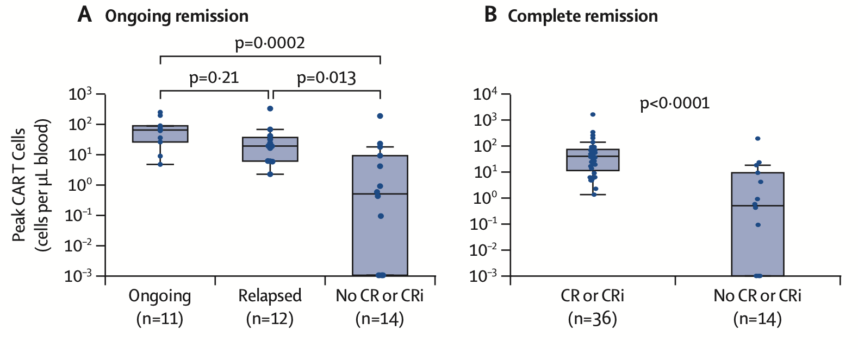
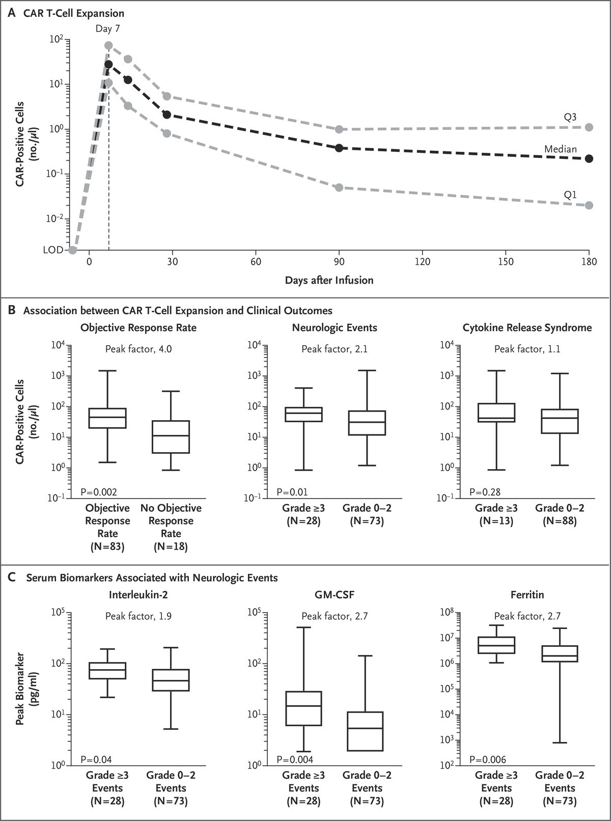
Expansion as a predictor of response
Axi-cel in Large B Cell Lymphoma
Tecartus in B Acute Lymphoblastic Leukemia
Neelapu SS et al. N Engl J Med 2017;377:2531-2544.
Shah, Bijal D et al. Lancet vol. 398,10299 (2021): 491-502.

Slide 8
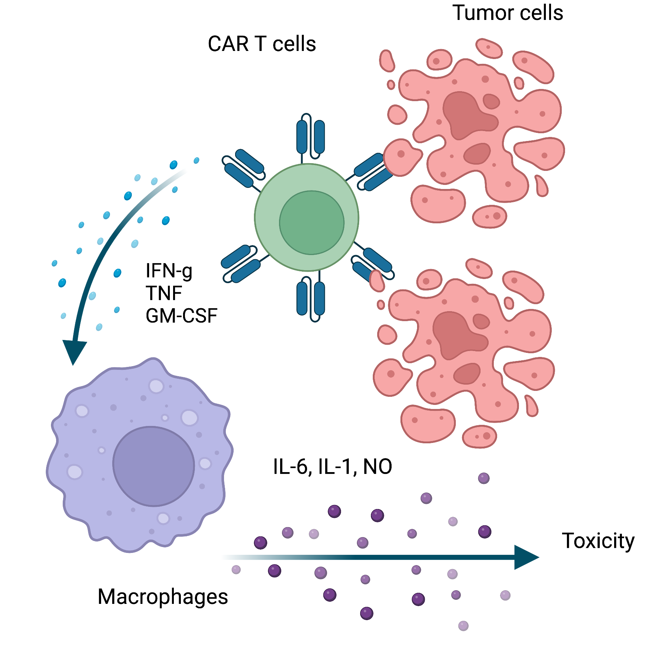
Toxicity
Cytokine release syndrome (CRS)
Immune effector cell associated neurotoxicity (ICANS)
Prolonged cytopenia

Slide 9
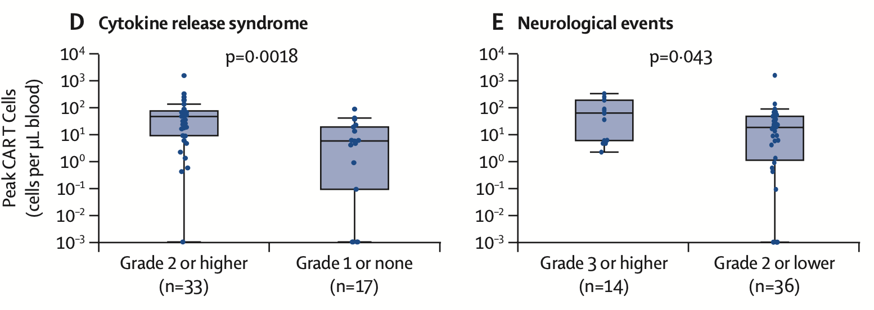
Toxicity
Tecartus in Mantle Cell lymphoma
Tecartus in B Acute Lymphoblastic Leukemia
M Wang et al. N Engl J Med 2020;382:1331-1342
Shah, Bijal D et al. Lancet vol. 398,10299 (2021): 491-502.

Slide 10
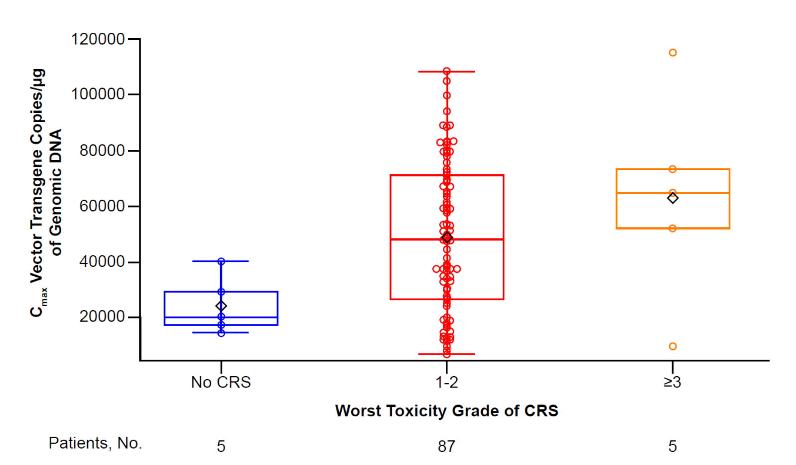
Toxicity
Axi-cel in Large B Cell Lymphoma
Cilta-cel in Multiple Myeloma
Neelapu SS et al. N Engl J Med 2017;377:2531-2544.
Berdeja, Jesus G et al. Lancet vol. 398,10297 (2021): 314-324.

Slide 11
Flow based CAR T cell detection

Slide 12
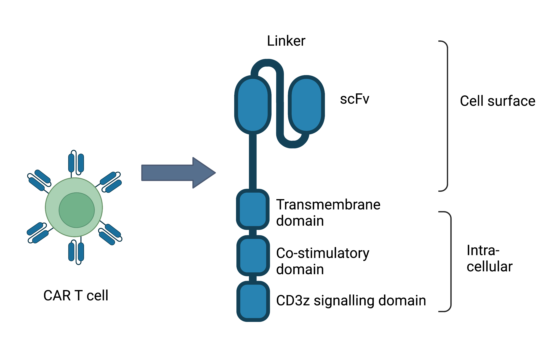

What to detect on CAR T cells?
Additional cell surface tags e.g. tEGFR

Slide 13
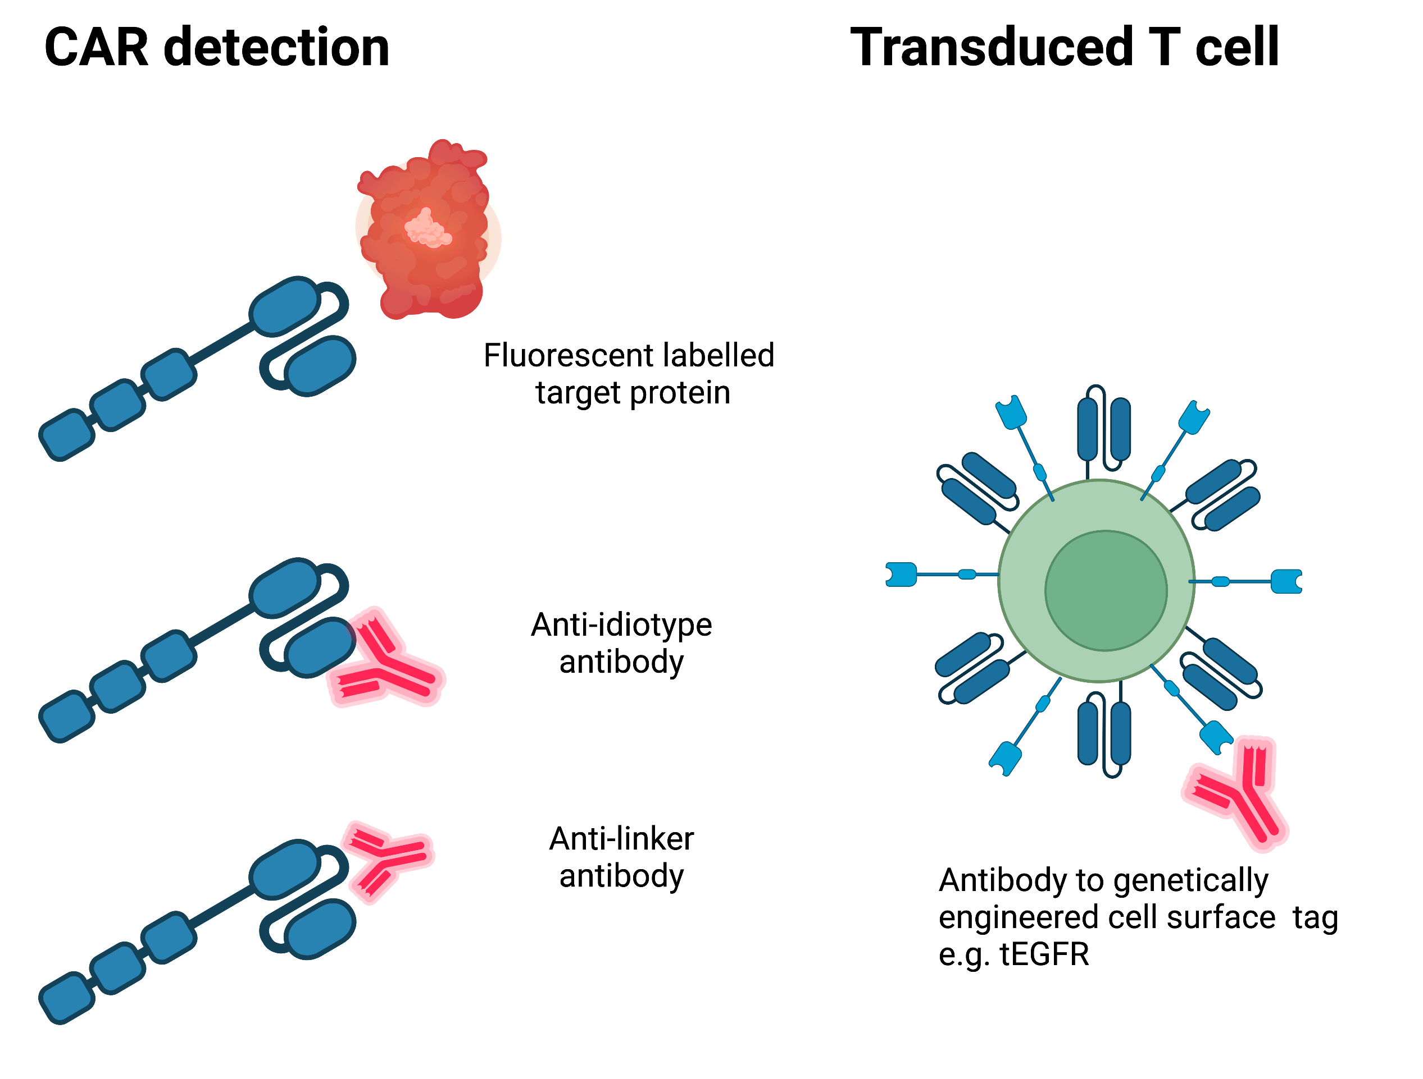
Flow cytometry detection of CAR T cells

Slide 14
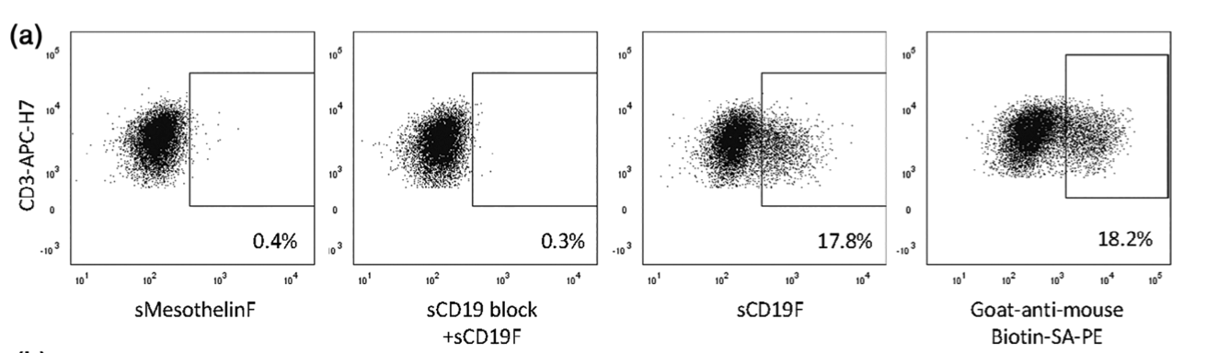
Soluble CD19 binds to CD19 targeting CAR T cells
Tisagenlecleucel
Notes:
Time course assay showing that 40 minute incubation with sCD19 increased % positive compared to 20 minutes, without increasing non-specific binding. No further increase was seen after 60 minutes.
Performed with a stain lyse wash protocol applicable to routine clinical practice.

Slide 15
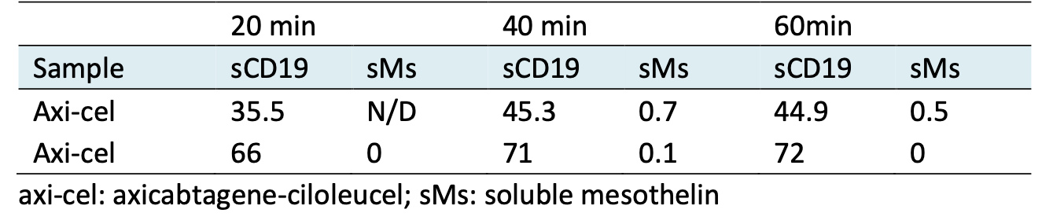
Time course experiment with soluble CD19

Slide 16
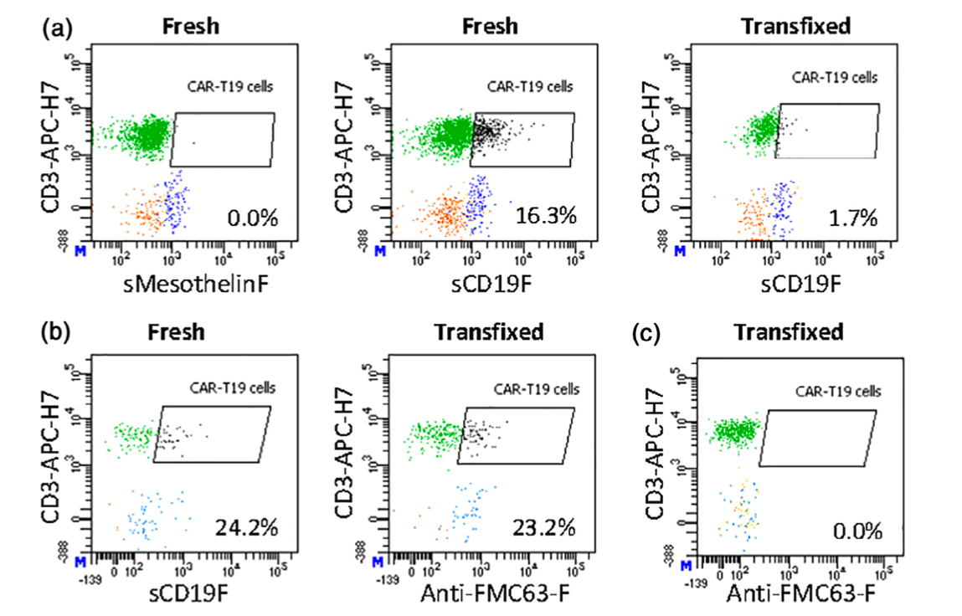
sCD19 has impaired detection of CAR T cells in transfixed cerebrospinal fluid
CSF
Patient 1 ICANS
CSF
Patient 2
ICANS
CSF
Patient 3 non-CAR treated
Johansson U, Gallagher K, et al.. Cytometry B Clin Cytom. 2021 Nov;100(6):622-631
Notes:
F I G U R E 4 Measuring CAR-T19 presence in CSF. Panel (a): The sCD19F assay can be used on fresh but not transfixed CSF samples. The example shown is from a DLBCL patient treated with axicabtagene-ciloleucel and who suffered from ICANS. The freshly analyzed aliquot of the sample showed 16.3% CAR-T-cells of total T-cells, results from the control protein are also shown. The transfixed aliquot for the same sample had a greatly reduced signal. Panel (b): Transfixed CSF samples may be tested for CAR-T19 cells using anti-idiotype mAb. The example shown is from another axicabtagene-ciloleucel-treated DLBC patient. The freshly analyzed aliquot was tested with the sCD19F assay, showing 24.2% CAR-T19 cells of total T-cells. The transfixed aliquot of the same sample was tested with the anti-idiotype-FITC mAb, which produced similar results. Panel (c): No false-positive signal was observed for the anti-idiotype-FITC mAb when labeling transfix-treated CSF samples from patients not treated with CAR-T19. The example shown is from a B-ALL patient with a modest reactive infiltrate. All labeling was according to the standard protocols for control protein, sCD19F or anti-FMC63 mAb, and with the basic mAb cocktail (CD3, CD4, CD8, CD14, CD56, CD45). The gating strategy was the same as that shown for PB samples. All dot-plots show all the cells in the respective samples; CD3+ T-cells in green, CD3 + CAR-T19 cells in black, CD14+ monocytes in blue, and CD3-CD56+ NK-cells in beige. The blue “M” in the lower-left corner of the dot-plots signifies the use of bi-exponential (logicle) mode

Slide 17
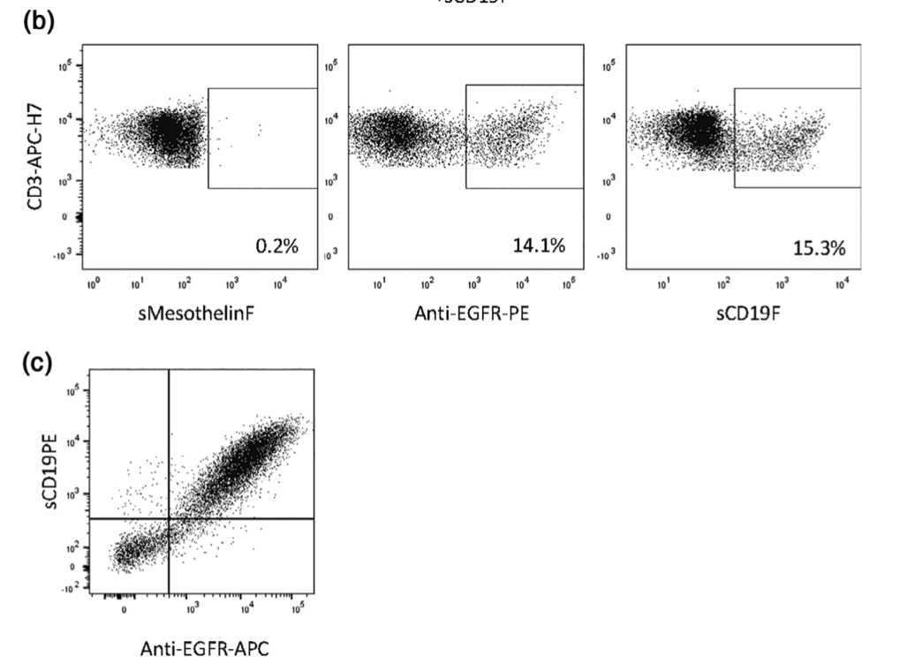
Anti-EGFR antibody and Soluble CD19 detect Liso-cel

Slide 18
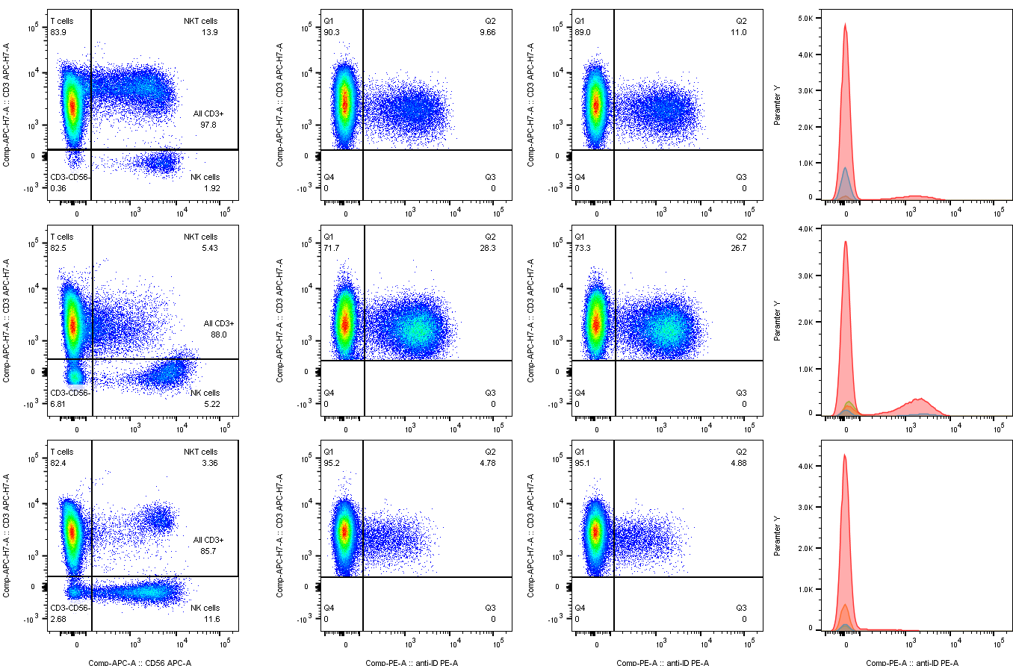
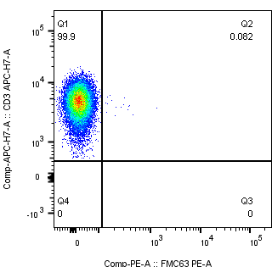

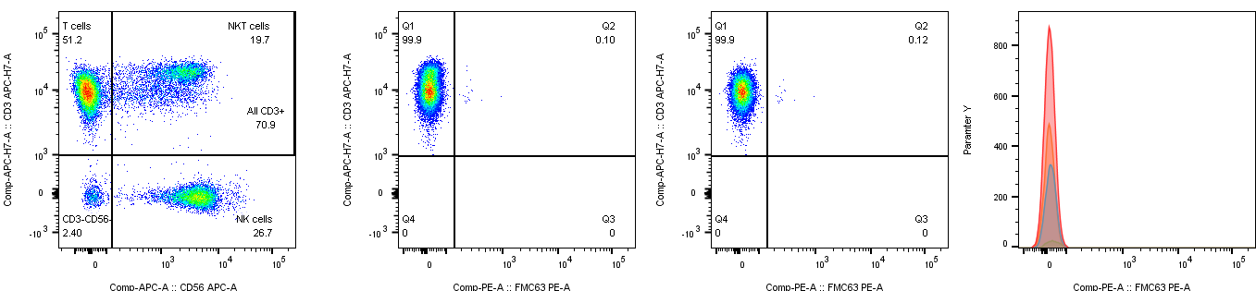

Anti-idiotype antibody
Day 7 PBMC post infusion (Kymriah) Healthy controls
(% of T cells)
11.0%
0.08%
0.04%
Pt1
76.0%
23.9%
26.7%
0.12%
Pt2
4.88%
0.07%
Pt3
FMC63
Kyrmiah product: reported %transduction: 22.5%
FMC63 Result: 23.9%
CD3
LLOB 0.13%
LLOD 0.23%
α-FMC63+
Notes:
Llod here is LOB + 3SD of blank
You can say we will be collecting more blanks to get more robust LLOB and LLOD
Performed on cryopreserved PBMC
Dead cells excluded with 7-AAD
Look for accuracy test

Slide 19
Anti-G4S linker antibody
Control PB-EDTA
PB-EDTA spiked CAR19 with tEGFR tag
CD3
EGFR
G4S
G4S
Kathleen Gallagher and Won-Ho Lee
Notes:
This is an image of the G4S vs the tEGFR-APC stain.
Shows good agreement between the stains.

Slide 20
CAR detection panel (12 color FACS Lyric)
CD45 BV786
CD3 APC-H7
CD4 V450
CD8 V500c
CD56-APC
CD22-PE-Cy7
Anti-CAR-PE
7-AAD /CD14-PerCP Cy5.5 (dump channel)
(Fc Block prior to staining)

Slide 21
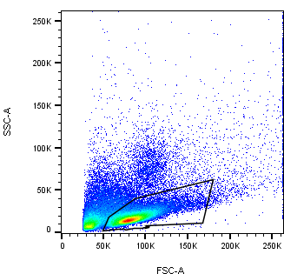
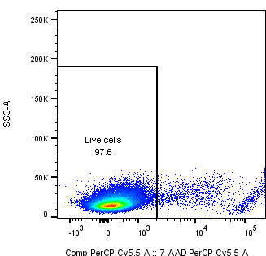
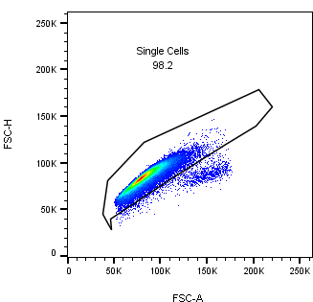
CAR detection – Immune Monitoring Lab

Slide 22
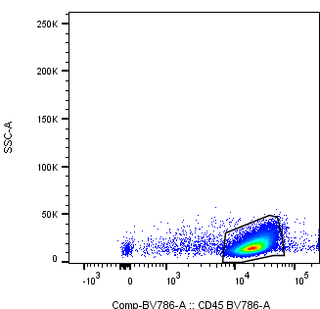
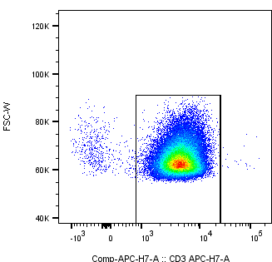
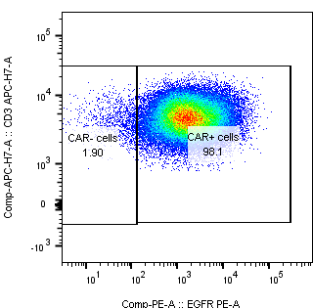
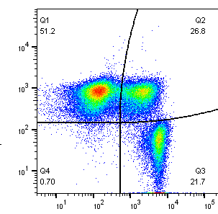
SSC
CD45
CD3
CD3
CD8
CAR-PE
CD4
Notes:
Not uncommon to see a significant double pos population, likely CD4 upreg on activated CD8 T cells
I haven’t shown it here, but I also evaluate NK and B cell component of Lymph gate.
If you also do this, you will notice in some patients a large expansion of CD56+ within the CAR+ population.

Slide 23
Quantifying CAR T
% of CD3 T cells expressing CAR is useful but can be misleading if absolute T cell numbers are changing!
Ideal is to provide an absolute count CAR+ T/ul
Recommend either developing a lyse no wash Trucount assay with CAR T detection reagent incorporated, or using absolute CD3 counts from IVD assay in combination with custom CAR detection assay.
To save money, we opt for RBC lysis with the CAR detection assay described earlier, combined with the Absolute Lymph Count.
Notes:
While it is great to see these peaks and contractions of % CAR, we know that % are also impacted by expansion and contraction of other populations.
More valuable is the ability to report the absolute count. CAR T per ul blood.

Slide 24
% of Lymphs: CAR+ T cells
X Absolute lymph count = estimated # CAR T/ul blood
RBC lysis
Stain
Wash
Notes:
Pros: often patients are lymphopenic due to low dose chemo prior to infusion, so we can ensure we acquire enough cells
Cons: RBC lysis method could potentially lead to slight distortions in the true CD3+ CAR+ T cells
Refer to papers that tell us higher peak expansion associated with better outcomes
Unfortunately I cant share the data yet but we have parallel qPCR data for many of these patients and see excellent correlation between the estimated absolute CAR counts and the molecular assay.

Slide 25
Translational research utilizing CD19 CAR T patient samples

Slide 26
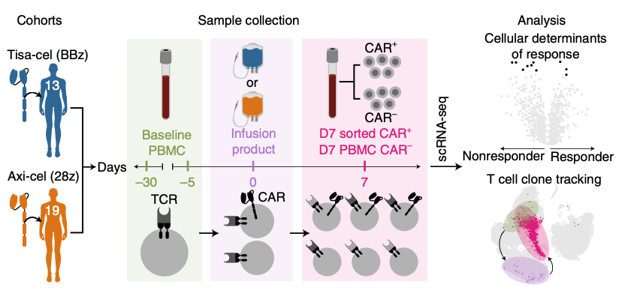
Isolating CAR T cells to identify predictors of response
Haradhvala, N.J., Leick, M.B., Maurer, K. et al. Nat Med 28, 1848–1859 (2022)

Slide 27
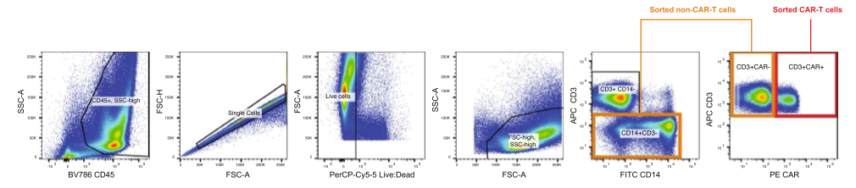
Interrogation of both CAR and endogenous immune cells
Haradhvala, N.J., Leick, M.B., Maurer, K. et al. Nat Med 28, 1848–1859 (2022)

Slide 28
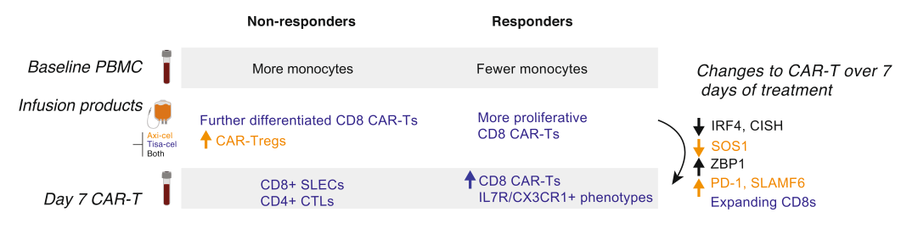
Distinct cellular dynamics associated with response between CAR T products
Haradhvala, N.J., Leick, M.B., Maurer, K. et al. Nat Med 28, 1848–1859 (2022)

Slide 29
New targets, new challenges

Slide 30
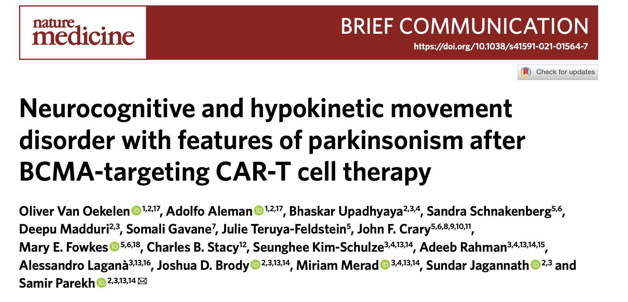

Slide 31
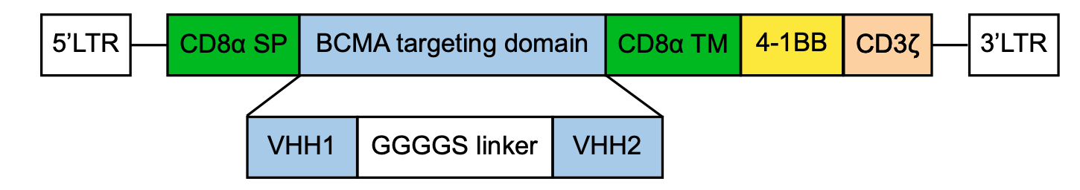
Cilta-cel- The biepitopic CAR T cell (LCAR-B38M)
Xu et al PNAS 2018
Movement and neurocognitive treatment-emergent adverse events (MNTs) ~5% of patients
Cohen, A.D., et al. Blood Cancer J. 12, 32 (2022).
Notes:
Two BCMA targeting single domain antibodies –camel antibody/nanobodies
Lentiviral vector
LCAR-B38 M trial used FITC-labeled human BCMA protein (ACRO Biosystems) to measure expansion

Slide 32
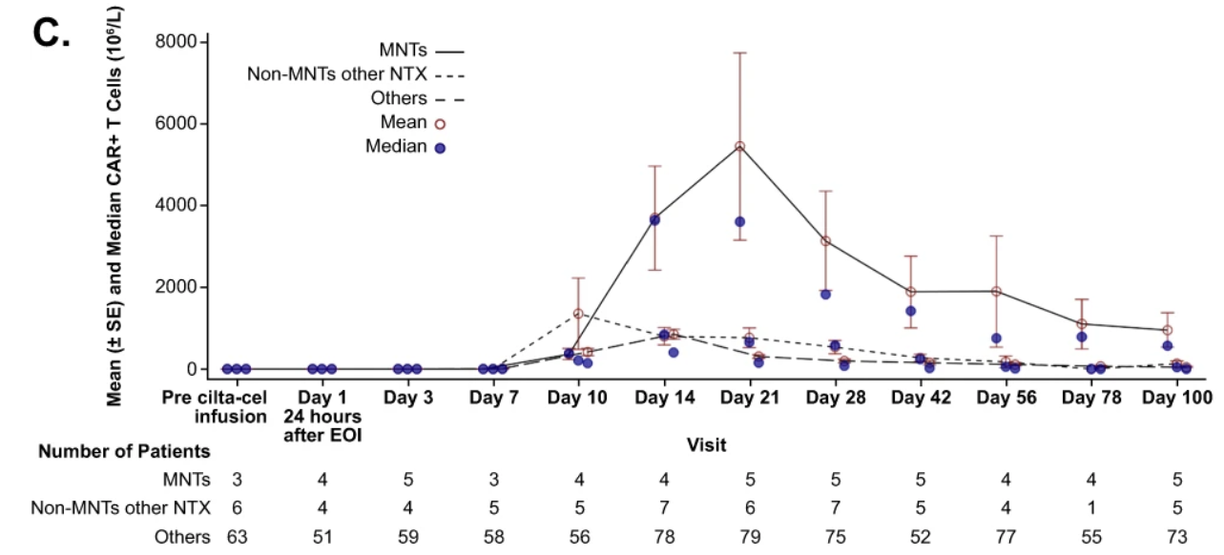
CAR T expansion and persistence is linked to MNTs
CAR T detected in CSF of patients who had MNTs
Cohen, A.D., et al. Blood Cancer J. 12, 32 (2022).

Slide 33
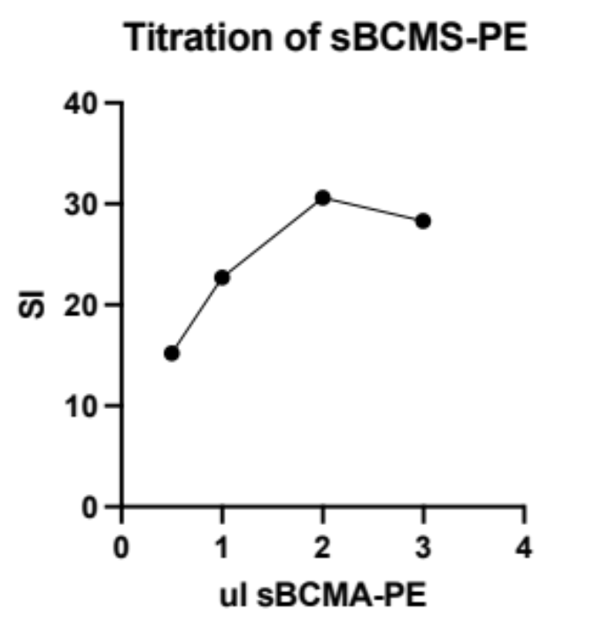
Optimization of sBCMA-PE staining volume
Whole blood from LHC56 spiked with BCMA CAR (pMGH391, ND99). tCD34 tag
Incubated 200ul blood for 40 minutes at 4C with either 3, 2, 1, or 0.5ul s-BCMA-PE.
Then added CD3, CD4, CD4, CD45, CD34 (for CAR) for further 15 minute incubation
Perform RBC lysis 15 mins RT. Wash. Acquired
7AAD removes dead cells
CD34-APC
sBCMA-PE
Stain Index =
(Median of Positive - Median of Negative) / (rSD of Negative * 2)
Kathleen Gallagher and Won-Ho Lee
Notes:
Calc stainig index
Include the equation
We selected 2ul staining volume

Slide 34
Optimization of sBCMA staining time
40 minutes
30 minutes
20 minutes
CD3
sBCMA-PE
Kathleen Gallagher and Won-Ho Lee
Notes:
40 minutes incubation with sBCMA then additional 15 mins with antibodies. Total 55min inc
30 minutes incubation with sBCMA then additional 15 mins with antibodies Total 45min inc
20 minutes incubation with sBCMA then additional 15 mins with antibodies Total 35 min inc
Compared incubation times for sBCMA-PE to minimize assay time without compromising results
Total whole blood assay incubation is 35 minutes. Appropriate for a clinical laboratory.
Once we had volume and time fixed, looked to check what the background staining was and to assess linearity.

Slide 35
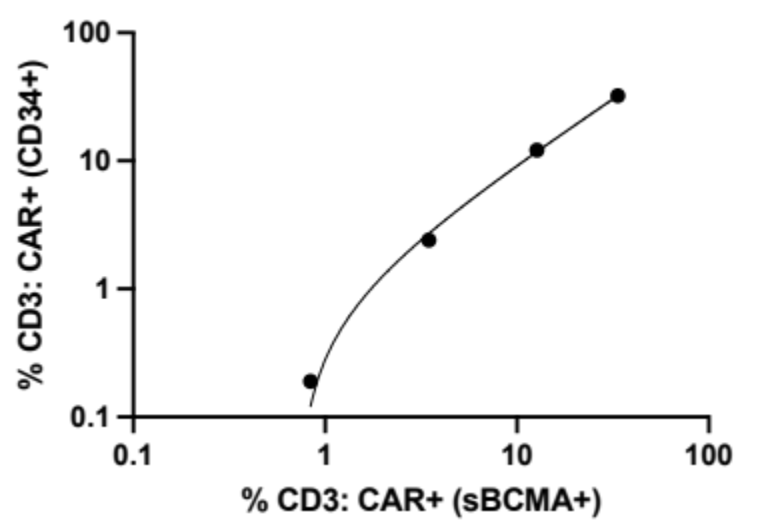
Assessment of background sBCMA staining and linearity of detection
LHC46 Pre-infusion (post LDC)
R2 0.9997
Low levels of background staining (still collecting data for LLOB calculation)
We assess linearity by performing serial dilution of control blood spiked with CAR19 which can be detected by tCD34 tag.
Excellent agreement between the 2 methods.
Kathleen Gallagher and Won-Ho Lee
Notes:
Non linear regression
Whole blood stain performed by spiking a BCMA CAR (pMGH391, ND99) with 42% transduction efficiency confirmed by staining for truncated CD34.
Measured % CD3+ cells positive for CAR using both sBCMA-PE and anti-CD34-APC.
Serially diluted the spiked blood sample with unspiked blood from same donor. At each dilution we performed flow to assess proportion of T cells positive for CAR by both staining methods.
Correlation between the proportion of T cells positive for tCD34-APC CAR specific tag and the binding of sBCMA-PE was excellent. If anyone asks, I would say that appears less accurate at the <1% level and that we plan to further evaluate LLOB, LLOD and LLOQ.
LoB = mean_{blank} + 1.645(SD_{blank})
LoD = LoB + 3SD of blank
LoQ is the lowest concentration at which the analyte can not only be reliably detected but at which some predefined goals for bias and imprecision are met. The LoQ may be equivalent to the LoD or it could be at a much higher concentration.

Slide 36
Soluble BCMA detects Ide-cel
PBMC day 43 post infusion with Ide-cel
CAR+ T cells
CD8
CD3
CD4
sBCMA-PE
(ALC 0.06)
Notes:
(sample16547) Method used for the G4S, BCMA.
Whole blood assay designed for use in clinical laboratories
200ul PB EDTA incubate with antibody or protein***
Add pharmlyse (1:9 blood to lysis buffer), then spin, wash, resuspend in facs buffer and acquire. Makes the whole assay faster which is more appropriate for a clinical assay.
Potential downsides of this type of assay is that if very lymphopenic, wont detect rare event T cells, but generally if CAR are v low then that is still a result. If you need to prove CAR are 100% gone you would want molecular assay anyway.
*** for BCMA protein we incubate with the protein first, then add antibodies for rest of surface stain for last 15 mins. This is because we want to have a longer incubation for protein binding.

Slide 37
In closing
Detecting CAR T cells can improve patient outcomes
We can track expansion which correlates with disease control
Understand new and emerging toxicity
Flow based detection reagents are available
These allow important translational research to improve CAR T cell therapy
Evolving landscape with new targets and new toxicity
This is an area rich in opportunity for translational research and clinical impact

Slide 38
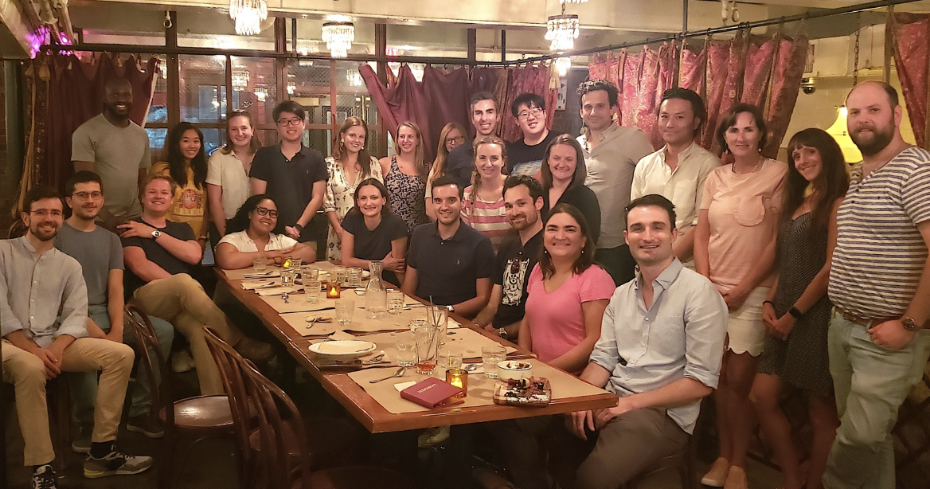

Acknowledgments
Maus Lab
Marcela V. Maus
Antonio Almazan
Stefanie Bailey
Trisha Berger
Filippo Birocchi
Amanda Bouffard
Diane Brunett
Magdi Elsallab
Elijah Darnell
Korneel Grauwet
Lu Huang
Mike Kann
Tamina Kienka
Felix Korell
Becca Larson
Mark Leick
Merle Phillips
Diego Salas-Benito
Emily Silva
Valentina Supper
Hana Takei
Immune Monitoring Lab
Kathleen Gallagher
Elba Gonzalez
Won-Ho Lee
Hadley Wiggin
Funding
AACR-GenMab Non-Hodgkin B-cell Lymphoma Research Fellowship

