Slide 1
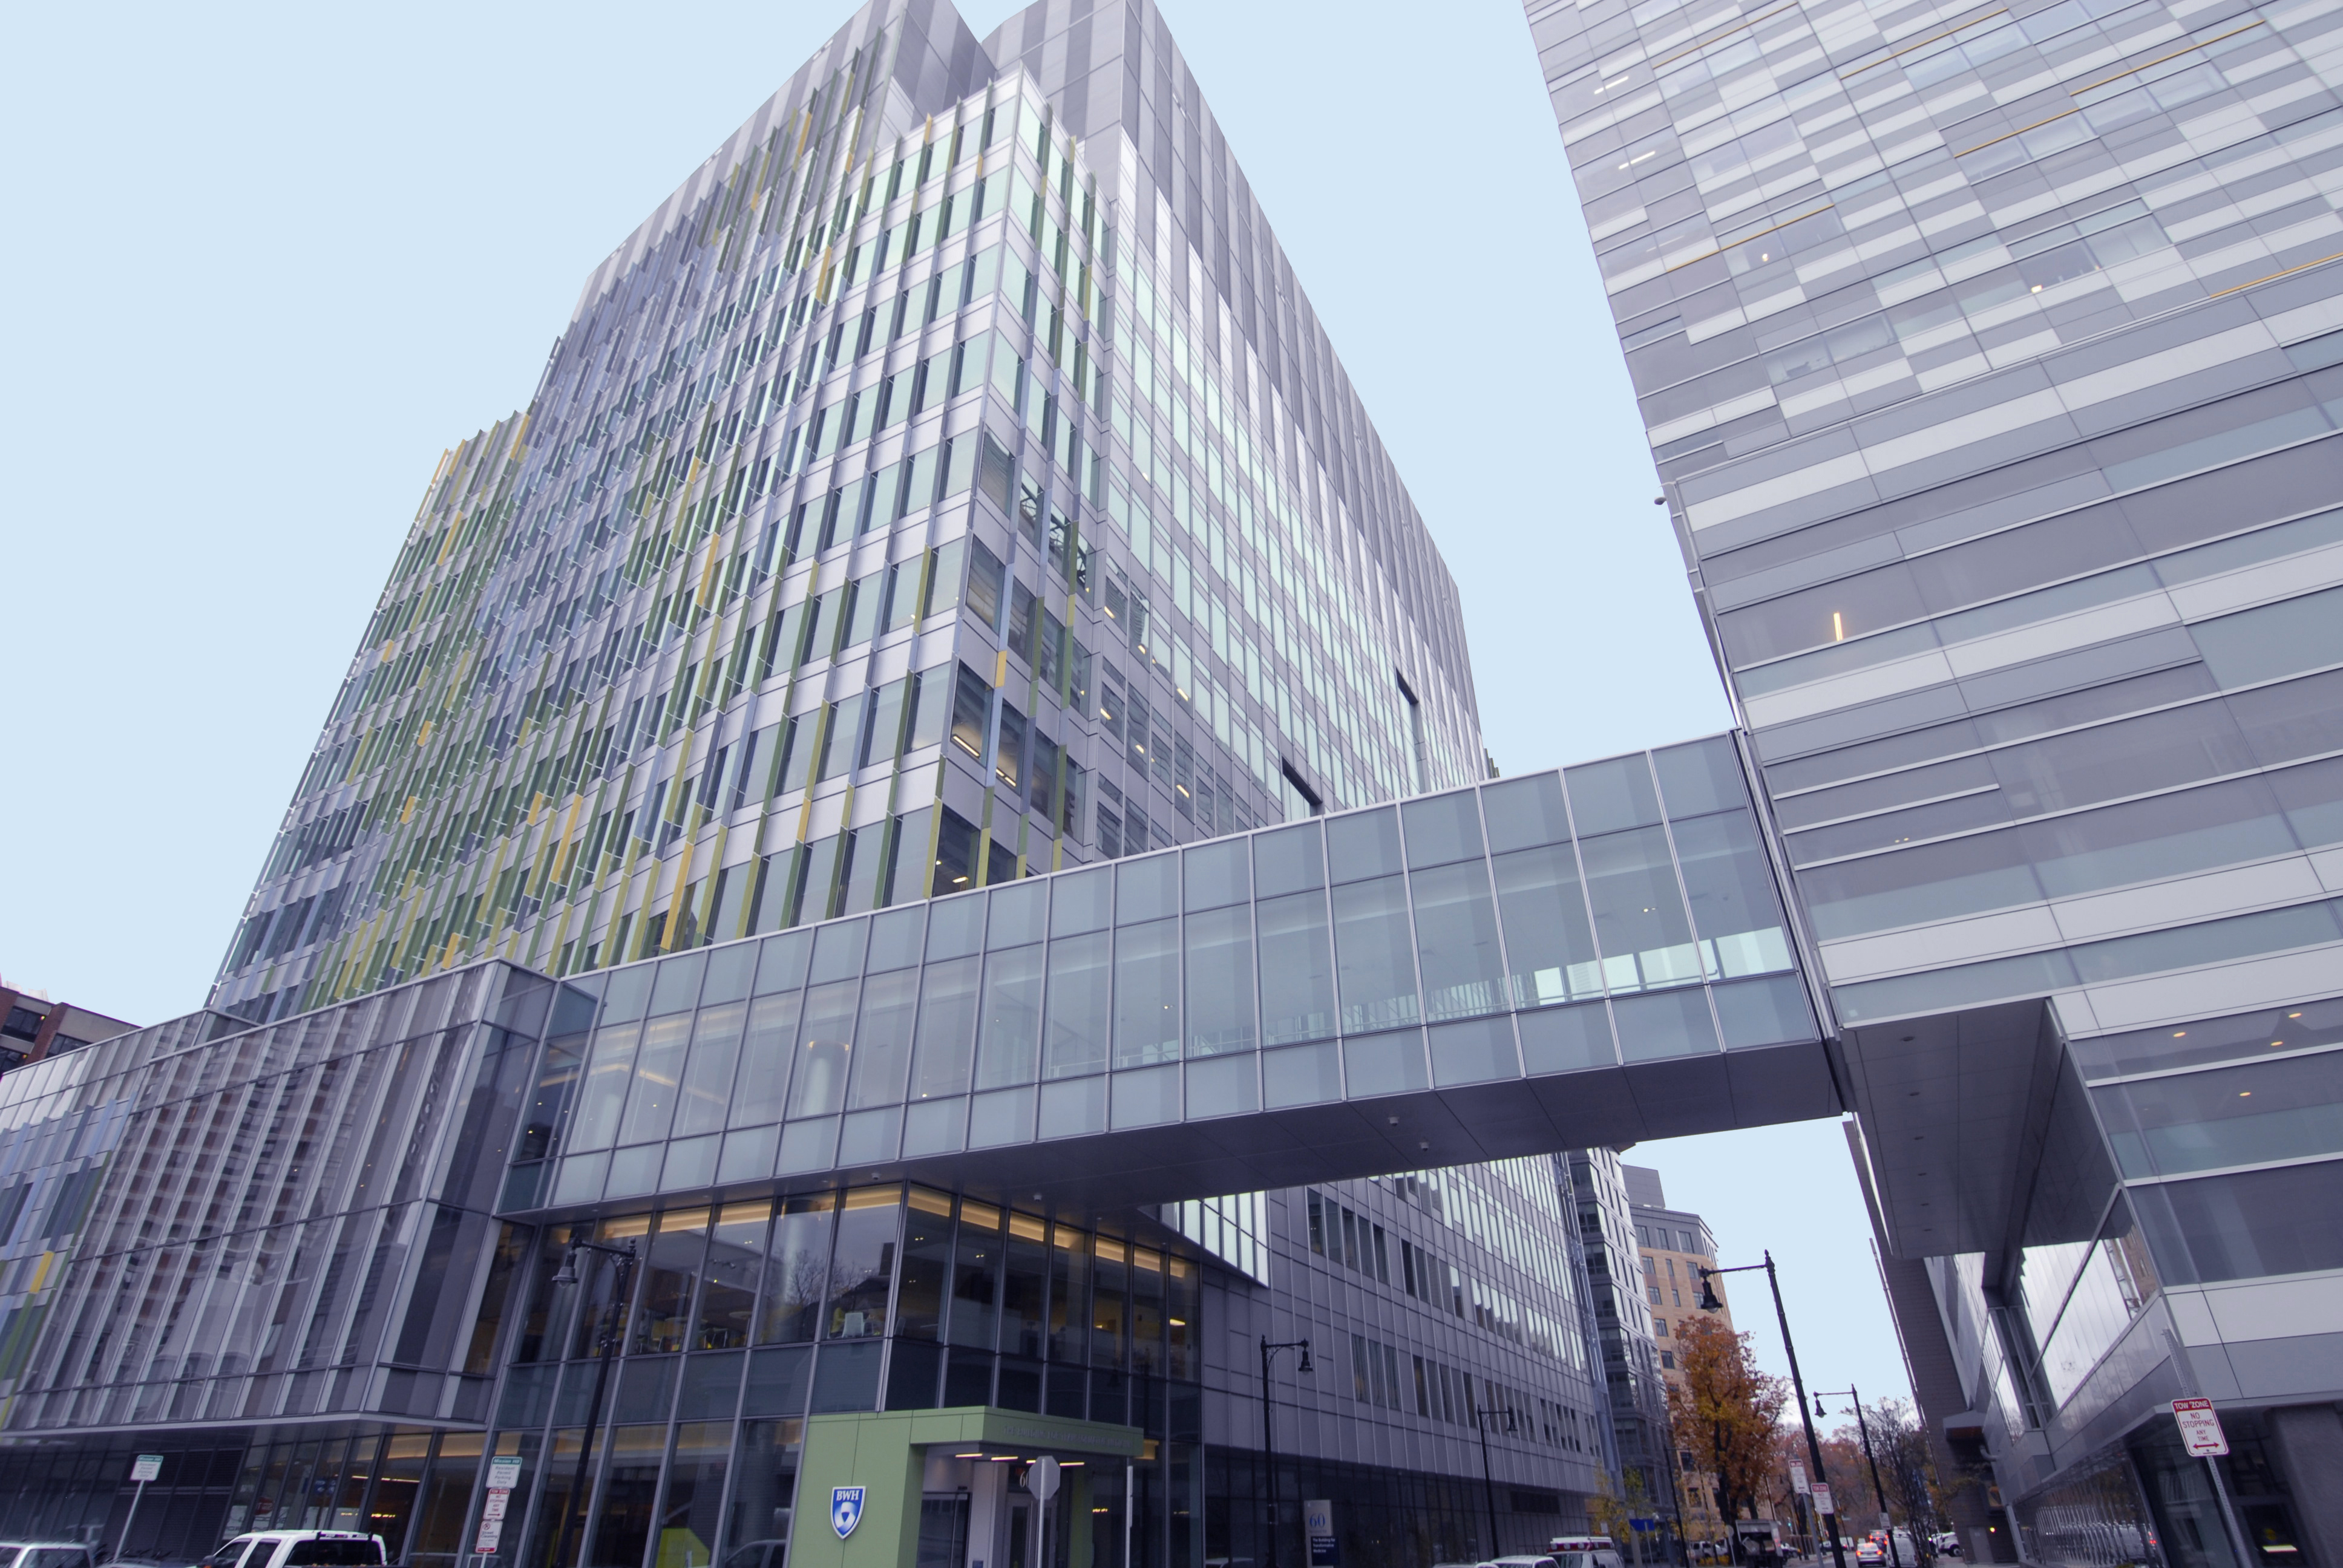



artificial intelligence in pathology -
you have compute, now just build a model, right?!
Drew Williamson, MD
Clinical Informatics Fellow
2021/2022 Molecular Fellow
Brigham and Women’s Hospital
Fabienne Lucas, MD PhD
Senior Resident Clinical Pathology
2021/2022 Hematopathology Fellow
Brigham and Women’s Hospital
NeCYTO October 27th 2022

Slide 2
disclosures: none
illustrations created with BioRender.com

Slide 3
Learning objectives
high level description of AI
  principles and concepts
  from idea to working AI model: processes and infrastructure for pathology AI
AI in cytometry:
  applications of AI within cytometry workflows
  examples of clinical applications
outlook: how AI will change clinical landscapes
enhance literacy in AI methods
provide framework for successful collaborations

Slide 4
Learning objectives
high level description of AI
  principles and concepts
  from idea to working AI model: processes and infrastructure for pathology AI
AI in cytometry:
  applications of AI within cytometry workflows
  examples of clinical applications
outlook: how AI will change clinical landscapes

Slide 5
Introduction to AI
What is machine learning/deep learning/AI?
Tasks
Supervision

Slide 6
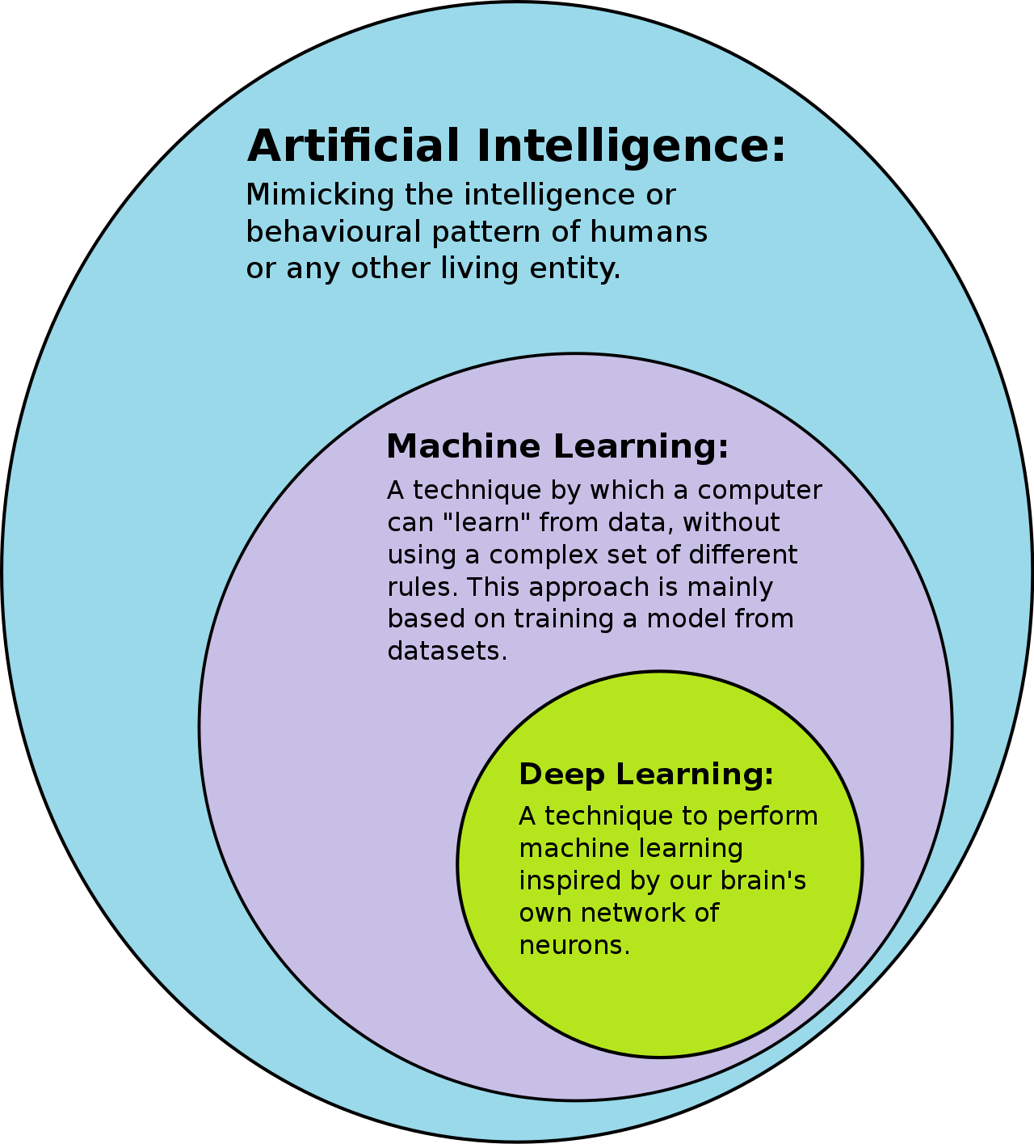
What is AI?
Differing definitions based on values, what it means to be human, etc.
Machine learning = a system which uses data to improve at some task
Deep learning = a particular class of machine learning algorithms
Deep learning relies on contemporary, powerful computing hardware
Wikipedia

Slide 7
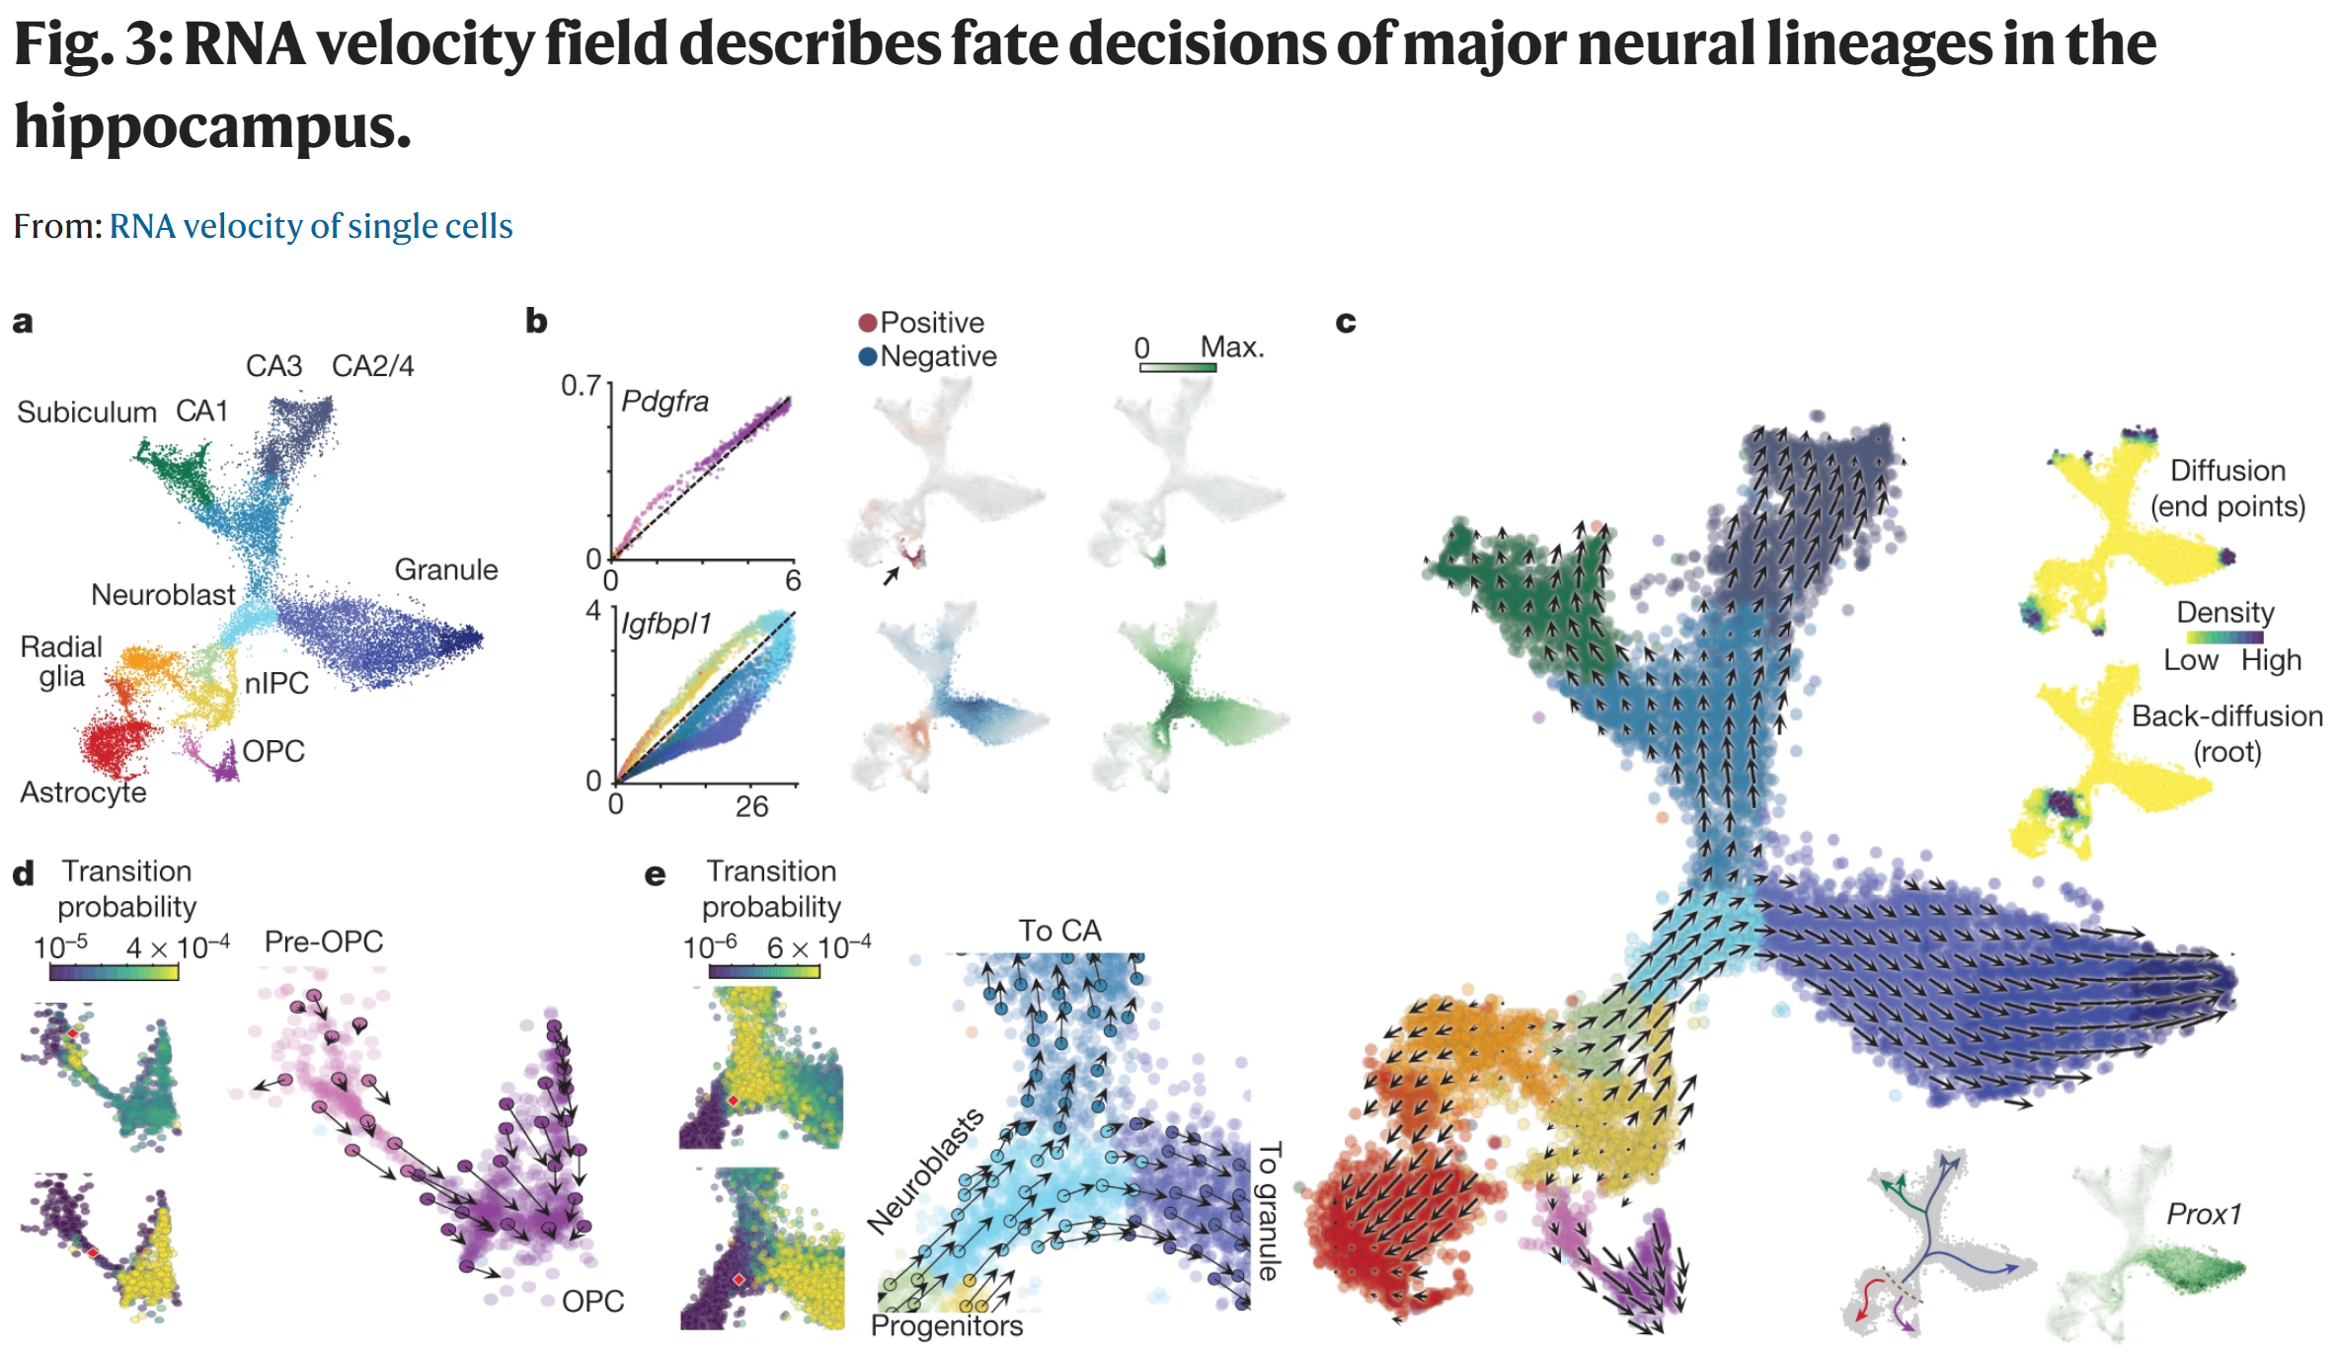
Machine Learning Tasks
Dimensionality reduction
  How can we represent this data more simply?
  e.g., PCA, t-SNE, UMAP
Clustering
  What things in the dataset are similar to each other?
  e.g., K means
Classification
  Which categories does this data fall into?
  e.g., recapitulating diagnoses
Regression
  What values should we assign this data?
  e.g., survival prediction
Translation
  How do we transform this data into another form?
La Manno, Gioele, et al. "RNA velocity of single cells." Nature 2018

Slide 8
Machine Learning Tasks
Dimensionality reduction
  How can we represent this data more simply?
  e.g., PCA, t-SNE, UMAP
Clustering
  What things in the dataset are similar to each other?
  e.g., K means
Classification
  Which categories does this data fall into?
  e.g., recapitulating diagnoses
Regression
  What values should we assign this data?
  e.g., survival prediction
Translation
  How do we transform this data into another form?
La Manno, Gioele, et al. "RNA velocity of single cells." Nature 2018

Slide 9
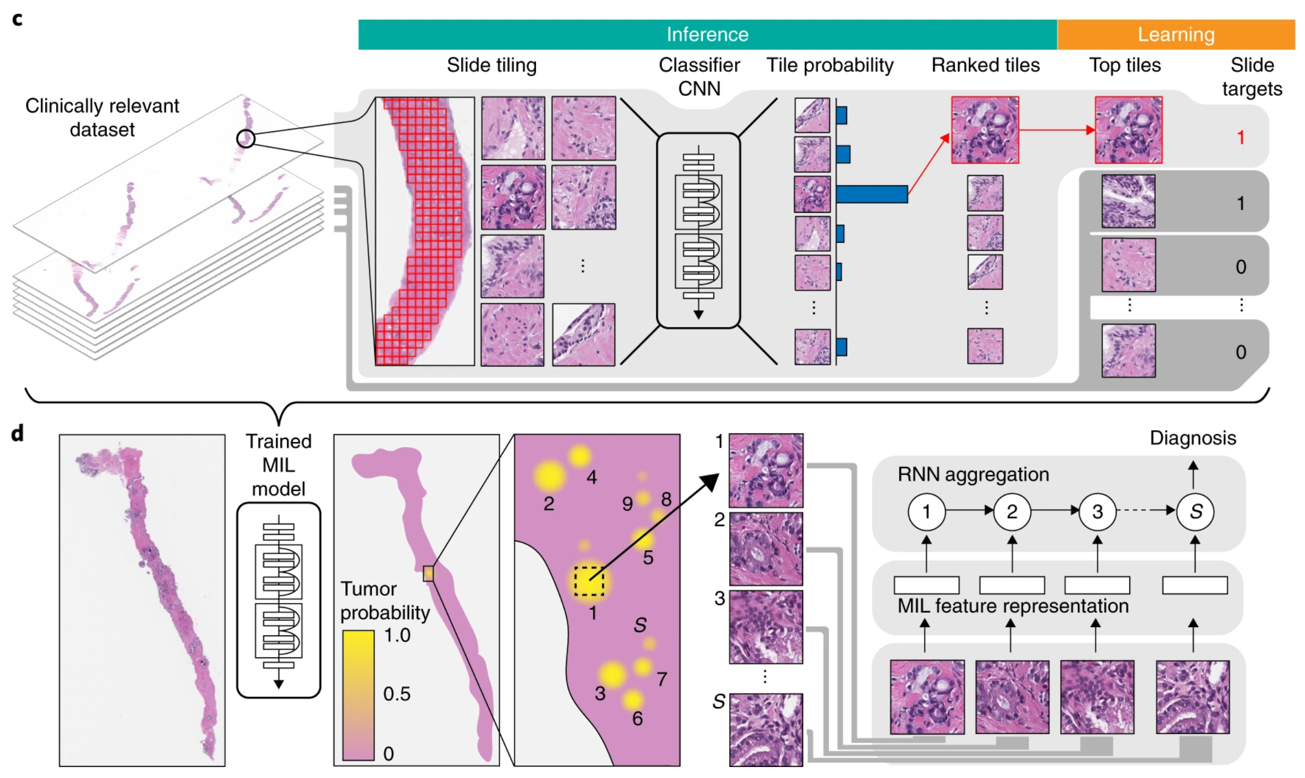
Machine Learning Tasks
Dimensionality reduction
  How can we represent this data more simply?
  e.g., PCA, t-SNE, UMAP
Clustering
  What things in the dataset are similar to each other?
  e.g., K means
Classification
  Which categories does this data fall into?
  e.g., recapitulating diagnoses
Regression
  What values should we assign this data?
  e.g., survival prediction
Translation
  How do we transform this data into another form?
Campanella, Gabriele, et al. "Clinical-grade computational pathology using weakly supervised deep learning on whole slide images." Nature Medicine 2019

Slide 10
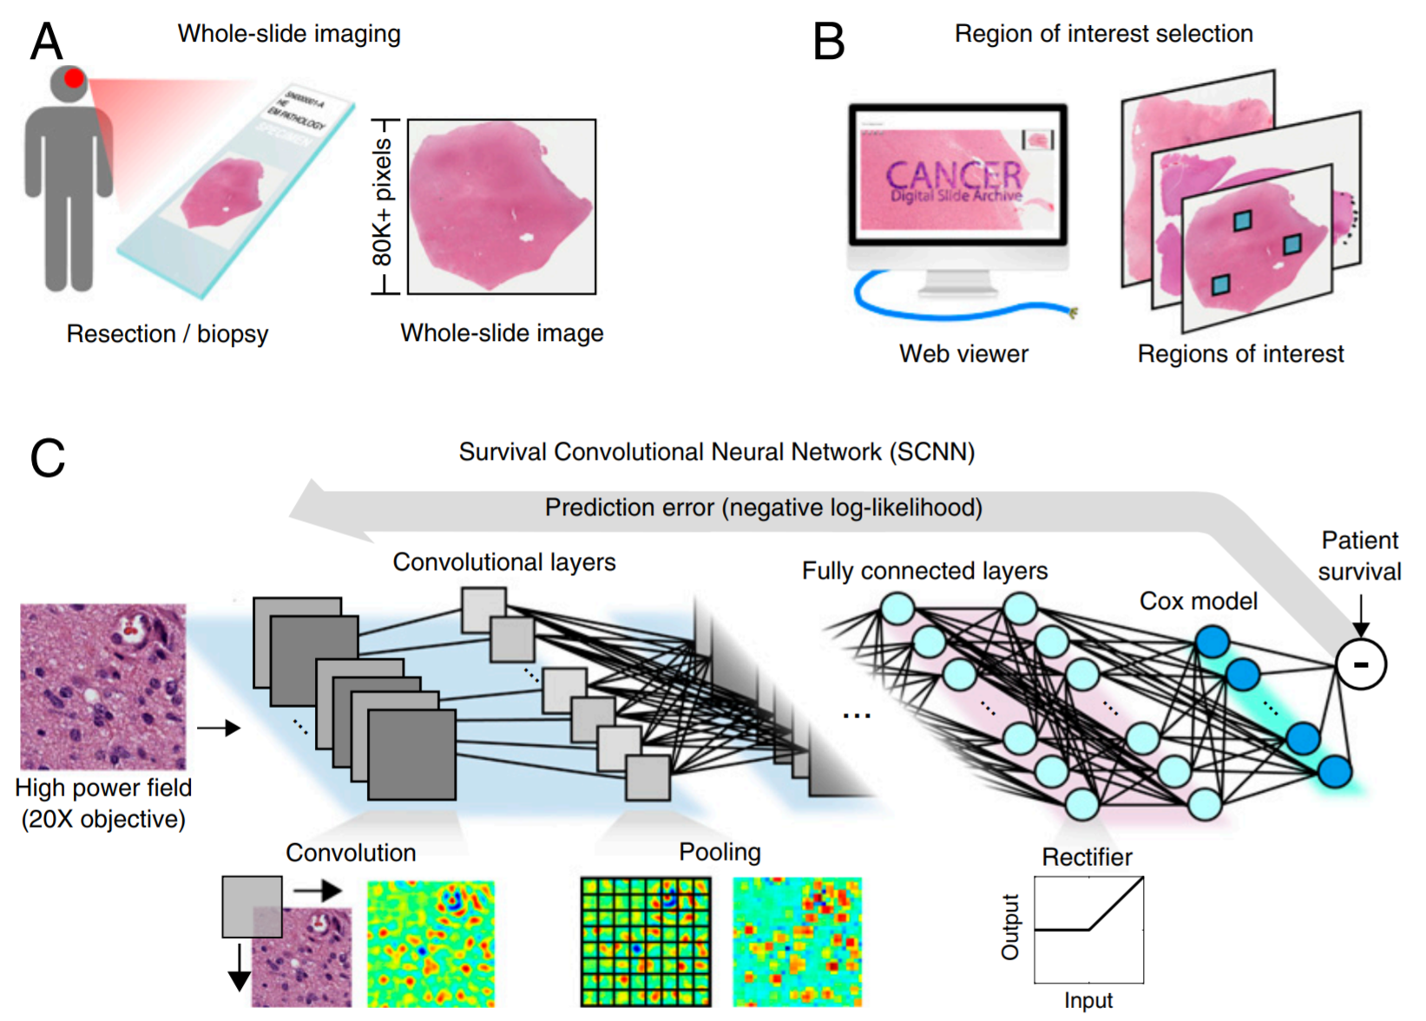
Machine Learning Tasks
Dimensionality reduction
  How can we represent this data more simply?
  e.g., PCA, t-SNE, UMAP
Clustering
  What things in the dataset are similar to each other?
  e.g., K means
Classification
  Which categories does this data fall into?
  e.g., recapitulating diagnoses
Regression
  What numerical values should we assign this data?
  e.g., survival prediction
Translation
  How do we transform this data into another form?
Mobadersany, Pooya, et al. "Predicting cancer outcomes from histology and genomics using convolutional networks." PNAS 2018

Slide 11
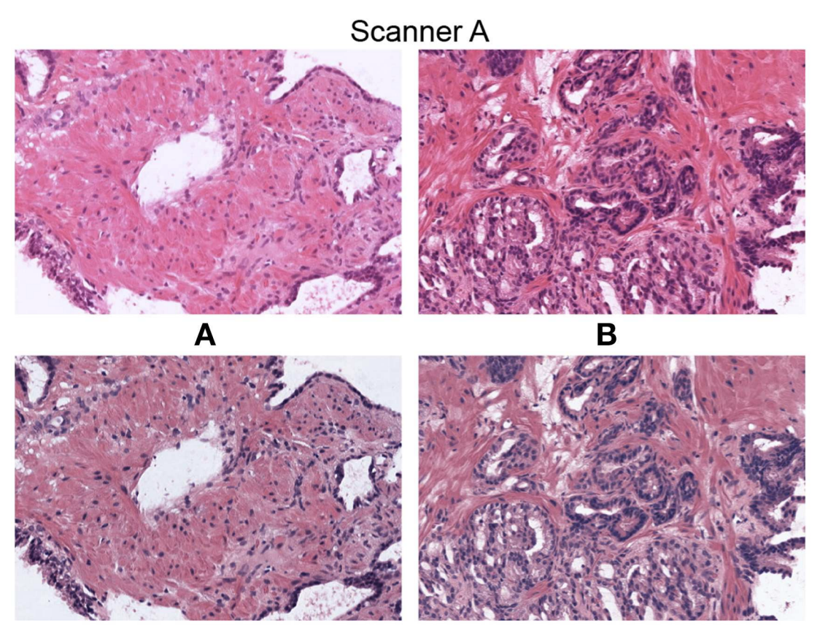
Machine Learning Tasks
Dimensionality reduction
  How can we represent this data more simply?
  e.g., PCA, t-SNE, UMAP
Clustering
  What things in the dataset are similar to each other?
  e.g., K means
Classification
  Which categories does this data fall into?
  e.g., recapitulating diagnoses
Regression
  What numerical values should we assign this data?
  e.g., survival prediction
Translation
  How do we transform this data into another form?
  e.g., GANs
Anghel, Andreea, et al. "A high-performance system for robust stain normalization of whole-slide images in histopathology." Frontiers in medicine 2019

Slide 12
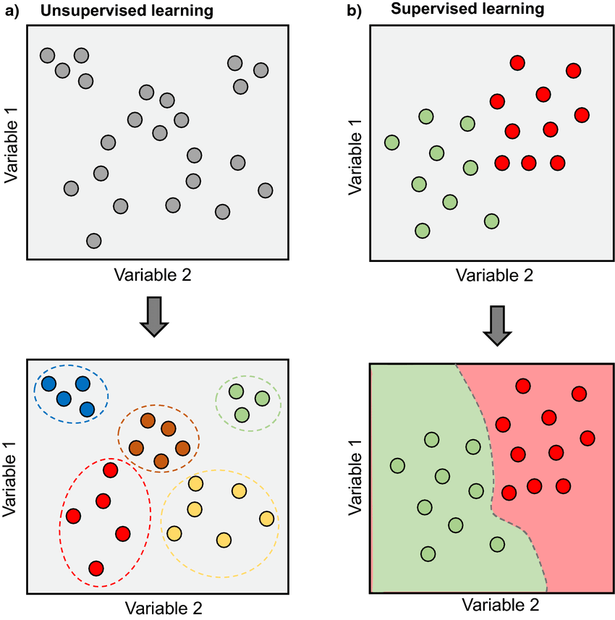
Supervision
Unsupervised ML
  Tasks: dimensionality reduction, clustering, translation
  Algorithms rely only on the data points themselves
Morimoto, Juliano, and Fleur Ponton. "Virtual reality in biology: could we become virtual naturalists?." Evolution: Education and Outreach 2021

Slide 13
Supervision
Unsupervised ML
  Tasks: dimensionality reduction, clustering, translation
  Algorithms rely only on the data points themselves
Supervised ML
  Tasks: classification, regression, translation
  Algorithms rely on data points with labels
Morimoto, Juliano, and Fleur Ponton. "Virtual reality in biology: could we become virtual naturalists?." Evolution: Education and Outreach 2021

Slide 14
Learning objectives
high level description of AI
  principles and concepts
  from idea to working AI model: processes and infrastructure for pathology AI
AI in cytometry:
  applications of AI within cytometry workflows
  examples of clinical applications
outlook: how AI will change clinical landscapes

Slide 15
Overview
What do you need to do AI?
  Partnership with computational experts
  Precisely stated problem
  Clean data
  Ethics and bias
  Choice of algorithm
  Metric for success or failure
  Hardware and software
  Interpretability
  Common sources of errors
Walkthrough of a published example from our lab
Notes:
spend more time talking about principles and concepts of ML, including biases and sources of errors. we should also talk about the workflow and pipeline set up a lot

Slide 16
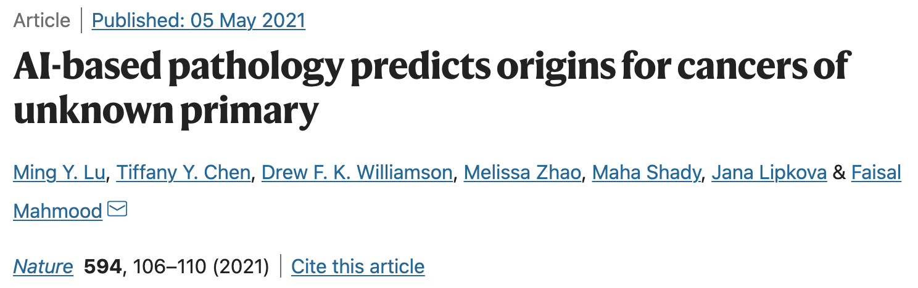
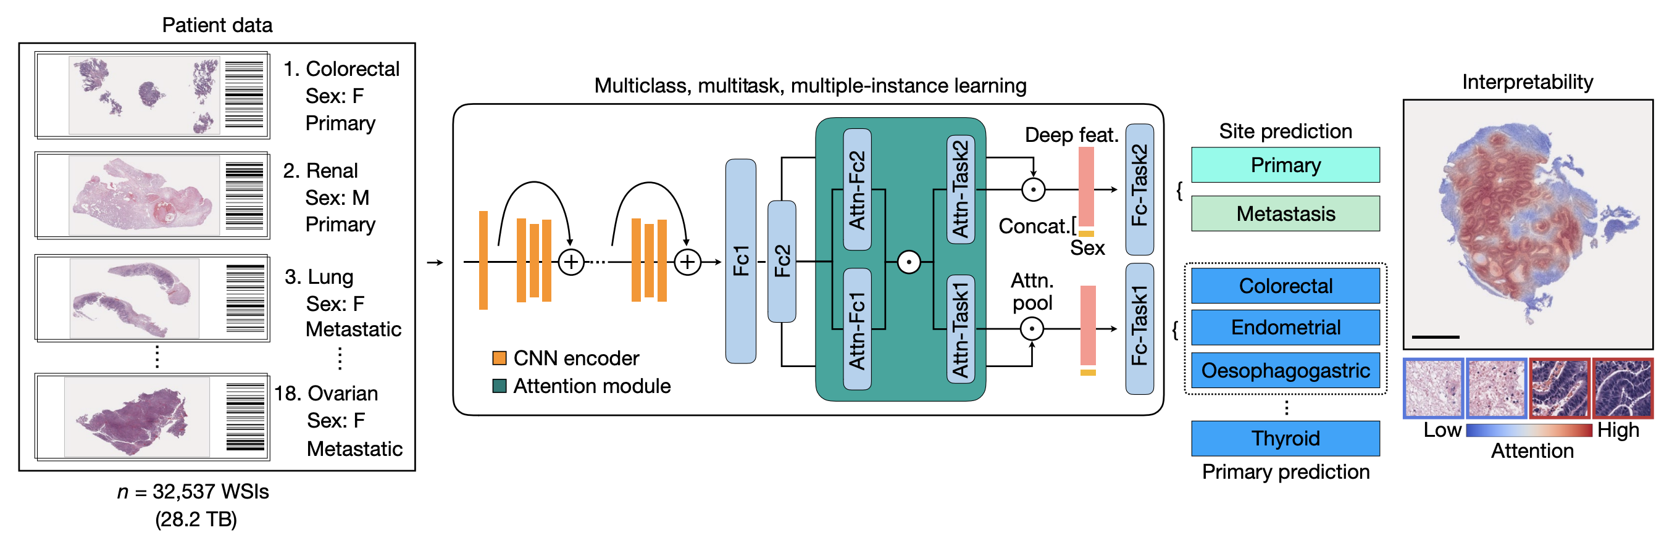

Slide 17
Partnership
Huge subjectivity and depth on both sides
Learn the language of the other side
Application of ML methods can be very high impact
  AlphaFold, Self driving cars, Facebook’s algorithms, Google PageRank
Computer scientists
Pathologists
Notes:
No exactly right answers means expertise is required

Slide 18



Problem
Precisely stated as possible
“Apply AI to lung cancer” or “diagnose lung cancer with AI”
For our paper, this was “classify a given H&E-stained whole slide image and matched patient’s sex as to whether or not the tumor on the slide is metastatic and from which of 18 sites did it originate”
Include task category, data, and specific task at minimum
Notes:
machines don’t deal well with ambiguity

Slide 19
Problem
Precisely stated as possible
“Apply AI to lung cancer” or “diagnose lung cancer with AI”
For our paper, this was “classify a given H&E-stained whole slide image and matched patient’s sex as to whether or not the tumor on the slide is metastatic and from which of 18 sites did it originate”
Include task category, data, and specific task at minimum
Notes:
machines don’t deal well with ambiguity

Slide 20
Data
80+% of the time in a project will be spent on gathering and cleaning data
How much data can you get? Is it all from the same source?
Data normalization
The generalization gap
Notes:
deep learning algorithms don’t generalize as well as we would like

Slide 21
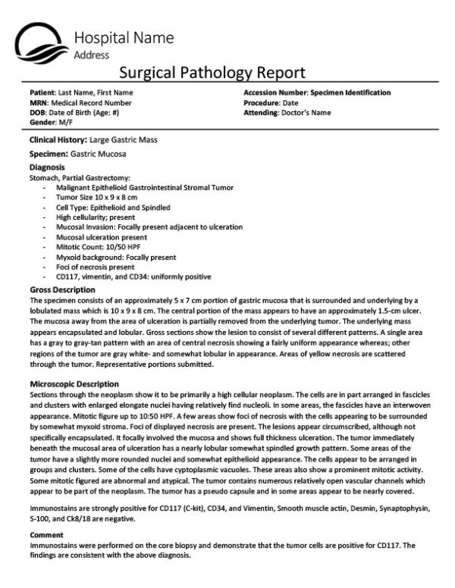
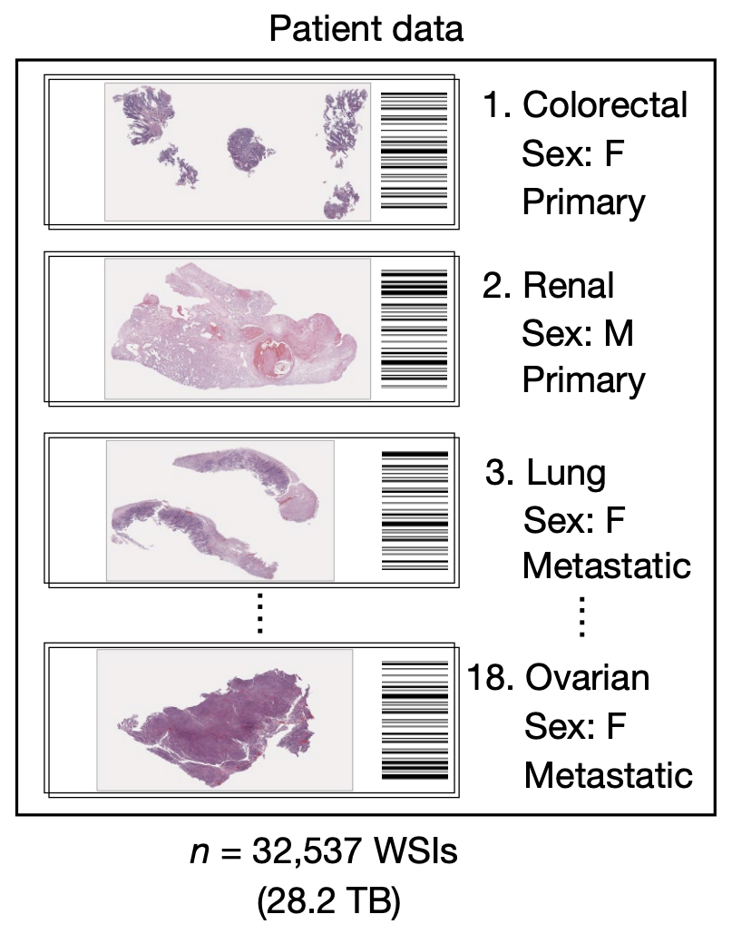

Slide 22
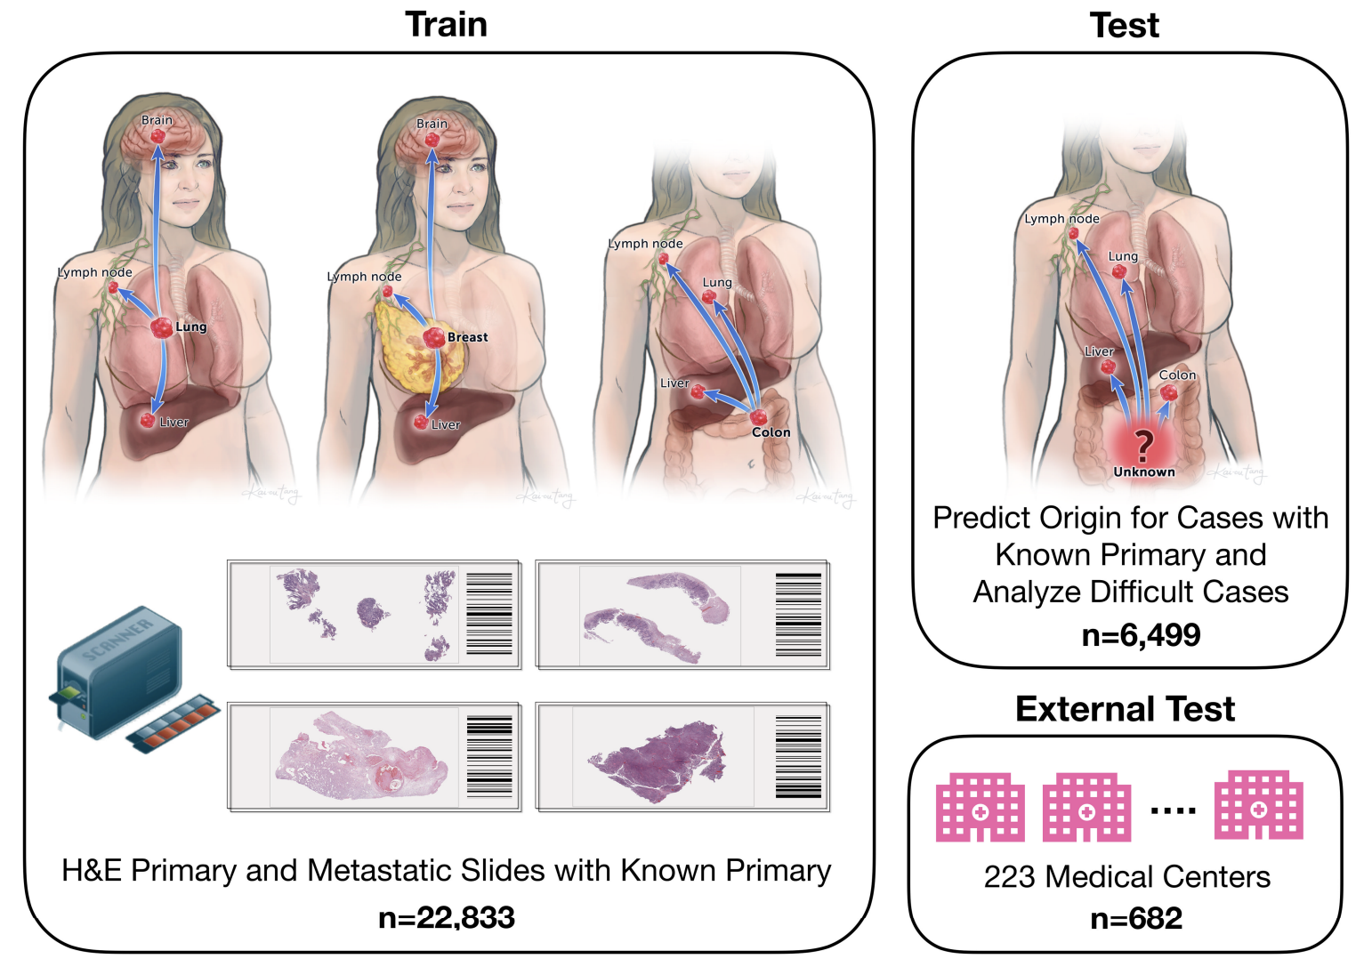

Slide 23
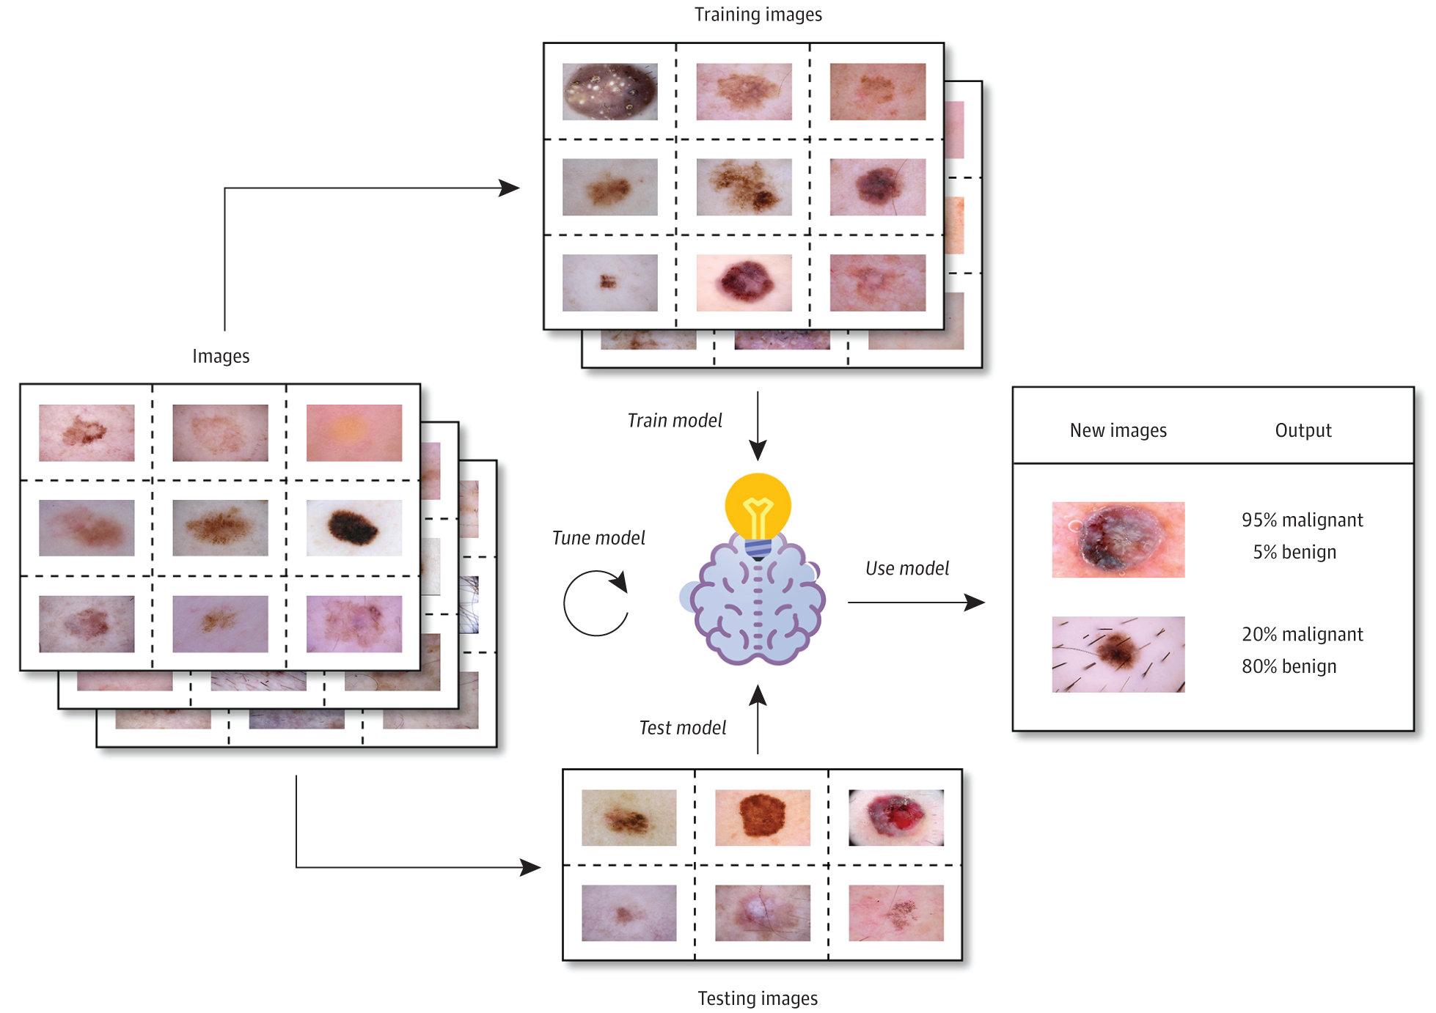
Ethics and Bias
Is your study population representative of the population where the model will be deployed?
Is your model perpetuating biases in your training data?
Adamson, Adewole S., and Avery Smith. "Machine learning and health care disparities in dermatology." JAMA Dermatology 2018
Notes:
amazon hiring
facial recognition
brown skin and melanomas

Slide 25
Choosing an algorithm
Problem statement should suggest a task and supervision paradigm
Amount and structure of data will suggest (or force) an exact algorithm choice
Every algorithm comes with trade-offs

Slide 26
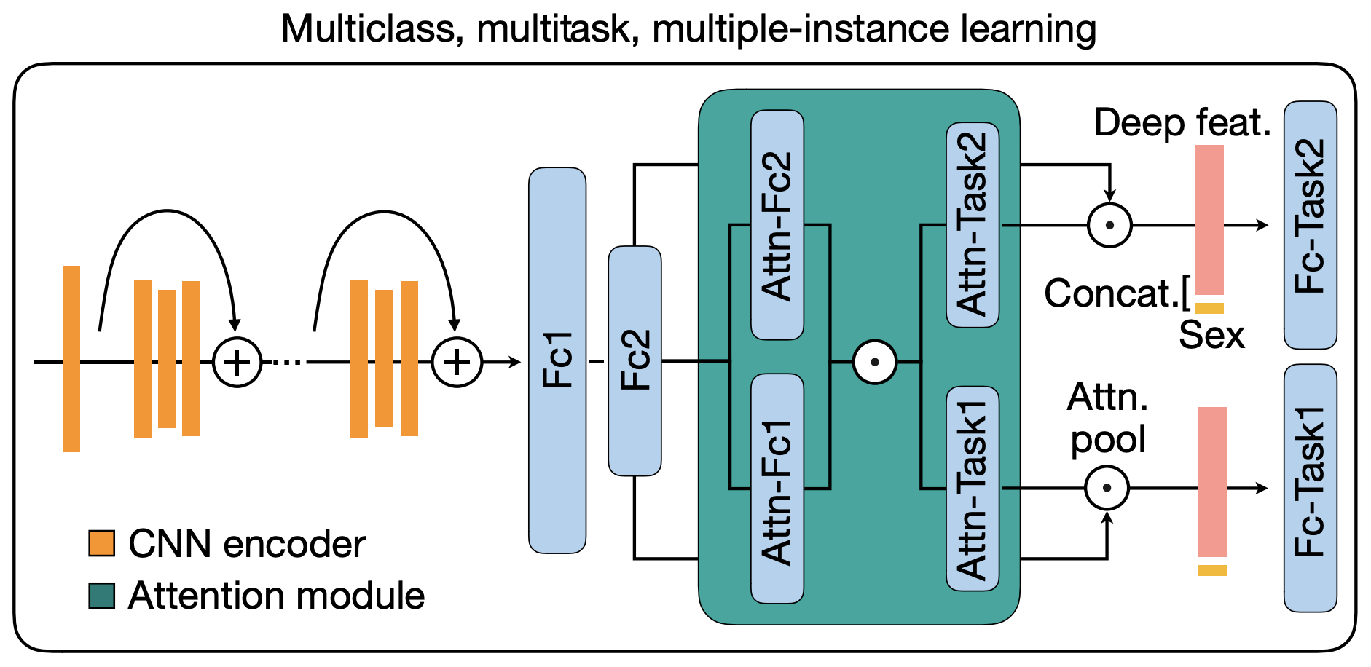

Slide 27
Metric for success or failure
What are you trying to optimize for?
  “Loss function”
How will you measure that performance?
Supervised models:
  AUC(ROC), accuracy, sensitivity, specificity, c-index, F1
Unsupervised models are more complicated to evaluate
  prototype on labeled data, extend to unlabeled
Notes:
What sort of performance would you be happy with?
Easy: my classification algorithm needs at least 90% sensitivity and specificity to be deployable
Hard: I want the synthetic images to look good

Slide 28
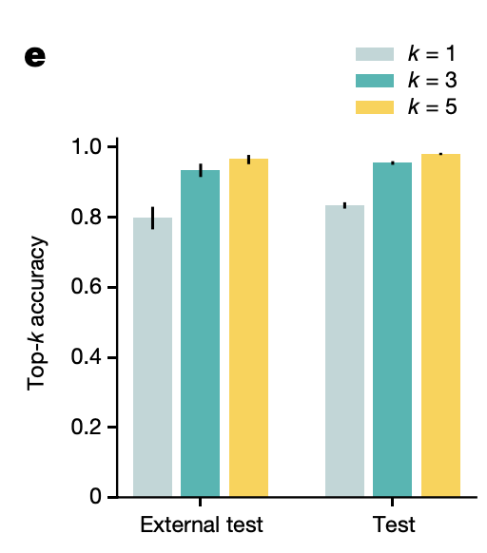
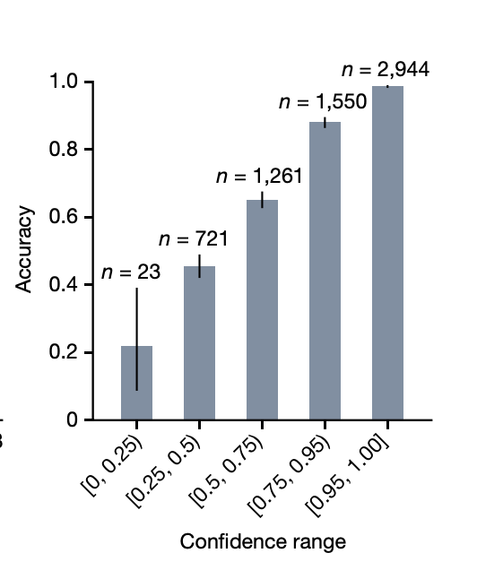
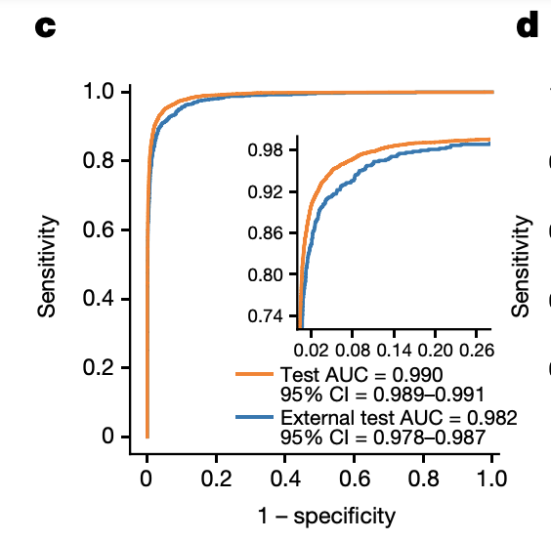

Slide 29
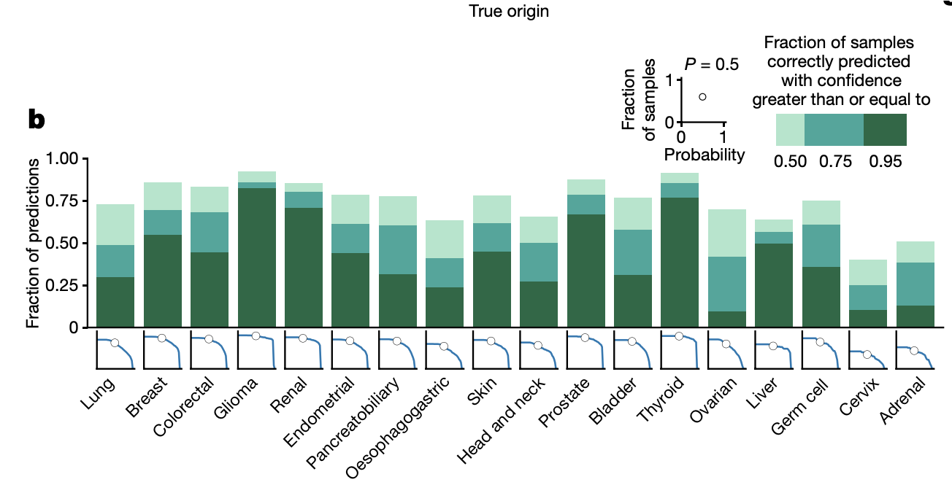

Slide 30










Hardware and Software
Highly model dependent and highly collaborator dependent
Software:
  ”Basic” (linear or logistic regression): Excel → R
  ”Intermediate” (random forest, SVM): R → Python
  “Advanced” (neural networks): Python
  No code solutions
Hardware
  ”Basic” (linear or logistic regression): laptop
  ”Intermediate” (random forest, SVM): laptop or desktop
  “Advanced” (neural networks): workstation
  Cloud solutions
Notes:
we used workstations with 3-4 GPUs, ~$15,000 each
Python, pytorch

Slide 31
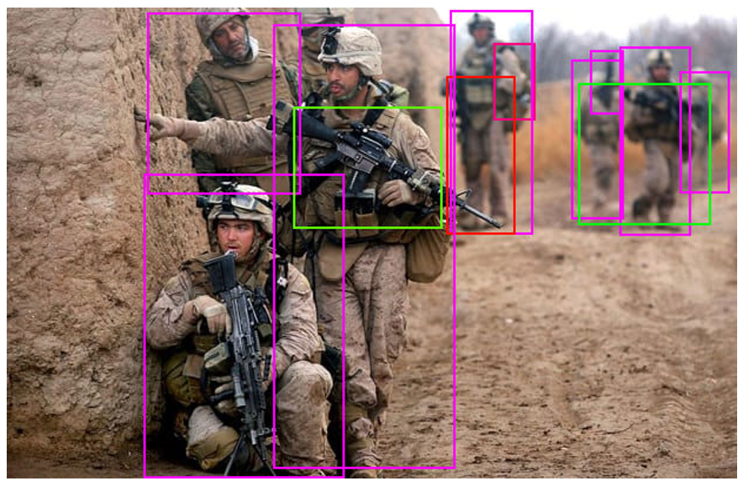
Interpretability
Interpretability = why and how your model makes decisions
How will you debug the model when it makes incorrect predictions?
How important is interpretability to your application?
Do you even want an interpretable model?
Wang, Tony, “Recognizing Firearms from Images and Videos in Real-Time with Deep Learning and Computer Vision” Medium 2019
Notes:
Predicting how the output will change given some change to the input

Slide 32
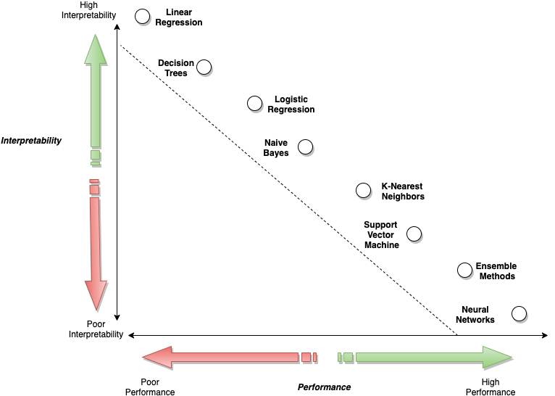
Model Explainability with AWS Artificial Intelligence and Machine Learning Solutions, AWS Whitepaper
Notes:
interpretability depends entirely on your choice of model
more complexity = better capturing intricacies in the data
similar to life: more complex life can better harness resources from the environment

Slide 33
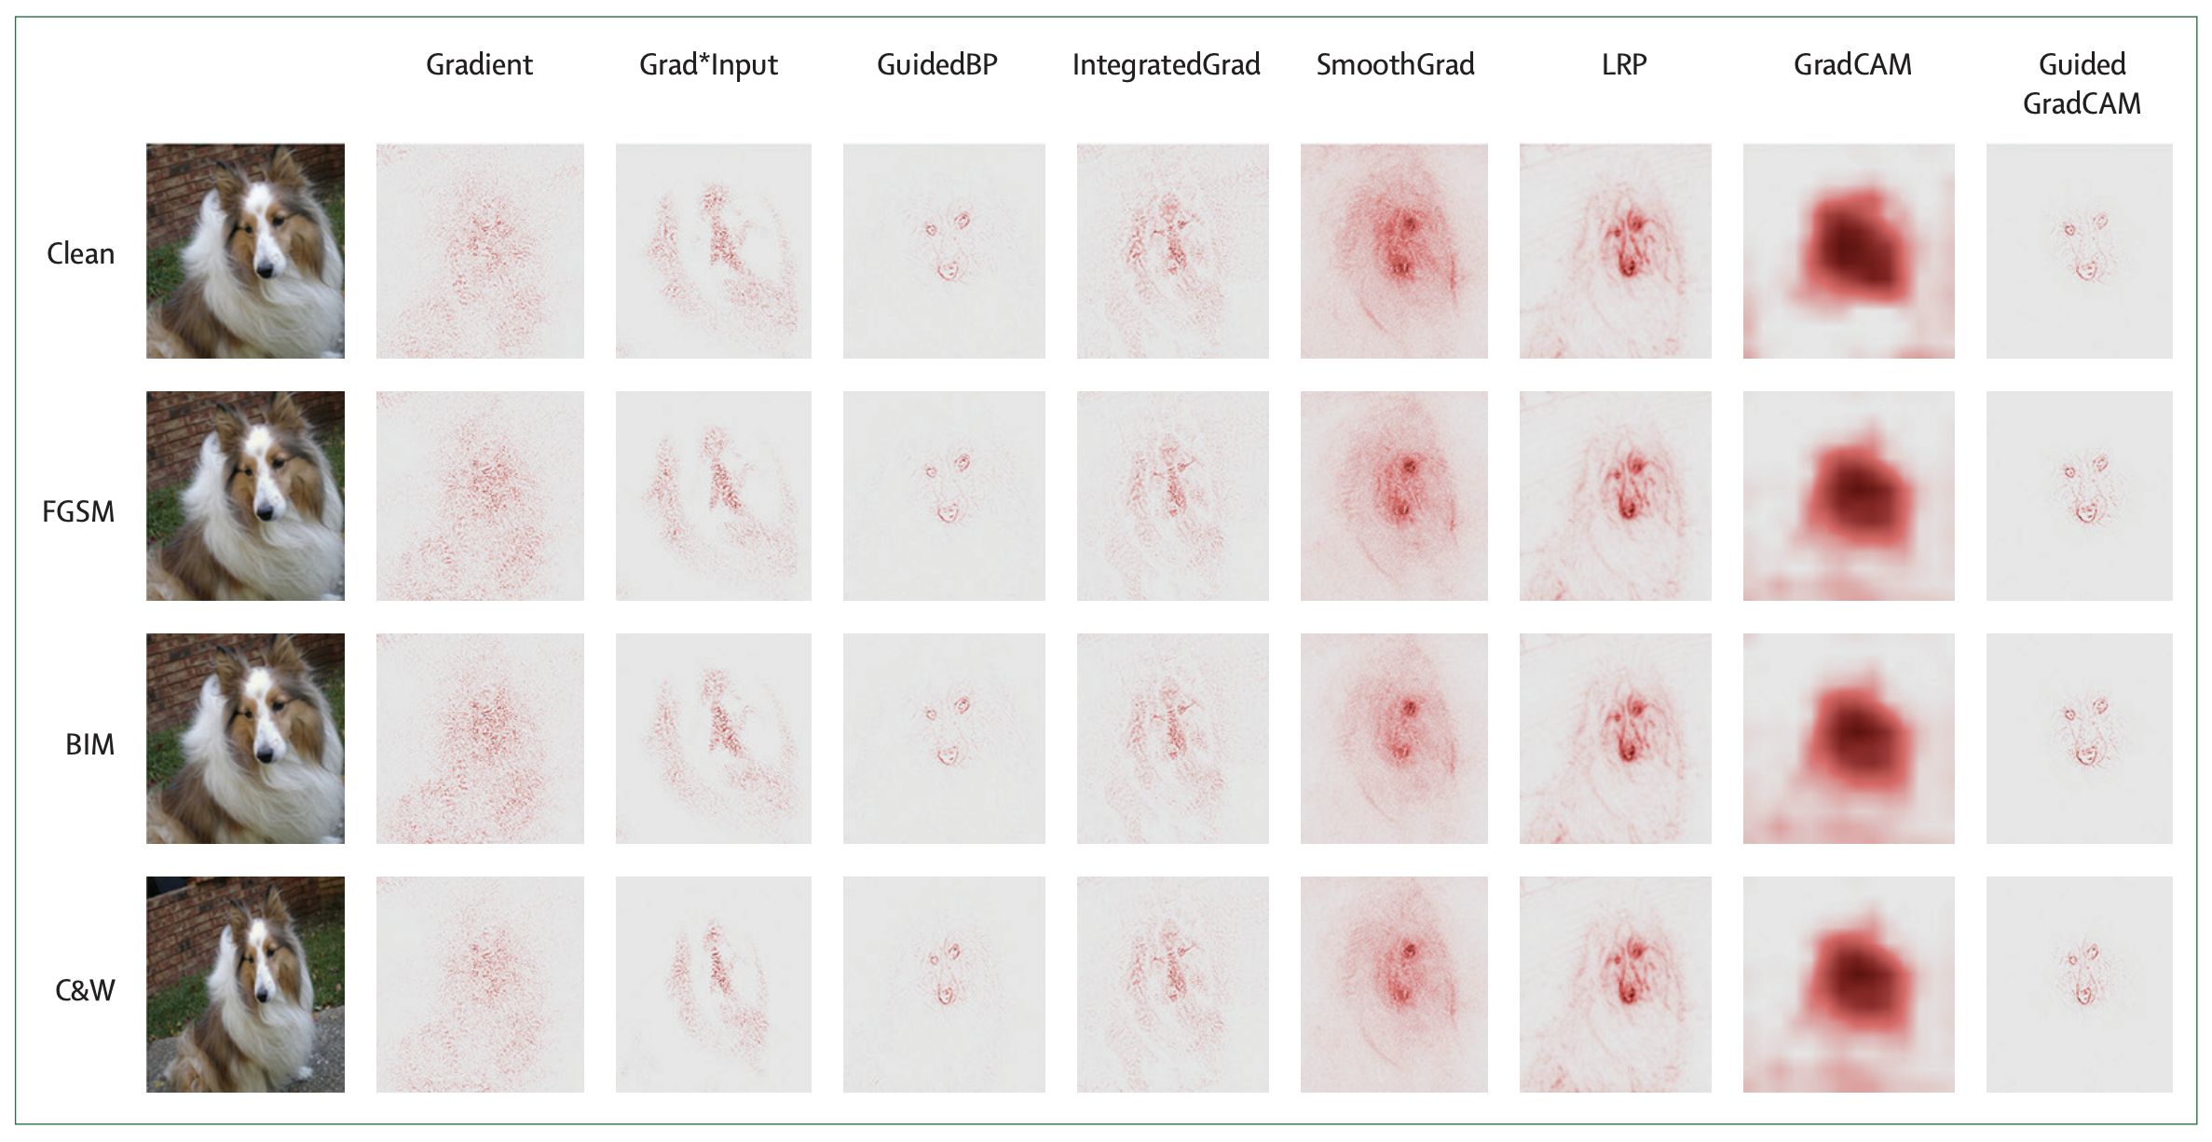
Figure 2 from Ghassemi, Marzyeh, Luke Oakden-Rayner, and Andrew L. Beam. "The false hope of current approaches to explainable artificial intelligence in health care.” in The Lancet Digital Health 2022

Slide 34
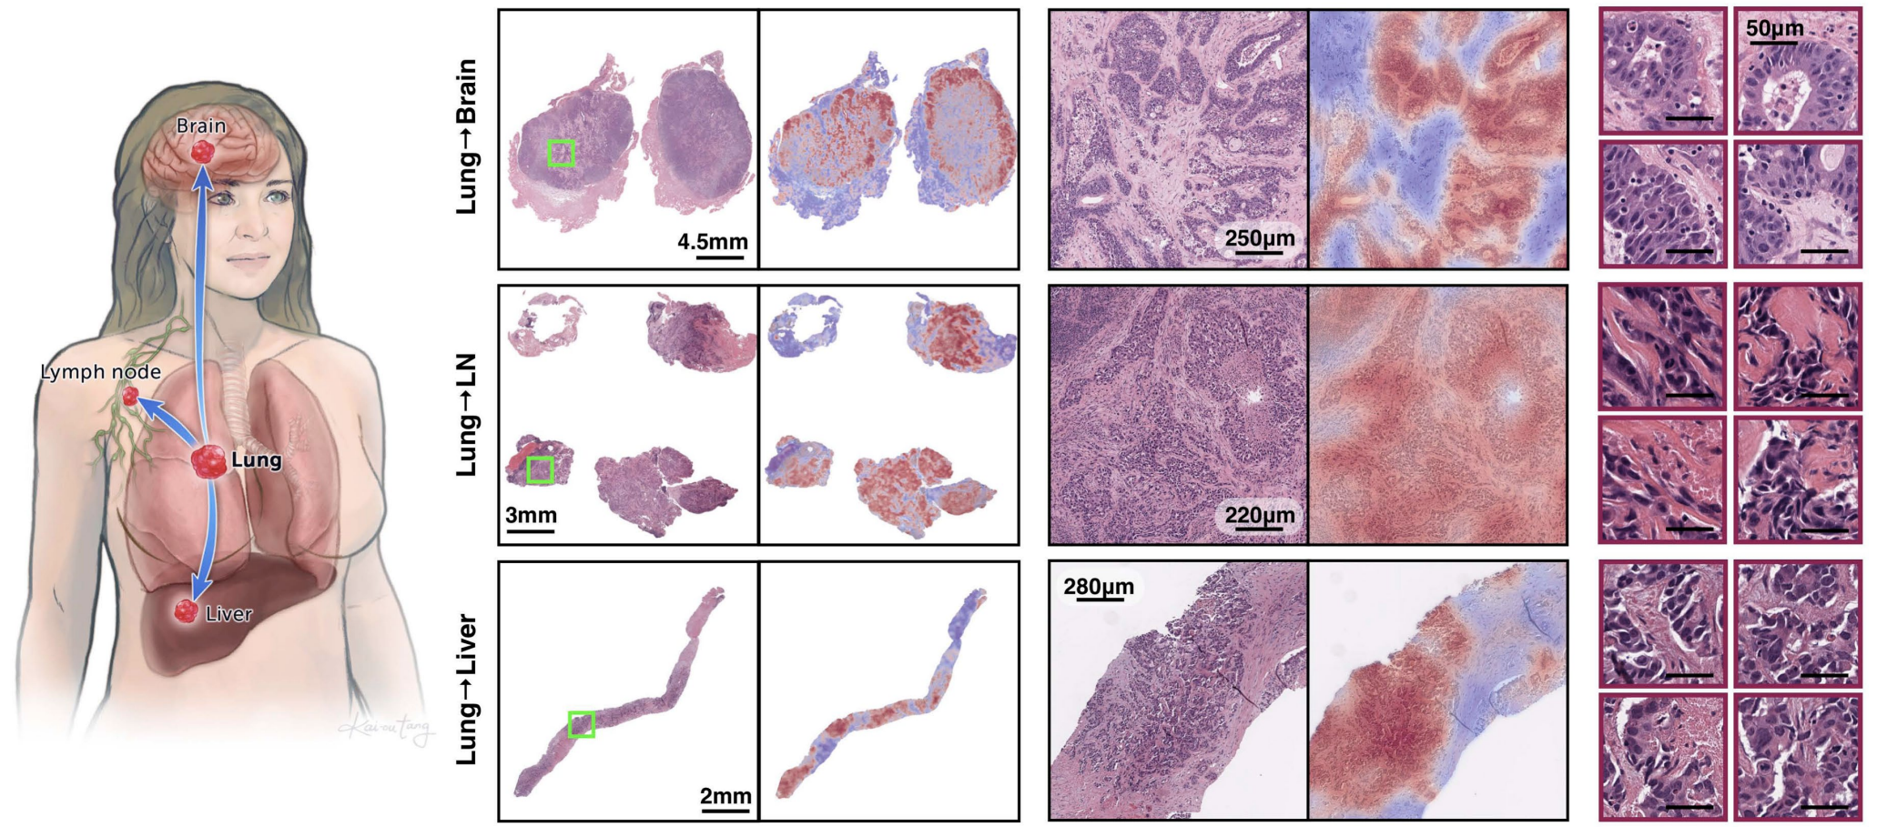

Slide 35
Common sources of errors
Bad choice of metric
  Optimizing for the wrong thing or obfuscating results
Bias in the data
  Domain shift between train and test
Data leakage
  Testing data accidentally includes training data
Confounders

Slide 36
Overview
Partnership with computational experts
Precisely stated problem
Clean data
Ethics and bias
Choice of algorithm
Metric for success or failure
Hardware and software
Interpretability
Common sources of errors

Slide 37
The hard parts
Packaging for publication
  How can you make this interesting for cytometrists and AI folks?
Moving to wider adoption
  More external cohorts
  Informatics infrastructure
  Legal and regulatory hurdles
Notes:
need novelty on both sides, of data, application, methods, performance, etc.
this translation necessarily involves many more people from many disciplines

Slide 38
Learning objectives
high level description of AI
  principles and concepts
  from idea to working AI model: processes and infrastructure for pathology AI
AI in cytometry:
  applications of AI within cytometry workflows
  examples of clinical applications
outlook: how AI will change clinical landscapes

Slide 39

cytometry lends itself to computation

Slide 40
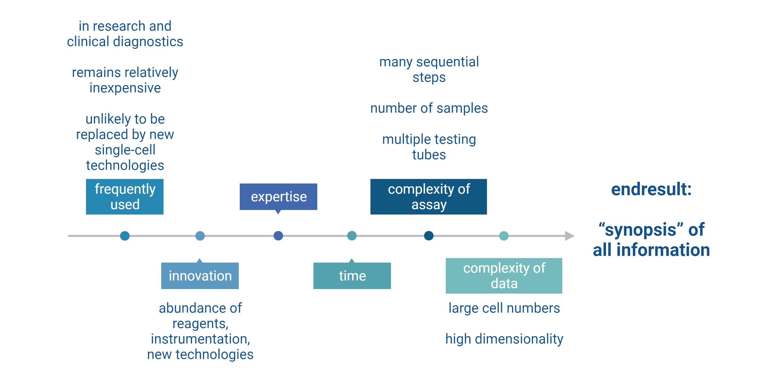

Slide 41
consequently
possibility of ​human error​/ bias​
insufficient/ overly simplified data representation and interpretation
low processing speed

Slide 42
what are we using machine-support for in cytometry?
Automation
Analysis
Decision
Discovery

Slide 43
what are we using machine-support for in cytometry?
Automation
Analysis
Decision
Discovery
improved workflow?

Slide 44
what are we using machine-support for in cytometry?
Automation
Analysis
Decision
Discovery
improved workflow?
data?
precise statement of the problem

Slide 45
cytometry machine support already used for
automation of manual tasks
data processing and analysis
normalization to level out differences in data sets
integration with other data types
clinical laboratory
  diagnosis:
    automated data analysis
    diagnostic support
  stewardship
  resource optimization

Slide 46
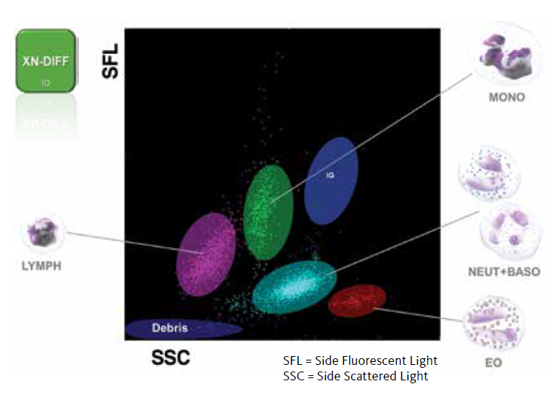
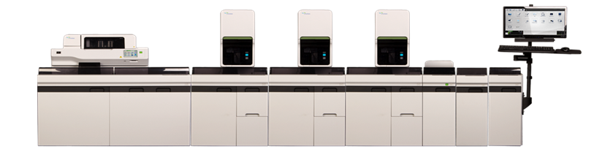
routine application: automated hematology analyzers
SYSMEX Detector/ Channel | Parameters reported
HGB | HGB
RBC/PLT | RBC, HCT, MCV, MCH, MCHC, RDW, PLT, MPV
WDF | WBC, #/% Neut, #/% Lymph, #/% Mono%, #/% Eo, #/% IG
PLT-F | PLT, Immature Platelet Fraction (IPF)
cell-specific lyses and fluorescent dyes
SLS-hemoglobin
impedance measurements
flow cytometry
Notes:
platelets are identified and counted using a platelet-specific, fluorescent RNA dye, Oxazine, which stains the rough surface endoplasmic reticulum and mitochondria.
This staining has excellent correlation with CD41/ CD61 stained platelets and minimizes interference from other cells. Using the forward scattered light and the fluorescence signal, the platelets are separated from red blood cells and white blood cells.

Slide 47
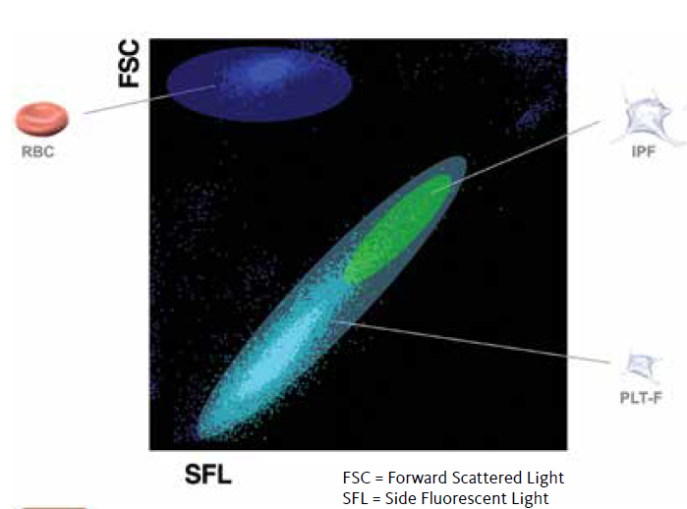
routine application: automated hematology analyzers
SYSMEX Detector/ Channel | Parameters reported
HGB | HGB
RBC/PLT | RBC, HCT, MCV, MCH, MCHC, RDW, PLT, MPV
WDF | WBC, #/% Neut, #/% Lymph, #/% Mono%, #/% Eo, #/% IG
PLT-F | PLT, Immature Platelet Fraction (IPF)
cell-specific lyses and fluorescent dyes
SLS-hemoglobin
impedance measurements
flow cytometry
Notes:
platelets are identified and counted using a platelet-specific, fluorescent RNA dye, Oxazine, which stains the rough surface endoplasmic reticulum and mitochondria.
This staining has excellent correlation with CD41/ CD61 stained platelets and minimizes interference from other cells. Using the forward scattered light and the fluorescence signal, the platelets are separated from red blood cells and white blood cells.

Slide 48
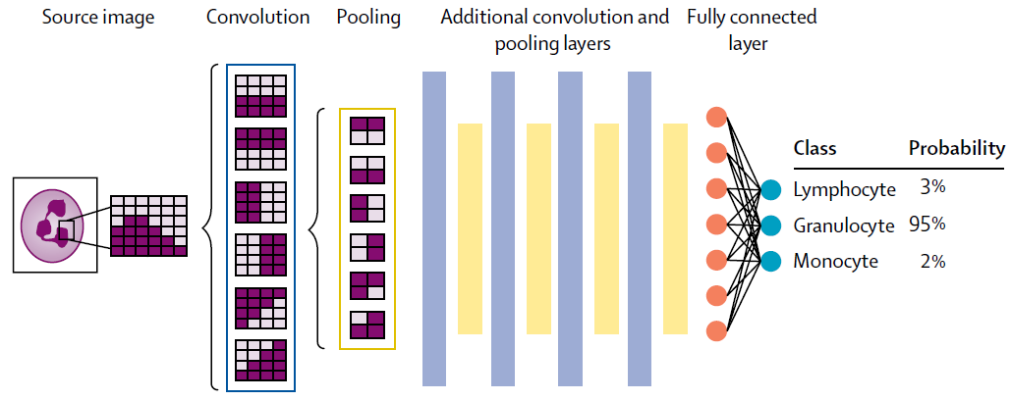
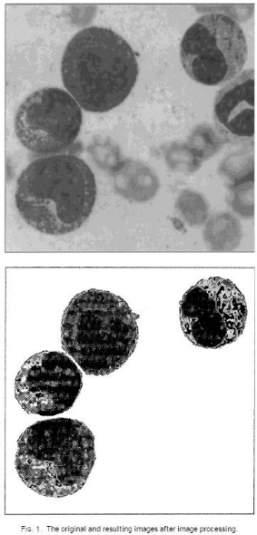
combined with CNN-based image analysis
Radakovich N et al, 2020. PMID: 32589980.
first use of neural networks
to recognize blood/ marrow cells:
blood smears of 39 pts, 8 controls to develop artificial expert system recognizing 16 types of nucleated hematopoietic cells during stages of differentiation
Beksaç et al, 1997. PMID: 9222100.
Notes:
In clinical pathology, AI-based techniques and approaches have been used in the clinical lab for quite some time. Neural networks to … were first reported in 1997, when blood smears of 39 patients and 8 control subjects were used to develop an artificial expert system that recognizes 16 different types of nucleated hematopoietic cells during the stages of differentiation. This has formed the basis for automated image analysis in combination with automated hematology analyzers, which are now routinely used in many hematology laboratories.

Slide 49
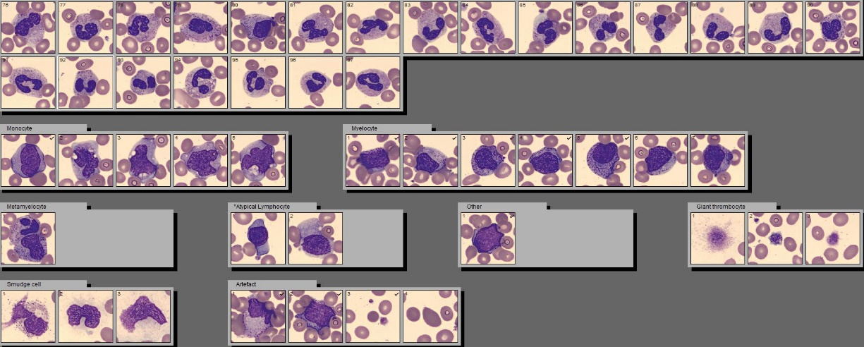
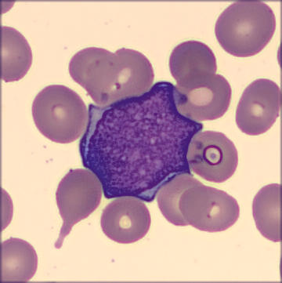
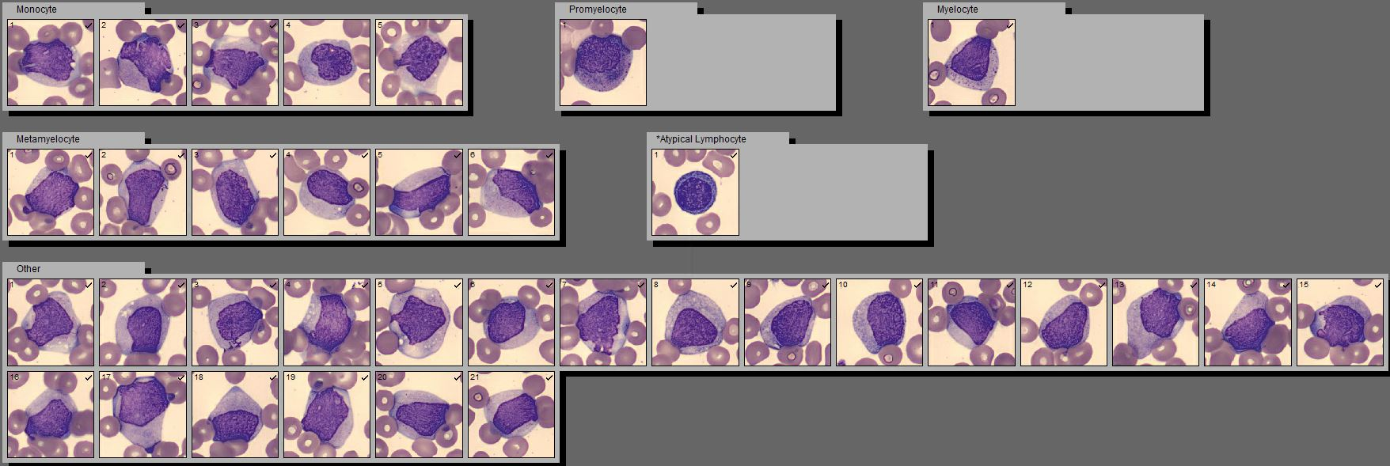
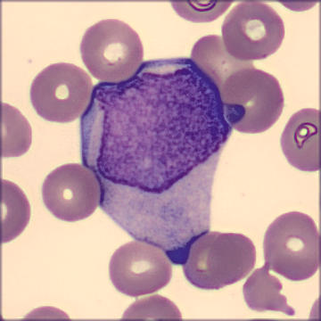
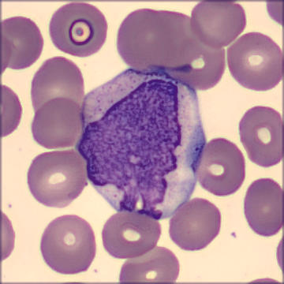
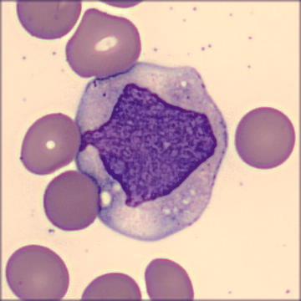
identification of lymphoma cells and blasts
Adapted from Alexander Christakis, MD, and Olga Pozdnyakova, MD PhD (BWH Pathology).
Notes:
This technology greatly facilitates the identification of circulating lymphoma cells and blasts

Slide 50
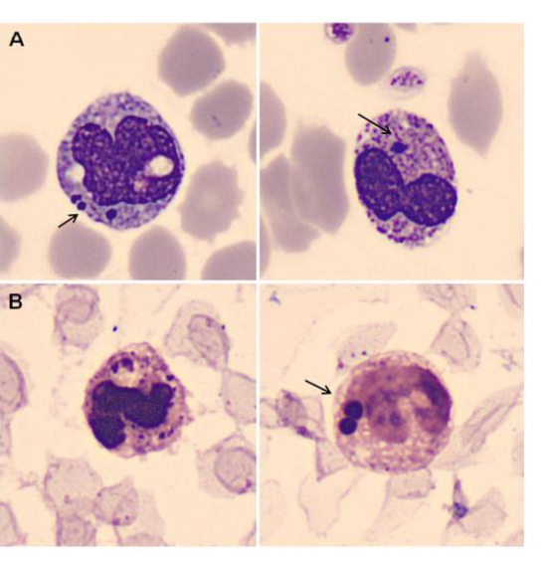
infectious workup
pneumococcal bacteremia
Serrando i Querol et al, 2015. PMID 25865945

Slide 51
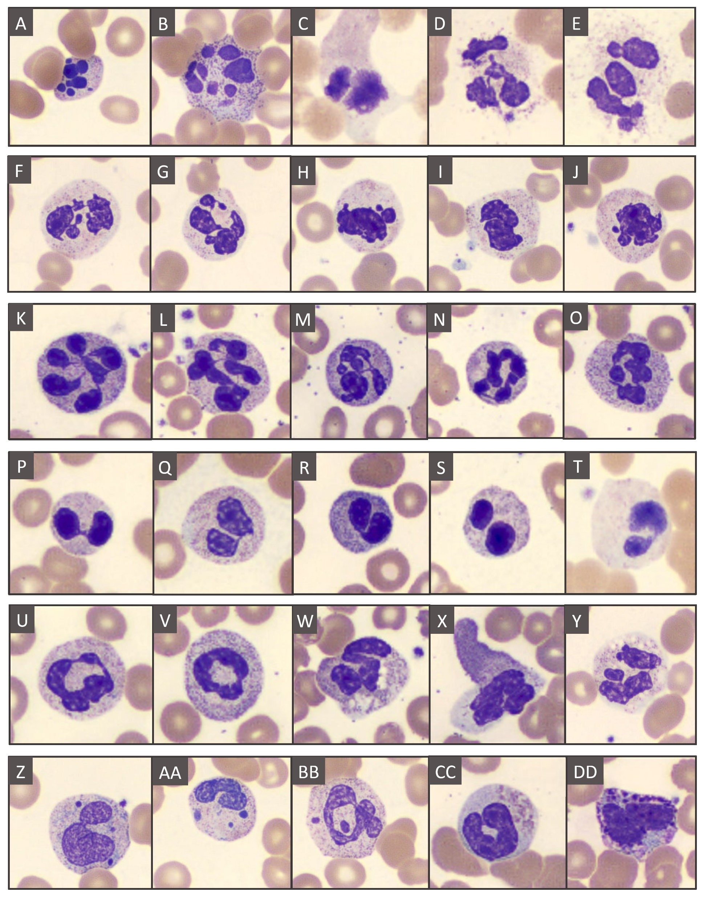
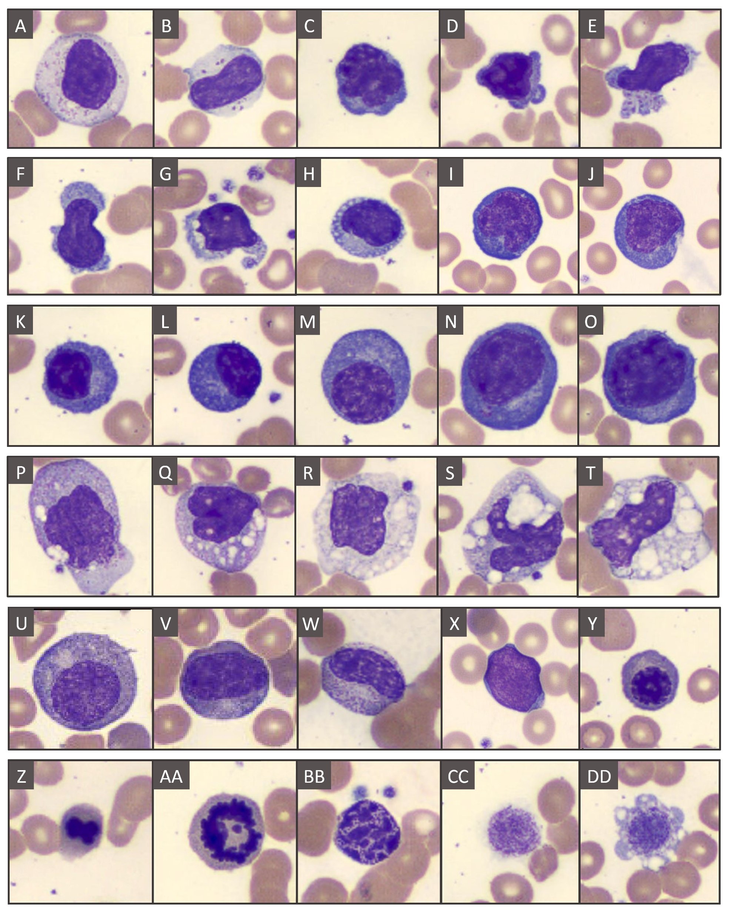
COVID-19 related peripheral blood features
Lucas F and Sadigh S, in press.
Notes:
Peripheral blood features are heterogeneous and very often include neutrophilia, lymphopenia, myeloid left shift, abnormally segmented neutrophils, atypical lymphocytes/ plasmacytoid lymphocytes, and atypical monocytes.

Slide 52
“ML on top of ML”
extended CBC parameters for construction of predictive models:
measured (but not reported) with all routine CBC on the WBC differential channel
  Cell complexity
  Size
  Level of maturity
Notes:
explored the clinical utility of the extended panel of CBC parameters, including all clinical and RUO parameters, measured on the Sysmex XN-Series haematology analyser. The study included cytopenic patients with a specific emphasis on identifying patients with cytopenia due to MDS. This study is the first to bring machine learning algorithms to the construction of predictive models and to examine the correlations between individual parameters, gene mutations and mutational pathways.

Slide 53
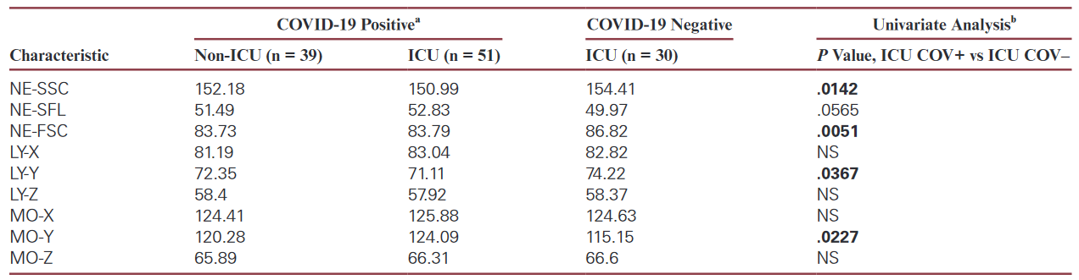
neutrophil parameters, lymphocyte and monocyte size differentiate ICU patients with and without COVID-19
Pozdnyakova O et al, 2021. PMID: 33269374.
Notes:
Pozdnyakova O, Connell NT, Battinelli EM, Connors JM, Fell G, Kim AS. Clinical Significance of CBC and WBC Morphology in the Diagnosis and Clinical Course of COVID-19 Infection. Am J Clin Pathol. 2021 Feb 11;155(3):364-375. doi: 10.1093/ajcp/aqaa231. PMID: 33269374; PMCID: PMC7799218.

Slide 54
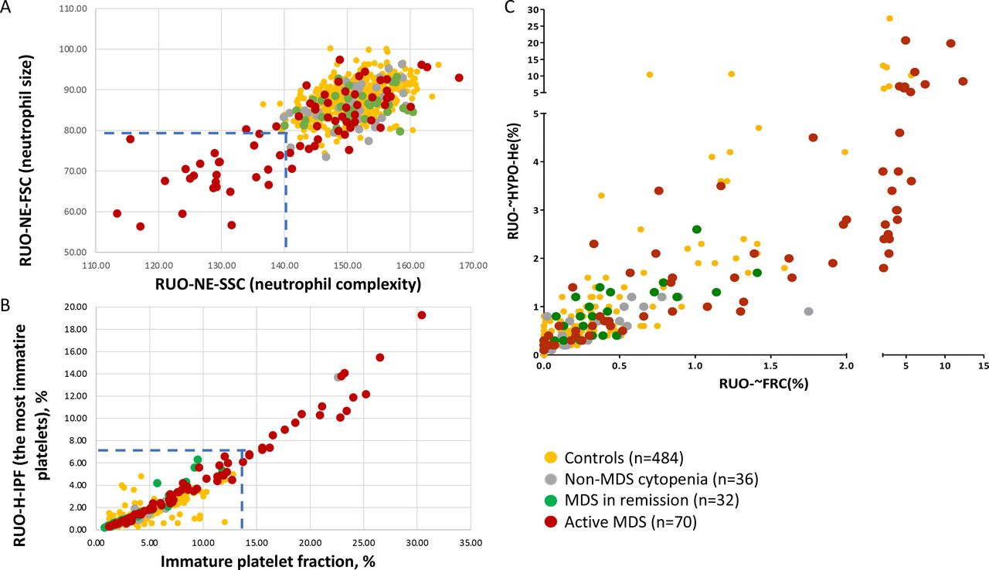
cell granularity, nuclear structure and complexity as discriminators of myelodysplastic neoplasm (MDS)
Pozdnyakova O et al, 2022. PMID: 35577566.
Notes:
(A) Distribution of research use only neutrophil parameters NE-SSC and NE-FSC in patients with active MDS, MDS in remission, unexplained cytopenia and controls. (B) Distribution of advanced platelet parameter, IPF, and research platelet parameter, H-IPF, in patients with active MDS, MDS in remission, unexplained cytopenia and controls. (C) Distribution of research use only RCC parameters FRC and HYPO-He in patients with active MDS, MDS in remission, unexplained cytopenia and controls. FRC, fragmented red cells; IPF, immature platelet fraction; MDS, myelodysplastic syndrome; NE-SSC, neutrophil side scatter; RCC, red cell count.

Slide 55
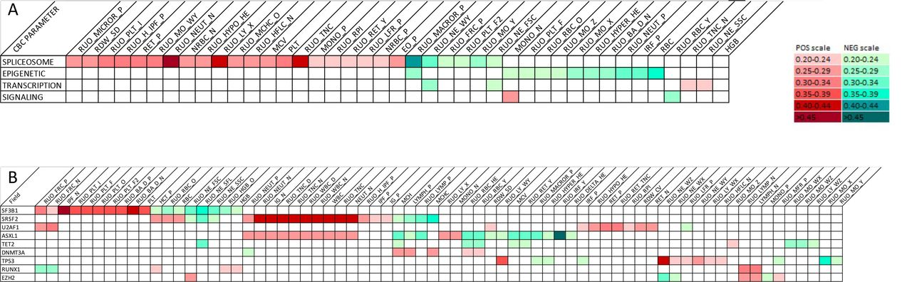
incorporation of genetic information
molecular genetic pathways
pathogenic variants (sufficiently recurrent genes only)
SF3B1: platelets
TP53: leukocyte morphology
SRSF2: leukocyte numbers
Pozdnyakova O et al, 2022. PMID: 35577566.
Notes:
Pathogenic somatic mutations were present in 70 MDS patients (68.62% of the combined active and remission MDS cohort) and included pathogenic variants in the epigenetic (n=44, 62.86%), spliceosome (n=38, 54.29%), transcription (n=17, 24.29%) and signalling (n=5, 7.14%) pathways. We performed the correlation analysis between the CBC parameters based on the mutational groups divided into the molecular pathways (spliceosome, epigenetic, transcription and signalling), as well as on the individual pathogenic variants (figure 3). Our exploratory correlation analysis showed that there was almost no overlap between the four molecular pathways with largely mutually exclusive associations between the pathways and CBC parameters (figure 3A). Spliceosome and epigenetic pathways pathogenic variants, representing typical founding drivers, showed the highest number of CBC correlations.
A very intriguing finding was a very distinct correlation between the CBC parameters and the individual genes (figure 3B). Only nine genes were sufficiently recurrent to allow their examination as individual parameters. The spliceosome pathogenic variants in SF3B1, SRSF2 and U2AF1 demonstrated near mutual exclusivity of correlations with CBC parameter features. SF3B1 demonstrated positive correlations with platelet enumeration while SRSF2 was associated with leucocyte numbers. Alternatively, there was a subset correlation overlap between the ASXL1 and TET2 gene pathogenic variants which appear largely distinct or opposite from the correlations with DNMT3A pathogenic variants. TP53 pathogenic variants also showed a unique CBC parameter correlation pattern with unique effects on leucocyte morphology.

Slide 56

cytometry machine support already used for
also not a super “new” thing
automation of manual tasks
data processing and analysis
normalization to level out differences in data sets
integration with other data types
clinical laboratory
  diagnosis:
    automated data analysis
    diagnostic support
  stewardship
  resource optimization

Slide 57

conventional computer supported FCM workflow
“if A, then B” logic
aims at displaying data in a clear manner to the human operator
might miss important information
  metadata
  additional parameters
limited automation or discovery

Slide 58
computational tools can automate every step of cytometry data analysis
tools utilize a wide range of computation methods,
ranging from rule-based algorithms to ML models
quality control
batch normalization
dimensionality reduction
cell population identification
data visualization
sample classification/ diagnosis
Tasks
Notes:
quality control
Monaco G. flowAI: Automatic and Interactive Anomaly Discerning Tools for Flow Cytometry Data. Bioinformatics (Oxf Engl) (2016) 32:2473–80. doi: 10.1093/bioinformatics/btw191
batch normalization
Schuyler RP Minimizing Batch Effects in Mass Cytometry Data. Front Immunol (2019) 10:2367. doi: 10.3389/fimmu.2019.02367’
Gassen SV, CytoNorm: A Normalization Algorithm for Cytometry Data. Cytometry A (2020) 97:268–78. doi: 10.1002/cyto.a.23904
dimensionality reduction
data visualization
Amir ED viSNE Enables Visualization of High Dimensional Single-Cell Data and Reveals Phenotypic Heterogeneity of Leukemia. Nat Biotechnol (2013) 31:545–52. doi: 10.1038/nbt.2594;
Becht E Dimensionality Reduction for Visualizing Single-Cell Data Using UMAP. Nat Biotechnol (2019) 37:38–44. doi: 10.1038/nbt.4314;
Qiu P Extracting a Cellular Hierarchy From High-Dimensional Cytometry Data With SPADE. Nat Biotechnol (2011) 29:886–91. doi: 10.1038/nbt.1991
cell population identification
Hu Z, MetaCyto: A Tool for Automated Meta-Analysis of Mass and Flow Cytometry Data. Cell Rep (2018) 24:1377–88. doi: 10.1016/j.celrep.2018.07.003
Mosmann TR, SWIFT-Scalable Clustering for Automated Identification of Rare Cell Populations in Large, High-Dimensional Flow Cytometry Datasets, Part 2: Biological Evaluation. Cytom Part J Int Soc Anal Cytol (2014) 85:422–33. doi: 10.1002/cyto.a.22445
Finak G Merging Mixture Components for Cell Population Identification in Flow Cytometry. Adv Bioinformatics (2009). doi: 10.1155/2009/247646
Aghaeepour N, Rapid Cell Population Identification in Flow Cytometry Data. Cytom Part J Int Soc Anal Cytol (2011) 79:6–13. doi: 10.1002/cyto.a.21007
Van Gassen S, FlowSOM: Using Self-Organizing Maps for Visualization and Interpretation of Cytometry Data. Cytom Part J Int Soc Anal Cytol (2015) 87:636–45. doi: 10.1002/cyto.a.22625
sample classification/ diagnosis
Bruggner RV, Automated Identification of Stratifying Signatures in Cellular Subpopulations. Proc Natl Acad Sci USA (2014) 111:E2770–7. doi: 10.1073/pnas.1408792111
Van Gassen S, Flow Density Survival Regression Using Minimal Feature Redundancy. Cytom Part J Int Soc Anal Cytol (2016) 89:22–9. doi: 10.1002/cyto.a.22734
Sensitive Detection of Rare Disease-Associated Cell Subsets via Representation Learning | Nature Communications . Available at: https://www.nature.com/articles/ncomms14825 (Accessed September 13, 2021).
Hu Z A Robust and Interpretable End-to-End Deep Learning Model for Cytometry Data. Proc Natl Acad Sci (2020) 117:21373–80. doi: 10.1073/pnas.2003026117

Slide 59
computational tools can automate every step of cytometry data analysis
quality control
batch normalization
dimensionality reduction
cell population identification
data visualization
sample classification/ diagnosis
Tasks
Notes:
quality control
Monaco G. flowAI: Automatic and Interactive Anomaly Discerning Tools for Flow Cytometry Data. Bioinformatics (Oxf Engl) (2016) 32:2473–80. doi: 10.1093/bioinformatics/btw191
batch normalization
Schuyler RP Minimizing Batch Effects in Mass Cytometry Data. Front Immunol (2019) 10:2367. doi: 10.3389/fimmu.2019.02367’
Gassen SV, CytoNorm: A Normalization Algorithm for Cytometry Data. Cytometry A (2020) 97:268–78. doi: 10.1002/cyto.a.23904
dimensionality reduction
data visualization
Amir ED viSNE Enables Visualization of High Dimensional Single-Cell Data and Reveals Phenotypic Heterogeneity of Leukemia. Nat Biotechnol (2013) 31:545–52. doi: 10.1038/nbt.2594;
Becht E Dimensionality Reduction for Visualizing Single-Cell Data Using UMAP. Nat Biotechnol (2019) 37:38–44. doi: 10.1038/nbt.4314;
Qiu P Extracting a Cellular Hierarchy From High-Dimensional Cytometry Data With SPADE. Nat Biotechnol (2011) 29:886–91. doi: 10.1038/nbt.1991
cell population identification
Hu Z, MetaCyto: A Tool for Automated Meta-Analysis of Mass and Flow Cytometry Data. Cell Rep (2018) 24:1377–88. doi: 10.1016/j.celrep.2018.07.003
Mosmann TR, SWIFT-Scalable Clustering for Automated Identification of Rare Cell Populations in Large, High-Dimensional Flow Cytometry Datasets, Part 2: Biological Evaluation. Cytom Part J Int Soc Anal Cytol (2014) 85:422–33. doi: 10.1002/cyto.a.22445
Finak G Merging Mixture Components for Cell Population Identification in Flow Cytometry. Adv Bioinformatics (2009). doi: 10.1155/2009/247646
Aghaeepour N, Rapid Cell Population Identification in Flow Cytometry Data. Cytom Part J Int Soc Anal Cytol (2011) 79:6–13. doi: 10.1002/cyto.a.21007
Van Gassen S, FlowSOM: Using Self-Organizing Maps for Visualization and Interpretation of Cytometry Data. Cytom Part J Int Soc Anal Cytol (2015) 87:636–45. doi: 10.1002/cyto.a.22625
sample classification/ diagnosis
Bruggner RV, Automated Identification of Stratifying Signatures in Cellular Subpopulations. Proc Natl Acad Sci USA (2014) 111:E2770–7. doi: 10.1073/pnas.1408792111
Van Gassen S, Flow Density Survival Regression Using Minimal Feature Redundancy. Cytom Part J Int Soc Anal Cytol (2016) 89:22–9. doi: 10.1002/cyto.a.22734
Sensitive Detection of Rare Disease-Associated Cell Subsets via Representation Learning | Nature Communications . Available at: https://www.nature.com/articles/ncomms14825 (Accessed September 13, 2021).
Hu Z A Robust and Interpretable End-to-End Deep Learning Model for Cytometry Data. Proc Natl Acad Sci (2020) 117:21373–80. doi: 10.1073/pnas.2003026117

Slide 60
ML methods for dimensionality reduction
does low dimensional visualization accurately represent information in the original data?
  information loss almost inevitable when high-dimensional data is compressed into two or three dimensions for visualization
toolbox for dimensionality reduction is huge, and expanding
different dimensionality reduction tools are designed to preserve various aspects of information in data:
  global data structure:
    Principle Component Analysis (PCA), Multidimensional scaling (MDS)
  local data structure:
    embedding methods (tSNE, UMAP)
    particularly suitable for visualizing cytometry data due to their ability to separate major cell subsets when projecting high dimensional data into two-dimensions

Slide 61
computational tools can automate every step of cytometry data analysis
quality control
batch normalization
dimensionality reduction
cell population identification
data visualization
sample classification/ diagnosis
Tasks
Notes:
quality control
Monaco G. flowAI: Automatic and Interactive Anomaly Discerning Tools for Flow Cytometry Data. Bioinformatics (Oxf Engl) (2016) 32:2473–80. doi: 10.1093/bioinformatics/btw191
batch normalization
Schuyler RP Minimizing Batch Effects in Mass Cytometry Data. Front Immunol (2019) 10:2367. doi: 10.3389/fimmu.2019.02367’
Gassen SV, CytoNorm: A Normalization Algorithm for Cytometry Data. Cytometry A (2020) 97:268–78. doi: 10.1002/cyto.a.23904
dimensionality reduction
data visualization
Amir ED viSNE Enables Visualization of High Dimensional Single-Cell Data and Reveals Phenotypic Heterogeneity of Leukemia. Nat Biotechnol (2013) 31:545–52. doi: 10.1038/nbt.2594;
Becht E Dimensionality Reduction for Visualizing Single-Cell Data Using UMAP. Nat Biotechnol (2019) 37:38–44. doi: 10.1038/nbt.4314;
Qiu P Extracting a Cellular Hierarchy From High-Dimensional Cytometry Data With SPADE. Nat Biotechnol (2011) 29:886–91. doi: 10.1038/nbt.1991
cell population identification
Hu Z, MetaCyto: A Tool for Automated Meta-Analysis of Mass and Flow Cytometry Data. Cell Rep (2018) 24:1377–88. doi: 10.1016/j.celrep.2018.07.003
Mosmann TR, SWIFT-Scalable Clustering for Automated Identification of Rare Cell Populations in Large, High-Dimensional Flow Cytometry Datasets, Part 2: Biological Evaluation. Cytom Part J Int Soc Anal Cytol (2014) 85:422–33. doi: 10.1002/cyto.a.22445
Finak G Merging Mixture Components for Cell Population Identification in Flow Cytometry. Adv Bioinformatics (2009). doi: 10.1155/2009/247646
Aghaeepour N, Rapid Cell Population Identification in Flow Cytometry Data. Cytom Part J Int Soc Anal Cytol (2011) 79:6–13. doi: 10.1002/cyto.a.21007
Van Gassen S, FlowSOM: Using Self-Organizing Maps for Visualization and Interpretation of Cytometry Data. Cytom Part J Int Soc Anal Cytol (2015) 87:636–45. doi: 10.1002/cyto.a.22625
sample classification/ diagnosis
Bruggner RV, Automated Identification of Stratifying Signatures in Cellular Subpopulations. Proc Natl Acad Sci USA (2014) 111:E2770–7. doi: 10.1073/pnas.1408792111
Van Gassen S, Flow Density Survival Regression Using Minimal Feature Redundancy. Cytom Part J Int Soc Anal Cytol (2016) 89:22–9. doi: 10.1002/cyto.a.22734
Sensitive Detection of Rare Disease-Associated Cell Subsets via Representation Learning | Nature Communications . Available at: https://www.nature.com/articles/ncomms14825 (Accessed September 13, 2021).
Hu Z A Robust and Interpretable End-to-End Deep Learning Model for Cytometry Data. Proc Natl Acad Sci (2020) 117:21373–80. doi: 10.1073/pnas.2003026117

Slide 62
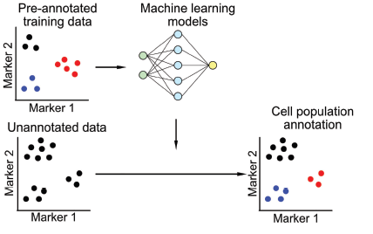
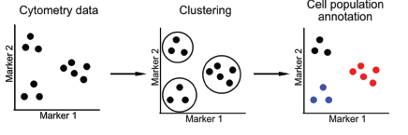
ML methods for cell population identification are used
understand cellular composition of tissues and disease-related changes
annotate established cell populations
discover novel cell subsets
SUPERVISED
UN-SUPERVISED
Hu Z et al. 2022, PMID: 35046945
Notes:
understand the cellular composition of tissues and disease-related changes.
Many machine-learning methods have been developed to annotate established cell populations, as well as to discover novel cell subsets from the high-dimensional cytometry data

Slide 63
supervised ML methods for cell population identification
learn a classifier from training dataset
learned classifier is applied to annotate new dataset
  linear discriminant analysis (LDA) classifier
  neural network models (DGCyTOF, DeepCyTOF)
Advantages:
  reduced rate of error in identification of cell types
  batch correction
Challenges:
  quality of the models depends on human-provided labels
  can potentially mirror human bias

Slide 64
unsupervised ML methods for cell population identification
identify groups of cells that are similar to each other based on data itself without external information
many generic unsupervised methods can be applied directly to cytometry data
  K-means, clustering and hierarchical clustering, probability-based methods (gaussian mixture models), density-based methods (HDBSCAN)
computational pipelines optimized for cytometry data:
  FLOCK, flowSOM, flowMeans, flowMerge, SWIFT, PhenoGraph, …
Advantages:
  unbiased
  automation/ minimal human input
Challenges:
  cell populations computed without any prior knowledge, not directly interpretable
  ignore rare cell populations -> conduct multiple rounds of clustering to identify small cell subsets within major cell populations
  datasets often not directly comparable -> batch correction methods (cytoNorm, MetaCyto)

Slide 65
computational tools can automate every step of cytometry data analysis
quality control
batch normalization
dimensionality reduction
cell population identification
data visualization
sample classification/ diagnosis
Tasks
Notes:
quality control
Monaco G. flowAI: Automatic and Interactive Anomaly Discerning Tools for Flow Cytometry Data. Bioinformatics (Oxf Engl) (2016) 32:2473–80. doi: 10.1093/bioinformatics/btw191
batch normalization
Schuyler RP Minimizing Batch Effects in Mass Cytometry Data. Front Immunol (2019) 10:2367. doi: 10.3389/fimmu.2019.02367’
Gassen SV, CytoNorm: A Normalization Algorithm for Cytometry Data. Cytometry A (2020) 97:268–78. doi: 10.1002/cyto.a.23904
dimensionality reduction
data visualization
Amir ED viSNE Enables Visualization of High Dimensional Single-Cell Data and Reveals Phenotypic Heterogeneity of Leukemia. Nat Biotechnol (2013) 31:545–52. doi: 10.1038/nbt.2594;
Becht E Dimensionality Reduction for Visualizing Single-Cell Data Using UMAP. Nat Biotechnol (2019) 37:38–44. doi: 10.1038/nbt.4314;
Qiu P Extracting a Cellular Hierarchy From High-Dimensional Cytometry Data With SPADE. Nat Biotechnol (2011) 29:886–91. doi: 10.1038/nbt.1991
cell population identification
Hu Z, MetaCyto: A Tool for Automated Meta-Analysis of Mass and Flow Cytometry Data. Cell Rep (2018) 24:1377–88. doi: 10.1016/j.celrep.2018.07.003
Mosmann TR, SWIFT-Scalable Clustering for Automated Identification of Rare Cell Populations in Large, High-Dimensional Flow Cytometry Datasets, Part 2: Biological Evaluation. Cytom Part J Int Soc Anal Cytol (2014) 85:422–33. doi: 10.1002/cyto.a.22445
Finak G Merging Mixture Components for Cell Population Identification in Flow Cytometry. Adv Bioinformatics (2009). doi: 10.1155/2009/247646
Aghaeepour N, Rapid Cell Population Identification in Flow Cytometry Data. Cytom Part J Int Soc Anal Cytol (2011) 79:6–13. doi: 10.1002/cyto.a.21007
Van Gassen S, FlowSOM: Using Self-Organizing Maps for Visualization and Interpretation of Cytometry Data. Cytom Part J Int Soc Anal Cytol (2015) 87:636–45. doi: 10.1002/cyto.a.22625
sample classification/ diagnosis
Bruggner RV, Automated Identification of Stratifying Signatures in Cellular Subpopulations. Proc Natl Acad Sci USA (2014) 111:E2770–7. doi: 10.1073/pnas.1408792111
Van Gassen S, Flow Density Survival Regression Using Minimal Feature Redundancy. Cytom Part J Int Soc Anal Cytol (2016) 89:22–9. doi: 10.1002/cyto.a.22734
Sensitive Detection of Rare Disease-Associated Cell Subsets via Representation Learning | Nature Communications . Available at: https://www.nature.com/articles/ncomms14825 (Accessed September 13, 2021).
Hu Z A Robust and Interpretable End-to-End Deep Learning Model for Cytometry Data. Proc Natl Acad Sci (2020) 117:21373–80. doi: 10.1073/pnas.2003026117

Slide 66
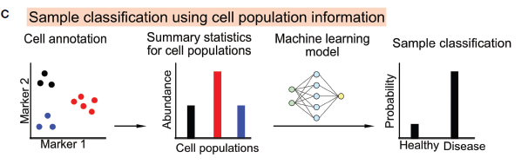
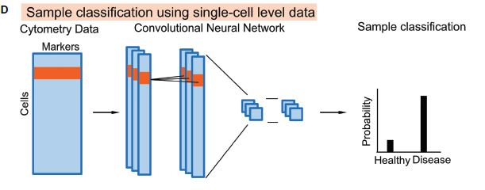
ML methods for sample classification support diagnosis and prediction of clinical or biological outcomes (response to vaccination, specific treatment,…)
Hu Z et al. 2022, PMID: 35046945

Slide 67
sample classification using cell population information
frequency, median or mean marker intensities as features
  highly intuitive and interpretable
  straightforward to implement
generic ML models: logistic regression, random forest, gradient boosted trees
  can be directly applied to cell subset information
  might miss rare populations: identification step is disconnected from predictive modeling step
  might lose information (correlation between cell markers, expression within cell subsets): original cytometry data are reduced to summary statistics of cell subsets
  may fail to detect cellular changes that do not lead to distinct cell populations (continuous up-regulation of immune checkpoints)
  requires all samples to be clustered in the same way, making it sensitive to batch effects and the choice of clustering methods
Notes:
summary statistics of cell populations (frequency, median or mean marker intensities) as features to classify samples
predictive modeling using cell subset information is highly intuitive and interpretable
straightforward to implement
Generic ML models: logistic regression, random forest, gradient boosted trees
can be directly applied to cell subset information
cell-subset identification step is disconnected from the predictive modeling step, might not be optimized for identifying cell populations that are most associated with outcome of interest (e.g., rare cell populations important for outcome might be missed)
original cytometry data are reduced to summary statistics of cell subsets, potentially leading to loss of information (correlation between cell markers, distribution of marker expression within each cell subset)
requires all samples to be clustered in the same way, making it sensitive to batch effects and the choice of clustering methods
may fail to detect cellular changes that do not lead to distinct cell populations (continuous up-regulation of immune checkpoints)
optimized for cytometry data:
CITRUS:
applies an unsupervised hierarchical clustering method to identify small cell subsets
then uses the Least Absolute Shrinkage and Selection Operator (LASSO) model to predict outcomes of interest from the cell subset information. The L1-regularization of the LASSO model allows the identification of the most informative cell subset information for prediction.
FloReMi
pipeline developed from the FlowCAP IV challenge to predict time until progression to AIDS for HIV patients
pipeline contains multiple steps for predictive modeling including data preprocessing, cell subset identification, feature selection, and predictive modeling.

Slide 68
sample classification using single cell data
ML model directly applied to single-cell level
Output: clinical or biological outcome
Input: protein marker profiles of cells within a sample
  single vector of features:
    logistic regression
    random forest
    gradient boosted trees
Notes:
Machine learning models directly applied to the single-cell level
Output: clinical or biological outcome
Input: protein marker profiles of cells within a sample
single vector of features: logistic regression, random forest, gradient boosted trees.
cytometry data is a collection of randomly ordered single-cell profiles, it is challenging to build predictive models using supervised learning methods.
Better: neural network models
highly flexible
can be directly applied to raw cytometry data and predict outcomes in an end-to-end fashion
possible to train supervised models using heterogeneous datasets, thus improving the generalizability
CellCNN:
CNN structure with set of filters to extract information from single cells
cell-level information is summarized into sample-level information by taking the mean or maximum across all cells
sample level information is associated with outcomes using dense neural network layers
DeepCNN:
larger number of internal layers to better capture complex interactions between cell marks in cytometry data
uses single-cell level cytometry data and circumvents cell-type identification step to avoid information loss in the cell gating step
Challenges
Computationally expensive
less intuitive and do not directly identification of cell types associated with clinical outcomes
Flow-up analysis needs to be conducted to interpret the model and identify cell subsets as biomarkers

Slide 69
as cytometry data is a collection of randomly ordered single-cell profiles
better: neural network models
  highly flexible
  predict outcomes in an end-to-end fashion
  can train supervised models using heterogeneous datasets (improved generalizability)
Challenges:
  computationally expensive
  less intuitive, do not directly identify cell types associated with outcomes
  flow-up analysis needed to interpret model and identify cell subsets as biomarkers
Notes:
Machine learning models directly applied to the single-cell level
Output: clinical or biological outcome
Input: protein marker profiles of cells within a sample
single vector of features: logistic regression, random forest, gradient boosted trees.
cytometry data is a collection of randomly ordered single-cell profiles, it is challenging to build predictive models using supervised learning methods.
Better: neural network models
highly flexible
can be directly applied to raw cytometry data and predict outcomes in an end-to-end fashion
possible to train supervised models using heterogeneous datasets, thus improving the generalizability
CellCNN:
CNN structure with set of filters to extract information from single cells
cell-level information is summarized into sample-level information by taking the mean or maximum across all cells
sample level information is associated with outcomes using dense neural network layers
DeepCNN:
larger number of internal layers to better capture complex interactions between cell marks in cytometry data
uses single-cell level cytometry data and circumvents cell-type identification step to avoid information loss in the cell gating step
Challenges
Computationally expensive
less intuitive and do not directly identification of cell types associated with clinical outcomes
Flow-up analysis needs to be conducted to interpret the model and identify cell subsets as biomarkers

Slide 70

cytometry machine support already used for
automation of manual tasks
data processing and analysis
normalization to level out differences in data sets
integration with other data types
clinical laboratory
  diagnosis:
    automated data analysis
    diagnostic support
  stewardship
  resource optimization
many new things

Slide 71
several clustering and ML techniques have been applied
joint cell clustering and identification of various hematologic malignancies, including AML and lymphomas
to accelerate, harmonize, and standardize minimal residual disease (MRD) measurements
in combination with genetic algorithms
without preceding image transformation
Notes:
37. Dundar M, Akova F, Yerebakan HZ, Rajwa B. A non-parametric
Bayesian model for joint cell clustering and cluster matching:
identification of anomalous sample phenotypes with random
effects. BMC Bioinforma. 2014;15:314.
38. Manninen T, Huttunen H, Ruusuvuori P, Nykter M. Leukemia
prediction using sparse logistic regression. PLoS ONE. 2013;8:
e72932
39. Lakoumentas J, Drakos J, Karakantza M, Nikiforidis GC, Sakellaropoulos
GC. Bayesian clustering of flow cytometry data for the
diagnosis of B-chronic lymphocytic leukemia. J Biomed Inform.
2009;42:251–61.
40. Zare H, Bashashati A, Kridel R, Aghaeepour N, Haffari G,
Connors JM, et al. Automated analysis of multidimensional flow
cytometry data improves diagnostic accuracy between mantle cell
lymphoma and small lymphocytic lymphoma. Am J Clin Pathol.
2012;137:75–85.
41. Pouyan MB, Jindal V, Birjandtalab J, Nourani M. Single and
multi-subject clustering of flow cytometry data for cell-type
identification and anomaly detection. BMC Med Genomics.
2016;9:41.
42. Angeletti C. A method for the interpretation of flow cytometry
data using genetic algorithms. J Pathol Inf. 2018;9:16.
43. Bigorra L, Larriba I, Gutiérrez-Gallego R. Machine learning
algorithms for accurate differential diagnosis of lymphocytosis
based on cell population data. Br J Haematol. 2019;184:1035–7.
44. Biehl M, Bunte K, Schneider P. Analysis of flow cytometry data
by matrix relevance learning vector quantization. PLoS ONE.
2013;8:e59401
45. Müller M-L, Nadarajah N, Jhalani K, Heo I, Wetton W, Haferlach
C, et al. Employment of machine learning models yields highly
accurate hematological disease prediction from raw flow cytometry
matrix data without the need for visualization or human
intervention. Blood. 2020;136:11
46. Ko B-S, Wang Y-F, Li J-L, Li C-C, Weng P-F, Hsu S-C, et al.
Clinically validated machine learning algorithm for detecting
residual diseases with multicolor flow cytometry analysis in acute
myeloid leukemia and myelodysplastic syndrome. EBioMedicine.
2018;37:91–100.
47. Licandro R, Reiter M, Diem M, Dworzak M, Schumich A, Kampel
M. Application of machine learning for automatic MRD assessment in
paediatric acute myeloid leukaemia. In: Proceedings of the 7th International
Conference on Pattern Recognition Applications and Methods.
SCITEPRESS - Science and Technology Publications. 2018.

Slide 72
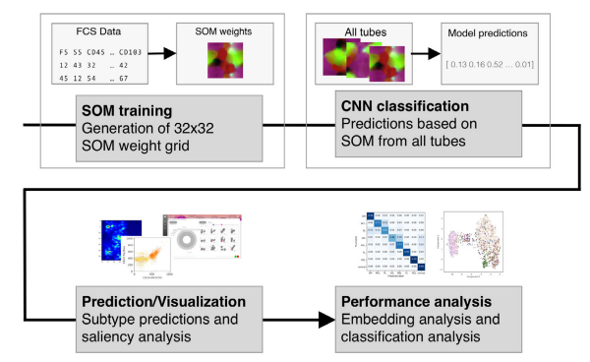
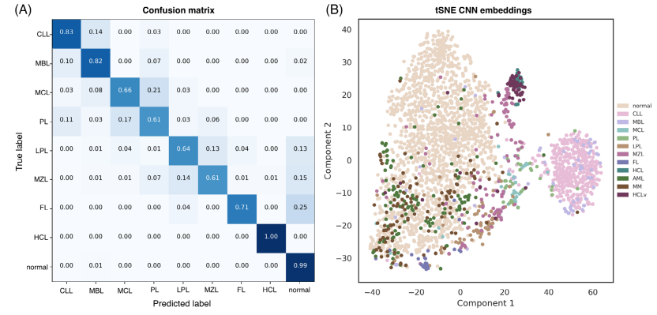
self-organizing maps of light emission profiles as input for deep CNN to classify mature B-neoplasm subtypes
performance: higher error rates between clinically similar subtypes
classification pipeline
Zhao M et al. 2020, PMID: 32519455.
Notes:
Overview of the classification pipeline. Individual 2D SOMs are generated for each tube of a single case. The weights of the SOM nodes are used as input for a CNN that predicts lymphoma subtypes. The trustworthiness of a suggested diagnosis is computed and the cells contributing most to this decision are visualized in density plots and saliency maps. The overall performance of the classification process is benchmarked with a confusion matrix and the similarity of cases is visualized by a t-SNE plot.
Performance of the classification process. The CNN was trained on an nine-class classification task for B-NHL subtypes (CLL, MBL, MCL, PL, LPL, MZL, FL, HCL), and normal healthy samples. The prediction accuracy was computed for a time-based holdout of 2,378 cases collected after April 01, 2018, achieving a weighed F1 score of 0.92 and average F1 score of 0.73 on the nine-class problem. (A) The confusion matrix also indicates the performance of the CNN for each subtype with higher error rates between clinically similar subtypes. (B) This similarity can also be observed for single cases in t-SNE embeddings of the intermediary output from the concatenation layer, showing clusters of MCL/PL and MZL/LPL. Additional cases with diagnoses that the network did not learn, such as AML, MM, and HCLv are reconsidered in the discussion of the main text

Slide 73
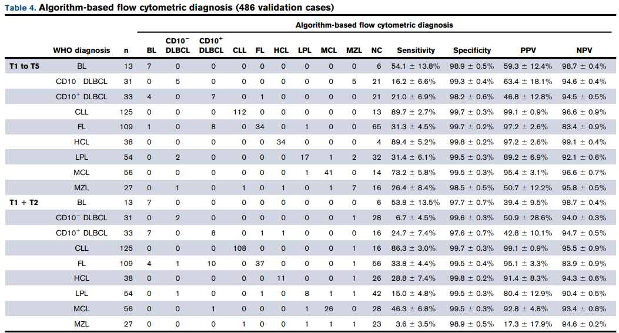
Euroflow: algorithm-guided classification of mature B-cell neoplasms based on canonical correlation analysis (CCA)
High PPV:
CLL, HCL, MCL
Ambiguity:
Burkitt/ CD10+ DLBCL
MZL/ LPL/ CD10- DLBCL
Böttcher S et al. 2022, PMID: 34814179.
Notes:
Although the NPV, except for FL cases tested in lymph node samples, always exceeded 90%, we found particularly high PPVs (.95%) for CLL, HCL, FL, and MCL.
Negative predictive values exceeding 92.1% were observed for all disease categories except for follicular lymphoma. Particularly high positive predictive values were returned in chronic lymphocytic leukemia (99.1%), hairy cell leukemia (97.2%), follicular lymphoma (97.2%), and mantle cell lymphoma (95.4%). Burkitt and CD10+ diffuse large B-cell lymphomas were difficult to distinguish by the algorithm. A similar ambiguity was observed between marginal zone, lymphoplasmacytic, and CD10- diffuse large B-cell lymphomas

Slide 74
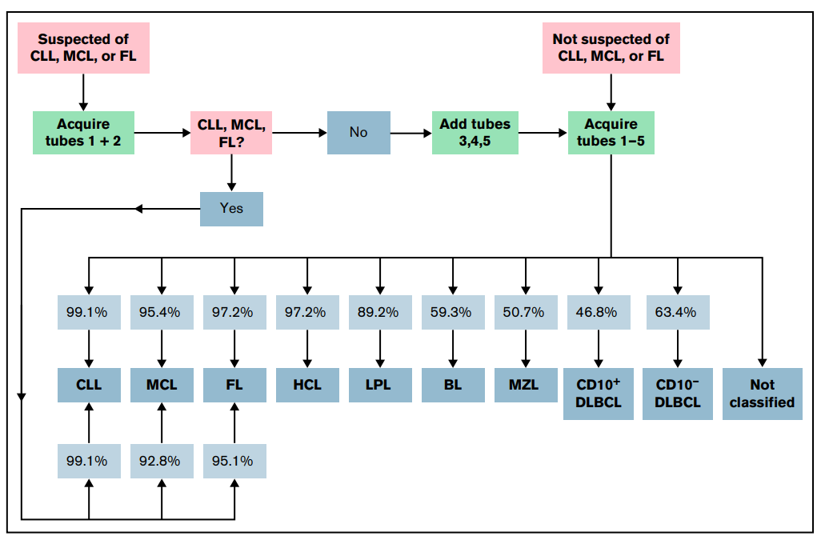
Böttcher S et al. 2022, PMID: 34814179.

Slide 75


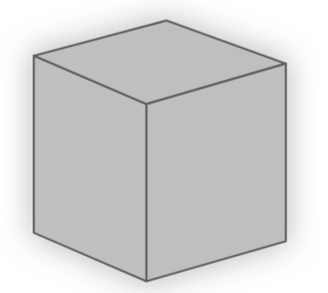
the architecture of many ML models is designed with performance
(not interpretability) in mind perception of ML models as
"black boxes"

Slide 76
cytometry lends itself to computation
and has some really big challenges
“the hard stuff”

Slide 77
Quality and Standards efforts
ground truth?
ambiguous language “consistent with” “highly suggestive” “suspicious for”
lack of standards
metadata of datasets is not standardized
use of non-standardized names for protein markers, sample types, experimental conditions, and disease states
cytometry data from different studies are highly heterogeneous
differences in antibody panels, fluorophore combinations, instruments, sample processing protocols
sensitivity?
how good is good enough?
novel ML techniques to make models robust to heterogeneities
lack of repositories
and requirements for data deposition
CNN black box might use features to label abnormal/ discriminative that are irrelevant to human decision making
methods of knowledge transfer
limited public data sharing
incentives for public data sharing
literacy in statistical and research methods
increase community enthusiasm
Notes:
For clinicians to understand machine learning’s intricacies at the level of a computer scientist is unrealistic and unnecessary. However, literacy in statistical and research methods

Slide 78


some practical pearls (as heard at ICCS 2022)
"for large sets and images, use neural networks"
"good annotations and clean data with minimal variation sets you up for success"
"choice of algorithm matters far less than quality and size of your training set"
"are you down for 90% to 93% improvement in exchange for many days of labor?"
"what you think matters, matters for Netflix, google, and facebook, but not you"
"retrospective is not prospective"
"what is clinical ground truth?"
"what is the use case?"
Dr. David Ng, ARUP
Dr. Wolfgang Kern, MLL

Slide 79
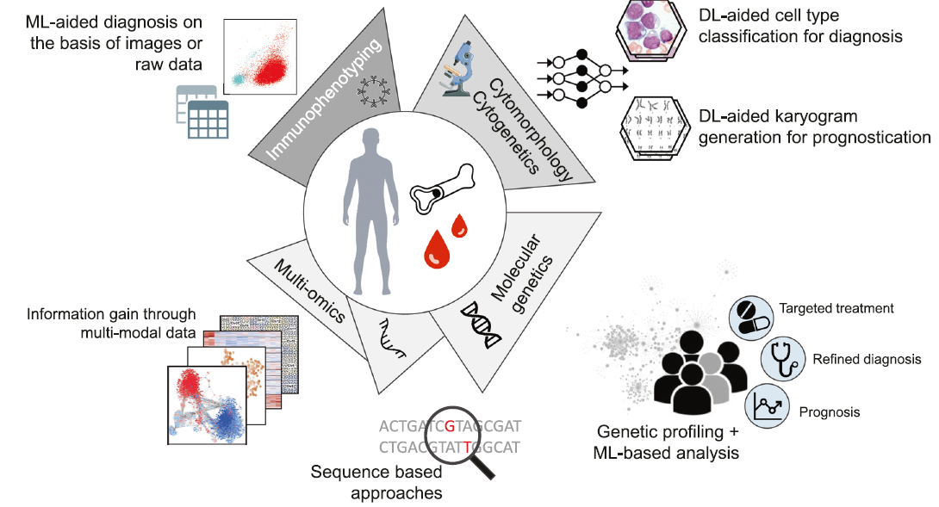
Walter W et al, 2021. PMID 34103684.

Slide 80



acknowledgements
BWH Pathology
Annette Kim
Faisal Mahmood
Mentoring Programs
Funding

Slide 81

Questions dwilliamson@bwh.harvard.edu flucas@bwh.harvard.edu https://faisal.ai/

Slide 83

explainable artificial intelligence: important cell populations in classic Hodgkin lymphoma
1,222 samples (9 color cHL-specific flow cytometry panel)
constructed 2D histograms:
  calculated for each possible pairwise combination of parameters
    9 fluorescence, 4 scattering parameters, with 78 possible pairwise combinations
  agnostic to important cell populations
CNN classifier to correspond to each constructed 2D histogram for classification and visualization of impactful cell populations
  EnsembleCNN approach analogous to manual diagnostic approaches
  intuitive to understand.
projection of 2D Shapley additive explanation (SHAP) values back to individual cells
  highlights individual feature importance in a model-agnostic manner
  generates explanations why a ML model predicts a particular outcome
Simonson PD et al. 2021, PMID: 34175918.
Notes:
algorithm achieved 67.7% recall (sensitivity), 82.4% precision, and 0.92 area under the receiver operating characteristic
The architecture of many machine learning models is designed with performance rather than interpretability in mind, contributing to the perception of machine learning models as black boxes.
Methods such as local interpretable model-agnostic explanations and shapely additive explanations (SHAP) help to address this concern by highlighting individual feature importance in a model-agnostic manner, and can be used to generate patient-level explanations of why a machine learning model predicts a particular outcome.75,76 The original developers of SHAP have published work detailing its use in surgical settings

Slide 84
explainable artificial intelligence: important cell populations in classic Hodgkin lymphoma
1,222 samples (9 color cHL-specific flow cytometry panel)
constructed 2D histograms:
  calculated for each possible pairwise combination of parameters
    9 fluorescence, 4 scattering parameters, with 78 possible pairwise combinations
  agnostic to important cell populations
CNN classifier to correspond to each constructed 2D histogram for classification and visualization of impactful cell populations
  EnsembleCNN approach analogous to manual diagnostic approaches
  intuitive to understand
projection of 2D Shapley additive explanation (SHAP) values back to individual cells
  highlights individual feature importance in a model-agnostic manner
  generates explanations why a ML model predicts a particular outcome
Simonson PD et al. 2021, PMID: 34175918.
Notes:
algorithm achieved 67.7% recall (sensitivity), 82.4% precision, and 0.92 area under the receiver operating characteristic
The architecture of many machine learning models is designed with performance rather than interpretability in mind, contributing to the perception of machine learning models as black boxes.
Methods such as local interpretable model-agnostic explanations and shapely additive explanations (SHAP) help to address this concern by highlighting individual feature importance in a model-agnostic manner, and can be used to generate patient-level explanations of why a machine learning model predicts a particular outcome.75,76 The original developers of SHAP have published work detailing its use in surgical settings

Slide 85
explainable artificial intelligence: important cell populations in classic Hodgkin lymphoma
1,222 samples (9 color cHL-specific flow cytometry panel)
constructed 2D histograms:
  calculated for each possible pairwise combination of parameters
    9 fluorescence, 4 scattering parameters, with 78 possible pairwise combinations
  agnostic to important cell populations
CNN classifier to correspond to each constructed 2D histogram for classification and visualization of impactful cell populations
  EnsembleCNN approach analogous to manual diagnostic approaches
  intuitive to understand
projection of 2D Shapley additive explanation (SHAP) values back to individual cells
  highlight individual feature importance in a model-agnostic manner
  generates explanations why a ML model predicts a particular outcome
Simonson PD et al. 2021, PMID: 34175918.
Notes:
algorithm achieved 67.7% recall (sensitivity), 82.4% precision, and 0.92 area under the receiver operating characteristic
The architecture of many machine learning models is designed with performance rather than interpretability in mind, contributing to the perception of machine learning models as black boxes.
Methods such as local interpretable model-agnostic explanations and shapely additive explanations (SHAP) help to address this concern by highlighting individual feature importance in a model-agnostic manner, and can be used to generate patient-level explanations of why a machine learning model predicts a particular outcome.75,76 The original developers of SHAP have published work detailing its use in surgical settings

Slide 86

SHAP values for top 20 most impactful features
enables model explainability while highlighting important cell populations in individual flow cytometry specimens
Simonson PD et al. 2021, PMID: 34175918.
Notes:
Shapley additive explanation (SHAP) values for top 20 most impactful features for the integrating random forest
classifier. Each feature is a prediction probability score (range = [0, 1]), produced by the convolutional neural networks (CNNs)
for the corresponding two-dimensional (2D) histograms using test set data. Dots correspond to individual flow cytometry
cases in the test data set. Of interest is the strong positive impact on final prediction that the FSC-A vs CD30-PE prediction
score has when it has a high value but little negative impact when it has a low value for the given cases. See

Slide 87
Learning Objectives
Audience engagement – poll everywhere or similar
High level description of AI
  Principles and concepts
processes and infrastructure required for AI
Relevance of ML in healthcare/ diagnostics/ pathology
  Automate manual/ tedious tasks
  Provide clinical decision support
  Improve quality, safety and efficiency of healthcare
  Improve work lives of providers
  Improve health of patients
  Provide high quality care to underserved populations
  Accelerate medical knowledge discovery to enhance disease detection and treatment
AI in cytometry: Why cytometry data lends itself to computational tools and current applications of AI within cytometry workflow
Translation to clinical workflows
AI in cytometry in 10 years – “debate”, pathology researcher and pathology diagnostician/ translational pathologist point of view, again audience engagement

Slide 88
Overview
Partnership with computational experts
Precisely stated problem
Clean data
Ethics and bias
Choice of algorithm
Metric for success or failure
Hardware and software
Interpretability
Common sources of errors

