Slide 1
Kelly Lundsten
Business Segment Manager, Adv Cytometry
PD Flow
A New Age of Spectral Cytometry: Expanding and Upgrading Fluorophore Selection

Slide 2
Seminar Overview
Spectral Cytometry
Fluorophore Development
Panel Design
26 color B-cell Lymphopoiesis on normal human bone marrow and PBMC
Expression Databases

Slide 3
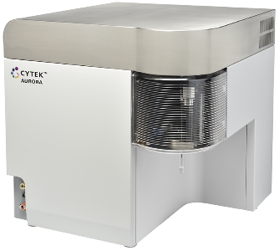

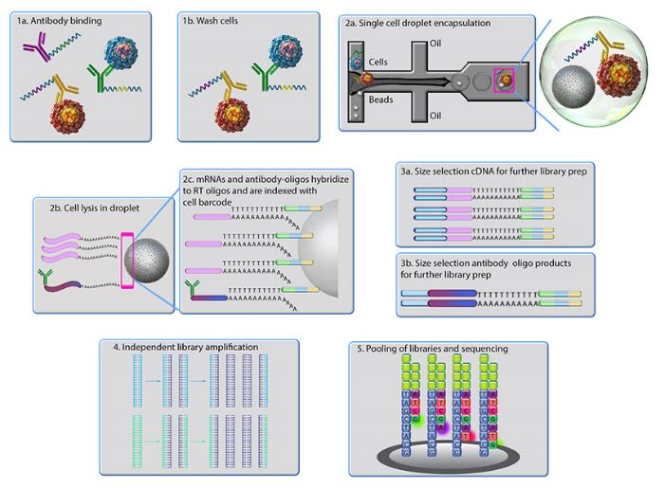
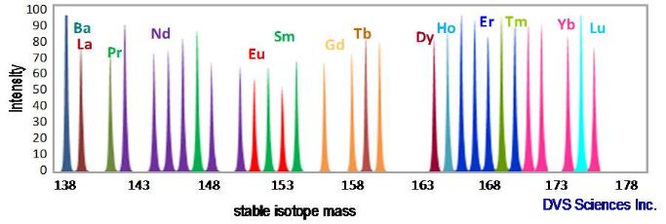
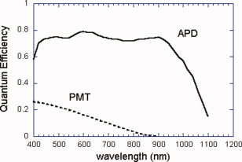
Multiplexing platforms
CyTOF
Single Cell Sequencing
(Total-Seq™)
Spectral Cytometry

Slide 4
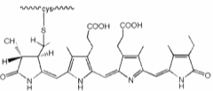
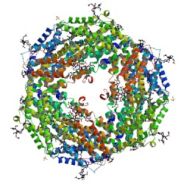
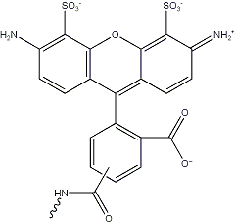
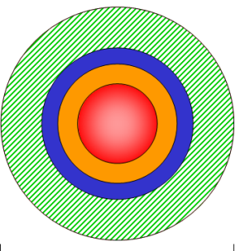
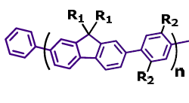
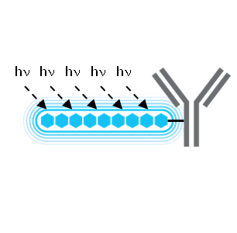
Types of fluorescent molecules
Cy5
Alexa
Alexa
488
488
PE
Cy5
Alexa
488
Cy5
Synthetic, organic dyes:
Alexa Fluors, Cyanine dyes, Horizon, Dylight, etc
Proteins:
PE, APC, GFP, mCherry
Semiconductor nanocrystals: Qdots
Organic polymers:
Brilliant VioletTM
Notes:
There are 4 basic family of fluorescent molecules, each with their own strengths and weaknesses which we must balance to make a good multicolor assay. Organic dyes are very stable to different solvents like PFA and MeOH and we can use reactive dyes (like Alexa 647 succinimidyl ester) to conjugate our own antibodies. But they are small and thus have limited brightness. Proteins are bright since one PE molecule can have 10-20 chromophores embedded into the protein (depending on the variant) and we can couple them (PE, APC, PerCP) with Cy5, Cy5.5 and Cy7 to expand our color selection of reagents, but proteins are sensitive to denaturing solvents and have limited photostability.

Slide 5
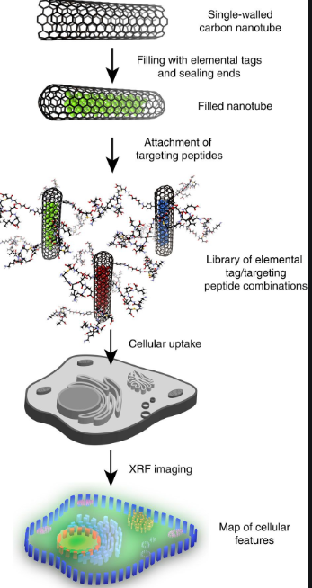
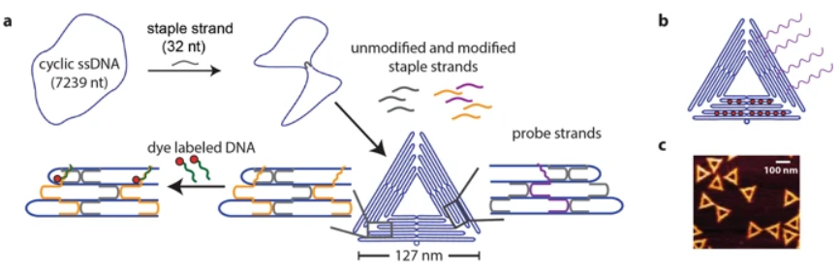
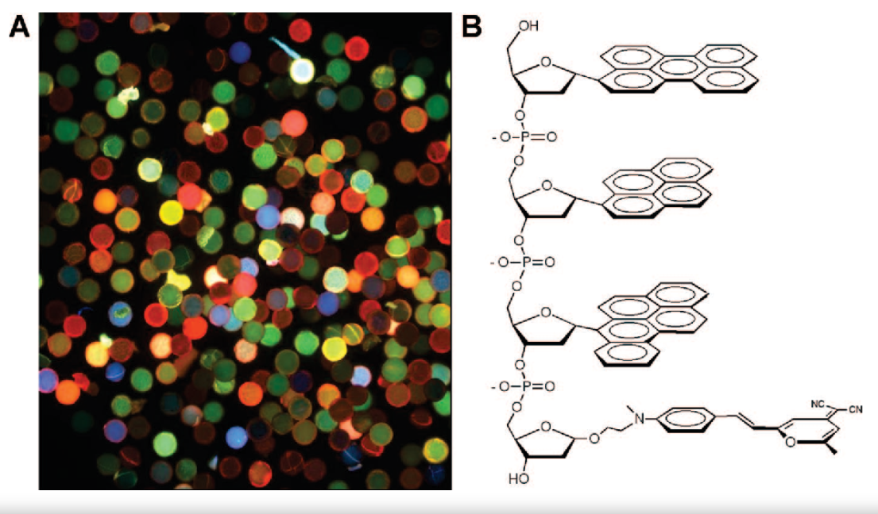
The future of fluorescent molecules
DNA Origami
Graphene-like nanostructures
Nature March 18 Mar 2019, Rodiger et al.
Nature Chemistry, 16 2Oct 017, Kool et al
Nature Comm 26 Oct 2016, Davis et al.
Fluorescent nucleobases

Slide 6
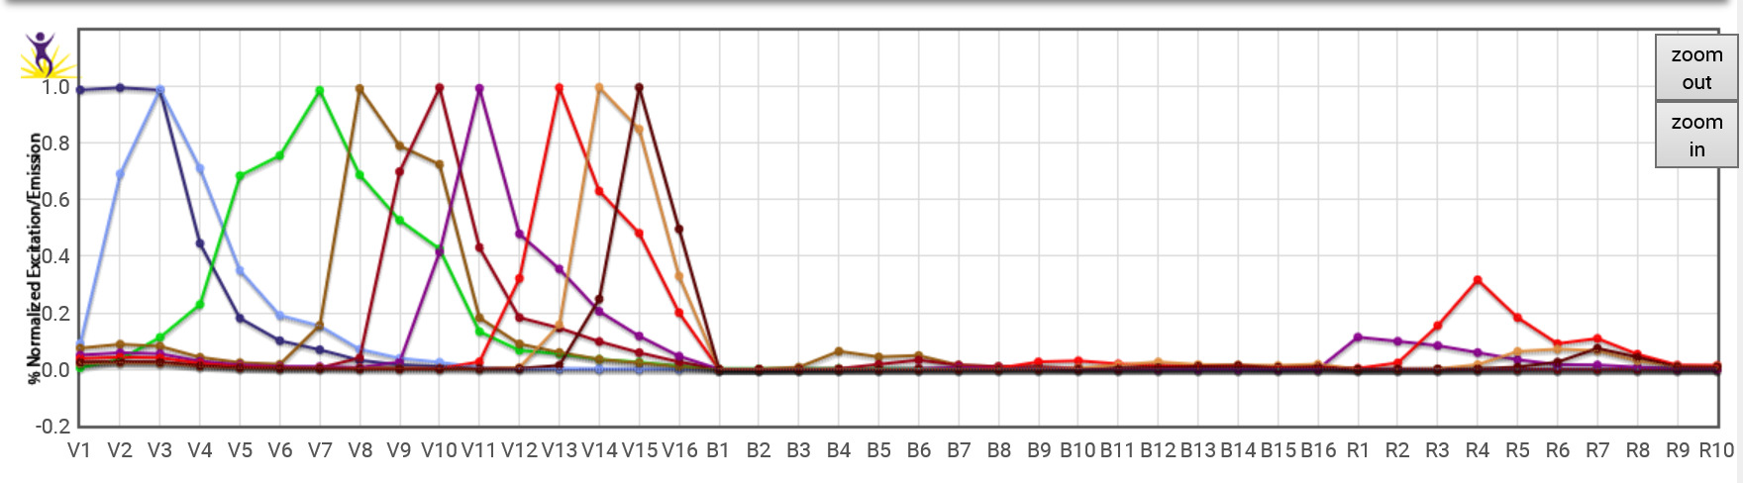
Simultaneous Fluors-5L and 34 colors
https://www.biolegend.com/en-us/aurora-spectra-analyzer
UV1 | 372/15 |  |  | V1 | 428/15 | Brilliant Violet™ 421
UV2 | 387/15 | BUV395 |  | V2 | 443/15 | Pacific Blue
UV3 | 427/15 |  |  | V3 | 456/15
UV4 | 443/15 |  |  | V4 | 473/15 | Brilliant Violet™ 480
UV5 | 458/15 |  |  | V5 | 508/20 | Brilliant Violet™ 510
UV6 | 473/15 | BUV496 |  | V6 | 528/21
UV7 | 514/28 |  |  | V7 | 549/22
UV8 | 542/28 |  |  | V8 | 571/23 | Brilliant Violet™ 570
UV9 | 581/31 | BUV563 |  | V9 | 594/23
UV10 | 612/31 |  |  | V10 | 618/24 | Brilliant Violet™ 605
UV11 | 664/27 | BUV661 |  | V11 | 664/27 | Brilliant Violet™ 650
UV12 | 691/28 |  |  | V12 | 692/28
UV13 | 720/29 |  |  | V13 | 720/29 | Brilliant Violet™ 711
UV14 | 750/30 | BUV737 |  | V14 | 750/30 | Brilliant Violet™ 750
UV15 | 780/30 |  |  | V15 | 780/30 | Brilliant Violet™ 785
UV16 | 812/34 | BUV805 |  | V16 | 812/34
B1 | 508/20 | Alexa Fluor® 488
B2 | 528/21
B3 | 549/22 | Spark Blue 550™
B4 | 571/23
B5 | 594/23
B6 | 618/24
B7 | 660/17
B8 | 678/18 | PerCP
B9 | 697/19
B10 | 717/20 | PerCP/Fire 720™
B11 | 738/21
B12 | 760/23
B13 | 783/23
B14 | 812/34
YG1 | 577/20 | R-PE
YG2 | 598/20 | Spark YG™ 590
YG3 | 615/20 | PE/Dazzle™ 594
YG4 | 660/17 | PE/Fire™ 640
YG5 | 678/18 | PE/Cy5
YG6 | 697/19 | PE/Fire™ 700
YG7 | 720/29
YG8 | 750/30
YG9 | 780/30 | PE/Cyanine 7
YG10 | 812/34 | PE/Fire™ 810
R1 | 660/17 | APC
R2 | 678/18 | Alexa Fluor® 647
R3 | 697/19 | Spark NIR 685™
R4 | 717/20 | Alexa Fluor® 700
R5 | 738/21
R6 | 760/23
R7 | 783/23 | APC/Fire™ 750
R8 | 812/34 | APC/Fire 810™

Slide 7
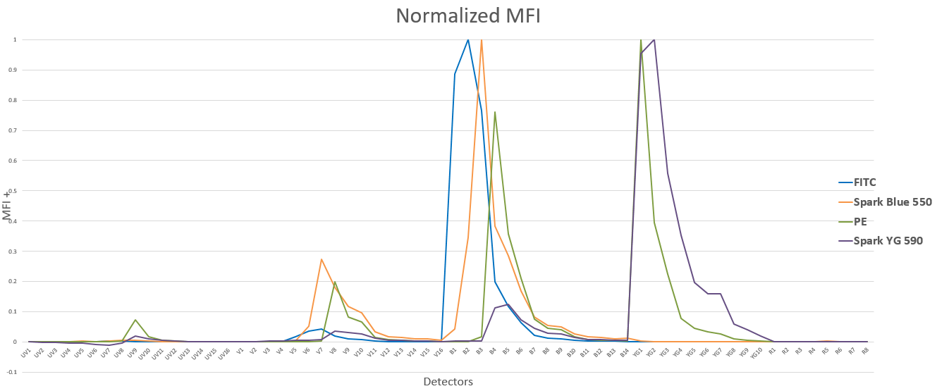
Spectrally Distinct Fluorophores

Slide 8
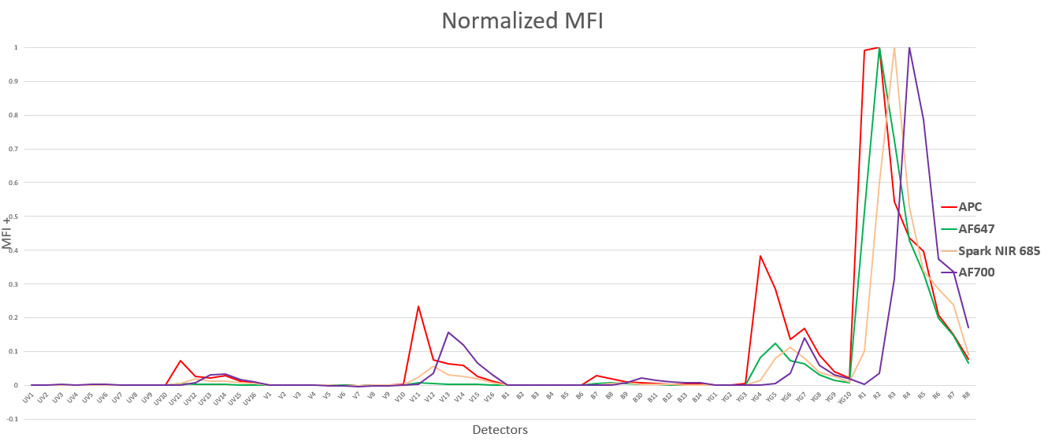
Spectrally Distinct Fluorophores

Slide 9
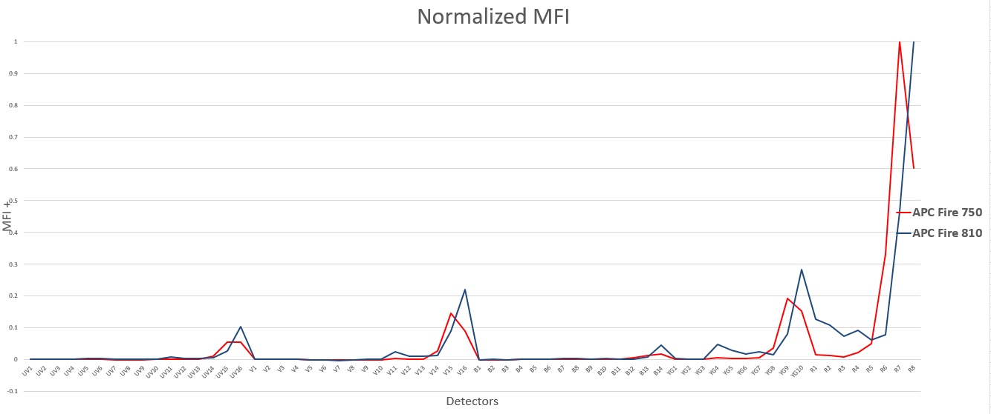
Spectrally Distinct Fluorophores

Slide 10
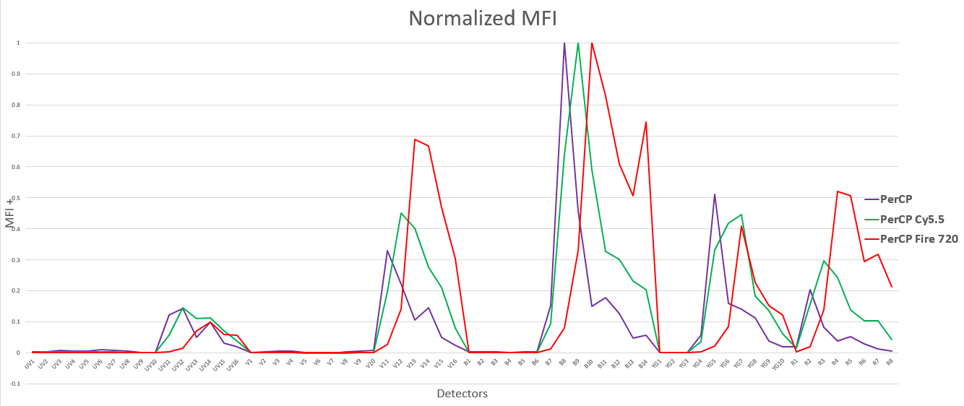
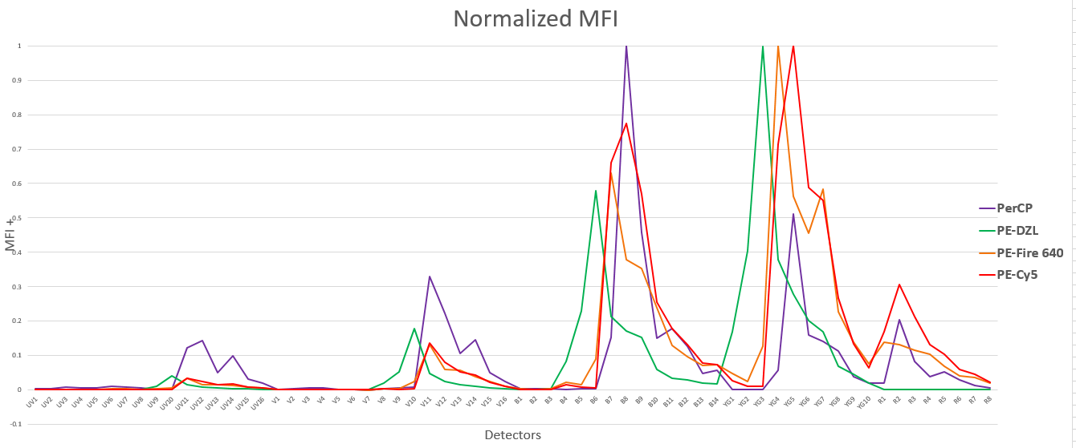
Spectrally Distinct Fluorophores

Slide 11
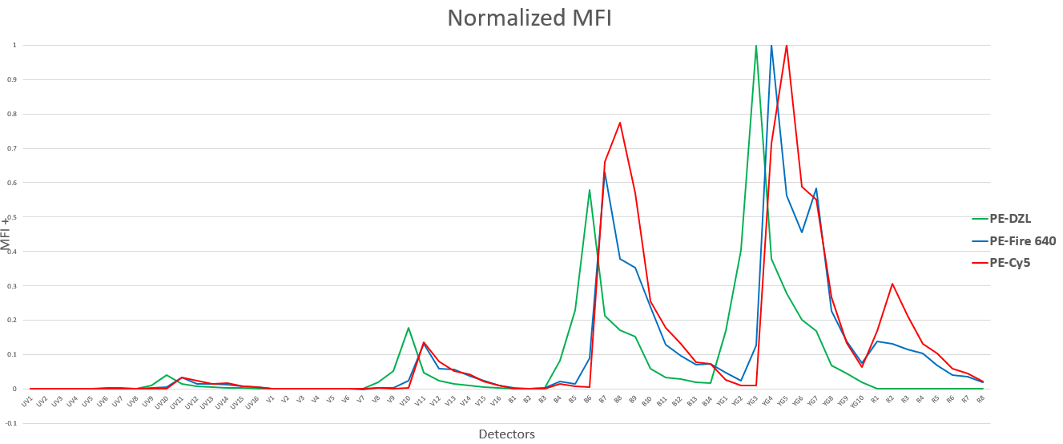
Spectrally Distinct Fluorophores

Slide 12
Spectrally Distinct Fluorophores

Slide 13
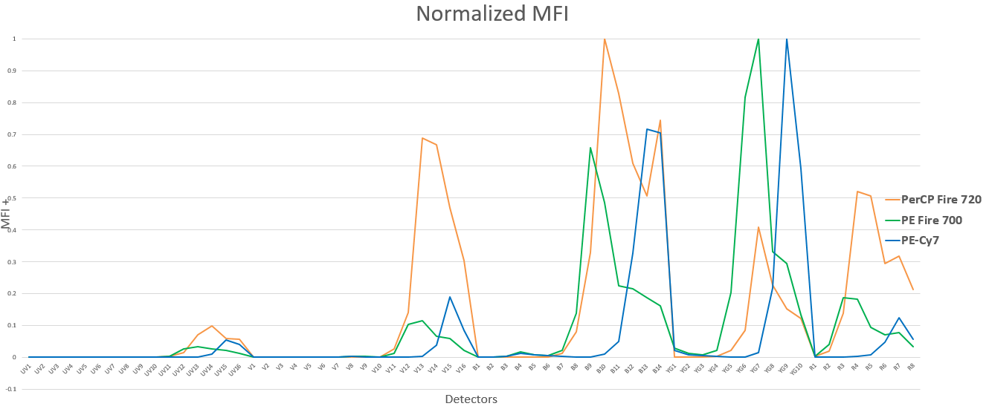
Spectrally Distinct Fluorophores

Slide 14
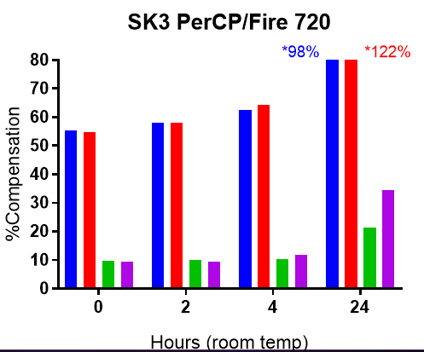
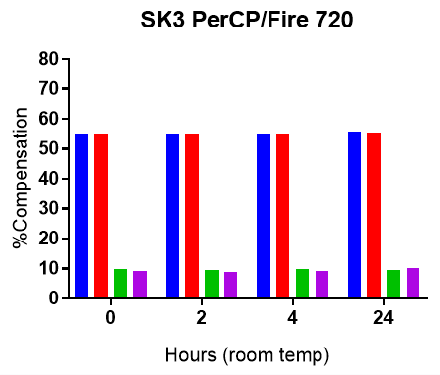
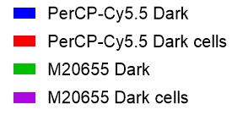
Photostability Test- Veri-Cells™
Stored in the dark
SK3 PerCP/Fire™ 720
Stored in the light
SK3 PerCP/Fire™ 720
Stored in the light
PerCP-Cy5.5
PerCP-Cy5.5
PerCP-Fire™ 720
PerCP-Fire™ 720
% comp into PerCP
% comp into PerCP
Notes:
Notice that the Comp into PerCP for the PerCP-Cy5.5 left in the light for 24 hrs is 98% and 122%.

Slide 15
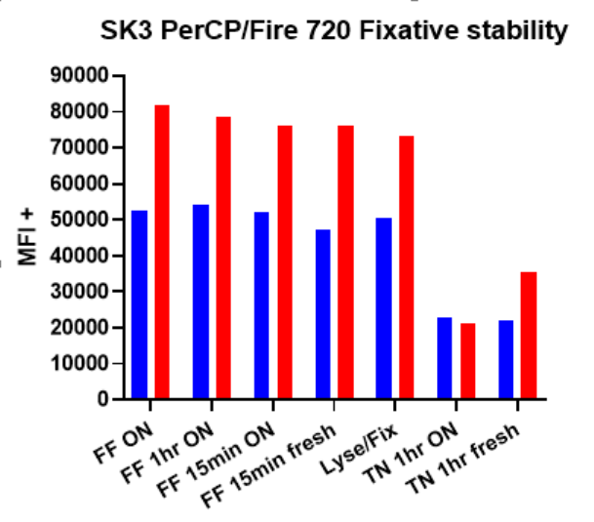
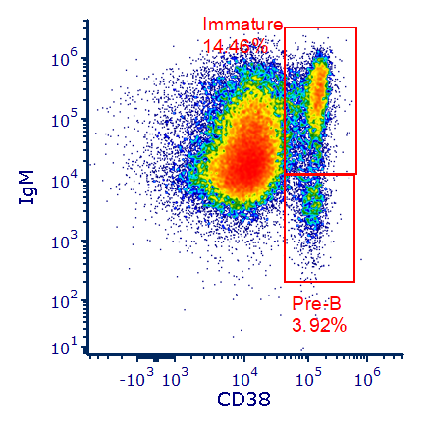
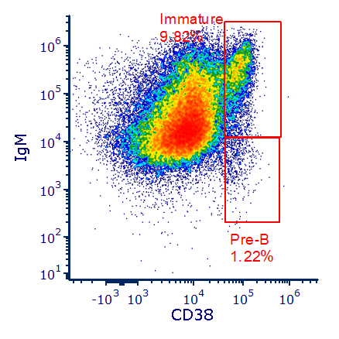
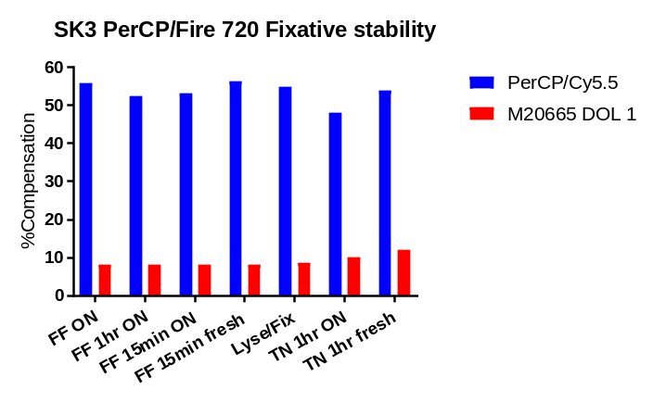
Fixatives affect fluorophores
Fluorofix
Cytokine Fix/Perm Buffer
IgM Alexa Fluor 647
IgM Alexa Fluor 647
PerCP/Cy5.5
PerCP/Fire™ 720
CD38 PCP-Fire 720
CD38 PCP-Fire 720
% comp into PerCP
FF: Fluorofix
TN: True-Nuclear™
Lyse/fix
O/N was stored in Cytolast™
Notes:
When you see a drop in MFI like this, but not a large change in compensation (for the TN) conditions, that often means the condition (in this case fixative) is affecting the PerCP fluorophore more so than the acceptor fluors.

Slide 16
Fluorophore Development Conclusions
New fluorophores either fill in spectral gaps between the current repertoire of fluorophores or they offer a unique spectral fingerprint that would aid in unmixing.
Fluorophores are rigorously tested in-house, prior to release in stability conditions that relate to their use

Slide 17
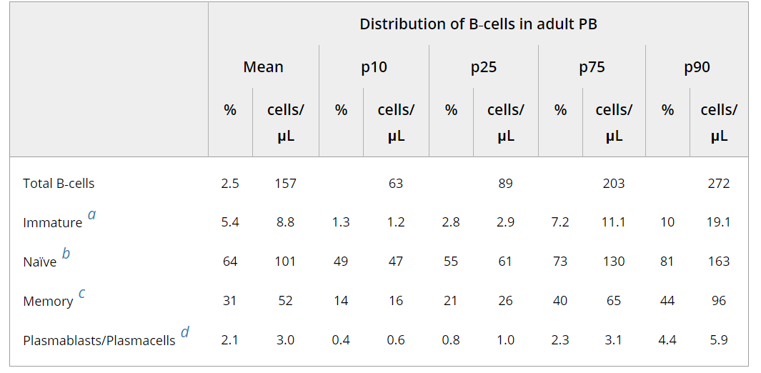
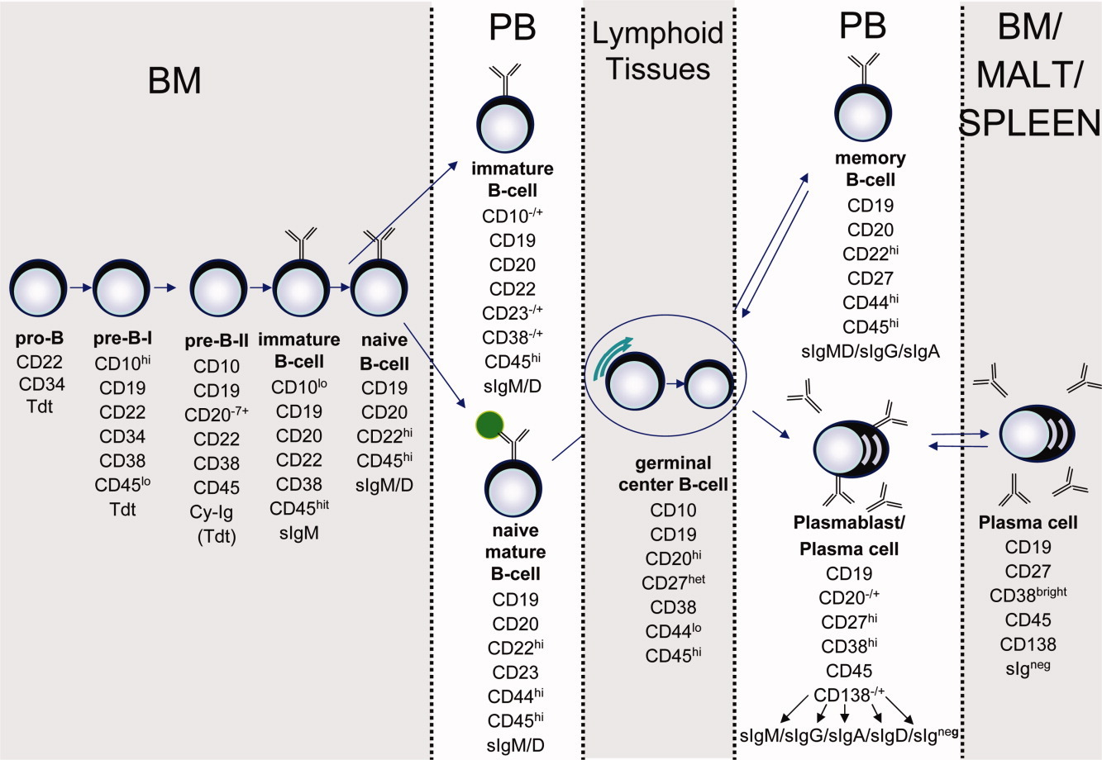
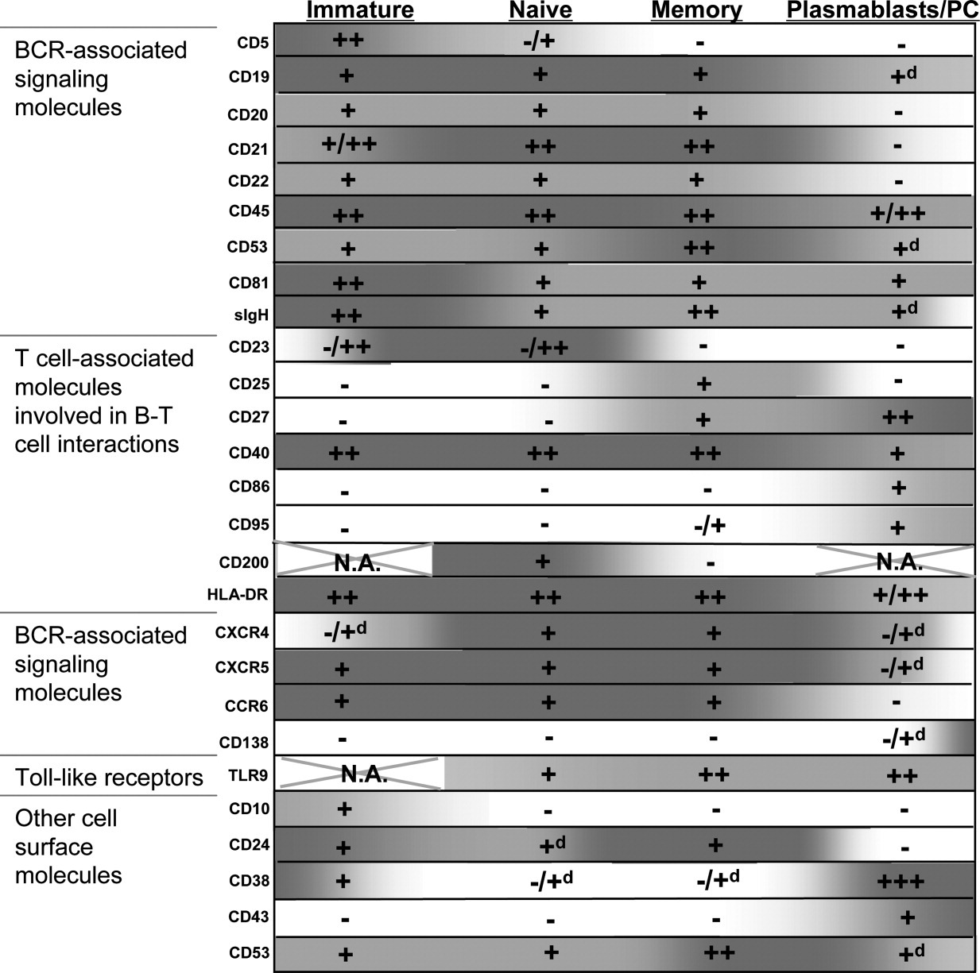
Choosing markers for the panel- B-cell phenotypes
References: Cytometry Part B (Clinical Cytometry) 78B (Suppl. 1):S47-S60 (2010) Perez-Anders and Orfao et al
Notes:
The majority of the work is to determine what the right marker choices are, how definitive of a marker they are, whether the definitive phenotype has changed over time, etc. While reading the papers, you should be mapping out gating schemes to derive those definitive phenotypes. This saves time and increases the accuracy of your panel when you go to choose fluor combinations.

Slide 18
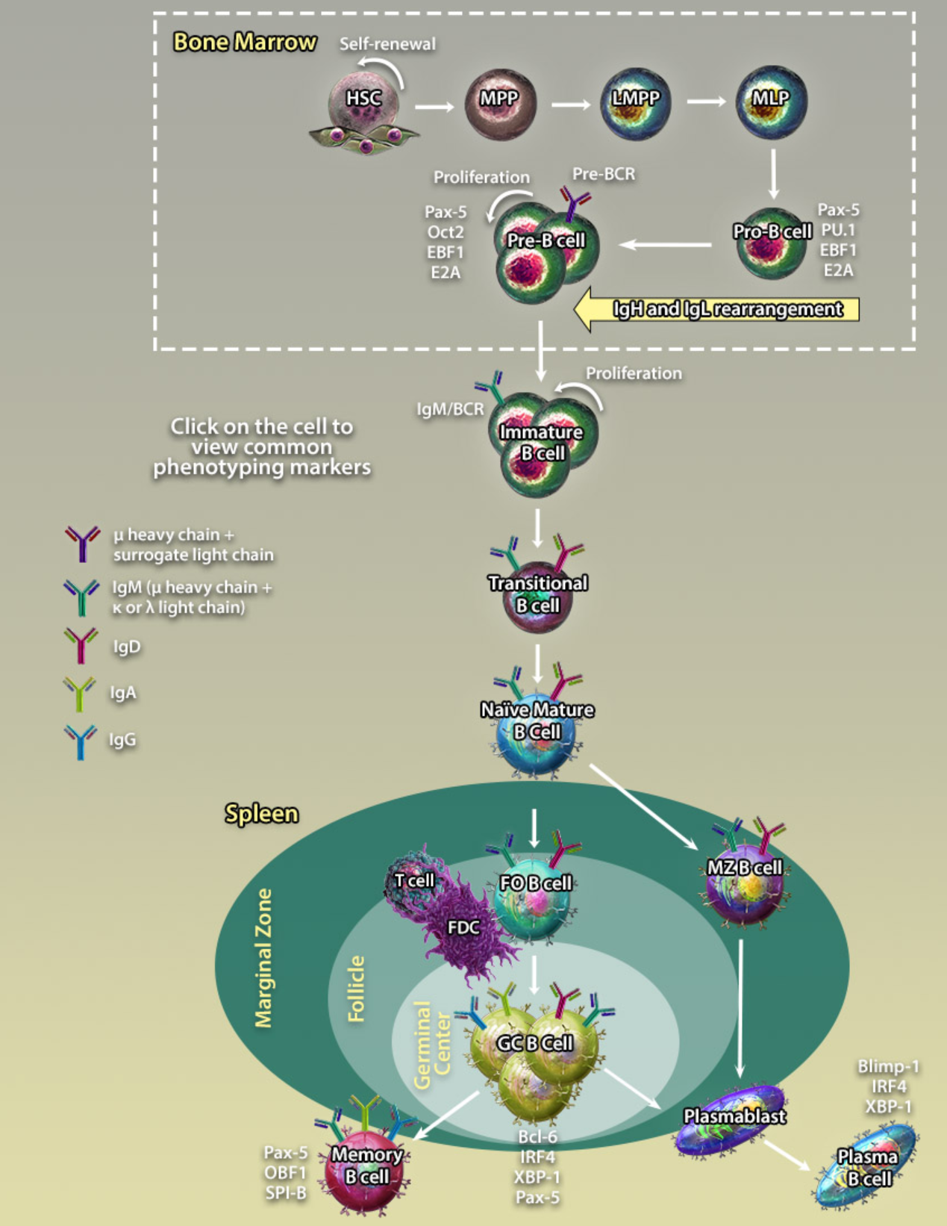
Panel marker decisions and optimization
 |  | HSC | MPP | LMPP | MLP | Pro | Pre | Imm | Trans | Naïve Mature | memory | Pblast | plasma
CD34 | BV650™ | + | + | + | + | + | - | - | -
CD135 | PE-Cyanine 5 | - | + | + | + | + | ?
CD38 | PCP-Fire™ 720 | - | - | - | - | ++ | ++ | + | hi to low | +/lo | - | hi | hi
CD27 | BV750™ |  |  |  |  |  | - | - | - | +/- subsets | + | hi | hi
CD10 | BV711™ | - | - | - | + | + | ?lo | ?lo | +/lo | +/- subsets |  |  | -
CD5 | PE-DZL™594 |  |  |  |  |  |  | - | + | - | - |  | -
CD45RA | BV510™ | - | - | + | + | + | +
CD24 | BV785™ |  |  |  |  | + | + | + | hi | +/lo |  |  | -
CD19 | Spark Blue™ 550 | - | - | - |  | + | + | + | + | + | + | + | lo
CD20 | PerCP | - | - | - | - | -/lo | + | + | + | + | + | lo | -
BAFF-R | PE/Cyanine7 |  |  |  |  |  |  |  | +? | +?
IgD | BV605™ |  |  |  |  | - | - | - | on CD21hi | + | +/- | - | -
IgM | AF®647 |  |  |  |  | - | - | + | +? | + | +/- | +/- | -
CD21 | PE-Fire™ 700 |  |  |  |  |  |  |  | hi to low | + |  | + | -
CXCR4 | BV421™ |  |  |  |  |  |  |  |  | + | + |  | +
CD90 | APC | + | - | - | - |  |  |  |  | lo
CD138 | APC-Fire™ 750 |  |  |  |  |  |  |  |  |  |  | - | +
CD44 | FITC |  |  |  |  |  |  |  | +? | +? |  |  | +
CD86 | BV480™ |  |  |  |  |  |  |  |  | + |  | lo | +
TLR9/ TdT | PE
Dump CD56 BV570™, CD11c Spark NIR™ 685, CD14 QD625, CD3 PE-Fire™ 810, CD123 Pac Blue, CD303 AF®700
https://www.biolegend.com/maturation_markers
Notes:
This is how I organize the info from the lit. Creating a chart of co-expression, variability of expression, what is certain and what is unknown, etc. We have an excellent resource on line especially for T-cell and B-cell lymphopoiesis in mouse and human at that web address.

Slide 19
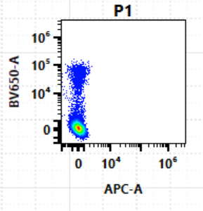
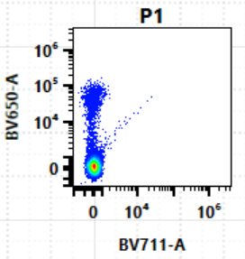
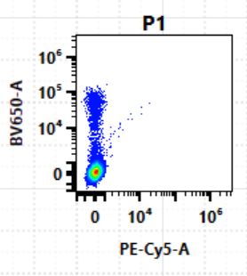
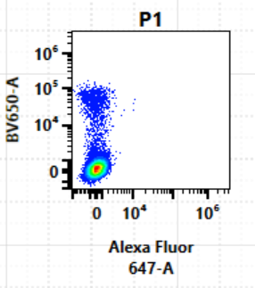
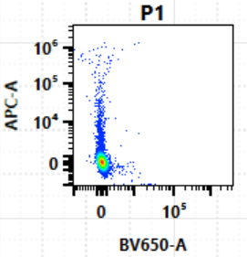
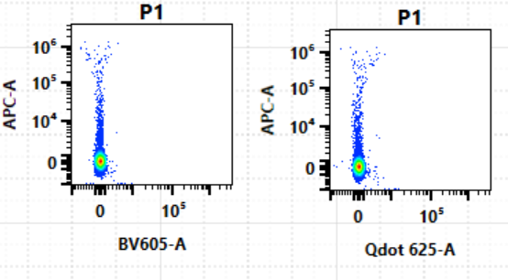
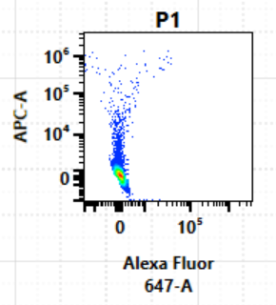
Panel and key differentiating markers
CD19 | Spark Blue™ 550
CD20 | PCP
CD3 | PE-Fire™ 810
CD11c | Spark NIR™ 685
CD56 | BV570™
CD14 | biotin/ QD625
CD34 | BV650™
CD135 | PE-Cyanine 5
CD38 | PCP-Fire™ 720
CD27 | BV750™
CD10 | BV711™
CD5 | PE/Dazzle™ 594
CD45RA | BV510™
CD24 | BV785™
BAFF-R | PE/Cyanine 7
IgD | BV605™
IgM | AF647®
CD21 | PE/Fire™ 700
CXCR4 | BV421™
CD90 | APC
CD138 | APC/Fire™ 750
CD44 | FITC
CD86 | BV480™
CD123 (IL3R) | PacBlue
CD303 | AF700®
TLR9/ TdT/ BCR | PE
CD19 Spark Blue™ 550 vs CD20 PerCP
CD34 BV650™ vs CD90 APC
CD123 Pacific Blue vs CD303 Alexa Fluor® 700
CD38 PCP-Fire™ 720 vs CD27 BV750™
CD45RA BV510™ vs CD10 BV711™
IgM Alexa Fluor® 647 vs IgD BV605™
Primary Tier
Secondary Tier
Tertiery Tier
Dump/excluded
Notes:
As you are reading papers, ask yourself. Which markers are necessary just for the basic cell phenotype? Those are primary tier markers. Which markers give more specific subsetting info? Those are secondary tier markers. Which are “wish list” antigens that might be specific to the disease state or the finer topic of the research? Those are tertiary tier. I didn’t use a single dump channel because I was interested in still being able to pull out pDCs from my analysis.

Slide 20
Optimized commercial panels
 |  | P1 | P2 | P3 | P4 | P5
 |  | core | HSC/Progen/Pro | Pre/Imm | Trans/Naïve/Mem | Plasma
CD34 | BV650 |  | x
CD38 | PCP-Fire 720 | x
CD3 | PE-Fire 810 | x
CD27 | BV750 | x
CD10 | BV711 |  |  |  | x
CD5 | PE-DZL 594 |  |  | x
CD45 | Spark 550 | x
CD24 | BV785 |  |  | x
CD19 | Spark 685 | x
CD20 | PCP | x
IgD | BV605 |  |  |  | x
IgM | AF647 |  |  | x
CD21 | PE-Fire 700 |  |  |  | x
CD90 | APC |  | x
CD138 | APC-Fire 750 |  |  |  |  | x
CD44 | New NIR Spark dye |  |  |  | x

Slide 21
Spreading spillover matrix (CD4)
SSM/SSE is how much spread of the fluorophore in the row reduces stain index/resolution of the marker labeled with the fluorophore in the column. Antigen density higher than CD4 can survive a higher % (90%).
TABLE3.1 | BV421+ | SB436+ | e450+ | BV480+ | BV510+ | BV605+ | BV650+ | BV711+ | BV750+ | BV785+ | BB515+ | A488+ | A532+ | PE+ | PerCP-Cy55+ | PerCP-e710+ | PE-Dazzle594+ | PE-Cy5+ | PE-Cy7+ | APC+ | A647+ | A700+ | APC-Fire750+
BV421+ | 0% | 73% | 78% | 55% | 28% | 1% | 0% | 0% | 0% | 0% | 0% | 0% | 0% | 0% | 2% | 0% | 0% | 0% | 0% | 0% | 23% | 0% | 0%
SB436+ | 79% | 0% | 78% | 63% | 39% | 12% | 0% | 0% | 0% | 0% | 0% | 0% | 0% | 0% | 11% | 6% | 0% | 0% | 0% | 34% | 84% | 31% | 0%
e450+ | 59% | 52% | 0% | 33% | 14% | 0% | 0% | 0% | 0% | 0% | 0% | 0% | 0% | 0% | 2% | 0% | 0% | 0% | 0% | 0% | 2% | 0% | 0%
BV480+ | 45% | 38% | 52% | 0% | 51% | 44% | 16% | 0% | 0% | 0% | 15% | 26% | 11% | 0% | 5% | 0% | 6% | 0% | 0% | 1% | 0% | 0% | 0%
BV510+ | 27% | 17% | 33% | 49% | 0% | 53% | 35% | 14% | 11% | 4% | 0% | 0% | 0% | 0% | 14% | 5% | 13% | 0% | 0% | 1% | 0% | 2% | 0%
BV605+ | 23% | 11% | 21% | 26% | 27% | 0% | 67% | 52% | 44% | 36% | 38% | 50% | 69% | 52% | 61% | 53% | 85% | 60% | 30% | 28% | 15% | 29% | 0%
BV650+ | 23% | 12% | 24% | 2% | 0% | 25% | 0% | 57% | 51% | 42% | 0% | 0% | 2% | 0% | 64% | 52% | 11% | 72% | 16% | 65% | 57% | 56% | 0%
BV711+ | 28% | 17% | 28% | 1% | 0% | 0% | 9% | 0% | 74% | 72% | 0% | 0% | 0% | 0% | 60% | 62% | 0% | 42% | 43% | 43% | 55% | 89% | 35%
BV750+ | 17% | 4% | 18% | 0% | 0% | 0% | 0% | 42% | 0% | 77% | 0% | 0% | 0% | 0% | 16% | 17% | 0% | 0% | 27% | 0% | 0% | 52% | 15%
BV785+ | 28% | 16% | 26% | 0% | 0% | 0% | 0% | 6% | 62% | 0% | 0% | 0% | 0% | 0% | 11% | 10% | 0% | 0% | 46% | 0% | 0% | 9% | 37%
BB515+ | 0% | 0% | 0% | 0% | 0% | 0% | 0% | 0% | 0% | 0% | 0% | 90% | 85% | 35% | 16% | 4% | 7% | 0% | 0% | 1% | 0% | 0% | 0%
A488+ | 0% | 0% | 0% | 0% | 0% | 0% | 0% | 0% | 0% | 0% | 69% | 0% | 63% | 0% | 5% | 0% | 0% | 0% | 0% | 0% | 0% | 0% | 0%
A532+ | 0% | 0% | 0% | 0% | 0% | 0% | 0% | 0% | 0% | 0% | 0% | 5% | 0% | 0% | 3% | 0% | 0% | 0% | 0% | 0% | 0% | 0% | 0%
PE+ | 0% | 0% | 4% | 65% | 68% | 62% | 43% | 25% | 0% | 0% | 91% | 93% | 96% | 0% | 56% | 46% | 79% | 58% | 26% | 22% | 10% | 4% | 0%
PerCP-Cy55+ | 0% | 0% | 0% | 0% | 0% | 0% | 17% | 44% | 36% | 31% | 0% | 0% | 0% | 0% | 0% | 60% | 0% | 51% | 39% | 38% | 48% | 58% | 0%
PerCP-e710+ | 0% | 0% | 0% | 0% | 0% | 0% | 28% | 74% | 70% | 64% | 0% | 0% | 0% | 0% | 83% | 0% | 0% | 78% | 67% | 53% | 58% | 85% | 29%
PE-Dazzle594+ | 0% | 0% | 1% | 50% | 54% | 62% | 41% | 57% | 7% | 0% | 87% | 90% | 94% | 95% | 80% | 66% | 0% | 73% | 49% | 37% | 40% | 13% | 0%
PE-Cy5+ | 0% | 0% | 0% | 16% | 17% | 12% | 78% | 91% | 71% | 54% | 58% | 67% | 79% | 60% | 96% | 90% | 29% | 0% | 80% | 90% | 89% | 77% | 19%
PE-Cy7+ | 0% | 0% | 0% | 0% | 0% | 0% | 38% | 87% | 66% | 77% | 0% | 12% | 31% | 48% | 71% | 91% | 3% | 68% | 0% | 36% | 57% | 74% | 57%
APC+ | 0% | 0% | 0% | 0% | 0% | 0% | 67% | 53% | 31% | 18% | 0% | 1% | 5% | 0% | 86% | 72% | 0% | 92% | 37% | 0% | 80% | 78% | 22%
A647+ | 0% | 0% | 0% | 0% | 0% | 0% | 36% | 33% | 18% | 1% | 0% | 0% | 0% | 0% | 65% | 53% | 0% | 83% | 32% | 87% | 0% | 82% | 39%
A700+ | 0% | 0% | 0% | 0% | 0% | 0% | 0% | 26% | 27% | 19% | 0% | 0% | 0% | 0% | 31% | 47% | 0% | 15% | 26% | 32% | 38% | 0% | 26%
APC-Fire750+ | 0% | 0% | 0% | 0% | 0% | 0% | 0% | 9% | 12% | 37% | 0% | 0% | 0% | 0% | 8% | 26% | 0% | 0% | 87% | 23% | 7% | 40% | 0%
Notes:
The SSM is instrumental in choosing fluor combinations WITH THE KNOWLEDGE of how the gating scheme will be set up and which markers are co-expressed. Combinations that should be in general avoided on co-expressed antigens are: PE/Cy5, PerCP, PerCP/Fire 720 and PE/Fire 700. Avoid APC, AF647 and AF685 on co-expressed markers.

Slide 22
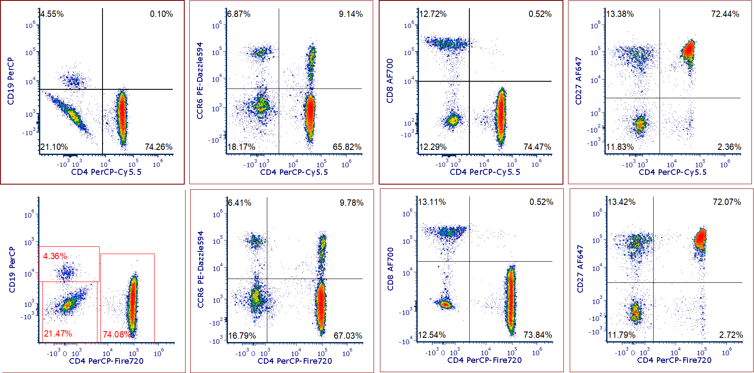
PerCP/Cy5.5 vs PerCP/Fire™ 720
Tube 1:
CD19 PerCP
CCR6 PE-Dazzle ™ 594
CD4 PerCP-Cy5.5
CD8 Alexa Fluor® 700
CD27 Alexa Fluor® 647
Tube 2:
CD19 PerCP
CCR6 PE-Dazzle ™ 594
CD4 PerCP-Fire™ 720
CD8 Alexa Fluor® 700
CD27 Alexa Fluor® 647

Slide 23

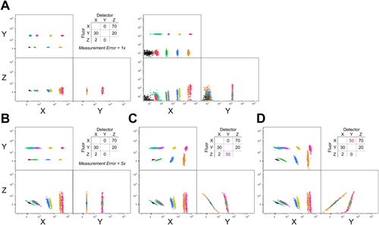

Distortions of the negative population

Slide 24
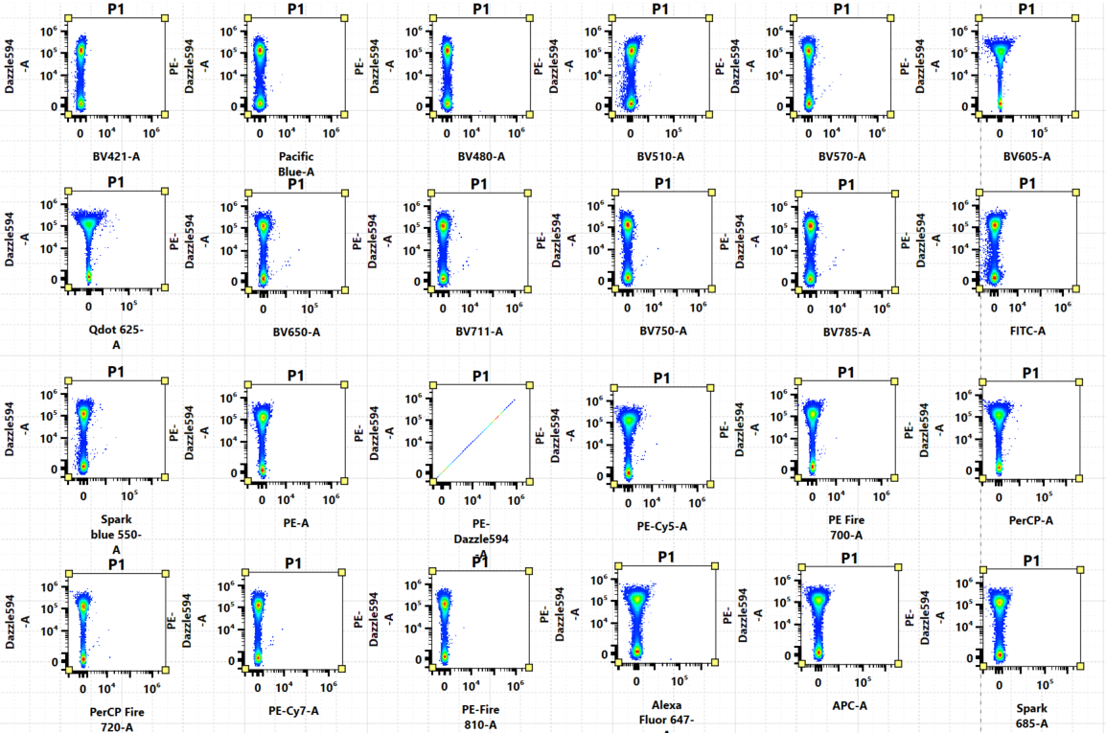
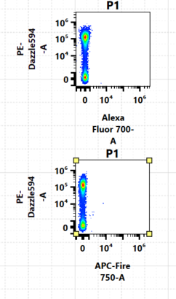
Verifying accuracy of unmixing controls- positives
Data file for single stained PE-Dazzle 594 on cells, check for accurate unmixing against every other fluorescent marker in the panel.

Slide 25
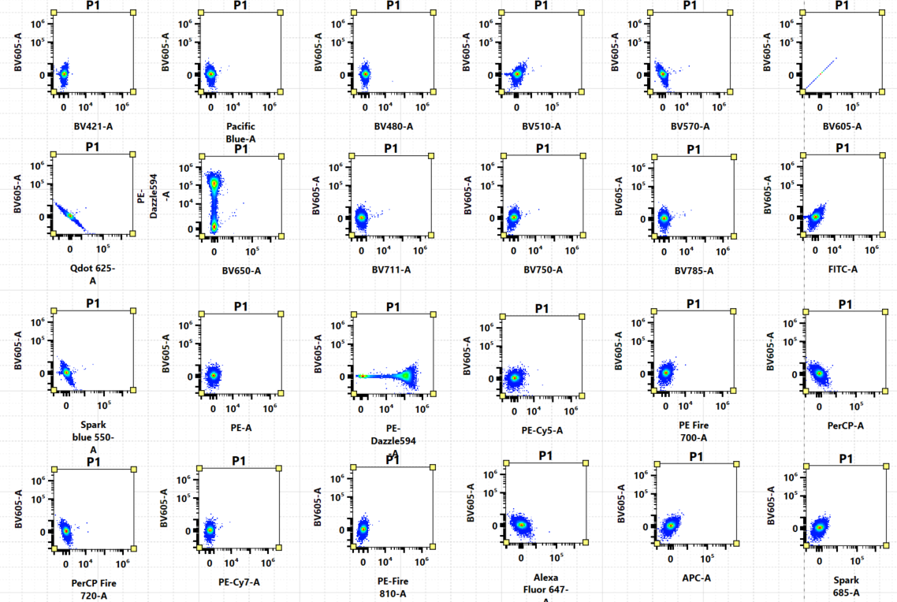
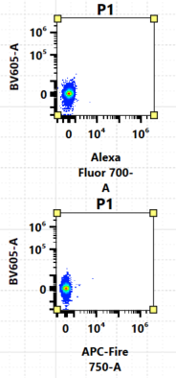
PE-Dazzle™ 594 into BV605™ - negatives
Data file for single stained PE-Dazzle™ 594 on cells. Unmixing accuracy will be reflected in any false positives.

Slide 26
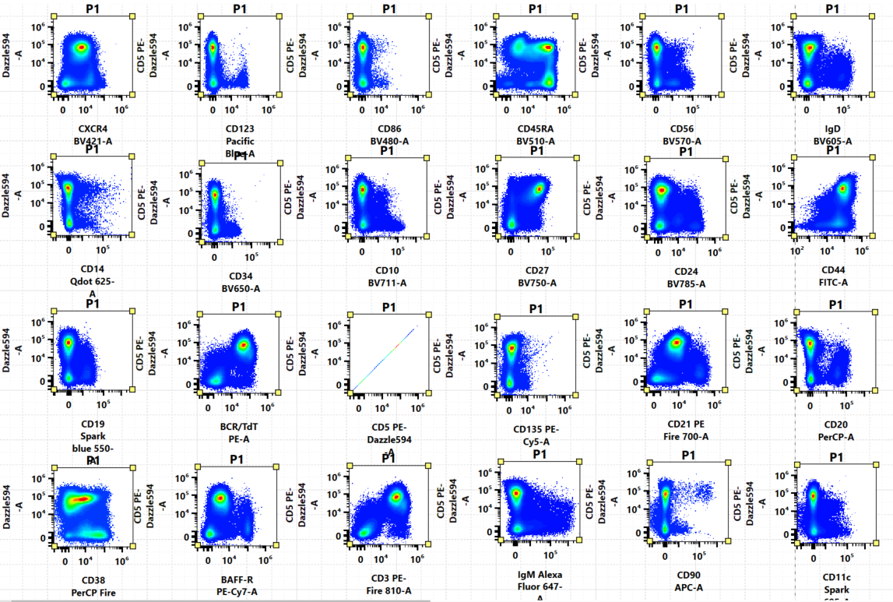
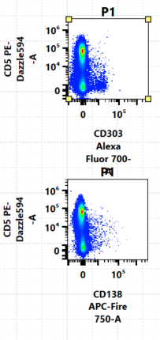
NxN full panel
Data file for fully stained cell sample. Check for any obvious aberrations in how they plot against each fluorophore.
Lymph-gated bone marrow

Slide 27
Fluorophore choice conclusion
Work out the full analysis prior to fluor choice
Understand what spreading error is and its impact on population resolution in a panel
Implement rigorous assessment of controls and full panel in an NxN matrix to confirm unmixing accuracy

Slide 28
Isolating B-cell progenitors
HSC:
CD34+CD90+, CD135/FLT3- CD45RA-
Multipotent Progenitor (MPP):
CD34+CD90-, CD135+, CD19-CD20-, CD45RA-CD10-
Multi-Lymphoid Progenitor (MLP/CLP):
CD34+CD90-, CD135+, CD19-CD20-, CD45RA+CD10+, CD38-
Pro-B:
CD34+CD90-, CD135+, CD19+CD20-, CD45RA+CD10+, CD38++ IgM-
CD303 AF700
CD11c Spark 685
CD123 PacBlue
CD56 BV570
HSC
Viability
CD90 APC
CD27 BV750
Pre
progenitors
CD34 BV650
CD135/FLT3 PE-Cy5
Pro-B (CD34+)
CD14 Qdot 625
CD38 PerCP-Fire 720
CD135/FLT3 is expressed at low levels on 100% of B-cell ALLs (acute lymphocytic leukemia).
Expression relates to self-renewal, negative on HSCs but positive on multipotent and progenitor stages (incapable of self-renewal).
CD19 Spark 550
LMPP
MLP
CD45RA BV510
MPP
CD20 PerCP
CD10 BV711
Blood. 1997 July 1; 90(1):111-25 Rappold and Buhring et al (FLT3 expression)
Cell. 2014 April 24; 157(3): 714-725 Bendall and Pe’er et al
Notes:
All progenitors except Pre-B are defined by CD34+. HSC will also be CD90+. What differentiates MPP, LMPP and MLP from eachother is CD45RA and CD10. Past MLP/CLP, all cells will be CD45RA+ and Pro-B, Pre-B will acquire CD38+

Slide 29
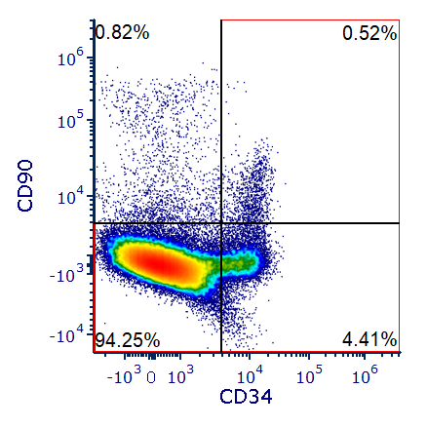
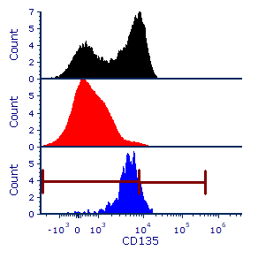
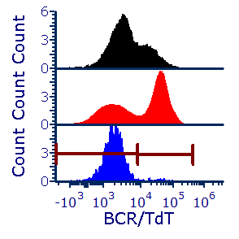



B-cell progenitors in bone marrow
200K P1 events, Backgating: singlets, all PBMC scatter, CD303-CD123-, CD56-CD14-, CD11c-, CD3-
 |  | CD135 | TdT
 | Progenitors CD34+ CD90- | 1.2%neg 2% pos | 1.8%neg 0.7%neg
 | CD34-CD90- (Pre-B and non-progenitors) | 57% neg/lo | 25.3%neg 34.5%pos
 | HSC CD34+CD90+ | 0.26%neg 0.04%pos | 0.26%neg 0.01%pos
CD90 APC
M1
M2
CD34 BV650™
CD135 PE-Cyanine5
TdT PE
25.4%
38.4%
TdT is expressed in CD34- early pre-B and pre-T lymphoid development and in ALL (acute lymphocytic leukemia).
CD90 inhibits HSC proliferation.
CD20 PerCP
CD45RA BV510™
CD90 APC
34.6%
CD19 Spark Blue™ 550
CD10 BV711™
TdT PE
Notes:
HSC are the only cells that are CD34+CD90+. The rest of the progenitors will be CD34+ but not CD90+. Two interesting markers that can be variably expressed on progenitors are TdT and CD135. CD135 is expressed on non-dividing cells, so the progenitors but not stem cells. TdT is expressed to generate diversity of TCRs and IgG heavy chains.

Slide 30





Pre-B and Immature B-cells- Bone Marrow
Immature
transitional
Naïve Mature (CD5-)
CD38 PCP-Fire 720
CD24 BV785
IgD BV605
IgD BV605™
Immature B-cells
CD27 BV421
CD5 PE-DZL 594
IgM AF647
CD38 PCP-Fire™ 720
CD24 BV785™
Pre- B-cells
IgM Alexa Fluor® 647
CD27 BV750™
CD5 PE-Dazzle 594
FMO BV785™ and PE-Dazzle™ 594
Pre-B:
CD34-CD90-, CD135-, CD19+CD20+, CD27-CD38+, CD24+CD5-, IgM-IgD-
Immature:
CD34-CD90-. CD19+CD20+, CD27-CD38+, CD24+CD5- , CD21hi-lo, IgM+IgD-
Transitional:
CD34-CD90-. CD19+CD20+, CD27-CD38+, CD24hi-lo CD5+ , CD21+, IgM/IgD variable
IgD BV605™
Confirm Transitional B-cells (CD21)
CD24 BV785™
IgM Alexa Fluor® 647
CD5 PE-Dazzle™ 594
Notes:
Pre-B and onwards will all be CD19+ CD20+. Prior to any localization to a secondary lymphoid tissue, they’ll be CD38+ on naïve B-cells and on activated cells like plasma and plasmablasts. Lots of pre-B cells in the bone marrow versus PBMCs

Slide 31






Transitional Subsets- BM
Transitional: CD38hi CD27-, CD5+ CD24hi/+
T1: CD21lo, CD10+, IgDlo
T2: CD21hi, CD10+, IgDhi
T3: CD21hi, CD10-, IgD+
Immature
transitional
T3
T1/T2
CD38 PCP-Fire 720
CD24 BV785
CD21 PE-Fire 700
CD5+
CD5-
T2
T2
CD27 BV421
CD5 PE-DZL 594
CD10 BV711
T3
T1
CD24 BV785™
CD21 PE-Fire™ 700
T3
T1
CD21 PE-Fire™ 700
Memory
CD24 BV785
IgD BV605
IgD BV505
CD5 PE-Dazzle™ 594
CD10 BV711™
CD10 BV711™
T1
FMO PE-Fire™ 700
T2
T3
CD44 FITC
BAFF-R AF647
IgM BV510
Majority of transitional cells in bone marrow should be T1 (emigrating B-cells). Maturation to T2 involves BCR stimulation.
T1 to T2 to T3 characterized by loss of CD10, CD5 and IgM and upregulation of CD22, CD44, CD21 and CD23.
IgD BV605™
IgD BV605™
IgD BV605™
IgM Alexa Fluor® 647
IgM Alexa Fluor® 647
IgM Alexa Fluor® 647
Clinical and Experimental Immunology, 174:53-59 Agrawal and Sewell et al. (Transitional B cell subsets in BM)
Notes:
For the transitional subset, paper suggested some transitional cells may also be CD27+. In Bone marrow and PBMC it didn’t make a difference in the distribution of T1-T3.

Slide 32





Transitional Subsets- PBMC
Transitional: CD38hi CD27-, CD5+ CD24hi/+
T1: CD21lo, CD10+, IgDlo
T2: CD21hi, CD10+, IgDhi
T3: CD21hi, CD10-, IgD+
Immature
transitional
T3
T1/T2
CD38 PCP-Fire 720
CD24 BV785
CD21 PE-Fire 700
CD24+CD5- (T3)
CD24+CD5+ (?)
T3
T1/T2
CD27 BV421
CD5 PE-DZL 594
CD10 BV711
CD24 BV785™
CD21 PE-Fire™ 700
CD21 PE-Fire™ 700
Memory
CD24 BV785
IgD BV605
IgD BV505
CD5 PE-Dazzle™ 594
CD10 BV711™
CD10 BV711™
CD44 FITC
BAFF-R AF647
IgM BV510
FMO CD5 PE-DZL and CD24 BV785™
FMO CD21 PE-Fire™ 700 and CD10 BV711™
CD24 BV785™
CD21 PE-Fire™ 700
Clinical and Experimental Immunology, 174:53-59 Agrawal and Sewell et al. (Transitional B cell subsets in BM)
CD5 PE-Dazzle™ 594
CD10 BV711™

Slide 33








Naïve mature and memory subsets in PBMC
Naïve mature:
CD3-, CD19+CD20+, CD21+CD5-, CD38+CD27-
Memory B-cells:
CD3-, CD19+CD20+, CD21+CD5-, CD27+CD38-
memory
Plasma/ Pblast
CD21 PE-Fire™ 700
CD27 BV750™
Naive
 | CD27+ memory
 | CD27+ CD38+
 | CD38+ Naive
 | FMO
CD5 PE-Dazzle™ 594
CD38 PCP-Fire™ 720
FMO PE-Fire™ 700
FMO PE-Dazzle™ 594
IgD BV605™
IgM Alexa Fluor® 647
CD21 PE-Fire™ 700
CD21 PE-Fire™ 700
CD5 PE-Dazzle™ 594
CD5 PE-Dazzle™ 594
CXCR4 BV421™
CD44 FITC
Front Immunol 2011 Dec 26. Wu and Dunn-Walters, et al. CD27 in PBMC
Notes:
The majority of B-cells in the periphery are memory (30%) and Naïve mature (64%). Plasma and plasmablasts are 2%.

Slide 34



TLR9 expression in PBMC
memory
Plasma/ Pblast
Surface-only staining
Total intracellular staining
CD27 BV750™
 | pDCs
 | CD38+ Naive
 | CD27+ Memory
 | unstained
Naive
CD38 PCP-Fire™ 720
TLR9 PE
TLR9 PE
CD303 Alexa Fluor® 700
TLR9 mediates antiviral immunity by activation in response to unmethylated CpG. However, expression might also be important in cancer.
Novel clone S16013D for IC staining.
CD123 PacBlue

Slide 35




Plasmablasts and Plasma Cells in PBMC
6-8 day Influenza-specific response
Healthy donor
CD19 Spark 550
CD38 PCP-Fire 720
CD38 PCP-Fire™ 720
CD20 PerCP
CD27 BV421
Plasmablast:
CD19+ CD20lo/-, CD27hi CD38hi, CD21+ CD138-
Plasma Cells:
CD19lo CD20-, CD27hi CD38hi, CD21- CD138+
CD27 BV421™
All CD38+/CD27+
CD21 PE-Fire™ 700
CD138 APC-Fire™ 750
CD138 APC-Fire™ 750
J Immunol. 2017 June 15. Arumugakani and Tooze et al. (Plasmablast to Plasma Cell Transition)

Slide 36



Expression heat maps- Astrolabe
Bone Marrow
TLR9 cell surface
TLR9 intracellular
PBMC

Slide 37


Antigen Expression Databases- CD Maps
http://www.hcdm.org/
http://bioinformin.cesnet.cz/CDmaps

Slide 38
Best practices
Planning is everything
Scrutinize the accuracy of your controls- spectrum, contamination, etc
Don’t mess with the gain settings, it changes the spectrum. If you do, do it uniformly and consistently
Employ unmixing controls, fluorescence minus multiple controls, any control that ensures you don’t question accuracy later

Slide 39

THANK YOU!

