Slide 1

Forensic Flow Cytometry
DO NOT CROSS CRIME SCIENCE – DO NOT CROSS CRIME SCIENCE - DO
BAD
DATA
STOPPERS
Jennifer Wilshire, PhD
jennifer.wilshire@stemcell.com

Slide 2
Overview
7 Practical Rules of Flow Cytometry
Part 1: You will suggest the crime in each case
Part 2: You will investigate flow crimes in an experiment
Notes:
2

Slide 3
Motivation
Bayer Healthcare team found only 25% of studies could be replicated
Prinz et al. Nat. Rev. Drug Discov. 10, 712, 2011
Amgen could only robustly replicate 6 out of 53 “landmark” oncology studies from 2001-2011.
Begley & Ellis Nature 483, 531–533, 2012
DO GOOD FLOW!
BAD
DATA
STOPPERS

Slide 4
Case 1
Unstained
CD3-PE
PE+
87%
Notes:
-lymphs
-FcR blocked
-single color experiment
-CD3 expression is bi-modal (on or off)
CD3 - PE
Problem:
Incorrect pattern and % of CD3+
Notes:
4

Slide 5
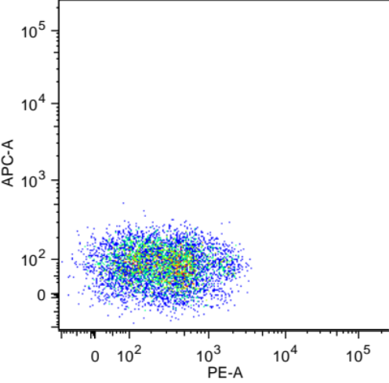
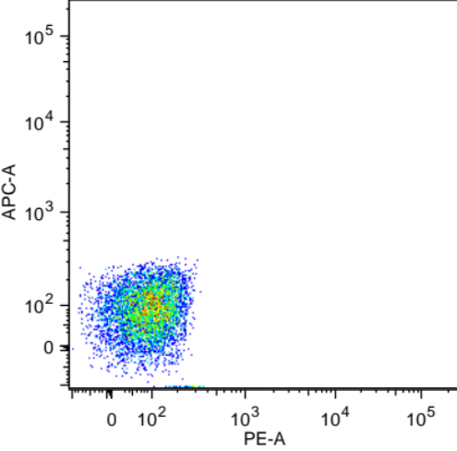
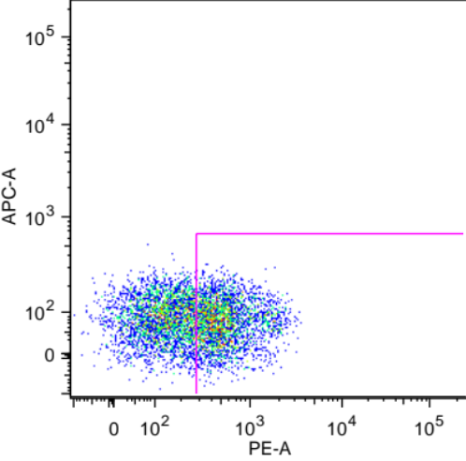
Titrate to make data great!
Correct PE+ %
OVERSTAINED!
PE+
87%
PE+
72%
CD3 - PE
CD3 - PE
Unstained
Expression is a smear
Gate valid ONLY if antibody properly titrated!
Where do you place the gate?
Gate on unstained
CCR7 - PE
CCR7 - PE
CCR7 - PE
Notes:
5

Slide 6
Case 1
Titrate to make data great!
Antibody
Proteins stick to each other
  Antibodies stick to membrane proteins
  Concentration specific
Titrate your reagents – more is NOT merrier!
Goals:
  Saturate positives
  Negatives stay unstained
Cell
Notes:
  Keep Time, Temperature and Total volume (concentration) constant
  Number of cells isn’t that important
Notes:
6

Slide 7
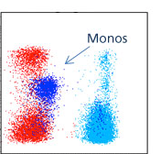
Case 2
CD158i - A647
Notes:
-Lysed Blood cells
-CD158i is expressed on NK cells and some T cells
-Monocytes are in blue
CD3 - FITC
Problem:
Incorrect pattern and % of 158i
Data courtesy of BD Biosciences
Notes:
7

Slide 8
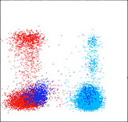
Fc Block to make data Rock!
MONOS BIND
ANTIBODY VIA FcR
FcR blocked
CD158i - A647
CD158i - A647
CD3 - FITC
CD3 - FITC
Notes:
8

Slide 9
Case 2
Fc Block to make data Rock!
Antibody
Fc Receptors bind antibodies
  False positives!
Block FcR before staining
  Anti-CD16/32 antibody (mouse cells)
  200 ug/ml purified IgG (human cells)
  Commercial Fc block
Fab
Fc
Non-specific
Specific
Fc
Receptor
Antigen
Notes:
9

Slide 10
Case 3
CD8
Notes:
-Lymphocytes
-CD4 and CD8 are mutually exclusive
-FcR were blocked
-microscope shows single cell prep
CD4
Problem:
CD4,CD8 double positives
Data from Nature Reviews Immunology 4, 648-655
Notes:
10

Slide 11

Dead Cells Kill Your Data
DEAD CELLS
BIND ANTIBODIES
DAPI negative
CD8
CD8
CD4
CD4
Notes:
11

Slide 12
Case 3
Dead Cells Kill Your Data
Dead cells bind antibodies indiscriminately
  False positives!
Scatter gating does not remove ALL dead cells
Exclude dead cells with a viability dye
  DAPI, PI, ToPro3…
  Fixable live/dead dyes (fixed cells)
Notes:
12

Slide 13
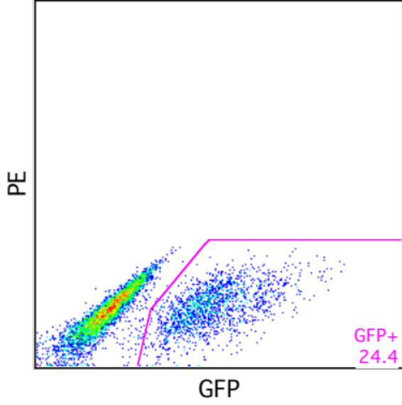
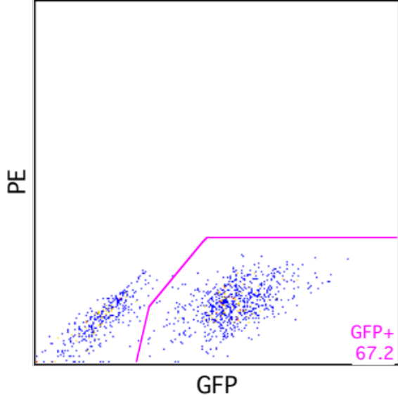
Case 4
PRE-sort
24% GFP+
POST-sort
67% GFP+
Notes:
-Cell line transfected with GFP
-post-sort purity was poor
-recovery was good (too good?)
-bead test sort showed good purity
Problem:
Poor post-sort purity
Notes:
13

Slide 14
DOUBLE Trouble
POST-sort
GFP- HITCHHIKE
WITH GFP+
Notes:
14

Slide 15
Case 4
DOUBLE Trouble
Cells stick together → Doublets
  Not removed by filtering
  Cause poor sort purity
  Give false double positive populations
Width/Height and Area/Height pulse gating doesn’t remove all doublets
Cell preparation is key!
  Some adhesion molecules require Ca⁺⁺/Mg⁺⁺
    Add EDTA
  DNA released from dead cells is sticky
    Stop killing your cells
    Add DNAse
Pulse
Width
Pulse
Width
Pulse
Width
Notes:
15

Slide 16
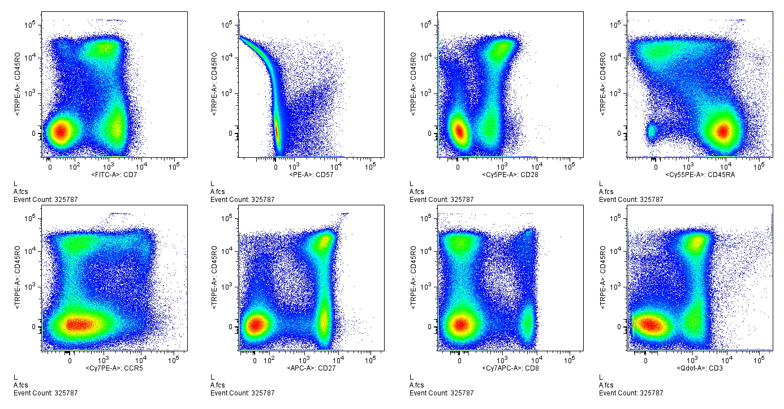
Case 5
Notes:
-Single color controls:
-CD3 TR-PE
-CD57 PE
-controls are as bright as experimental stain
CD45RO TR-PE
CD57 PE
Problem:
Improper compensation
Data courtesy of Mario Roederer
Notes:
16

Slide 17
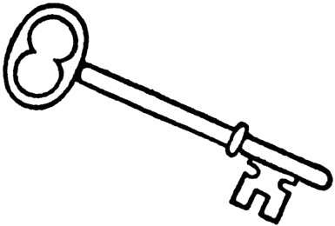
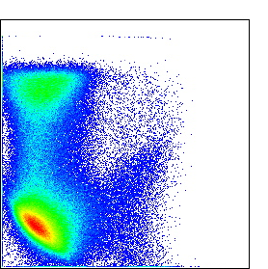
Compensation Controls are KEY
Correct compensation
TR-PE SPILLOVER
DIFFERS BY VIAL
Single color controls:
-CD3 TR-PE
-CD57 PE
Single color controls:
-CD45RO TR-PE
-CD57 PE
CD45RO TR-PE
CD45RO TR-PE
CD57 PE
CD57 PE
Notes:
17

Slide 18
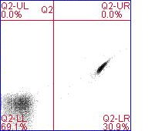
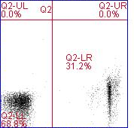
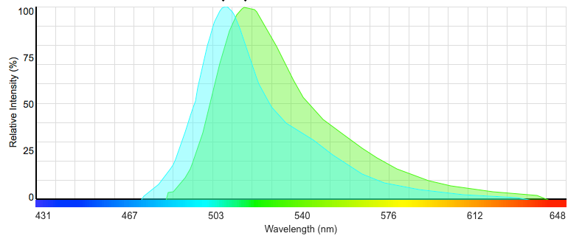
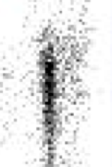
Case 5
Compensation Controls are KEY
RULE #1
Stain single color control with same fluorochrome
  Each lot of tandem dye is different!
  GFP, FITC, A488, CFSE are all green but have different spectra
FITC stain
Emission spectra of GFP and FITC
GFP stain
Orange
Orange
Green
Green
Notes:
18

Slide 19
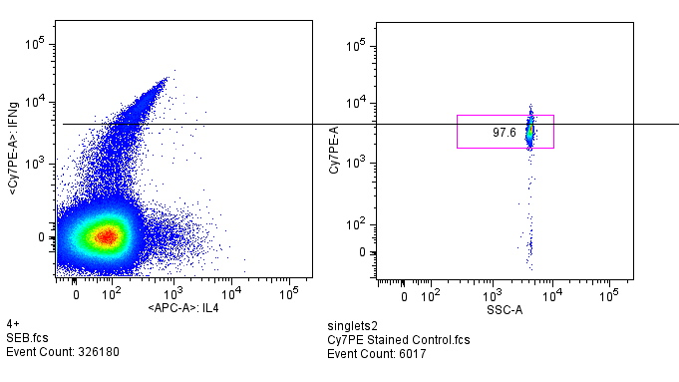
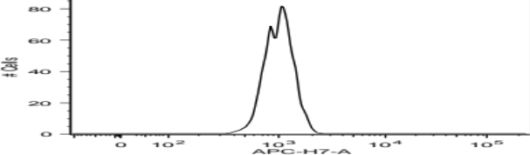
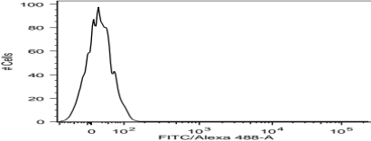
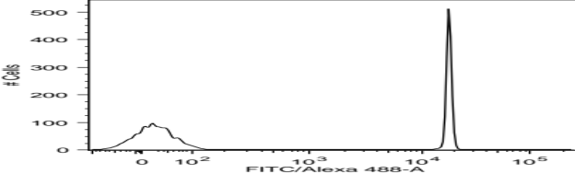
Case 6
Notes:
-Single color controls:
Cy7PE
Single
IFNg Cy7PE
10³
10⁴
10⁵
IFNg Cy7PE
APC
Single
10³
10⁴
10⁵
IL4 APC
IL4 APC
Problem:
Improper compensation
Data courtesy of Mario Roederer
Notes:
19

Slide 20

Compensation Controls are KEY
Compensated sample
Cy7PE
single
CONTROL NOT AS
BRIGHT AS SAMPLE
IFNg Cy7PE
IL-4 APC
APC
single
Notes:
20

Slide 21
Case 6
Compensation Controls are KEY
RULE #2
Single color controls must be as bright or brighter than sample
Notes:
21

Slide 22
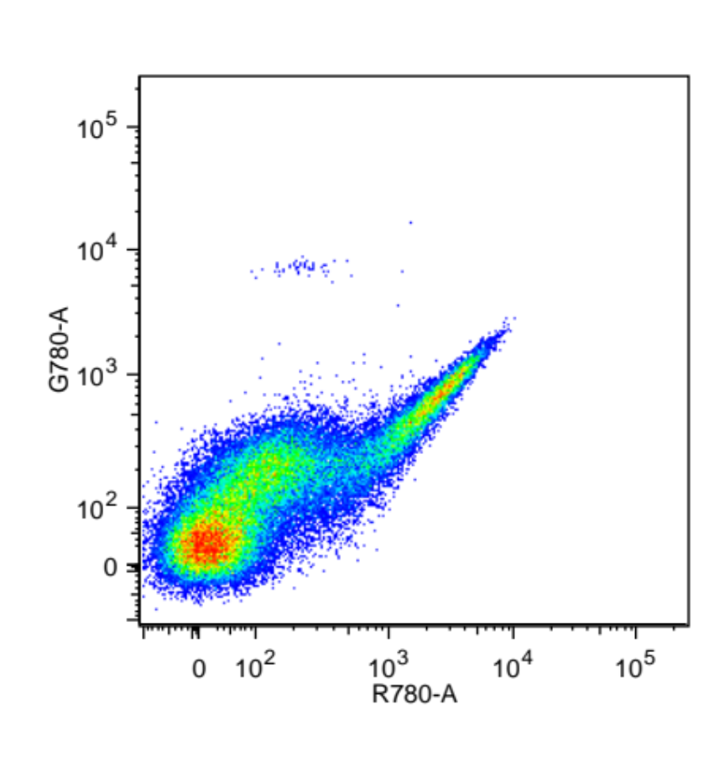
Case 7
PE CDY
Notes:
-Single color controls:
-FITC CDX bound to beads
-PE CDY bound to cells
-“Universal Negative” = unstained cells
-Single color controls = bright as sample
FITC CDX
Problem:
Improper compensation
Notes:
22

Slide 23
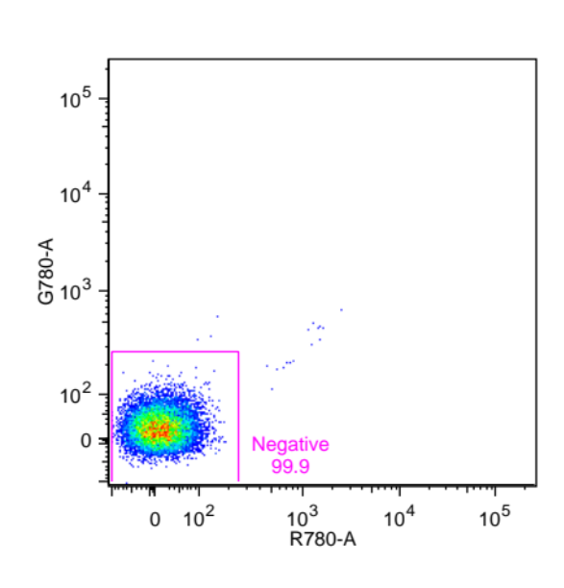
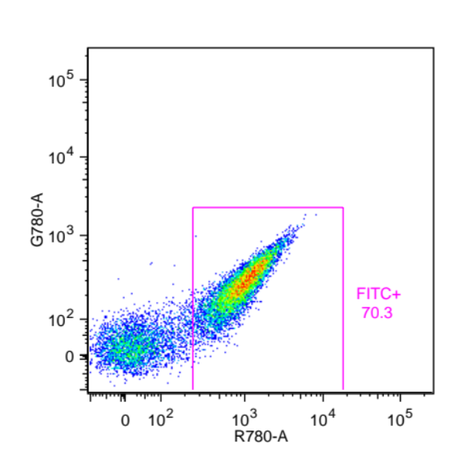
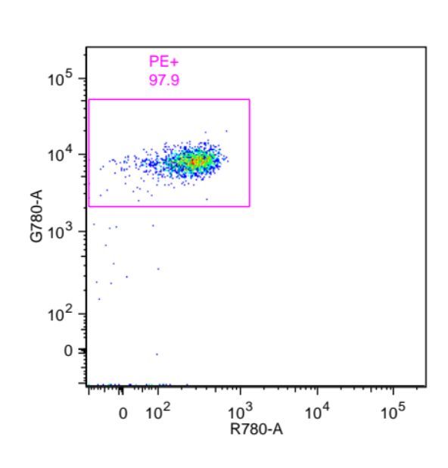
Compensation Controls are KEY
AUTOFLUORESCENCE DIFFERS
NEG AND POS POPULATION
CELLS
CELLS
BEADS
Universal Negative
FITC Single Control
PE Single Control
PE
PE
PE CDY
FITC
FITC CDX
FITC
Notes:
23

Slide 24
Case 7
Compensation Controls are KEY
RULE #3
Match autofluorescence of pos and neg pops
  …for each color
  Make FSC vs SSC gate small
    Uniform autofluorescence
  Be wary of universal negative
Notes:
24
Don’t let P1 autosize
Correctly calculated comp applies to all cell types

Slide 25
Compensation Rules
RULE #1
Same fluorochrome
RULE #2
As bright or brighter
RULE #3
Autofluorescence
Additional rules:
  Treat controls same as samples
  Record enough events
Notes:
25
Voltage change
Treat

Slide 26
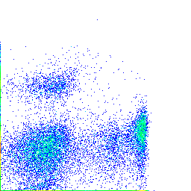
Case 8
Unstained
PRE-sort
POST-sort
Cy7PE
Cy7PE: CD20
Cy7PE: CD20
PE
PE: CD8
PE: CD8
Notes:
-Compensation is correct
-bead test sort showed good purity
Problem:
Poor post-sort purity of DP population
Notes:
26

Slide 27
Gate it don’t debate it!
SPREADING DUE TO
MEASUREMENT ERROR
Fully Stained
Cy7PE FMO
Cy7PE: CD20
Cy7PE: no stain
PE: CD8
PE: CD8
Notes:
27

Slide 28
Case 8
Fluorescence Minus One
Gate it don’t debate it!
Spreading due to measurement error
  Populations spread out in multicolor experiments
  Cannot set gates on unstained
FMO = Fluorescence Minus One
  Leave out one reagent at a time
Cy7PE FMO
+
+
_
Cy7PE - No Stain
+
+
_
+
_
_
_
Spreading due to
measurement error
PE - CD8
Notes:
28

Slide 29
Case 9
Cells
Stain
100
Unstimulated no stain
80
Stimulated MIP1beta stained
60
23%
40
Notes:
-FcR blocked
-single color experiment
-antibody titered correctly
20
0
0
10
2
10
3
10
4
10
5
PE detector
Problem:
MIP1beta % is too high
Notes:
29

Slide 30
Gate it don’t debate it!
Cells
Stain
Unstimulated no stain
DIFFERENT
AUTOFLUORESCENCE
Stimulated MIP1beta stained
Stimulated no stain
Proper Gate
100
80
5%
23%
60
% of Max
40
20
PE detector
0
PE detector
Notes:
30
Transfected vs non-transfected. Good example.

Slide 31
Case 9
Gating Controls - Autofluorescence
Gate it don’t debate it!
Gating control MUST match autofluorescence of sample
Notes:
31

Slide 32
Case 10
Untransfected
GFP transfected
# Cells
Notes:
-single color experiment
-microscope showed single cell prep
-bead test sort showed good purity
-recovery is good
GFP
Problem:
Poor purity
Notes:
32

Slide 33

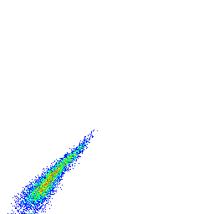
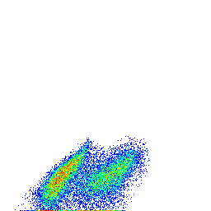
Histograms Hide Data
HISTOGRAMS MASK SEPARATION BETWEEN AUTOFLUORESCENCE AND GFP FLUORESCENCE
Negative Control
GFP sample
# Cells
# Cells
GFP
GFP
PE
PE
GFP
GFP
Notes:
33

Slide 34
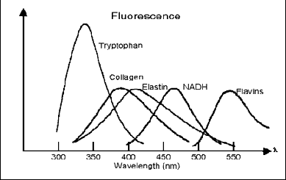
Case 10
Histograms Hide Data
Dot Plots distinguish high autofluorescence and GFP fluorescence
  Autofluorescence is fairly constant in neighboring parameters
  Autofluorescence = emission from many chemicals in the cell
Emission spectra
Notes:
34

Slide 35

Summary
Titrate to make data great!
Fc Block to make data Rock
Dead Cells Kill Your Data
DOUBLE Trouble
Compensation Controls are KEY
Gate it don’t debate it!
Histograms Hide Data
Fc
Notes:
35

Slide 36
Summary
Crime doesn’t pay
  bad data = bad science
Follow “7 Practical Rules” to avoid flow felonies
An experiment is not always salvageable
  rehabilitation may not be possible
  but can identify problems to avoid in future
BAD
DATA
STOPPERS
Notes:
36

Slide 37
Acknowledgements
STEMCELL Technologies
Hank Pletcher
Jan Hendrikx
Tim Bushnell
Mario Roederer
Notes:
37

Slide 38
Part 2
Use forensic flow cytometry to investigate the flow “crimes”
Notes:
38

Slide 39
Experimental Sample |  | GFP | CD3 APC | CD4 PE-Cy7 | CD8 PE | ?
Unstained | Cells | GFP | - | - | - | -
Single Color GFP | Cells | CD3 FITC | - | - | - | -
Single Color APC | Cells | - | CCR7 APC (low expressing) | - | - | -
Single Color PE-Cy7 | Cells | - | - | CD8 PE-Cy7 | - | -
Single Color PE | Beads | - | - | - | CD8 PE | -
Single Color ? | Cells | - | - | - | - | ?
 | Cells
 | Cells
 | Cells
 | Cells
What is missing?
What type of controls are missing?
Can a universal negative control of be used when compensating?
If yes – should it be cells or beads?
Notes:
39
Voltage change
Treat

